Slide 1



v
Team Block Busters
Arun S M
Deepika Karanji
Nidhi Singh
Walmart Global Tech
Blockchain Use Case - State Machine which can process state operations parallel with Consistency.
v

Slide 2
v
Problem Statement
Given statement:
Implementation of a multi-raft setup with sharding (parallelism) at Key level.
Mechanism to maintain the deterministic order of the operations/states
Implementation to support horizontally scaling up and scaling down the number of nodes.
Purpose:
To speed up transactions
Introduce fault tolerance during transaction execution
Issues:
Fabric uses RAFT consensus for block Replication among orderer Nodes
Multi-RAFT protocol – allows for parallel log to be replicated only if Data is sharded.
Data – refers to Trx Blocks.
Trx Blocks – Depend on Previous Block hash – Vital for chain creation
Can NEVER be Sharded due to previous block dependency.
To improve performance/ TPS of independent transactions on a Fabric network through data sharding
NOT POSSIBLE THROUGH MULTI RAFT

Slide 3


v
Single Raft setup
Clients
Z = 6
State Machine
State Machine
State Machine
Consensus Module
Consensus Module
Consensus Module
x | 1
y | 2
z | 3
x | 1
y | 2
z | 3
x | 1
y | 2
z | 3
Servers
Log
Log
Log
X = 3 | Y = 2 | X = 1 | Z = 6
X = 3 | Y = 2 | X = 1 | Z = 6
X = 3 | Y = 2 | X = 1 | Z = 6
Leader

Slide 4
v
Multi Raft setup
Sharded Data
Clients
S1 | S2 | S3 | S4
Z = 6
State Machine
State Machine
State Machine
Consensus Module
Consensus Module
Consensus Module
x | 1
y | 2
z | 3
x | 1
y | 2
z | 3
x | 1
y | 2
z | 3
Servers
X = 3 | Y = 2 | S2 | Z = 6
Log 1
X = 3 | Y = 2 | S2 | Z = 6
Log 1
X = 3 | Y = 2 | S2 | Z = 6
Log 1
S1 | J = 2 | L = 5 | K = 6
Log 2
S1 | J = 2 | L = 5 | K = 6
Log 2
S1 | J = 2 | L = 5 | K = 6
Log 2
A = 3 | S3 | A = 1 | C = 6
Log 3
A = 3 | S3 | A = 1 | C = 6
Log 3
A = 3 | S3 | A = 1 | C = 6
Log 3
Leader

Slide 5
v
Issue with Multi Raft setup
Sharded Data
Clients
S1 | S2 | S3 | S4
Z = 6
State Machine
State Machine
State Machine
Consensus Module
Consensus Module
Consensus Module
x | 1
y | 2
z | 3
x | 1
y | 2
z | 3
x | 1
y | 2
z | 3
S1
S2
S3
X = 3 | Y = 2 | S2 | Z = 6
Log 1
X = 3 | Y = 2 | S2 | Z = 6
Log 1
X = 3 | Y = 2 | S2 | Z = 6
Log 1
Ordering?
Needs Prev Hash
S1 | J = 2 | L = 5 | K = 6
Log 2
S1 | J = 2 | L = 5 | K = 6
Log 2
S1 | J = 2 | L = 5 | K = 6
Log 2
A = 3 | S3 | A = 1 | C = 6
Log 3
A = 3 | S3 | A = 1 | C = 6
Log 3
A = 3 | S3 | A = 1 | C = 6
Log 3
Servers
Leader

Slide 6
v
Problem Statement
Given statement:
Implementation of a multi-raft setup with sharding (parallelism) at Key level.
Mechanism to maintain the deterministic order of the operations/states
Implementation to support horizontally scaling up and scaling down the number of nodes.
Purpose:
To speed up transactions
Introduce fault tolerance during transaction execution
Issues:
Fabric uses RAFT consensus for block Replication among orderer Nodes
Multi-RAFT protocol – allows for parallel log to be replicated only if Data is sharded.
Data – refers to Trx Blocks.
Trx Blocks – Depend on Previous Block hash – Vital for chain creation
Can NEVER be Sharded due to previous block dependency.
To improve performance/ TPS of independent transactions on a Fabric network through data sharding
NOT POSSIBLE THROUGH MULTI RAFT

Slide 7
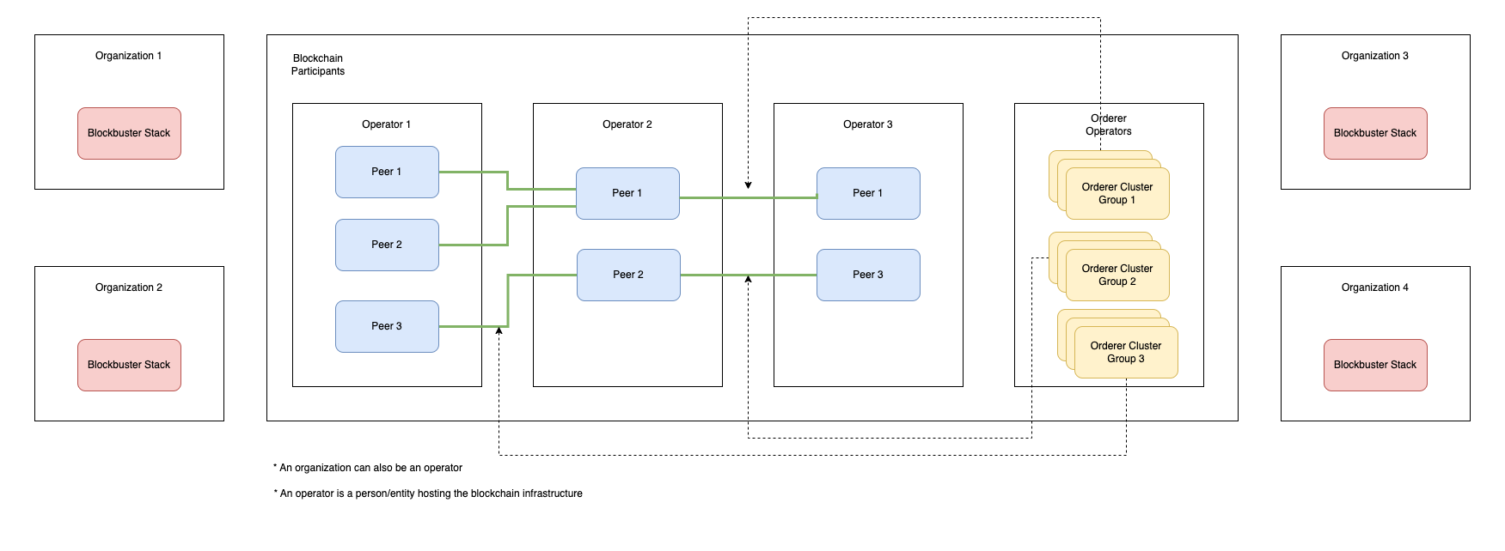
v
Solution – Blockbuster Stack

Slide 8
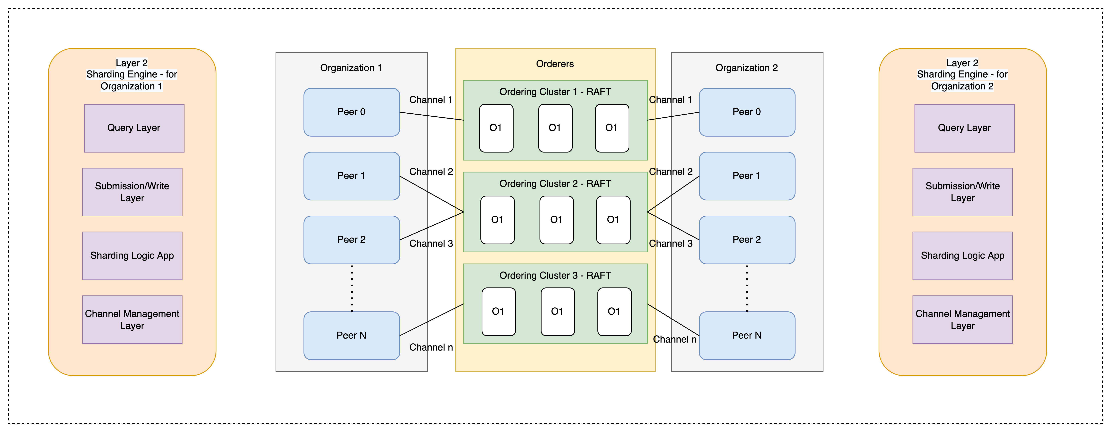

v
v

Slide 9
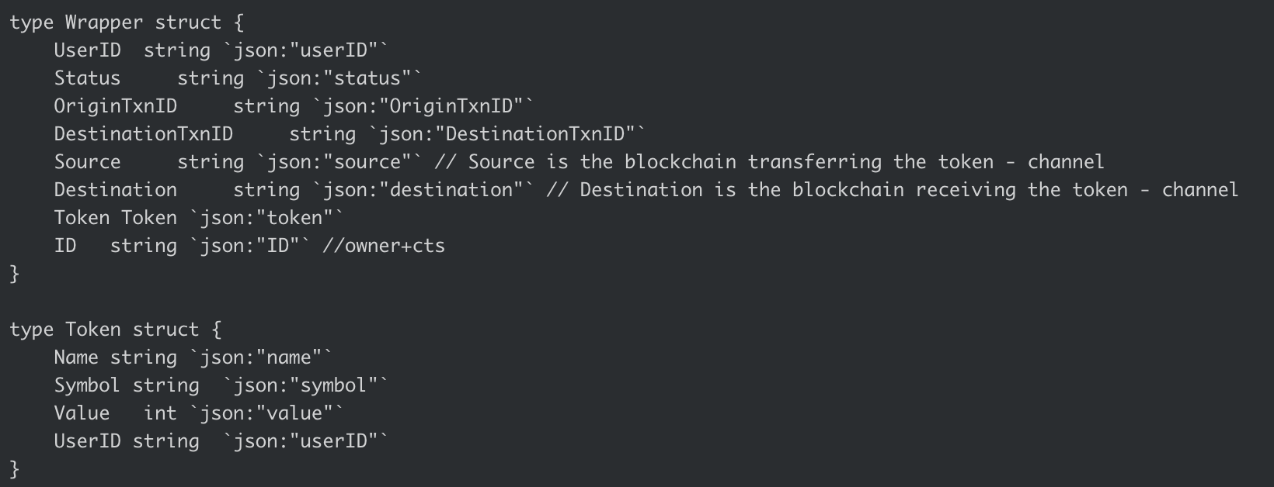
v
Solution – Blockbuster Stack
Bridge Payload

Slide 10
Demo – Usecase : Digital Rupee Transfer across accounts on different channels
v
v

Slide 11
Performance – Single Orderer vs Multi Orderer- Multi channel setup with cross channel token transfer
v
v

Slide 12
Thanks ☺
v
v

Slide 13
Extra Slides
v
v

Slide 14
Problem Statement
v
Issue with implementation of Multi Raft setup
Fabric uses RAFT consensus for block Replication among orderer Nodes
Block creation step has dependency on the previous block structure to be finalized. Previous block hash is an important parameter for creating a chain of block.
Multi-RAFT protocol allows for parallel log to be replicated only as long as the data is sharded.
In the case of Hyperledger Fabric, blocks are the data elements that are replicated
These are never sharded due to previous block dependency.
Goal –
To improve performance/ TPS of independent transactions on a Fabric network through data sharding.
As explained above, multi-raft cannot solve this goal.
v

Slide 15
Solution Approach
v
Develop a layer 2 framework which takes care of data sharding and distributing them on different channels as needed on a blockchain network.
Hyperledger Fabric provides a mechanism to isolate data across channels.
Each channel could be running on different peer nodes
There can be different orderer node cluster managing each of these peer nodes.
A client application can shard the data across to multiple channels, each channel is associated with it’s own dedicated ordering cluster service.
v

Slide 16
Working
v
Use Cases:
UTXO/ Token based use cases
Token exchange/ transfer
Tokens can be – precious metals, NFTs, Real estate etc.
v

Slide 17
Requirements
v
Hyperledger Fabric network
Client trx payload generator server
Token standards
Go
v

