Slide 1
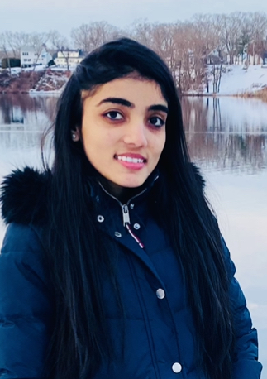
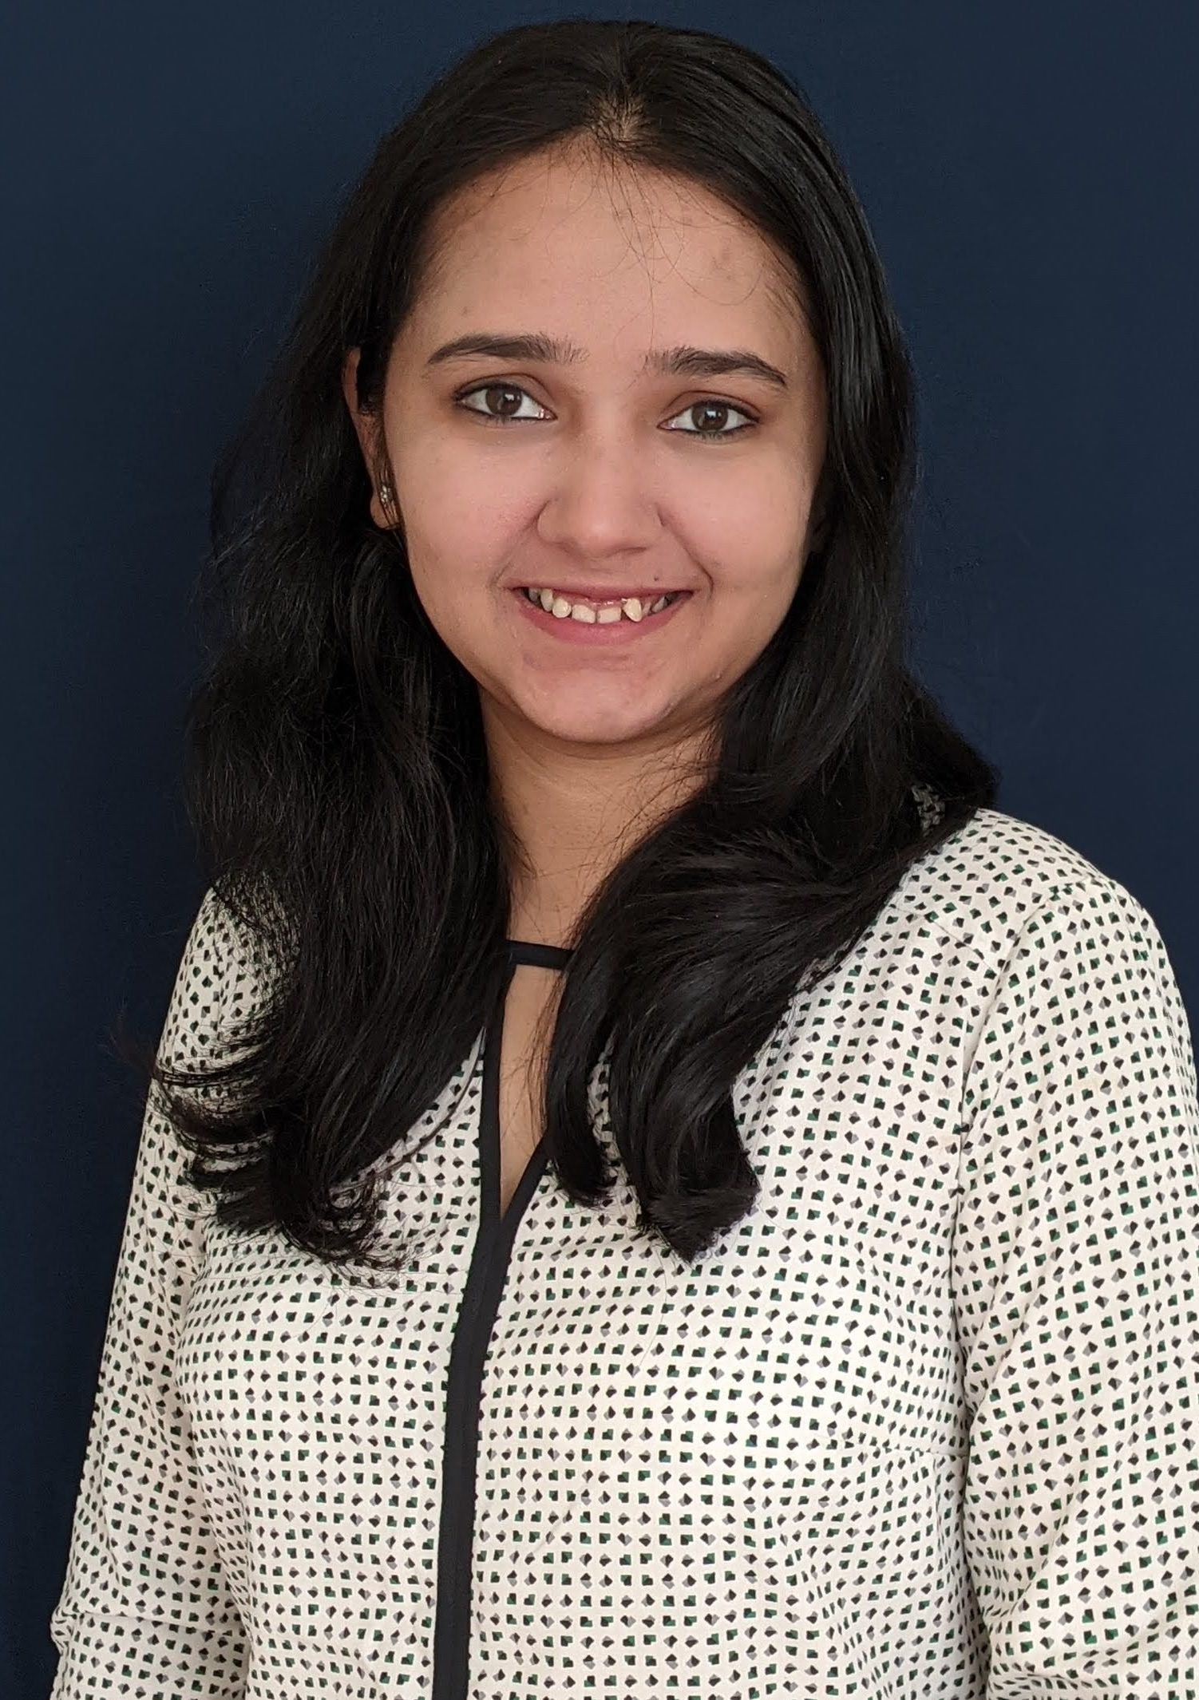
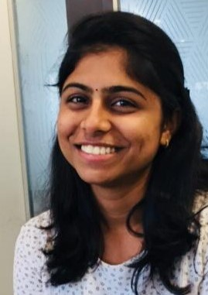
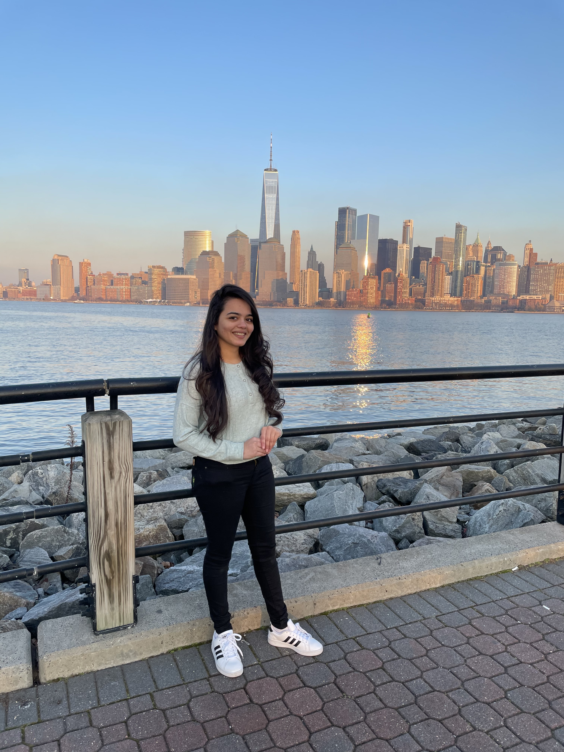
Name: Janki Patel Major: Computer Science Home City: Surat, Gujarat, India
Name: Nidhi Chovatiya
Major: Computer Science
Home City: Surat, Gujarat, India
Name: Mugdha Kamat
Major: Information Systems
Home City: Mumbai, Maharastra, India
Name: Malarvizhi Pandian
Major: MIS
Home City: Namakkal, Tamilnadu, India

