Slide 1
University Timetable Optimization System
DESIGN AND ANALYSIS OF ALGORITHMS | 5TH SEMESTER MINI PROJECT
Course: Design and Analysis of Algorithms
Students: Megha Suthar 12402080601082
Mudra Panwala 12402080601086
Nidhi Patel 12402080601093
Vira Patel 12402080601151
Faculty: Professor Yamini Dubey
Each colour = one time slot
Notes:
Introduce the project: an automatic university timetable generator using graph colouring, greedy algorithms and backtracking. Every member introduces themselves. Replace the bracketed text with your group details.

Slide 2




Problem Statement
Input
Output
Lectures (subject, teacher, student group), the number of rooms, and a weekly grid of 5 days x 6 periods = 30 slots.
A clash-free weekly timetable: every class gets one time slot and one room.
Constraints
Objective
No teacher or student group can be in two places at once. With 3 rooms, at most 3 lectures run together.
Use the fewest time slots possible (closest to the theoretical lower bound) in very little time.
Notes:
Define the problem clearly: inputs, outputs, constraints, objective. Stress that the system must produce a timetable with zero clashes and as few slots as possible.

Slide 3



Motivation & Real-World Use
Why it matters
Where it is used
Who benefits
Building a timetable by hand takes days
Clashes are found late, after students are affected
Wasted rooms and teacher time
Universities, colleges and schools
Exam scheduling
Shift and roster planning (same graph idea)
Students: no clashing lectures
Teachers: valid, fair schedules
Admin staff: saves days of manual work
Notes:
Explain why automatic timetabling is useful and who benefits. Keep it to one minute.

Slide 4
Project Objectives
Model the timetable as a graph colouring problem (lecture = dot, clash = line, colour = time slot)
Write 3 algorithms in separate files: basic colouring, greedy and backtracking
1
2
Guarantee 0 clashes: no teacher or group double-booked, rooms never overfull
Test with 10, 20, 30, 50 and 100 classes and record time and slots used
3
4
Compare theoretical complexity with the measured results
Build a simple GUI and a step-by-step page that explains how it works
5
6
Notes:
Six measurable objectives. Each one ties directly to the DAA requirements: algorithm design, complexity analysis, testing and comparison.

Slide 5
Existing Approach
Manual scheduling
Our idea: graph colouring
Staff place classes by hand or with simple first-come scheduling.
C2
C1
Limitations
C3
C4
Very slow for a whole university
Clashes found only after the timetable is made
No way to know if fewer slots were possible
Does not scale to hundreds of classes
C5
Dot = one class
Line = clash (same teacher or group)
Colour = time slot (joined dots never share one)
Notes:
Existing approach: manual or simple first-come scheduling, with its limitations. Our need: an automatic method with a guarantee of no clashes. The graph colouring idea turns the timetable into a colouring problem: connected dots must get different colours.

Slide 6
Proposed Approach
1
2
3
4
Problem definition
Input / data
Algorithm selection
Design / pseudocode
Inputs, outputs, constraints
Random generator or GUI input
Colouring, greedy, backtracking
Steps and complexity
5
6
7
8
Implementation
Testing
Performance comparison
Results & conclusion
Python + simple GUI
10 to 100 classes
Time, slots, clashes
Graphs and analysis
Notes:
This is the required project flow: problem, data, algorithm selection, design, implementation, testing with different sizes, comparison, and conclusion. Read the steps left to right, top row then bottom row.

Slide 7
Algorithms Used
Graph colouring
Greedy
Backtracking
Idea
Take lectures in the order typed. Give each the first safe slot.
Why chosen
The simplest starting point.
Data structures
Dictionary of lists, slot counts
Idea
Same, but sort first: the lecture with most clashes goes first (Welsh-Powell).
Why chosen
Hardest first, fewer wasted slots.
Data structures
Sorted list, adjacency lists
Idea
Can all lectures fit in k slots? Try, get stuck, undo, retry.
Why chosen
Gives the best answer to compare with.
Data structures
Recursion stack, slot counts
Notes:
All three algorithms solve the same graph colouring model. Greedy ones are fast heuristics; backtracking is exact but slow. We compare them to see the speed versus quality trade-off.

Slide 8
Algorithm & Pseudocode
Greedy (Welsh-Powell) / Basic
Backtracking (fewest slots)
order = classes sorted by
number of clashes
for each class c in order:
for slot s in 0..29:
if a room is free in s and
no clashing class is in s:
put c in slot s
break
Basic colouring: same loop,
but order = the order typed
solve(i, k):
if i == n: return True
c = order[i]
for slot s in 0..k-1:
if clash(c, s): continue
place(c, s, room)
if solve(i+1, k): return True
remove(c, s, room) # undo
return False
for k = LB, LB+1, ...:
if solve(0, k): stop # best
Time O(V²) Space O(V + E)
Time O(k^V) worst Space O(V + E)
Notes:
V = classes, E = clashes, k = time slots, LB = lower bound on slots. Greedy places each class once. Backtracking starts at k = LB and asks whether all classes fit in k slots; if not, it tries k + 1. For each class it tries the slots, and undoes the choice when it gets stuck, so its worst case is exponential. To save time, a class may open only one new slot, and the search stops after 200,000 steps.

Slide 9
System Architecture
User
Input
Graph builder
Algorithms
Output
GUI window or HTML page
Lectures, teachers, groups
Lectures become dots, clashes become lines
Colouring, greedy, backtracking
Clash check and timetable
gui.py
data.py
conflict_graph.py
algo1 / algo2 / algo3
checker.py, show.py
Test module (compare.py): runs all 3 algorithms on 10 to 100 classes and prints time and slots.
Notes:
Walk through the flow: the user gives input through the GUI window (or uses the sample or random data), the input module builds the class list, the graph builder creates the conflict graph, the algorithm engine produces a timetable, and the output module validates it and shows it. The benchmark module runs the same pipeline for many sizes.

Slide 10



Implementation
Language & tools
Important modules
Data structures
Python 3.12
tkinter (GUI window)
HTML + JavaScript (explainer page)
Matplotlib (optional chart)
Plain lists and dictionaries
algo1 / algo2 / algo3: the algorithms
conflict_graph.py: dots and lines
rules.py: is this slot safe?
checker.py: proves 0 clashes
Dictionary of lists (graph)
Dictionary: lecture to slot
Dictionary: slot to count
Recursion stack (backtracking)
Notes:
Python was chosen for fast development and easy plotting. The graph is stored as a dictionary mapping each class to the set of classes it clashes with. Backtracking uses recursion and undoes choices when stuck.

Slide 11
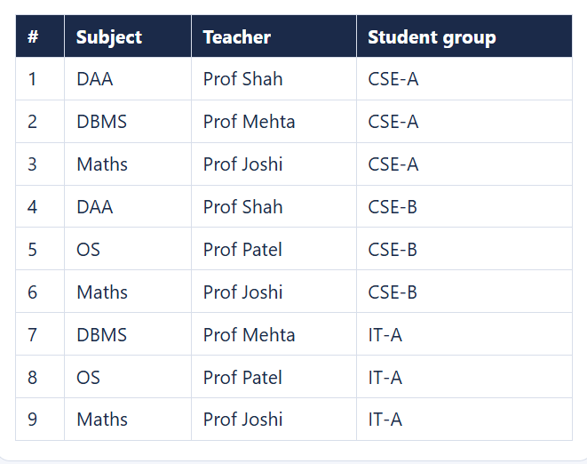
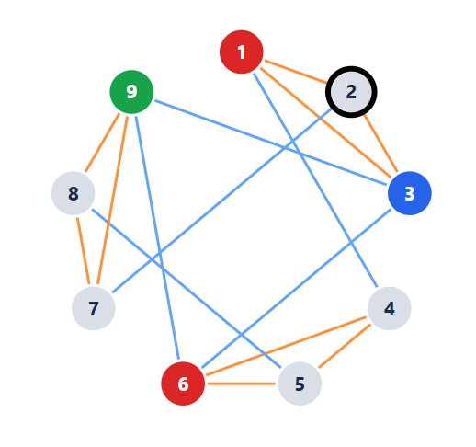
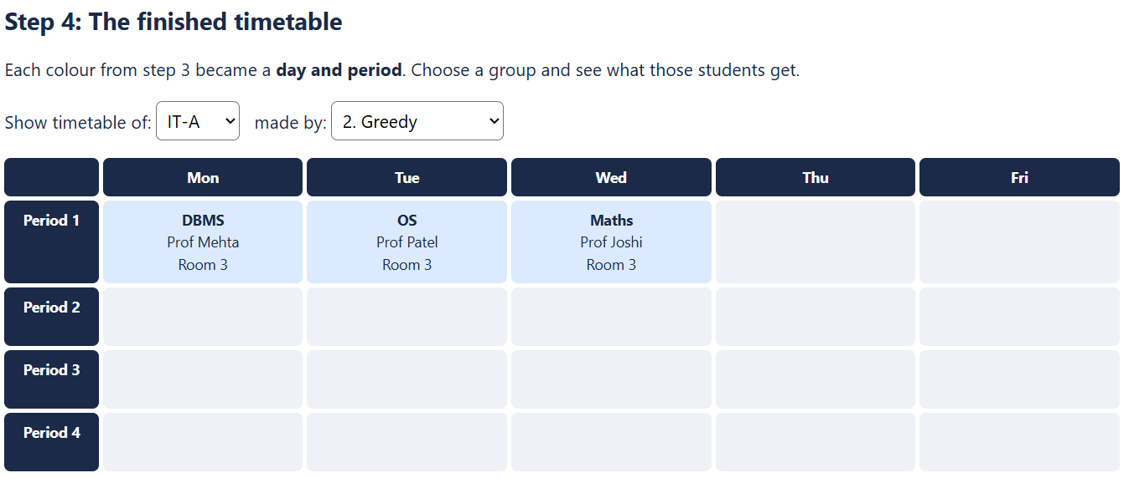
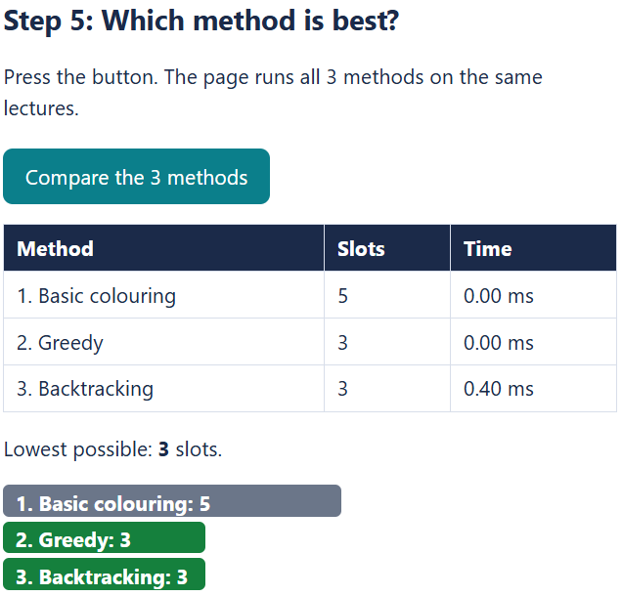
Project Screenshots
1. Input
2. Processing
Lectures, teachers and student groups, plus rooms, days and periods
Greedy running step by step: dots turn colour, rejected slots are explained
3. Output
4. Performance
Weekly timetable of one student group, no overlapping lectures
All 3 algorithms compared: slots used and time, against the lower bound
Notes:
These screenshots come from our GUI (python gui.py). Retake them on your own computer if you like (Windows + Shift + S). Each one has a caption that says what it demonstrates.

Slide 12
Results
Classes | Colouring | Greedy | Backtr.
10 | 7 | 0.04 | 7 | 0.06 | 7 | 0.07
20 | 8 | 0.07 | 8 | 0.08 | 8 | 0.14
30 | 11 | 0.12 | 11 | 0.14 | 10 | 0.33
50 | 9 | 0.19 | 10 | 0.27 | 9 | 0.35
100 | 10 | 0.40 | 10 | 0.55 | gave up
Each cell: slots used | time in ms. Random data, 30 slots, rooms = classes / 8 (at least 3). Backtracking stopped after 200,000 steps at 100 classes.
0
7 | 6 | 6
gave up
clashes in every test run
slots on the 17-lecture sample (colouring | greedy | backtracking), lower bound 6
backtracking at 100 classes: over 200,000 steps (about 2.4 s)
Notes:
Numbers come from running python compare.py. Backtracking found fewer slots than the other two at 30 classes (10 instead of 11) but gave up at 100 classes. Greedy was not always better than basic colouring: at 50 classes basic used 9 slots and greedy 10. Be honest about this. Re-run compare.py on your computer and update the table if your numbers differ.

Slide 13
Complexity Analysis
Algorithm | Best case | Average | Worst case | Space
Graph colouring | O(V + E) | O(V²) | O(V²) | O(V + E)
Greedy | O(V log V + E) | O(V²) | O(V²) | O(V + E)
Backtracking | O(V) | Exponential | O(k^V) | O(V)
V = classes, E = clashes, k = time slots. Backtracking best case: the first try works, so nothing is undone. Space for backtracking = recursion depth.
Theory vs practice
Graph colouring
Greedy
Backtracking
Classes x10 (10 to 100) gave time x10 (0.04 to 0.40 ms). Grows gently.
Classes x10 gave time x9 (0.06 to 0.55 ms). Theory O(V²) allows x100; our graphs are sparse.
30 to 50 classes: still 0.35 ms or less. At 100 classes: over 200,000 steps, gave up.
Notes:
Explain best, average, worst and space complexity. Then compare with experiments: greedy grows polynomially, backtracking grows exponentially. If your own benchmark numbers differ, update the ratios on this slide.

Slide 14



Pros, Limits & Future Scope
Advantages
Limitations
Future scope
0 clashes in every test
Very fast: 100 classes in under 1 ms (greedy)
Backtracking finds the best answer on small inputs
Simple code: one file per algorithm
Backtracking gives up at 100 classes
Rooms are counted, not sized
No teacher preferences
One period per lecture (no 2-hour labs)
Room capacity and sizes
Teacher preferences as soft rules
Smarter exact search (branch and bound)
Export timetable to PDF or Excel
Notes:
Be honest about limitations: backtracking does not scale, room assignment is a simple rule, and soft preferences are not yet modelled. These are natural next steps.

Slide 15
Conclusion & References
Conclusion
References
We modelled timetabling as graph colouring and built 3 algorithms in separate files, with a GUI to explain them.
Cormen, Leiserson, Rivest, Stein. Introduction to Algorithms. MIT Press.
Welsh & Powell (1967). An upper bound for the chromatic number of a graph and its application to timetabling problems. The Computer Journal, 10(1).
Documentation: Python, tkinter, Matplotlib.
Dataset: sample college data and random data from our own data.py (no external dataset).
Key findings
All timetables had 0 clashes in every test
Greedy is fastest; backtracking found fewer slots at 30 classes (10 vs 11)
Backtracking gave up at 100 classes: exponential time
Notes:
Summarise the problem and solution, then the three key findings. Everyone must be ready to answer questions about the complete project.

