Slide 1
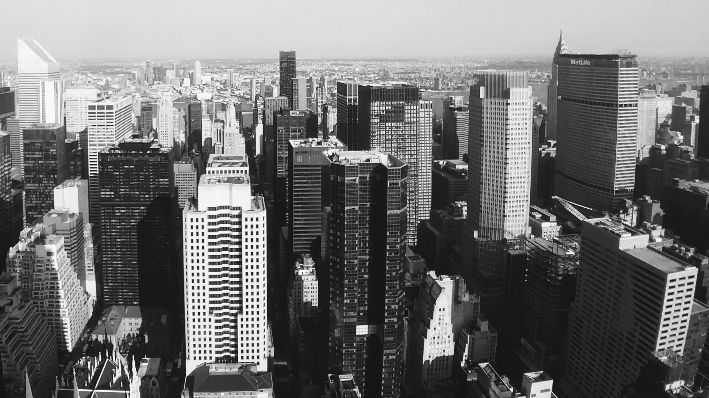
Slide 1
Impact on Workforce since Covid-19
Nidhi Ojha

Slide 2
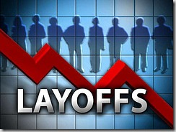
Slide 2
Motivation
Covid-19 has impacted the world in unprecedented way
Started late 2019
Rapid global spread throughout 2020
Affected 200+ countries and territories
Economic repercussions
Global Economic downturn
GDP contractions in numerous countries
Trade disruptions & broken supply chain
Financial market volatility
Industry-wide layoffs
Various industry segments impacted
Ripple effect disrupting retail, consumer, and manufacturing sectors
Shutdown of brick-and-mortars stores
Production halts and delays across sectors like entertainment, automotive and electronics sector
The Tech Disruption
Rise of remote work and digital transformation
Increased demand for digital tools, platforms, and infrastructure
Tech companies accelerated their growth to meet demand of digital world
2

Slide 3
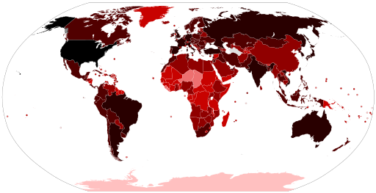
Slide 2
Motivation - continued
I worked in technology side of Media & Entertainment (M & E) industry and was impacted recently.
This led me to ask several questions to myself
Is M & E industry impacted the most since Covid-19?
Are there other industries that are impacted more or less than M & E industry?
While Tech companies like Google, Meta thrived during the COVID, why they are laying off people now?
Is the workforce impact only limited to the United States or it is beyond that?
Are the companies laying off people, start-up and small companies running on short budget?
3

Slide 4
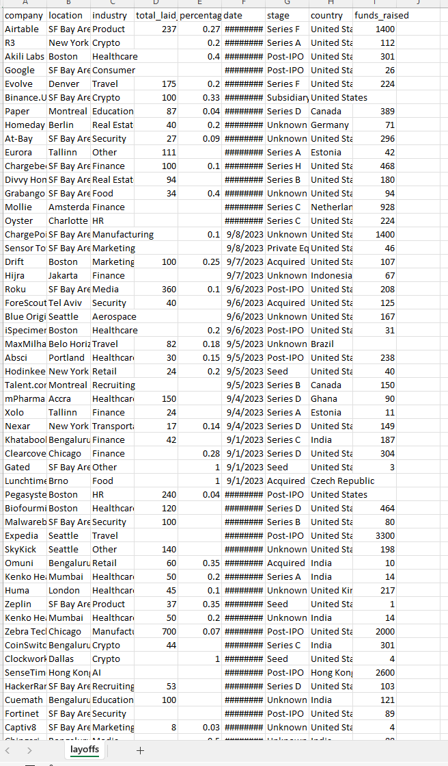
Slide 2
Dataset
Source Kaggle.com – https://www.kaggle.com/datasets/swaptr/layoffs-2022
Data timeline – Since start of pandemic (Mar 11 2020) till present Oct 16 2023
Columns
company – Name of the company
location – Headquarter city of the company
industry – Industry company falls into
total_laid_off – Number of employees laid off
percentage_laid_off – Percentages of employees laid off
date – Date of layoff (YYYY-MM-DD)
stage – Stage of funding company is
country – Country where Headquarter is situated
funds_raised – Funds raised by the company (in Millions $)
Total Rows – 3023
Dataset location for Cleanup – input/layoffs.csv
4

Slide 5
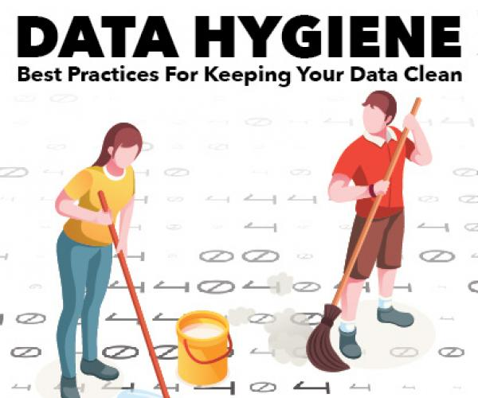

Slide 2
Dataset Cleanup
Loaded dataset into DataFrame
Removed column that are not needed for this project
Columns with NaN values (number of rows)
total_laid_off (991)
percentage_laid_off(1050)
Funds_raised (307)
Added two columns; ‘Lat’ and ‘Lon’ to support GeoViews in Analysis
Call GeoApify to capture Latitude and Longitude for compnay’s headquarter and populate two new columns
Save the sanitized dataset under ./output/Layoffs_sanitized.csv
Implemented Cache with a Dictionary object to avoid hitting GeoApify API for already queried City, Country combination
5

Slide 6
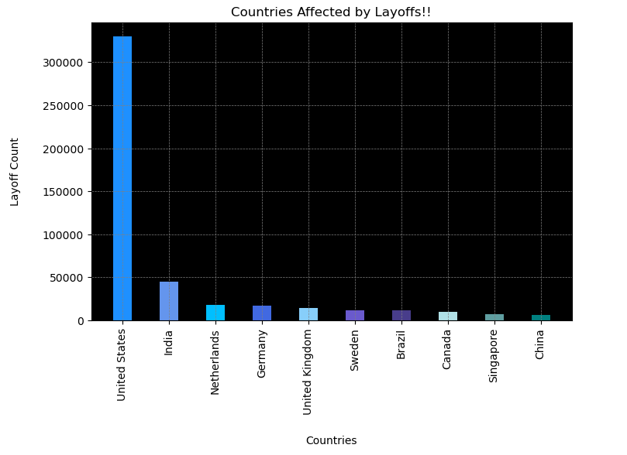
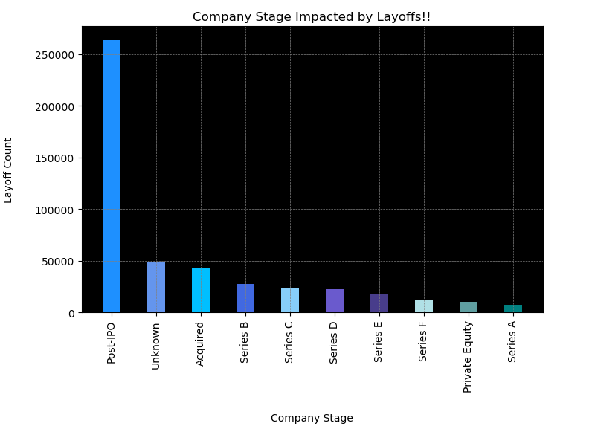
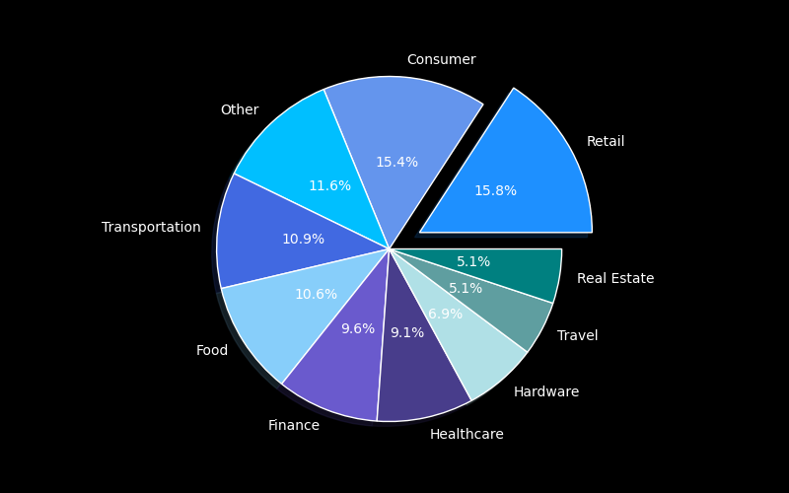
Slide 2
Data Analysis | Top 10 Countries, Industries and Stages Impacted
Industries Impacted by Layoffs!!
6

Slide 7
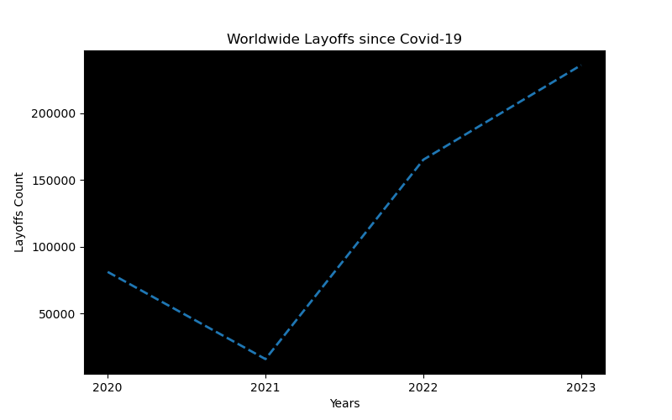
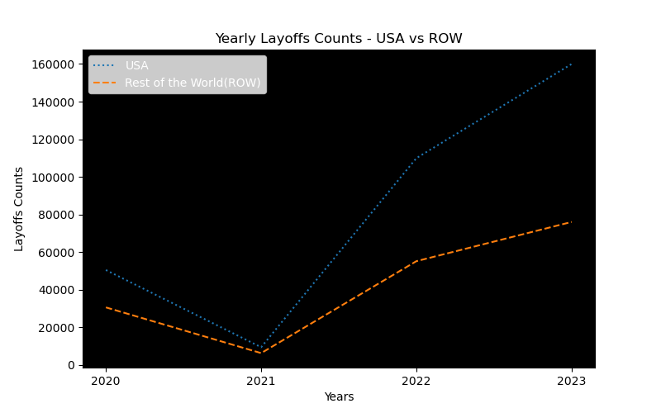
Slide 2
Data Analysis | Impact over the time in USA and Rest of the World
7

Slide 8
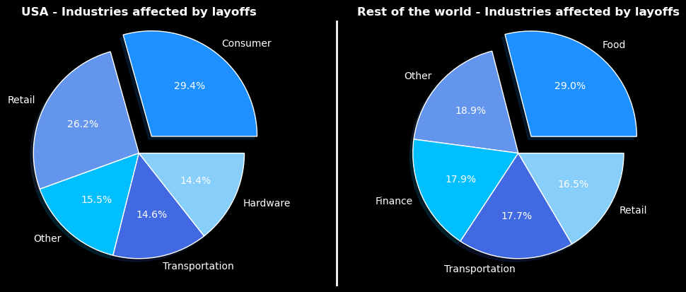
Slide 2
Data Analysis | How industries across USA vs ROW stack up?
8

Slide 9
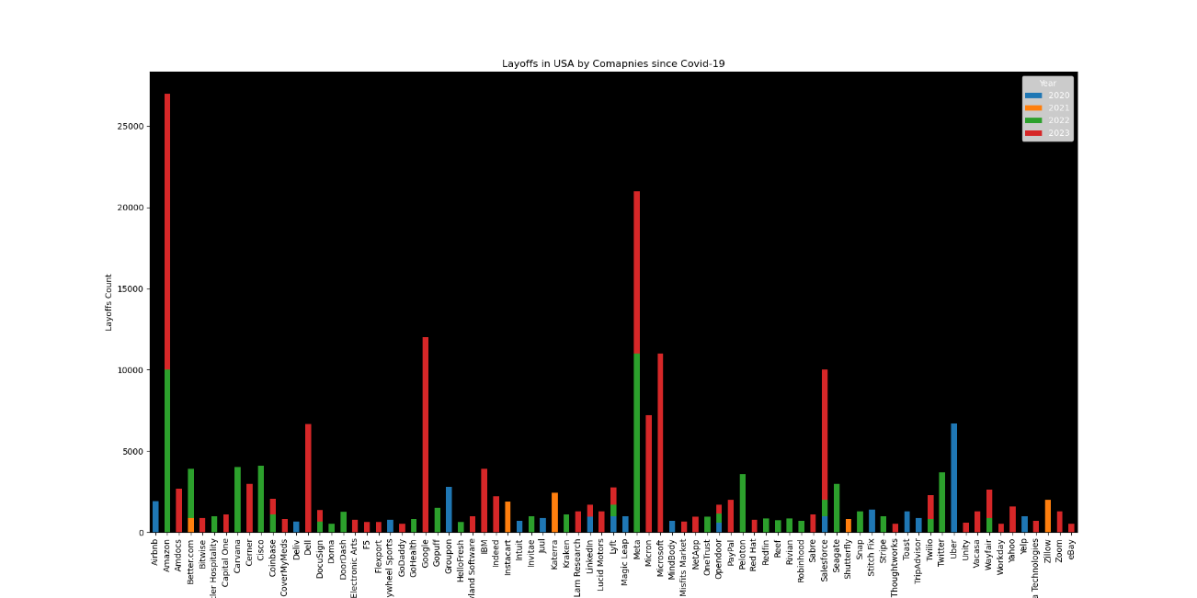
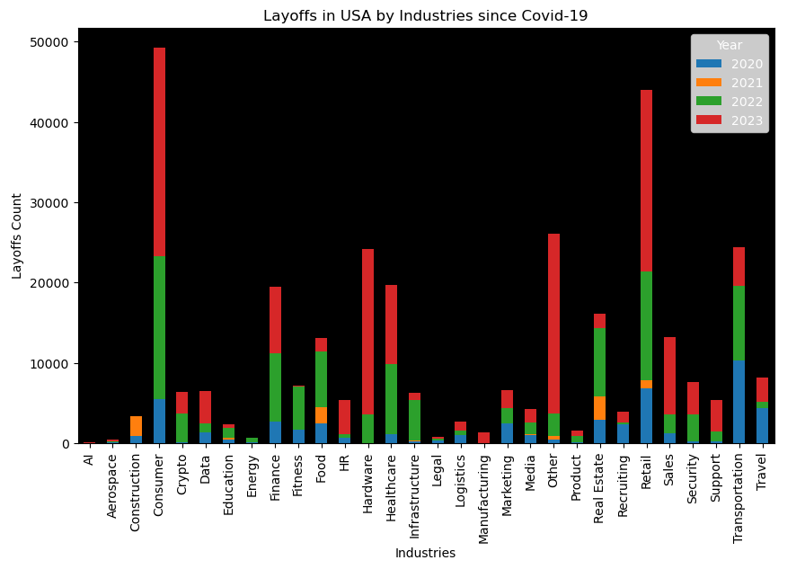
Slide 2
Data Analysis | Layoffs in USA across companies and industries
9

Slide 10
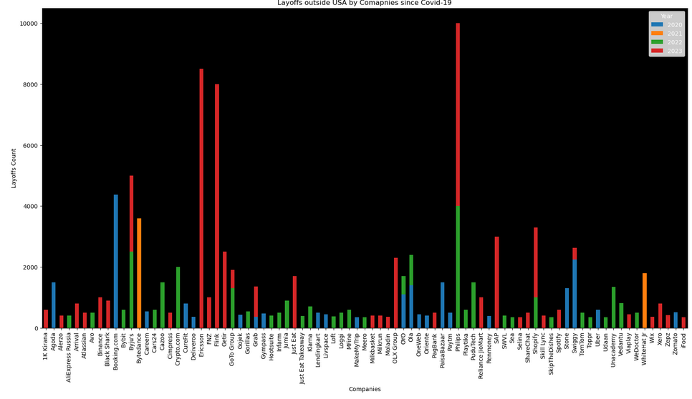
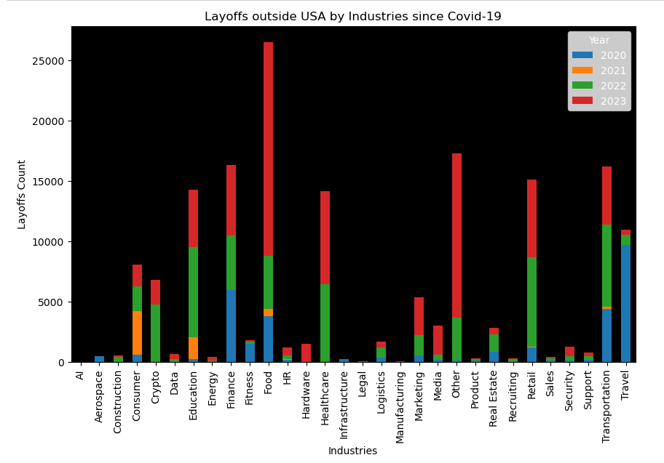
Slide 2
Data Analysis | Layoffs across industries and companies in ROW
10

Slide 11
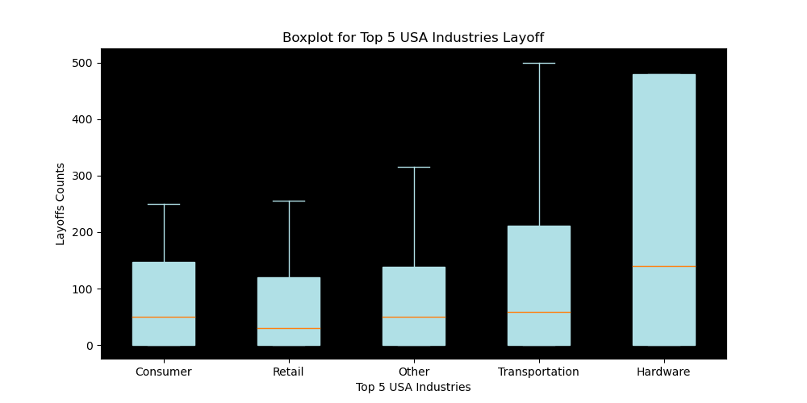
Slide 2
Data Analysis | USA – Quartiles and Median
11

Slide 12
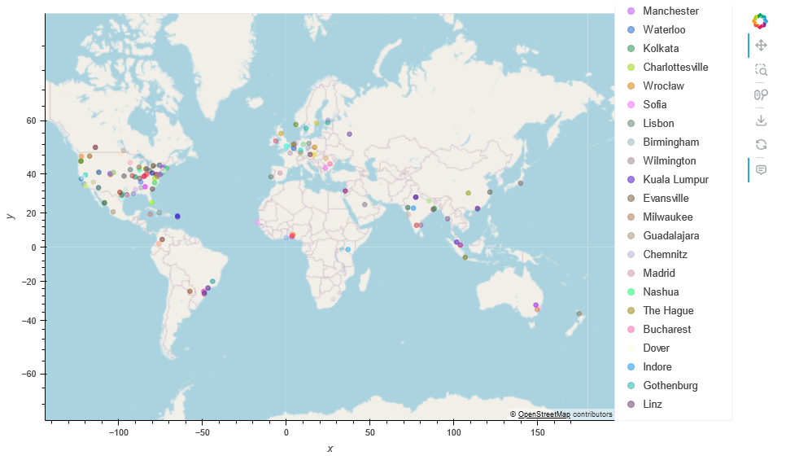
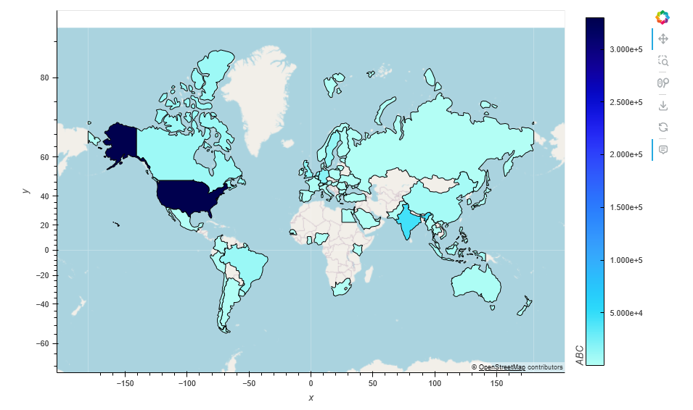
Slide 2
Data Analysis | GeoViews - Cities and Countries Impacted
12

Slide 13
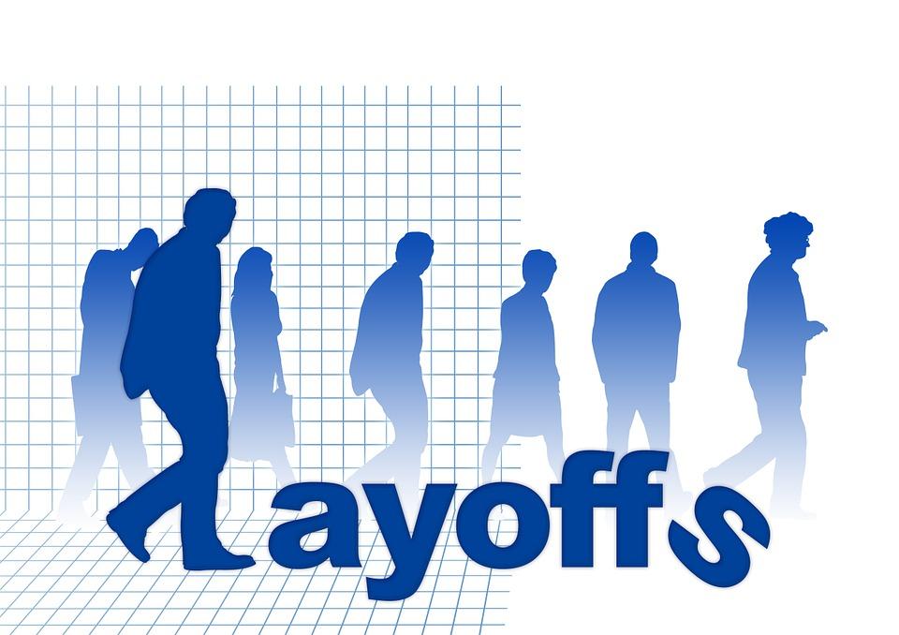
Slide 2
Conclusion
Impact of Covid-19 has been across the world
Top industries impacted were Consumer, Retail, Transportation
Surprisingly, Public companies are impacted more than privately funded companies. This could be because of the external pressure of shareholders on public companies which led to operational cost reduction
Though companies like Google, Meta are Tech companies they are categorized as consumer industry in this dataset because of their product offerings are consumer focused.
With start of Covid-19, there were specific industries like Transportation, Hospitality, Retail that got impacted immediately. However, with rise in digital work environment Tech companies over-hired during pandemic to support this growth. Post-pandemic (late 2022 and 2023), these companies and industries did most layoffs to balance for over hiring during pandemic.
13

Slide 14
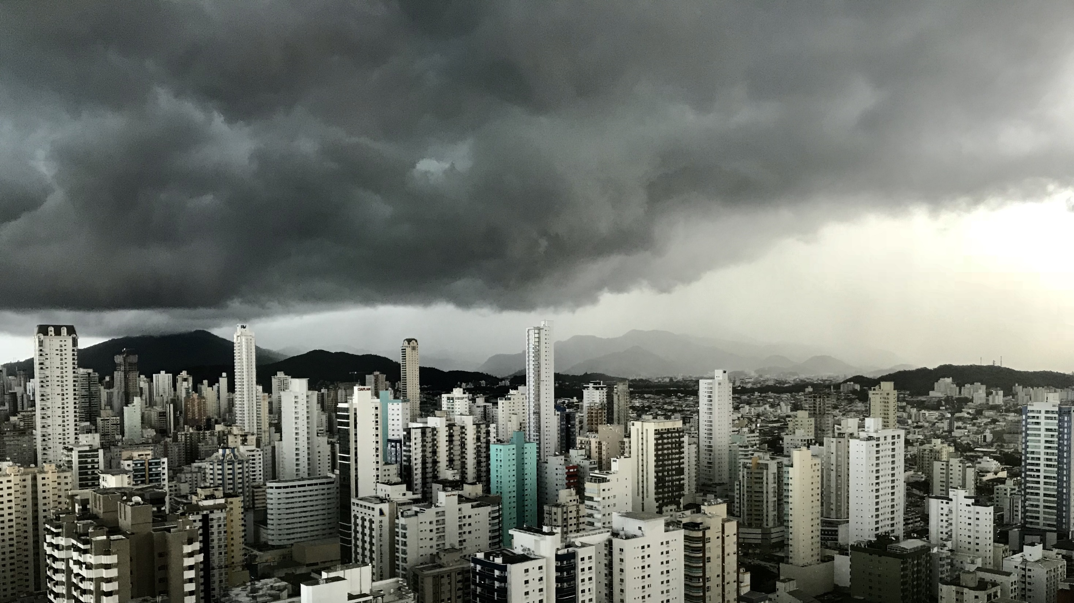
Slide 11
Thank you! Questions?

