Slide 1
Telstra Network Disruption Prediction
Group Members:
Vijayalakshmi Vedantham (163050006)
Vertika Srivastava (163050007)
Sakshi Maskara (163050041)
Nidhi Singh (163059004)

Slide 2
Problem Statement
The goal of our problem was to predict Telstra network's fault severity at a time at a particular location based on the log data available.
Each row in the main dataset (train.csv, test.csv) represents a location and a time point. They are identified by the "id" column, which is the key "id" used in other data files.
Fault severity has 3 categories: 0,1,2 (0 meaning no fault, 1 meaning only a few, and 2 meaning many).
Different types of features are extracted from log files and other sources: event_type.csv, log_feature.csv, resource_type.csv, severity_type.csv.

Slide 3
Motivation
Study of various data models and their practical implementation.
Application of Ensembling methods.
Learn application for practical problem.

Slide 4
Dataset Description
train.csv - the training set for fault severity
test.csv - the test set for fault severity
event_type.csv - event type related to the main dataset
log_feature.csv - features extracted from log files
resource_type.csv - type of resource related to the main dataset
severity_type.csv - severity type of a warning message coming from the log

Slide 5
Data Preprocessing
Convert features of the form ‘resource type x’, ‘event type x’, ‘location x’, ‘feature x’ etc into categorical variables.
Create a data frame with the index as unique id.
Concatenate train and test files.

Slide 6
Feature Enginnering
Location id based count
Number and Reverse number for each location id
Normalized number and reverse number
Resource type count
Frequency based encoding for resource type
Event type count
Frequency based encoding for event type
Log transformed volume
Aggregate functions on log volume

Slide 7
Approaches
The models that we applied in our project are:
Random Forests
Extra Trees
XG Boost

Slide 8
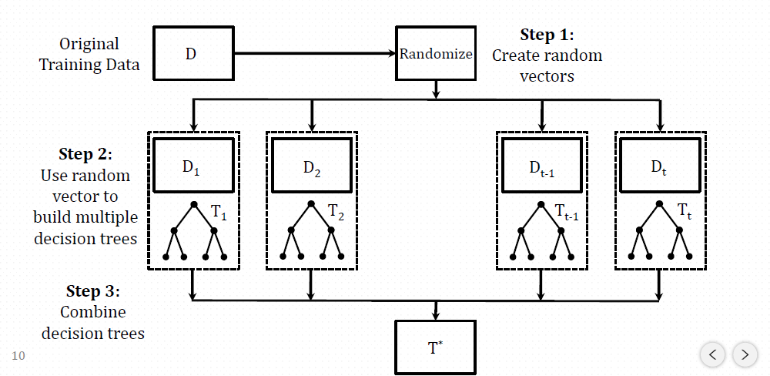
Random Forests
Random forests is a way of combining multiple decision trees which are trained on different parts of training set and different parts of feature set.

Slide 9
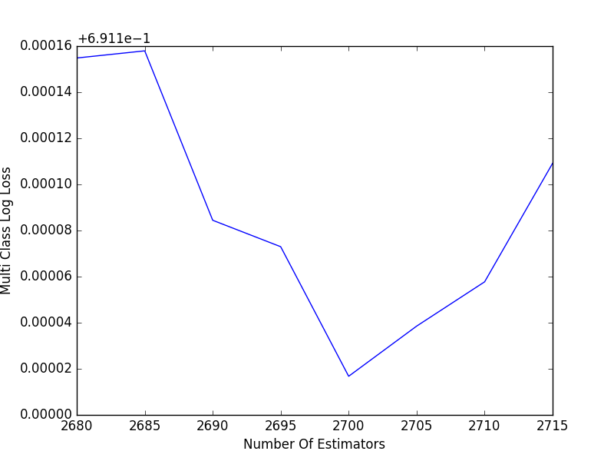
Random Forests-Implementation
We have implemented random forests on our data to predict the severity.
Different parameters like n_estimators and max_features are varied to get an estimation of parameter value.
The graph is plotted between No. of estimators i.e. trees and Multi class log loss. The lowest loss is obtained at 2700.

Slide 10
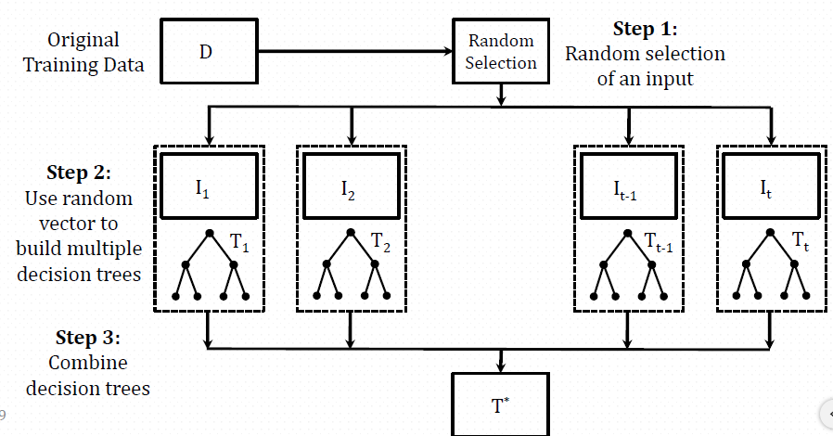
Extra Trees Classifier
Extra-trees combine classifiers without bagging by using random splits to generate different trees.

Slide 11
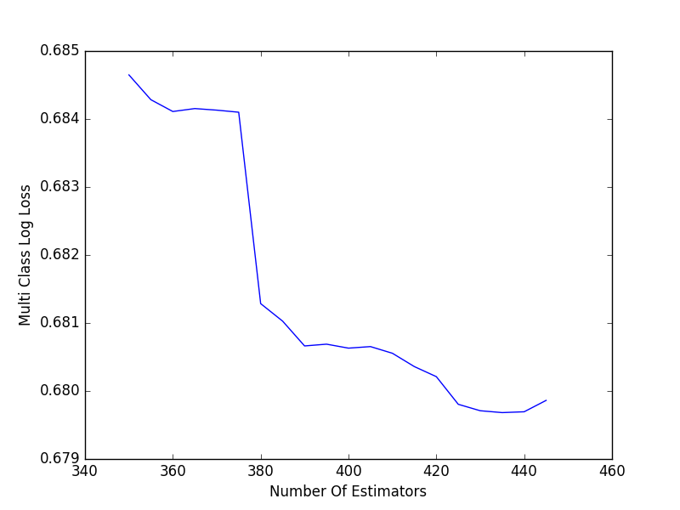
Extra Trees Classifier - Implementation
Here we have implemented extra trees classifier and tried to tune the parameter n_estimators.
A graph has been plotted by varying no. of estimators to multi class log loss.

Slide 12
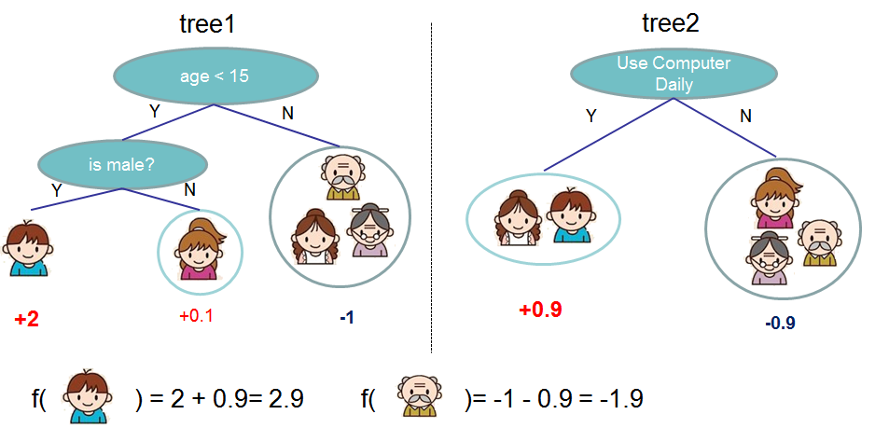
XGBoost Classifier
XGBoost is an implementation of gradient boosted decision trees designed for speed and performance.

Slide 13
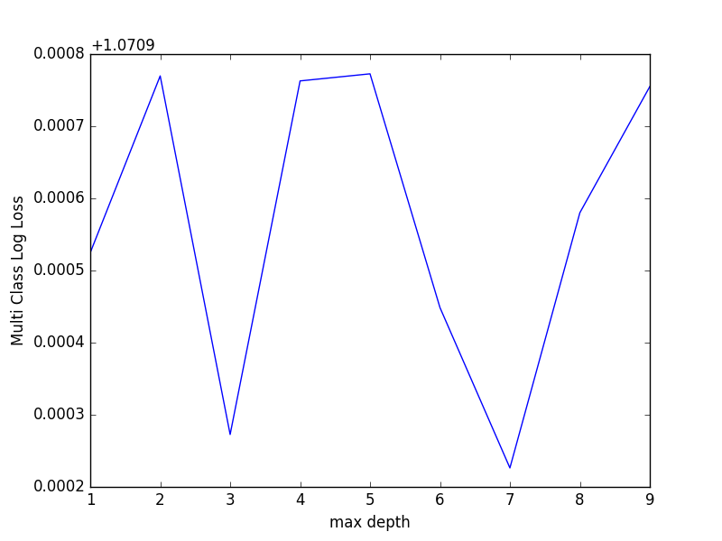
XGBoost Classifier - Implementation
Implemented XGBoost model for data prediction.
Divided data into 2 parts for train and test.
Divided train data into 2 parts with probability of 0.8 of taking a row in train and 0.2 of taking a row for watch.
Used parameters like eta,max_depth,softprop etc.
Used mlogloss and softprob to get the probability for each class.
Predicted accuracy on test data.

Slide 14
Observations and Results
Models | Train set accuracy | Test set accuracy
Random Forest | 100% | 70.08%
Extra Trees | 100% | 69.89%
XG Boost Classifier | 77.8% | 73.6%

Slide 15
Challenges
Feature engineering.
Combining data from various files into 1 files.
Tuning models.

Slide 16
Conclusion
We have implemented different ensembling methods like XGBoost, Random Forest and Extra Trees Classifier to predict the severity of disruption of Telstra Network.
We have also implemented Neural Networks but it was giving very less accuracy so we dropped it.
In this project, we have done considerable data preprocessing and feature engineering to model the raw data that was present in multiple data files.

Slide 17
Thank You

