Slide 1
Customer Churn Prediction and Retention Analysis
1 in 4
customers churned
Telco Customer Churn dataset (Kaggle)
Built in IBM SPSS Modeler, step by step
Presented by: [Your Name]
Notes:
Namaste. Ye project Telco company ke customers ke churn, yaani company chhod ke jaane, ko predict karta hai, aur batata hai ki use kaise roka jaye. Poora analysis IBM SPSS Modeler mein kiya gaya hai.

Slide 2
Our roadmap: the CRISP-DM method
We followed the standard data-mining process taught in class. Each phase has its own slides.
1
Business understanding
2
Data understanding
3
Data preparation
What is churn and what do we want to learn?
Dataset, variables, data audit, churn rate
Remove blanks, set field roles, split data
4
Analysis and modelling
5
Evaluation
6
Deployment
Chi-square, T-test, Logistic Regression, C5.0
Accuracy, confusion matrix, best model
Key drivers and retention actions
Notes:
CRISP-DM ke 6 phases: business understanding se lekar deployment tak. Humne har phase ke liye alag slide banayi hai.

Slide 3
Business understanding: why churn matters
What is churn?
A customer cancels the service and leaves the company. In a subscription business, every lost customer is lost monthly revenue.
Our four objectives
1
Measure the overall churn rate
2
Test which factors are linked to churn
Why it matters
Winning a new customer costs more than keeping an existing one, so knowing who may leave, and why, saves money.
3
Build and compare two prediction models
4
Turn findings into retention actions
Notes:
Churn matlab customer ka service chhod dena. Naya customer lana mehnga padta hai, isliye retention important hai. Humare 4 objectives hain.

Slide 4
Data understanding: the dataset
Telco Customer Churn (IBM sample data, from Kaggle): 7,043 customers and 21 fields. Each row is one customer.
Demographics
gender, SeniorCitizen, Partner, Dependents
Services used
PhoneService, MultipleLines, InternetService, OnlineSecurity, OnlineBackup, DeviceProtection, TechSupport, StreamingTV, StreamingMovies
Account details
tenure, Contract, PaperlessBilling, PaymentMethod, MonthlyCharges, TotalCharges
Target field
Churn (Yes = left, No = stayed). customerID is only an ID and is not used.
Notes:
Dataset 7043 customers ka hai. Fields 4 groups mein hain: demographics, services, account details aur target Churn.

Slide 5
Our SPSS Modeler stream at a glance
Excel source
7,043 rows, 21 fields
Select
Discard blank TotalCharges
Type
Churn = target
Partition
70% train, 30% test
Models
Logistic, C5.0, Analysis
Data Audit
Missing values, ranges, shapes
Distribution
Churn %, Contract with churn overlay
Matrix
Contract by Churn, chi-square
Means
Tenure and charges: churned vs retained
The stream runs left to right: prepare the data once, then branch out to tests and models.
Notes:
Ye humari poori stream ka overview hai. Upar wali line mein data prepare hota hai: source, select, type, partition, phir models. Neeche wali nodes Type node se judi hain aur statistical analysis karti hain.

Slide 6
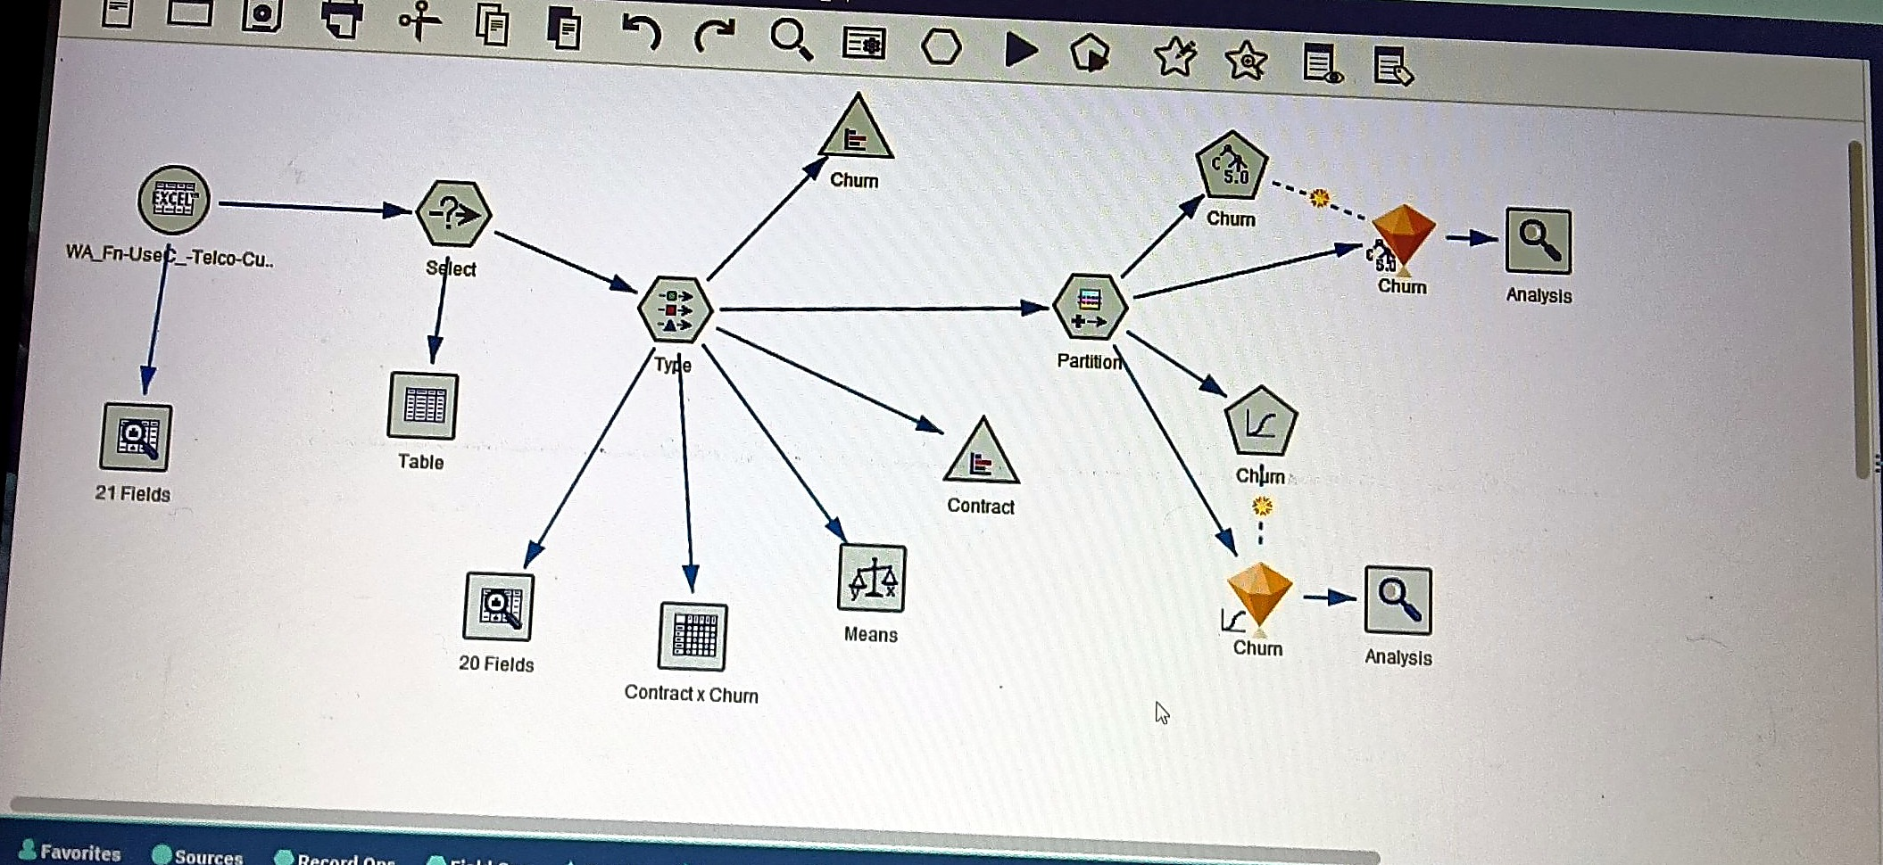
Screenshot: our final stream
The complete stream in SPSS Modeler: source, Select, Type, Partition, tests and both models with their Analysis nodes.
Notes:
Ye humari actual SPSS Modeler stream ka screenshot hai. Upar data prepare hota hai, neeche tests aur models hain.

Slide 7
Data preparation: three nodes
1
Select node
2
Type node
3
Partition node
Setting
Mode: Discard
Condition: @NULL(TotalCharges)
Setting
Churn = Target
customerID = None
SeniorCitizen = Flag
Setting
Training 70%
Testing 30%
Result
11 blank rows removed: 7,043 to 7,032 records
Result
Every field has the right role and type
Result
4,901 training and 2,131 testing records
Blank TotalCharges belong to brand-new customers and would break the models.
The model knows what to predict and ignores the ID.
Models learn on one part and are tested on unseen data.
Notes:
Pehle Select node se 11 blank TotalCharges rows hata di, ab 7032 records bache. Type node mein Churn ko target set kiya aur customerID ko none. Partition mein 70-30 split kiya: 4901 training aur 2131 testing.

Slide 8
Data Audit: is the data clean?
HOW IN MODELER
Output tab, Data Audit node, connected to the Type node, then Run.
Field | Min | Max | Mean | Std dev | Skew
tenure (months) | 1 | 72 | 32.42 | 24.55 | 0.24
MonthlyCharges | 18.25 | 118.75 | 64.80 | 30.09 | -0.22
TotalCharges | 18.80 | 8,684.80 | 2,283.30 | 2,266.77 | 0.96
tenure: U-shaped: many very new and many long-term customers.
MonthlyCharges: Two clusters: low phone-only plans and high internet plans.
TotalCharges: Right-skewed (0.96): most totals are small, a few are very large.
All 20 fields show 7,032 valid values, so no missing data is left.
Notes:
Data Audit se pata chala ki saari fields mein 7032 valid values hain, yani koi missing nahi. Tenure U-shape mein hai, TotalCharges right-skewed hai.

Slide 9
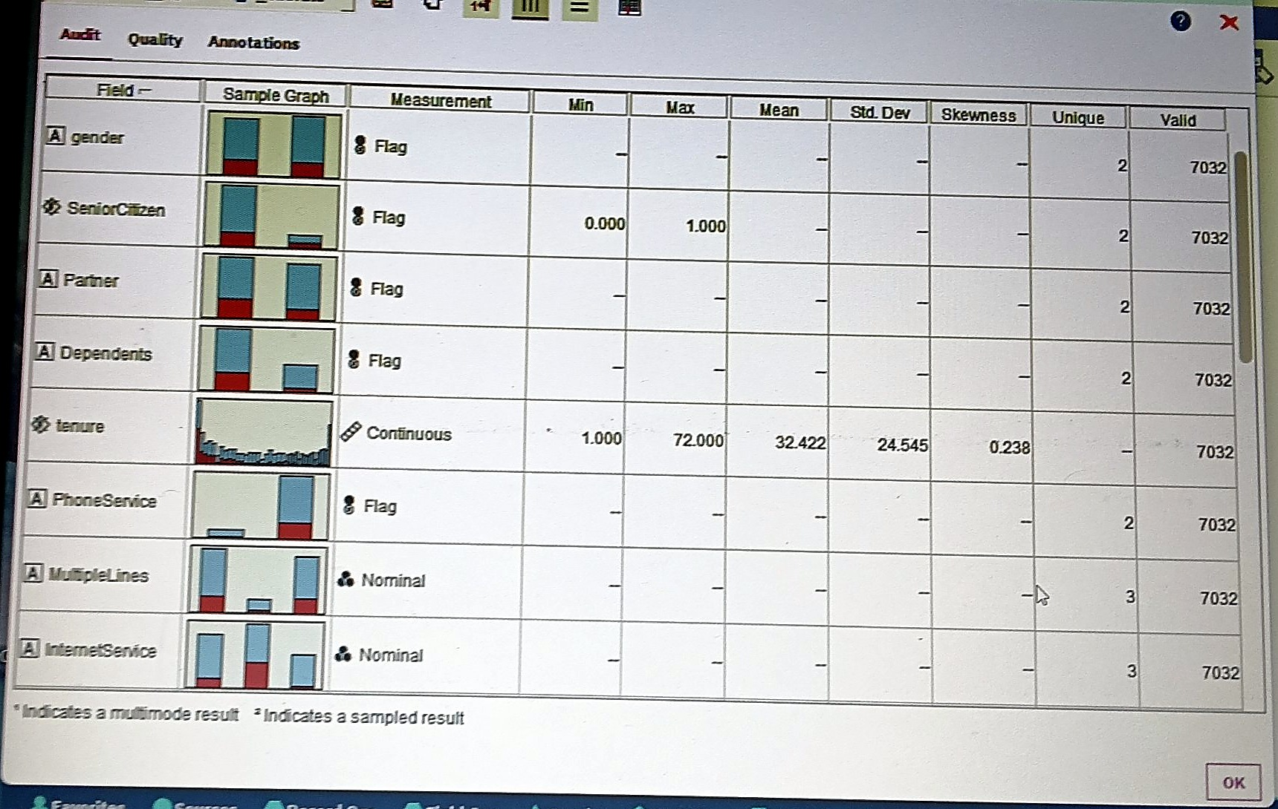
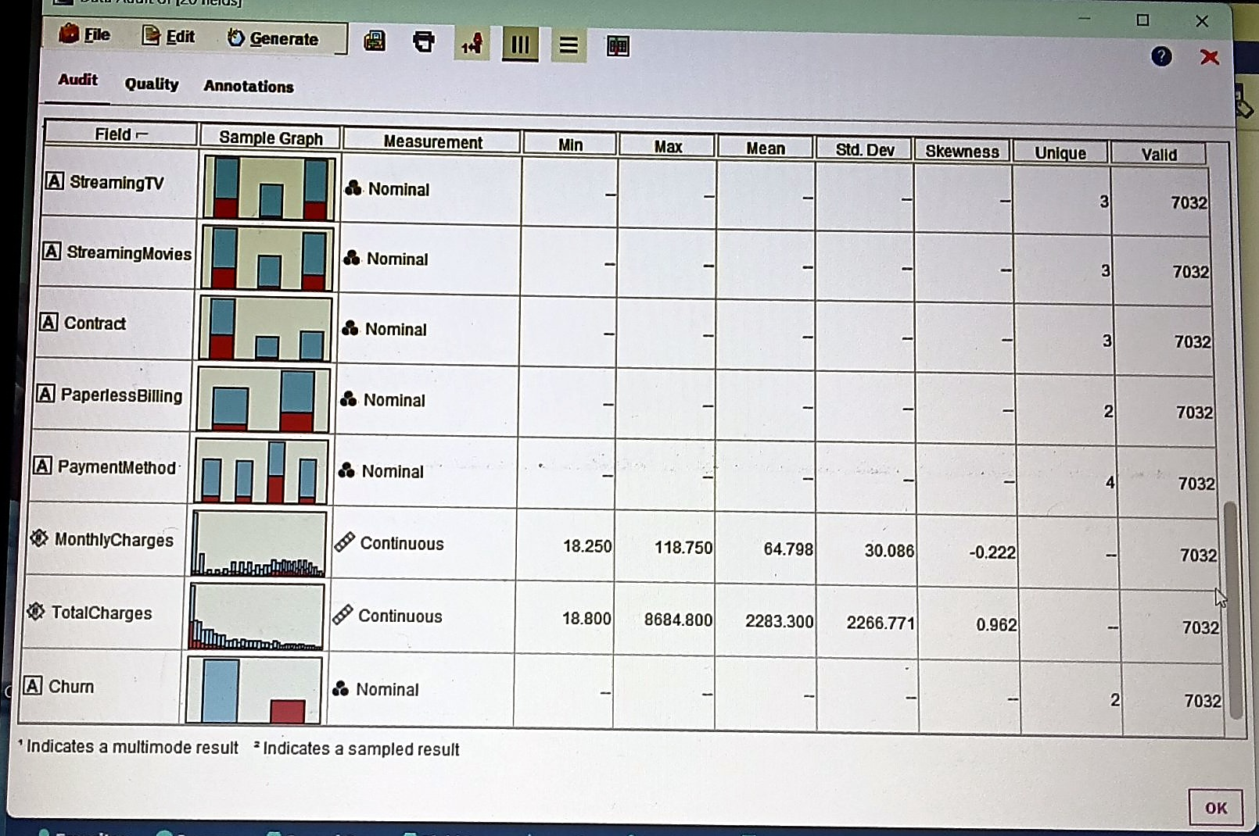
Screenshot: Data Audit output
Data Audit result: every field has 7,032 valid values, and the numeric summaries match the table on the previous slide.
Notes:
Data Audit ka output. Har field mein 7032 valid values hain, yaani missing nahi hai.

Slide 10
Churn rate: how many customers left?
HOW IN MODELER
Graphs tab, Distribution node, Field = Churn, then Run.
26.58%
1,869 churned, 5,163 retained (7,032 customers)
WHAT IT MEANS About 1 in 4 customers left. The data is imbalanced (3 stayers for every leaver), so accuracy alone can mislead.
Notes:
Distribution node se overall churn nikla: 26.58 percent, matlab 1869 customers gaye. Data imbalanced hai, isliye baad mein sirf accuracy par bharosa nahi kar sakte.

Slide 11
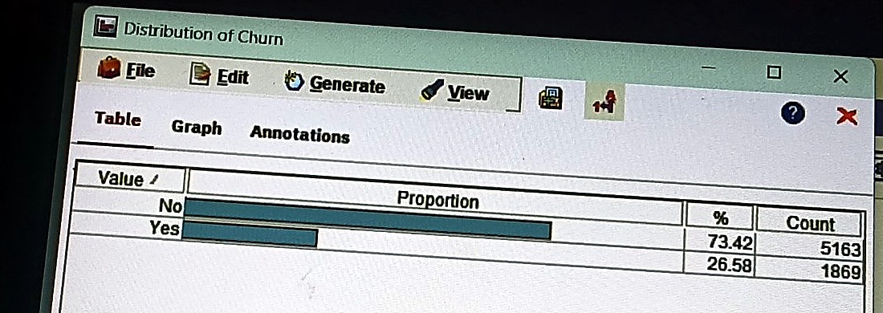
Screenshot: Churn distribution
WHAT TO NOTICE
No: 73.42% (5,163 customers)
Yes: 26.58% (1,869 customers)
Imbalanced, about 3 to 1
Distribution node output for Churn.
Notes:
Distribution node ka output: No 73.42 percent, Yes 26.58 percent.

Slide 12
Contract type vs churn: chi-square test
HOW IN MODELER
Distribution node: Field = Contract, Overlay = Churn.
Matrix node: Rows = Contract, Columns = Churn, Cross-tabulations with Expected, Residual and Row %.
H0: contract and churn are unrelated
H1: contract and churn are related
Chi-square = 1,179.55, df = 2, p < 0.001
p is far below 0.05, so we reject H0. Cramér's V ≈ 0.41 shows a moderate-to-strong link.
Notes:
Chi-square test se check kiya ki contract aur churn ka relation hai ya nahi. Value 1179.55, p almost zero, isliye null hypothesis reject. Cramer's V maine formula se nikala hai: root of chi-square divided by n, approx 0.41.

Slide 13
Reading the Matrix output
Contract | Retained | Churned | Churn % | Expected churned | Residual
Month-to-month | 2,220 | 1,655 | 42.71% | 1,029.9 | +625
One year | 1,306 | 166 | 11.28% | 391.2 | -225
Two year | 1,637 | 48 | 2.85% | 447.8 | -400
Expected vs actual
If contract did not matter, 1,030 month-to-month customers would churn. 1,655 actually did.
Residual
A positive residual (+625) means more churn than chance. Negative means less.
Row %
Month-to-month churn (42.7%) is about 15 times the two-year rate (2.9%).
Notes:
Is table se samajh aata hai: month-to-month wale customers expected se 625 zyada gaye, aur two year wale 400 kam. Month-to-month ka churn two-year se lagbhag 15 guna zyada hai.

Slide 14
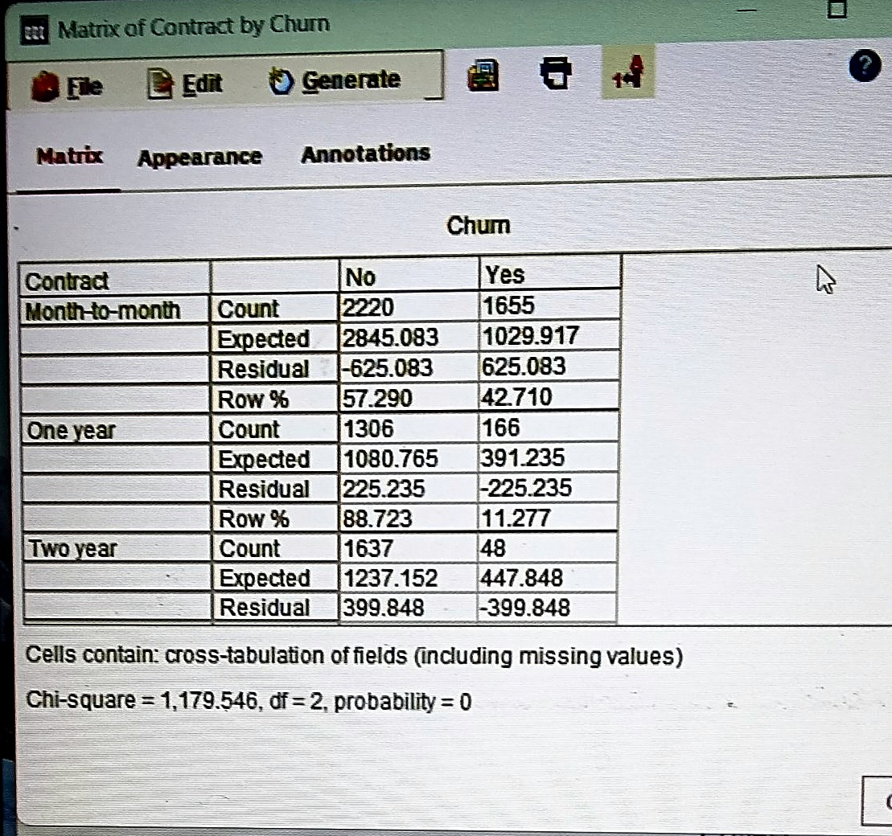
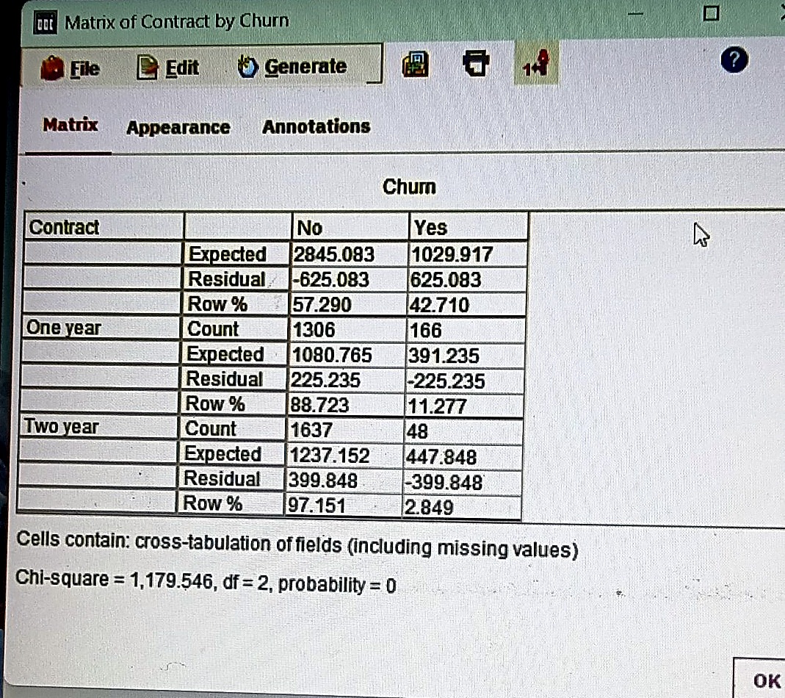
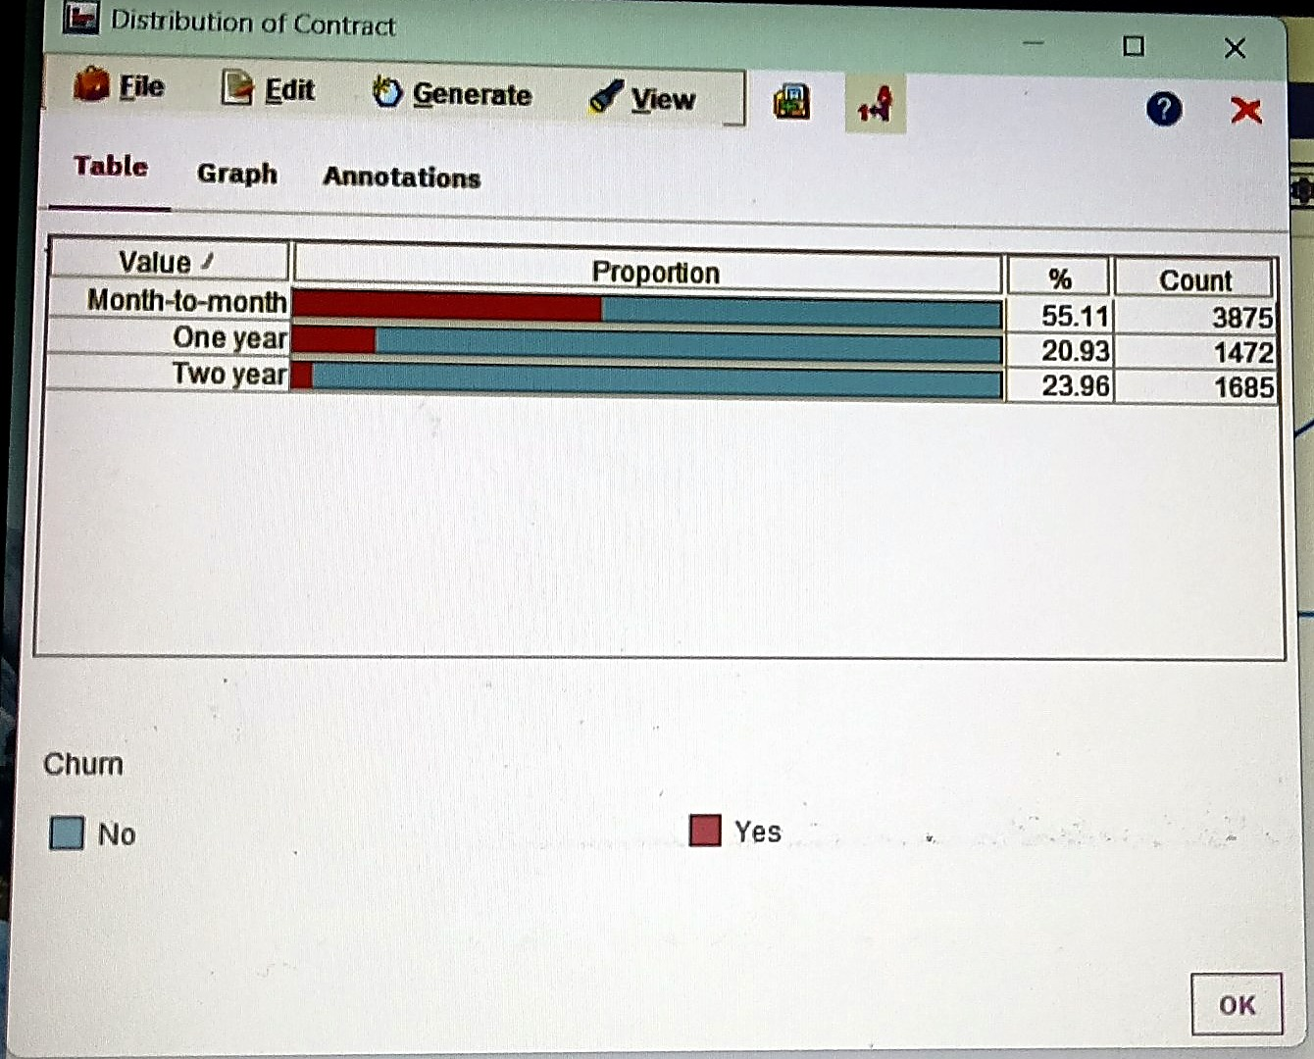
Screenshots: Contract and Matrix outputs
Left: Distribution of Contract with Churn overlay. Middle and right: Matrix output with Expected, Residual, Row % and the chi-square line.
Notes:
Left mein distribution of contract overlay ke saath. Beech aur right mein Matrix node ka output, jisme neeche chi-square 1179.546, df 2, probability 0 likha hai.

Slide 15
T-test: how do churners differ?
HOW IN MODELER
Output tab, Means node: Grouping field = Churn, Test fields = tenure and MonthlyCharges.
H0: group means are equal
Both differences are significant (p < 0.001; Modeler shows importance 1.000).
Churners stay half as long and pay about 13 more per month.
Notes:
Means node churned aur retained customers ke average compare karta hai. Churners ka average tenure 18 month hai jabki retained ka 38. Monthly charges churners ke zyada hain, 74 vs 61. Dono difference significant hain.

Slide 16
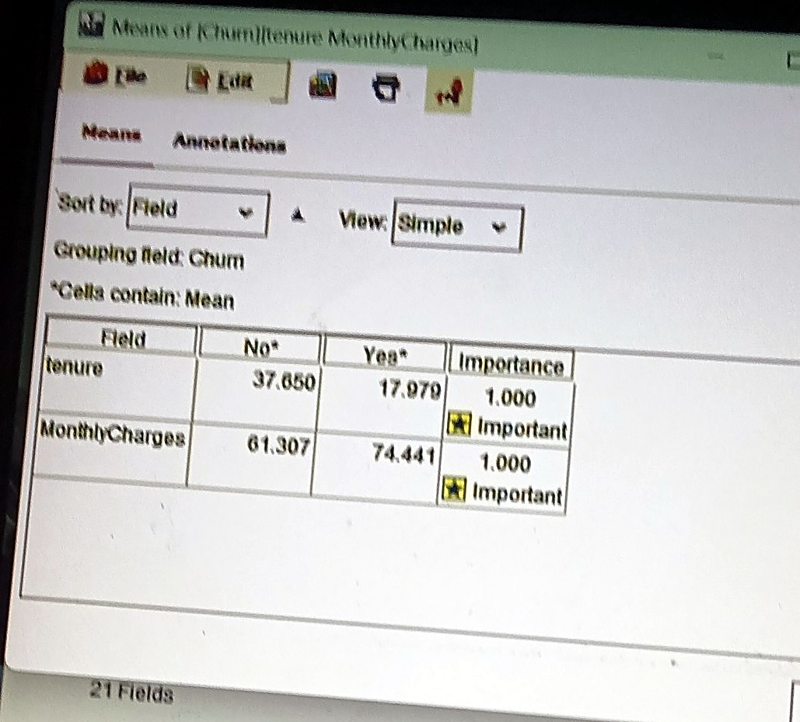
Screenshot: Means node (T-test)
WHAT TO NOTICE
tenure: 37.65 (retained) vs 17.98 (churned)
MonthlyCharges: 61.31 vs 74.44
Importance 1.000 on both: significant
Means node output, grouped by Churn.
Notes:
Means node ka output: tenure aur MonthlyCharges ke averages, aur importance 1.000.

Slide 17
Modelling: two prediction models
1
Logistic Regression
2
C5.0 decision tree
Estimates the probability that a customer churns from a weighted mix of fields.
Splits customers into groups with simple if-then rules, ending in a tree.
HOW IN MODELER
Modeling tab, Logistic node
Use partitioned data
Procedure: Binomial, Method: Enter
HOW IN MODELER
Modeling tab, C5.0 node
Use partitioned data
Output: Decision tree, Favor: Accuracy
Why use it: Easy to explain, stable
Why use it: Shows the rules visually
Notes:
Do models lagaye jo Partition node se judte hain. Logistic regression probability batata hai. C5.0 decision tree rules banata hai. Dono mein Churn target aur customerID none role hai.

Slide 18
Evaluation: confusion matrices
HOW IN MODELER
Output tab, Analysis node after each model nugget, with Coincidence matrices ticked. Below: results on the 2,131 testing records.
Logistic Regression
C5.0 decision tree
Actual | Predicted No | Predicted Yes
No (1,541) | 1,350 | 191
Yes (590) | 261 | 329
Actual | Predicted No | Predicted Yes
No (1,541) | 1,345 | 196
Yes (590) | 271 | 319
Blue = correct 'stayed' predictions. Red = churners the model correctly caught.
Rows show actual values, columns show what the model predicted.
Notes:
Confusion matrix mein rows actual hain aur columns prediction. Testing data mein 590 asli churners the. Logistic ne 329 pakde aur C5.0 ne 319.

Slide 19
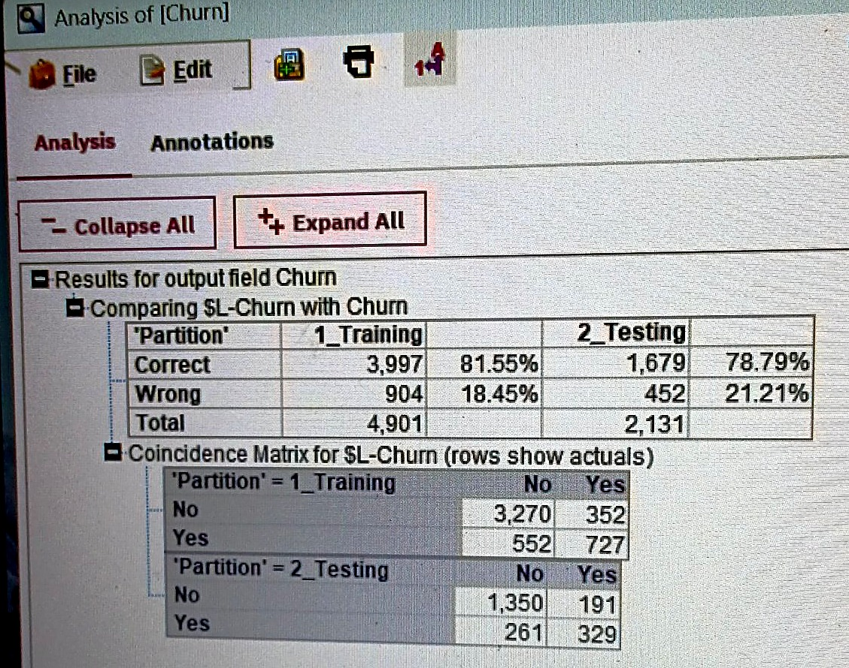
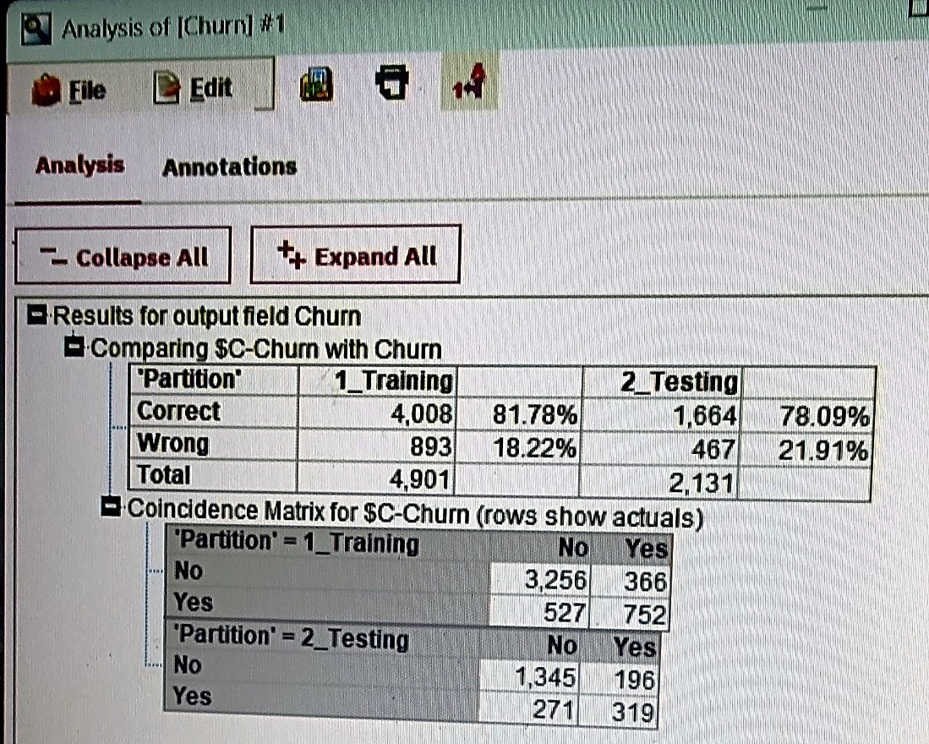
Screenshots: Analysis node results
Left: Logistic Regression (78.79% testing accuracy). Right: C5.0 (78.09% testing accuracy).
Notes:
Left mein Logistic ka Analysis output aur right mein C5.0 ka. Dono mein training aur testing accuracy aur coincidence matrix dikhta hai.

Slide 20
Which model is better?
Metric | Logistic | C5.0
Training accuracy | 81.55% | 81.78%
Testing accuracy | 78.79% | 78.09%
Churners caught (recall) | 55.8% | 54.1%
Churn calls correct (precision) | 63.3% | 61.9%
Our choice
Logistic Regression
Slightly better, but the two are close
A caution
Guessing 'No' for everyone scores about 73%. The real value is catching 56% of churners.
Recall and precision were calculated from the testing confusion matrices.
Notes:
Dono models lagbhag barabar hain. Logistic ka testing accuracy 78.79 hai, C5.0 ka 78.09. Humne Logistic choose kiya. Dhyan rahe: sabko No bol dein toh bhi 73 percent accuracy aati hai, isliye recall bhi dekhna zaroori hai.

Slide 21
What drives churn: the C5.0 tree
HOW IN MODELER
Double-click the C5.0 model nugget, open the Viewer tab and read the tree from top to bottom.
71%
Fiber, first 14 months (475 of 665)
Splits used
Contract, internet service, tenure, total charges, online security, tech support
Notes:
Tree mein pehle contract par split hota hai, phir month-to-month wale customers internet service par. Sabse risky group: fiber optic customers jinka tenure 14.5 mahine se kam hai, unme 71 percent churn karte hain.

Slide 22
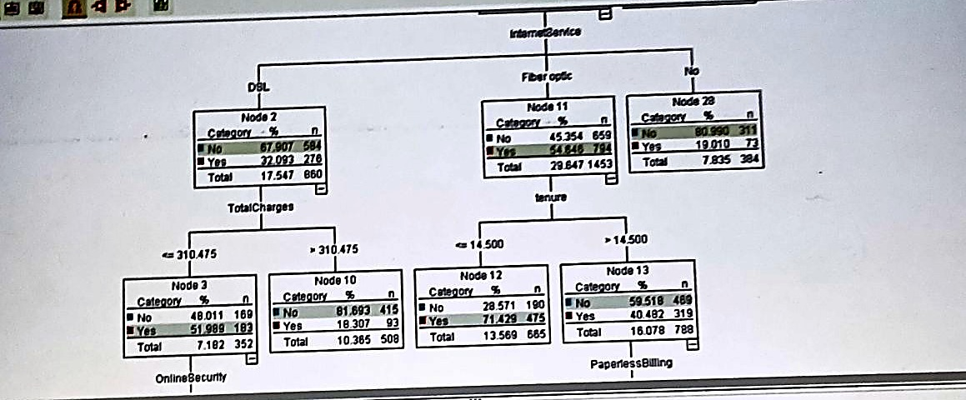
Screenshot: C5.0 tree, upper part
Internet service splits first, then tenure for fiber customers and total charges for DSL customers.
Notes:
Tree ka upar wala hissa: internet service, phir fiber mein tenure aur DSL mein total charges.

Slide 23
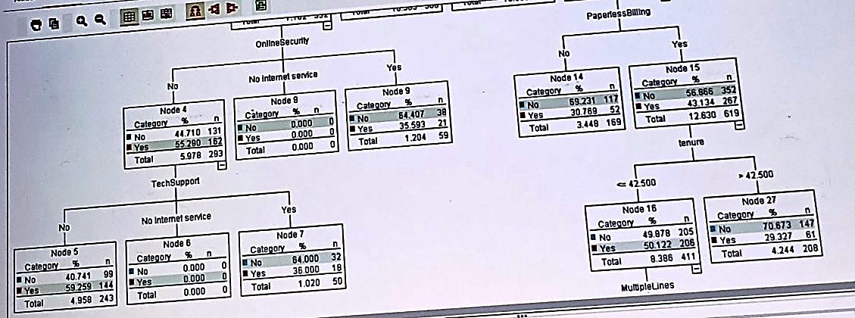
Screenshot: C5.0 tree, lower branches
Lower branches: Online Security, Tech Support, Paperless Billing and tenure splits.
Notes:
Tree ke neeche ki branches: online security, tech support, paperless billing aur tenure.

Slide 24
Findings turned into retention actions
Monthly contracts churn 42.7%, two-year only 2.9%
Offer perks and discounts to move customers to 1-2 year plans
Churners average 18 months of tenure; new fiber users churn 71%
Run onboarding and check-ins during the first 15 months
DSL users without Online Security or Tech Support churn 55-59%
Bundle a free trial of security and tech support
Churners pay about 13 more per month
Review fiber pricing and offer loyalty discounts
Use the model each month to list high-risk customers and contact them first.
Notes:
Har finding ke saamne ek action hai. Aur model ko har mahine chala ke high risk customers ki list banakar unhe pehle contact kar sakte hain.

Slide 25
Conclusion and limitations
What we found
26.58% of customers churned
Contract type is strongly linked to churn (chi-square, p < 0.001)
Churners are newer and pay more (T-test)
Logistic Regression: 78.79% test accuracy
Limitations and next steps
Only 56% of churners are caught; classes are imbalanced
Next: balance the classes and tune the cut-off
Link to the findings is association, not proof of cause
Single public dataset from one telecom company
Notes:
Conclusion: contract, tenure aur charges churn ke bade factors hain. Limitation: model sirf 56 percent churners pakadta hai. Future mein class balancing aur threshold tuning se improve kar sakte hain. Thank you.

