Slide 1
Zenoss Core
By Nidhi Mehta
Semester-6
121029

Slide 2
What is it?
Zenoss core is an open source IT infrastructure monitoring system.
It manages the performance and availability of various IT infrastructure like: network, server, storage, applications, converged infrastructure etc.
It also provides event and fault management.

Slide 3
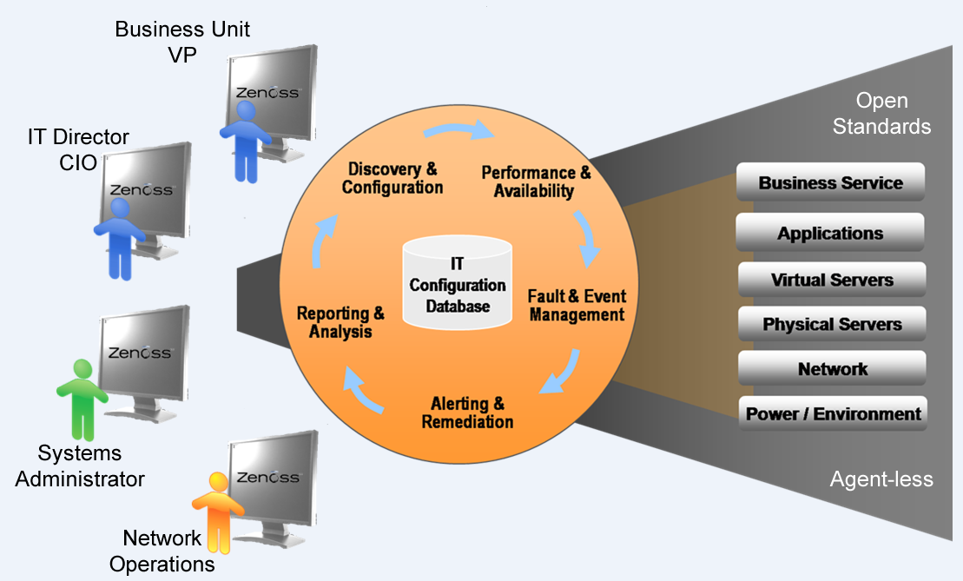
Current Technology
It uses Agent less technology. The modeling system uses SNMP, SSH, and WMI to collect information from remote machines
It uses a single web-based console.

Slide 4
Current Technology
Zenoss Core is built upon the following open source technologies:
Zope Application server Python Extensible programming language. Net-SNMP RRDtool MySQL Twisted

Slide 5
Benefits
First of all, it is free and open source.
It provides visibility of full lifecycle.
Cross-platform support
Single integrated view of networks, servers and apps
Distributed architecture proven to scale to thousands of devices.
Open architecture makes it easy to customize and extend
Affordable

Slide 6
Drawbacks
Performance
Complexity

Slide 7
References
http://community.zenoss.org/docs/DOC-5885
http://sourceforge.net/projects/zenoss/
http://www.zenoss.com/sites/default/files/documentation/Zenoss_Core_Administration_02-022014-4.2-v08.pdf
http://adminotes.blogspot.in/2011/08/zenoss-introduction.html

