Slide 1
Zenoss Core
By Nidhi Mehta
Semester-6
121029

Slide 2
What is it?
Zenoss core is an open source IT infrastructure monitoring system.
It manages the performance and availability of various IT infrastructure like: network, server, storage, applications, converged infrastructure etc.
It also provides event and fault management.
Notes:
It also provides events and fault management features that tie into the configuration database. These features help drive
operational efficiency and productivity by automating many of the notification, alerts, escalation, and remediation
tasks you perform each day.
2

Slide 3
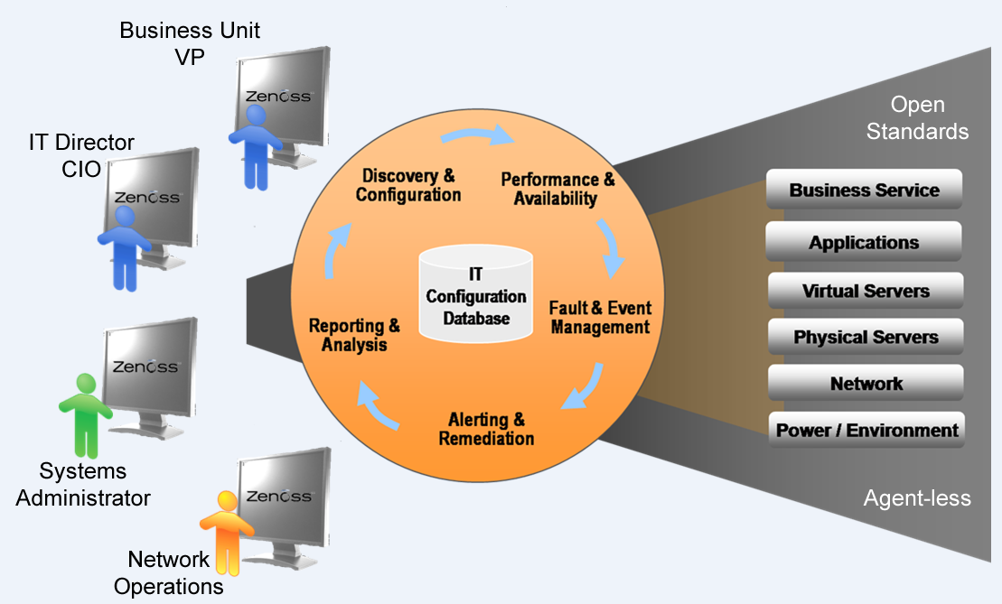
Current Technology
It uses Agent less technology. The modeling system uses SNMP, SSH, and WMI to collect information from remote machines
It uses a single web-based console.
Notes:
no need to install particular protocols that is agents in each and every computer system in network instead use the existing protocols.
Zenoss Core is built upon the following open source technologies:
• Zope Application server: An object-oriented web server written in Python. • Python Extensible programming language. • Net-SNMP: Monitoring protocol that collects systems status information. • RRDtool: Graph and log time series data. • MySQL: A popular open source database. • Twisted: An event-driven networking engine written in Python
3

Slide 4
Current Technology
Zenoss Core is built upon the following open source technologies:
• Zope Application server • Python Extensible programming language. • Net-SNMP • RRDtool • MySQL • Twisted

Slide 5
Benefits
First of all, it is free and open source.
It provides visibility of full lifecycle.
Cross-platform support
Single integrated view of networks, servers and apps
Distributed architecture proven to scale to thousands of devices
Open architecture makes it easy to customize and extend
Affordable
Notes:
1.Backed by the efforts of a large community of users
Deploy and adapt on your own terms
2. Discover & model your entire network/server infrastructure
Group, organize and visualize your environment
Track inventory & configuration changes
Monitor performance and availability
Centralize fault/alarm/event management
Real-time alerting & reporting
Use what you like for free
Buy support and other products you need when you need it
5

Slide 6
Drawbacks
Performance
Complexity

Slide 7
References
http://community.zenoss.org/docs/DOC-5885
http://sourceforge.net/projects/zenoss/
http://www.zenoss.com/sites/default/files/documentation/Zenoss_Core_Administration_02-022014-4.2-v08.pdf
http://adminotes.blogspot.in/2011/08/zenoss-introduction.html

