Slide 1

Machine Learning (Project-Fake News Detection)
Submitted By:-
Name: Nidhi Gupta
University R.no: 181500422
Department of Computer Engineering and Applications
Institute of Engineering and Technology
GLA University
Mathura-281406, India
2020

Slide 2


Slide 3


Slide 4

Problem Statement
To classify the given snippets of news as Real or Fake.

Slide 5
What is Fake News ?
Fake news is deliberately written and published usually with the intent to mislead in order to damage an agency, entity, or person, and/or gain financially or politically, often using sensationalist, dishonest, or outright fabricated headlines to increase readership.

Slide 6
Types of Fake News
Satire or parody
Misleading content
False context
Impostor content
Manipulated content
Fabricated content
Marketing Reviews

Slide 7
Requirement Analysis
The goal of the media is altered.
Political controversies.
Fake Reviews against a product
Democratic Impacts
Bullying and violence against innocent people
Impacts of fake news on social media and other things on Internet
are real and serious issues for sure and need to be tackled.
As the technology is growing, we have solution for this problem.
This project is the one among the solution and can be implemented

Slide 8

Machine Learning
Machine Learning is a sub-area of artificial intelligence enables computer system to learn from the past experiences as fed by the user to observe patterns without the intervention of the user and hence perform tasks in future.
It is basically an approach to give intelligence of human brain to a machine.

Slide 9

<Ways for a Machine to learn>
Supervised Learning
Unsupervised Learning
Reinforcement Learning
Supervised Learning
Unsupervised Learning
Reinforcement Learning

Slide 10
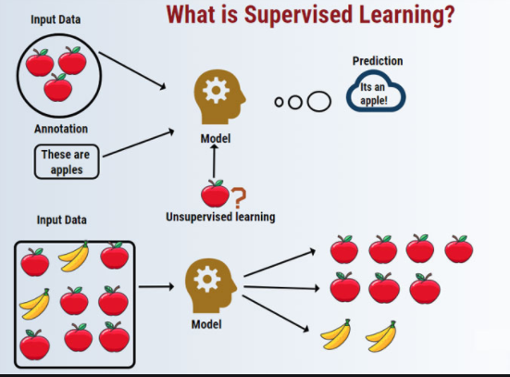
Supervised Learning

Slide 11



Unsupervised Learning
Unsupervised Learning
Recommendation

Slide 12

Natural Language Processing
Natural language processing (NLP) is the relationship between computers and human language. More specifically, natural language processing is the computer understanding, analysis, manipulation, and/or generation of natural language.
Natural language refers to speech analysis in both audible speech, as well as text of a language.

Slide 13
Text Classification
This is a Natural Language Processing task since the data is sometimes present in the text form, a language which the computer can’t understand.
So to convert the text into the vector of numbers we use text classification.

Slide 14
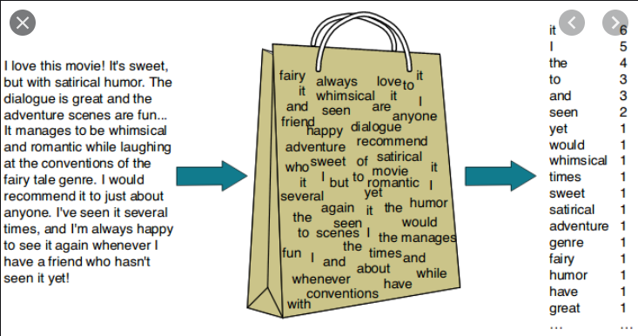
Bag of Words
Way of representing the text data when modeling with machine learning algorithms.
It transfers the text into the vector of numbers that describes the occurrence of words in the document.

Slide 15
But as the size of the vocabulary increases, the size of the vector representation of the element also increases. So we have :
Count Vectorizer
TF-IDF

Slide 16
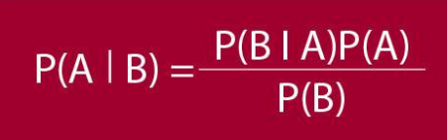
Algorithm Used
Naïve Bayes Algorithm:
Uses probability to predict tags of text based on the prior knowledge of conditions.
Calculate the probability of each tag of the given text and then predicts the class with higher probability.
Based on Bayes Probability theorem

Slide 17
Passive Aggressive Classifier
The family of algorithm used for large scale learning,
The data is inputted in a sequential iterative way and the model is trained step by step.
Useful in conditions where we have a large scale of data.

Slide 18
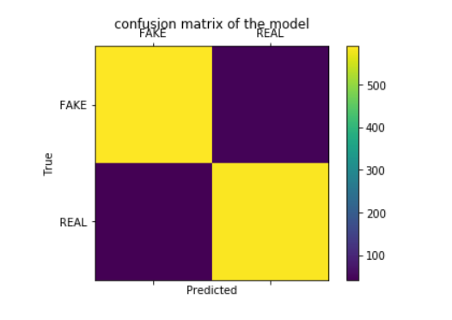
Experimental Analysis and Results
After applying the different algorithms that can be used for text classification, we obtained the best results from Passive Aggressive Classifier on one of the dataset I have chosen with the accuracy of 92.89%

Slide 19

Thank You !!
Thank You !!

