Slide 1
DC GAN model to generate faces
Model fine tuning
Learning Rate Schedules
Implemented learning rate schedules to decrease the learning rate as training progresses.
Regularization technique
Applied spectral normalization to the layers in the discriminator to stabilize training.
Label smoothing
Reduce the confidence of the discriminator by assigning labels of 0.9 to real images.
Batch size: decreased from 64 to 32
Introduce more noise into the gradient updates, which can act as a form of regularization
Noise dimension: increased from 100 to 150
Increasing the input noise influences the diversity of the generated images.
Increased number of epochs from 100 to 500

Slide 2
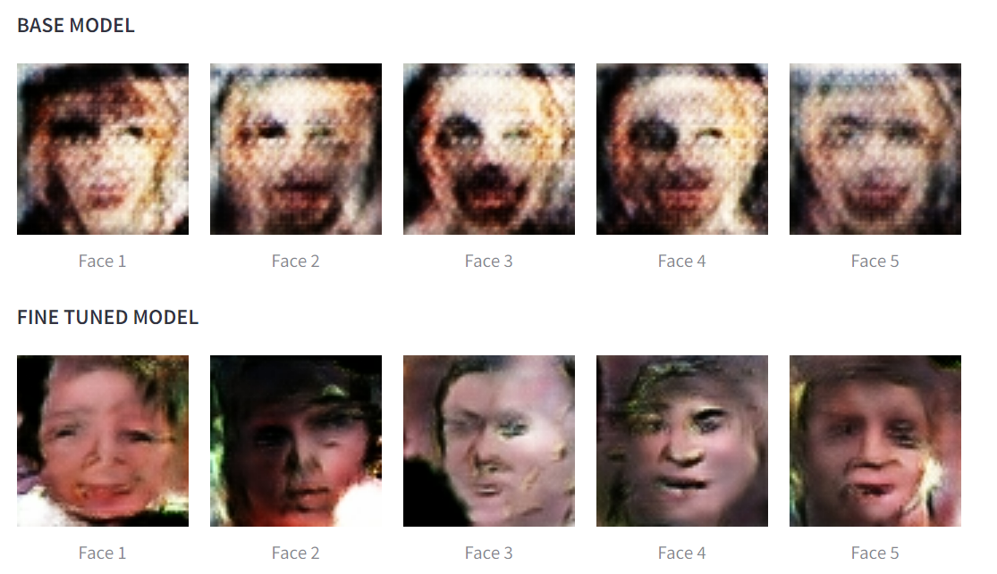
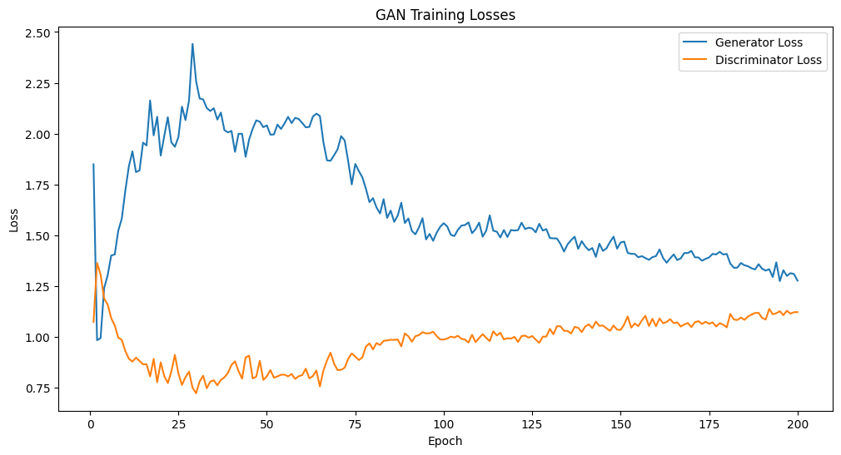
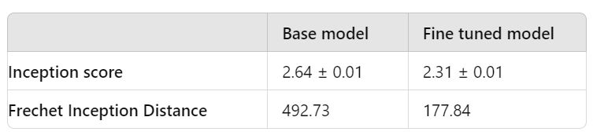
DC GAN model to generate faces
Model fine tuning
Monitoring training metrics during the process
Deployed model
https://huggingface.co/spaces/bguratti/face-genreator

Slide 3
EfficientNetB0 with pre-trained weights from ImageNet and the top layer removed.
Added Layers:
GlobalAveragePooling2D: Reduces each feature map to a single number.
Dropout (0.5): Regularization to prevent overfitting.
BatchNormalization: Normalizes the activations to improve stability.
Dense (1024 units, ReLU activation, HeNormal initializer, l2 regularizer): Fully connected layer.
Dropout (0.5): Additional regularization
BatchNormalization: Additional normalization.
Dense (Output layer, softmax activation, HeNormal initializer, l2 regularizer): Output layer with the number of classes.

Slide 4
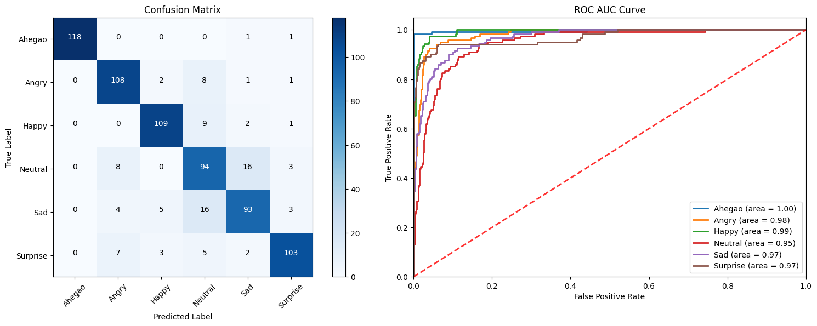
EVALUATION

Slide 5
Model Performance
Class | Precision | Recall | F1-Score
Ahegao | 1.00 | 0.98 | 0.99
Angry | 0.85 | 0.90 | 0.87
Happy | 0.92 | 0.90 | 0.91
Neutral | 0.71 | 0.78 | 0.74
Sad | 0.81 | 0.77 | 0.79
Surprise | 0.92 | 0.86 | 0.89
Accuracy |  |  | 0.86
Weighted Avg | 0.87 | 0.86 | 0.87
Train Accuracy: 93.78% Validation Accuracy: 82.17% Validation ROC AUC: 0.9756

Slide 6
Fine-tuning a CNN Model based on VGG
Hyperparameter Tuning:
Grid Search: Exhaustive search over specified parameter values.
Random Search: Randomly selecting parameter values to search through.
Bayesian Optimization: Using probabilistic models to select the next set of parameters.

Slide 7
Transfer Learning
Using pre-trained models on large datasets (e.g., ImageNet) to improve performance on smaller datasets.
Pre-trained Models:
- Example: VGG, ResNet, Inception
- Benefits: Faster convergence, improved accuracy

Slide 8
Fine-tuning Techniques:
- Freezing Initial Layers: Preventing certain layers from updating during training.
- Unfreezing and Retraining Specific Layers: Allowing specific layers to update.
- Adjusting Learning Rates: Setting different learning rates for different layers.

Slide 9
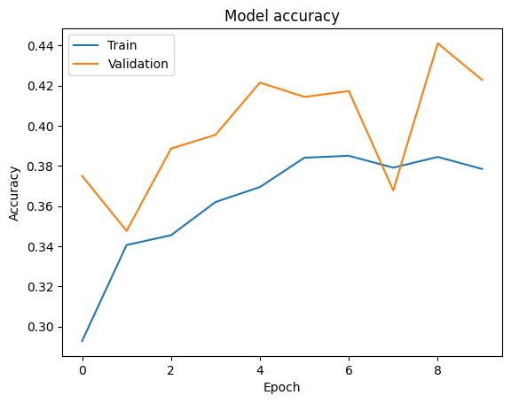
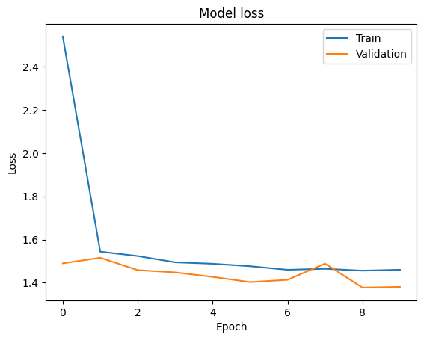
Ealuations

Slide 10
Thank You

