Slide 1
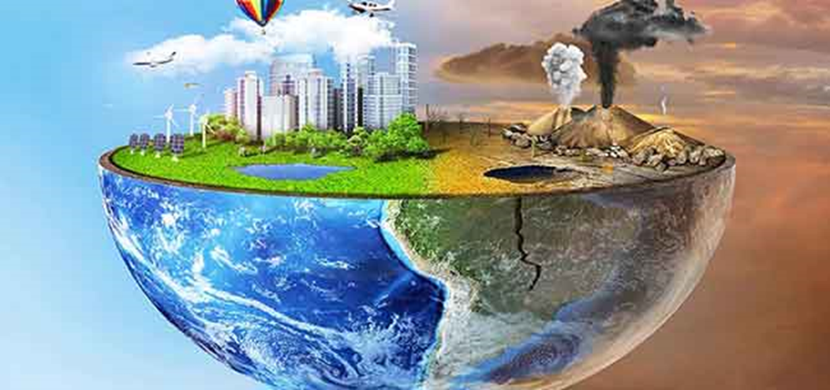
pollution Pollution is the introduction of harmful materials into the environment. These harmful materials are called pollutants. Pollutants can be natural, such as volcanic ash. They can also be created by human activity, such as trash or runoff produced by factories.6 Mar 2024

Slide 2
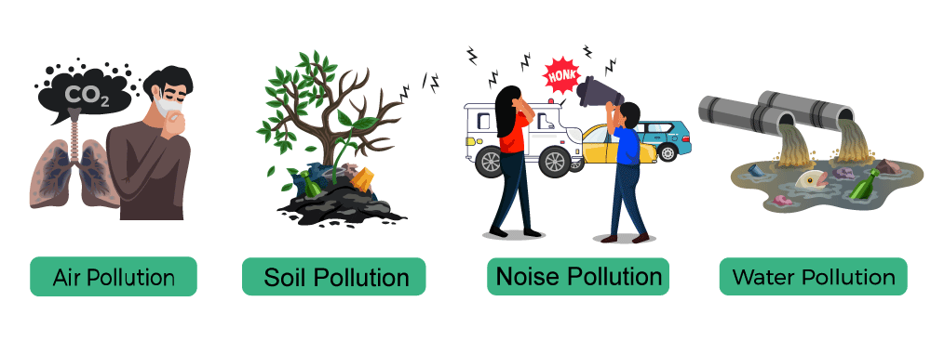
Type of pollution

Slide 3
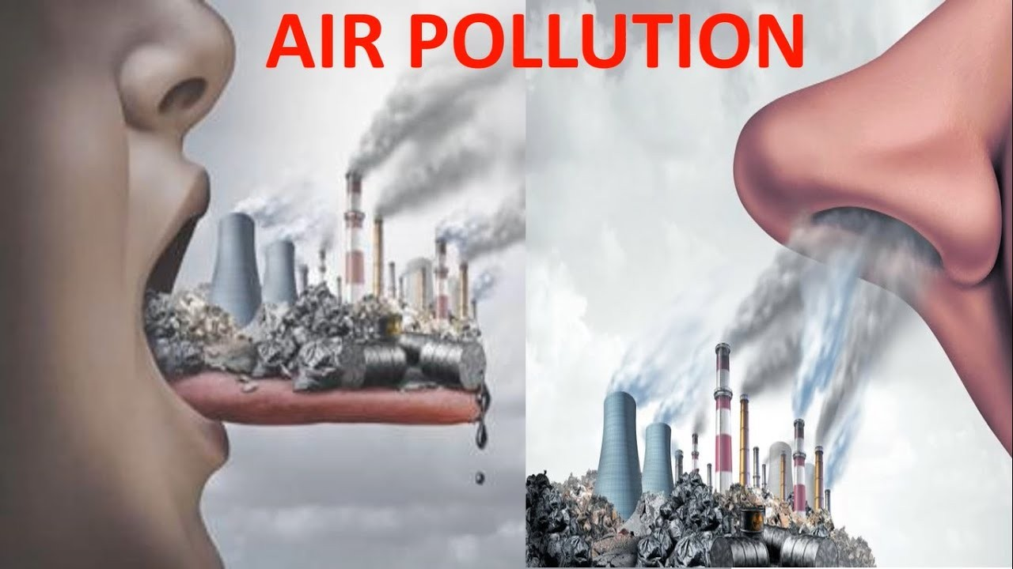
AIR POLLUTION
Air pollution is contamination of the indoor or outdoor environment by any chemical, physical or biological agent that modifies the natural characteristics of the atmosphere. Household combustion devices, motor vehicles, industrial facilities and forest fires are common sources of air pollution.

Slide 4
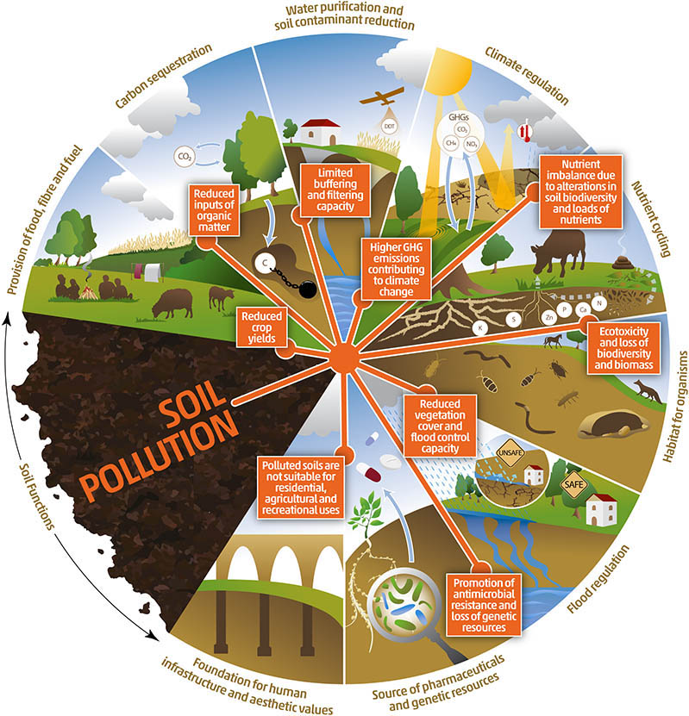
SOIL pollution
What is soil pollution essay?
Soil pollution can be defined as persistent of chemicals, salts, toxic compounds, radioactive materials, that have adverse effects on animal health and plant growth. There are many ways through which soils can get polluted. These are: Discharge of industrial waste into the Earth surfaces. Seepage through a landfill.

Slide 5
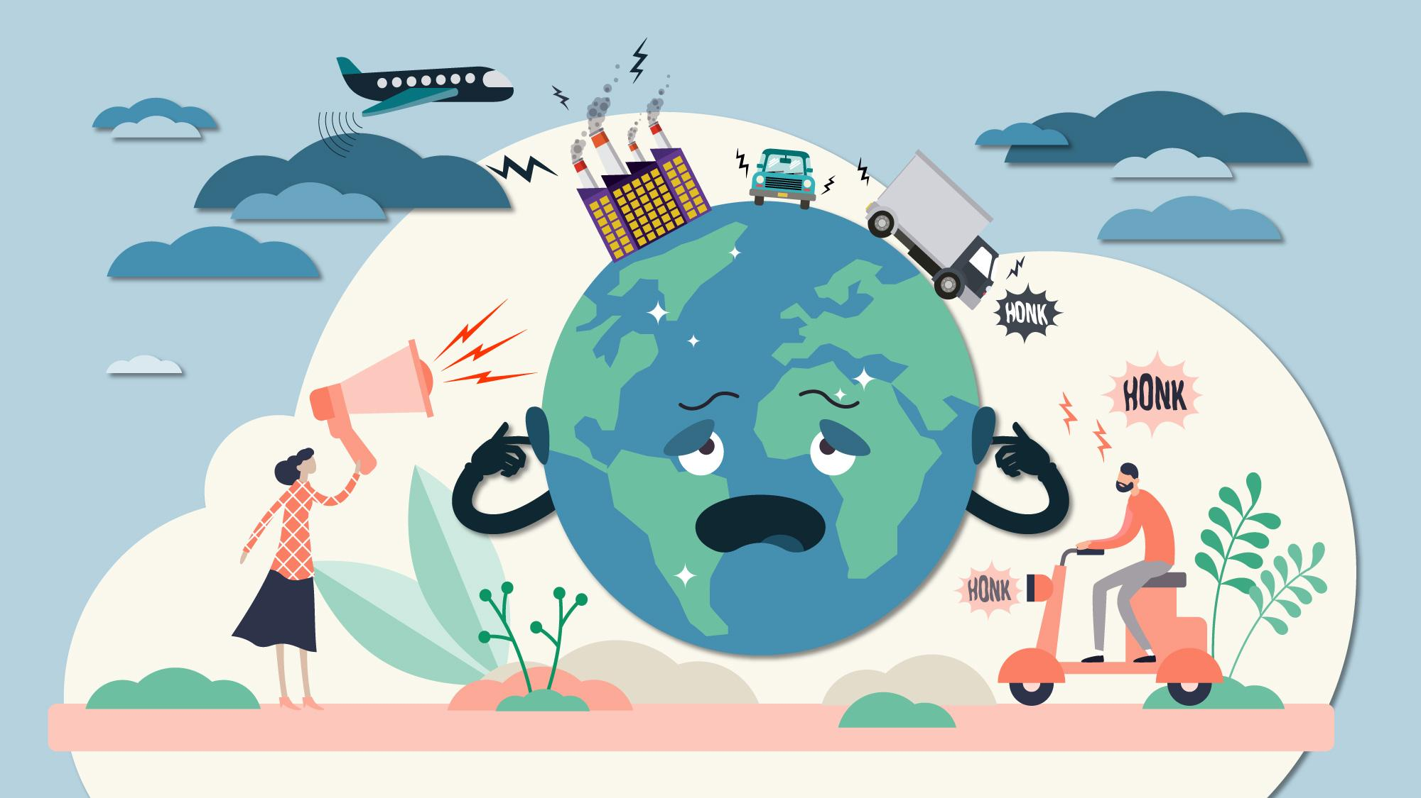
NOISE POLLUTION
What is noise pollution? Not all sound is considered noise pollution. The World Health Organization (WHO) defines noise above 65 decibels (dB) as noise pollution. To be precise, noise becomes harmful when it exceeds 75 decibels (dB) and is painful above 120 dB.

Slide 6
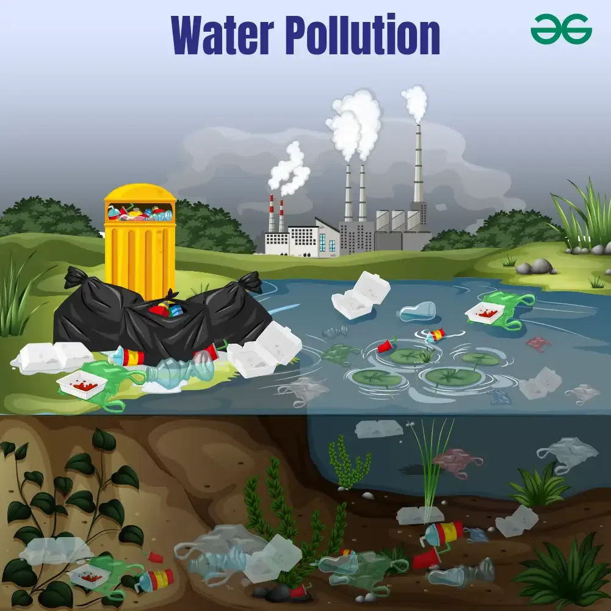
Water pollution
Water pollution occurs when harmful substances—often chemicals or microorganisms—contaminate a stream, river, lake, ocean, aquifer, or other body of water, degrading water quality and rendering it toxic to humans or the environment.
This widespread problem of water pollution is jeopardizing our health. Unsafe water kills more people each year than war and all other forms of violence combined. Meanwhile, our drinkable water sources are finite: Less than 1 percent of the earth’s freshwater is actually accessible to us. Without action, the challenges will only increase by 2050, when global demand for freshwater is expected to be one-third greater than it is now.

