Slide 1
Challenges and Techniques for Traditional Memory Allocation Algorithms in Relation with Today's Real Time Needs
Memory Management
Presented by:
Nidhi S Belur
Nithya V Kumar

Slide 2
CONTENTS:
Abstract
Introduction
Background
Dynamic memory Allocation
4.1. Sequential Fit
4.2. Segregated Fit
4.3. Buddy System
4.4. Other Fit algorithms
Comparative Analysis
Conclusion
References
4.4.1. Indexed Fit
4.4.2. Bitmapped Fit
4.4.3. Half Fit
4.4.4. Hoard
4.4.5. Two level segregated Fit

Slide 3
ABSTRACT
What is Memory Management?
Aspects that govern Memory management
Hardware level
Application level
Operating System level Memory Management
Challenges faced in Memory Management
Memory request on priority
Memory loss
Maintained locality of reference between memory blocks
Focus of paper
Analyze Dynamic Memory Allocation (DMA) with respect to functionality, response time and efficiency of algorithms

Slide 4
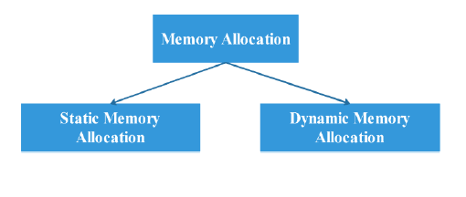
INTRODUCTION
Goal of Memory allocation algorithm is to provide real time support of memory allocation
Types of Memory allocation

Slide 5
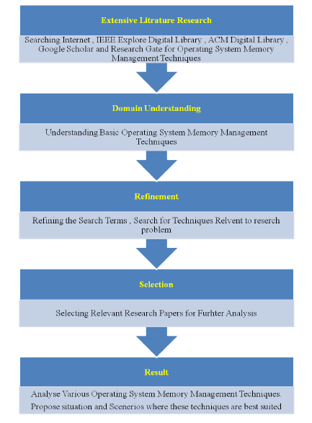
BACKGROUND

Slide 6
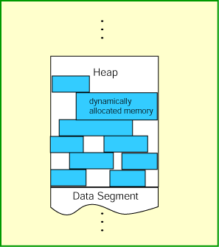
DYNAMIC MEMORY ALLOCATION
Allocates memory from heap during run time
Requests exactly required memory
Releases allocated memory when no longer needed.
Types of dynamic memory allocation
Sequential fit
Segregated fit
Buddy system
Indexed fit
Bitmapped fit
Half fit
Hoard
Two level segregated fit

Slide 7
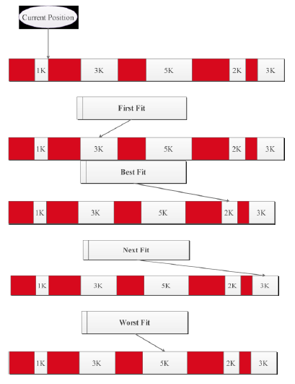
SEQUENTIAL FIT
This algorithm utilizes free blocks of memory in a linear order in the form of list called free list
Memory blocks are allocated using pointers
Types of approaches
First fit
Best fit
Next fit
Worst fit

Slide 8
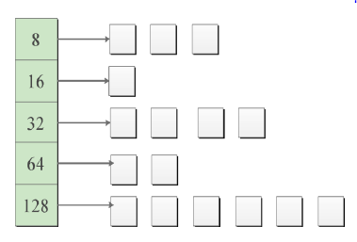
SEGREGATE FIT
This algorithm employs array of free blocks to allocate memory, by using size in power of 2.
Memory blocks are divided into classes holding different size blocks.
When a request for memory is received,
Round the size of request to best available class
Memory block of matching size is allocated.
If this request fails a larger block is taken from other list and split.
Types of approaches
Strict size class
Exact list
Classes with range

Slide 9
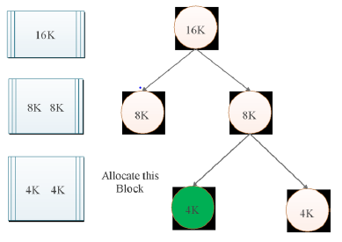
BUDDY SYSTEM
The buddy system divides the memory area into allowable block size and partition the area until minimum block size is achieved.
TYPES OF BUDDY SYSTEMS:
Binary Buddy
Weighted Buddy
Fibonacci Buddy
Double Buddy
Tertiary Buddy
Fig.4.1. Basic Buddy System

Slide 10
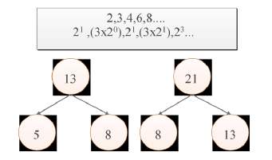
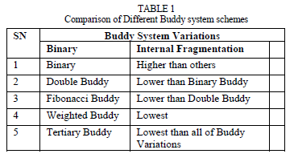
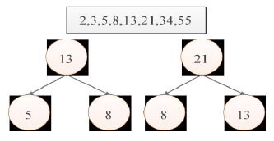
TYPES OF BUDDY SYSTEMS
Fig.4.2. Weighted Buddy
Fig1.3. Comparison-Buddy Systems
Fig.4.3. Fibonacci Buddy

Slide 11
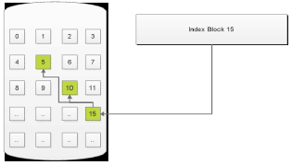
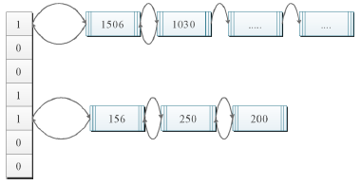
Dynamic memory management Algorithms
Indexed Fit
Memory allocator
Maintained using different types of data structures.
Bitmapped Fit
Improved variation of indexed fit
Keeps references to the used and free portion of array by using bits.
Half Fit
Half fit is much older technique
Uses bitmaps to keep reference to unfilled lists while using instructions of bitmap search technique to get those bits which are set in bitmaps.
Main theme behind half fit is to use segregated list of single level which is used to link variable size free blocks.
Fig.. Indexed Fit
Fig.. Half Fit

Slide 12
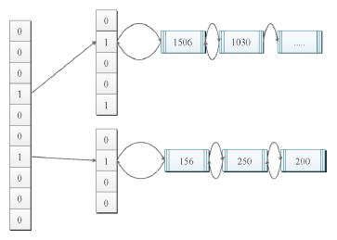
Dynamic memory management Algorithms
Hoard
Designed especially for multiprocessor systems and its performance is quite remarkable among other discussed algorithms.
Trick logic behind hoard is to use operating system virtual memory as superblocks and these superblocks are used to server blocks of memory of one class. To reduce external fragmentation it re cycle its superblocks which are not in use.
Two level segregated fit:
3 levels of segregated free lists are used to carry free blocks of memory of same class.
In first level there are free blocks of memory following power of 2 sequences while 2nd list uses user’s configured variables to divide free block classes of first list. Thus help to offer bounded response time. While allocating and de allocating it uses 3 different equations.
Fig.. Two level segregated fit

Slide 13
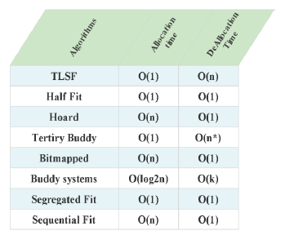
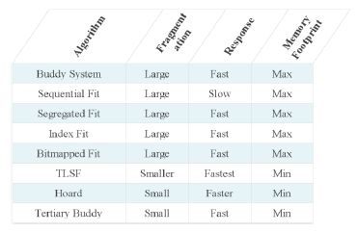
Comparative Analysis
Comparative analysis with respect to fragmentation and response time.
Among all these memory allocators, performance of two level segregated fit is better because it also minimizes the fragmentation with fast response time which makes it suitable for real time application.
comparative analysis is presented with respect to allocation and de allocation time of different algorithms.
Performance of two level segregated fit is better because its worst case time is less than other’s.

Slide 14
Conclusion
Different memory allocation techniques have been discussed along with their comparative analysis with respect to internal fragmentation they cause, response time, allocation time, de allocation time and memory footprint they use.
Analysis shows that TLSF among mentioned technique is best to use for real time systems because TLSF cause very low internal fragmentation, its response time is very good which is the primary demand of real time system where time is most important factor. Also TLSF allocation and de allocation time is small constant time that makes it much faster than other traditional techniques.
With comparative analysis it’s found that the larger fragmentation, slow response time, larger allocation and de allocation time with implementation constraints, it makes traditional dynamic memory allocators like segregated fit, indexed fit, bitmapped fit and simple buddy system infeasible and inefficient for real time system because real time systems always pose timing and bounded rationality constraints on operating system memory management allocators.
Therefore, Hoard, tertiary buddy system and two level segregated fit are suitable for real time applications with faster response time, minimum amount of fragmented memory respectively.

Slide 15
REFERENCES
Research paper:
Muhammad Abdullah Awais, “Memory Management: Challenges and Techniques for Traditional Memory Allocation Algorithms in Relation with Today's Real Time Needs” , International Journal of Multidisciplinary Sciences and Engineering, vol. 7, no. 3 (march 2016).
References:
[1] Nilesh Vishwasrao and Prabhudev Irabashetti , “Dynamic Memory Allocation: Role in Memory Management” , International Journal of Current Engineering and Technology , Vol.4, No.2 (April 2014).
[2] Valtteri Heikkilä , “A Study on Dynamic Memory Allocation Mechanisms for Small Block Sizes in Real-Time Embedded Systems”, University of Oulu Department of Information Processing Science, conference 17 (December 2012).
[3] Seyeon Kim, “Node-oriented dynamic memory management for real-time systems on ccNUMA architecture systems”, University of York Department of Computer Science, conference paper (April 2014).
[4] Dipti Diwase, Shraddha Shah, Tushar Diwase and, Priya Rathod, “Survey Report on Memory Allocation Strategies for Real Time Operating System in Context with Embedded Devices”, International Journal of Engineering Research and Applications (IJERA), Vol. 2, Issue 3, May-Jun 2012, pp.1151-1156.

Slide 16
QUESTIONS?

