Slide 1

SAMSUNG PRISM
Generative AI
Hackathon
3rd Edition 2026 – 27
Theme ID - 2
Team Name - Hustle
College Name – MS Ramaiah Institute of Technology
Member Name & Email 1- Nidhi C A & 1ms24cs110@msrit.edu
Submission Github link - https://github.com/nidhica/SGTE-Smart-Guided-Troubleshooting-Engine
Notes:
Opening slide for the 3rd edition of the PRISM Generative AI Hackathon. Replace the SAMSUNG PRISM pill with the official PRISM logo image if you have the asset. Confirm the academic year label (2026-27) before circulating.

Slide 2





Smart Guided
Troubleshooting
Engine
Theme 2
User
Complaint
AI
Understanding
Troubleshooting
Guided
Resolution
AI-Assisted Device Troubleshooting
and Guided Resolution

Slide 3














Existing Solutions & Gaps
Existing solutions
Key Gaps
Traditional Customer Support:
Users contact support agents who manually diagnose issues and suggest solutions. This often involves multiple interactions to identify the problem.
Limited Understanding:
Difficulty interpreting
vague, informal, and
complex user complaints.
Manual Effort:
Users must search
through multiple articles
and navigate device
settings themselves.
Knowledge Base Systems:
Provide troubleshooting articles and step-by-step instructions for common device problems. Users must search for relevant articles themselves.
Lack of Personalization:
Generic solutions may not
address the user's specific
symptoms or device
context.
Limited Actionability:
Instructions may lack
direct navigation links to
relevant device settings.
Automated Troubleshooting Tools:
Offer predefined diagnostic flows for specific device issues, such as display problems or touchscreen failures.
Insufficient Grounding:
Recommendations may
not always be supported
by verified troubleshooting
information.
Fragmented Troubleshooting:
Online Communities & Forums:
Users seek solutions from other users who have experienced similar issues, but the advice may vary in accuracy and relevance.
Relevant information may
be spread across different
support articles and
resources.
Device Diagnostic Tools:
Help identify certain hardware or software problems through built-in tests and diagnostic features.
Difficulty Handling Complex Symptoms:
Multiple symptoms occurring together can make it harder to identify the appropriate troubleshooting path.
Key Gaps
Limited Understanding: Difficulty interpreting vague, informal, and complex user complaints.
Manual Effort: Users must search through multiple articles and navigate device settings themselves.
Lack of Personalization: Generic solutions may not address the user's specific symptoms or device context.
Limited Actionability: Instructions may lack direct navigation links to relevant device settings.
Insufficient Grounding: Recommendations may not always be supported by verified troubleshooting information.
Fragmented Troubleshooting: Relevant information may be spread across different support articles and resources.
Difficulty Handling Complex Symptoms: Multiple symptoms occurring together can make it harder to identify the appropriate troubleshooting path.

Slide 4









Our Solutions & Architecture Diagram
Solution
SGTE is an AI-assisted troubleshooting platform that understands user complaints, generates structured troubleshooting plans and provides relevant navigation links.
Architecture Diagram
  USER/UI
  Enters device issue in natural language
QUERY ENRICHMENT Text normalization
Generate query paraphrases
Create semantic cache key
Understand
Accepts natural-language complaints
Normalizes informal queries into technical format
SEMANTIC CACHE
Fast path retrieval
ANALYZE
Identifies troubleshooting goals.
Extracts relevant actions and generates UI steps.
CACHE HIT
Return validated plan
CACHE MISS
Process, validate and cache plan
    NAVIGATE
    Maps device screens to available deep links.
    Organizes actions from non-invasive to critical steps
STRUCTURE EXTRACTION LLM/Parsing
Goal identification
Action extraction
UI step generation
    OPTIMIZE
    Uses semantic caching to reuse validated plans.
    Reduces repeated LLM processing and improves response time.
DEEPLINK MAPPING AND ACTION ORDERING Match device screens to catalog
Screen mapping
Order actions(non-invasive->critical)
  FASTAPI REST API Structured response
        Operational metadata
  REACT UI Troubleshooting steps
      Available links

Slide 5

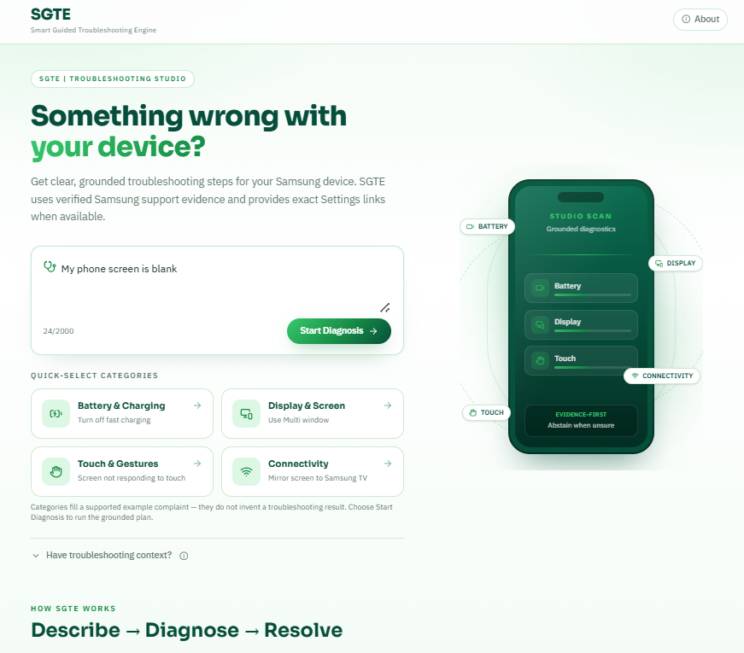
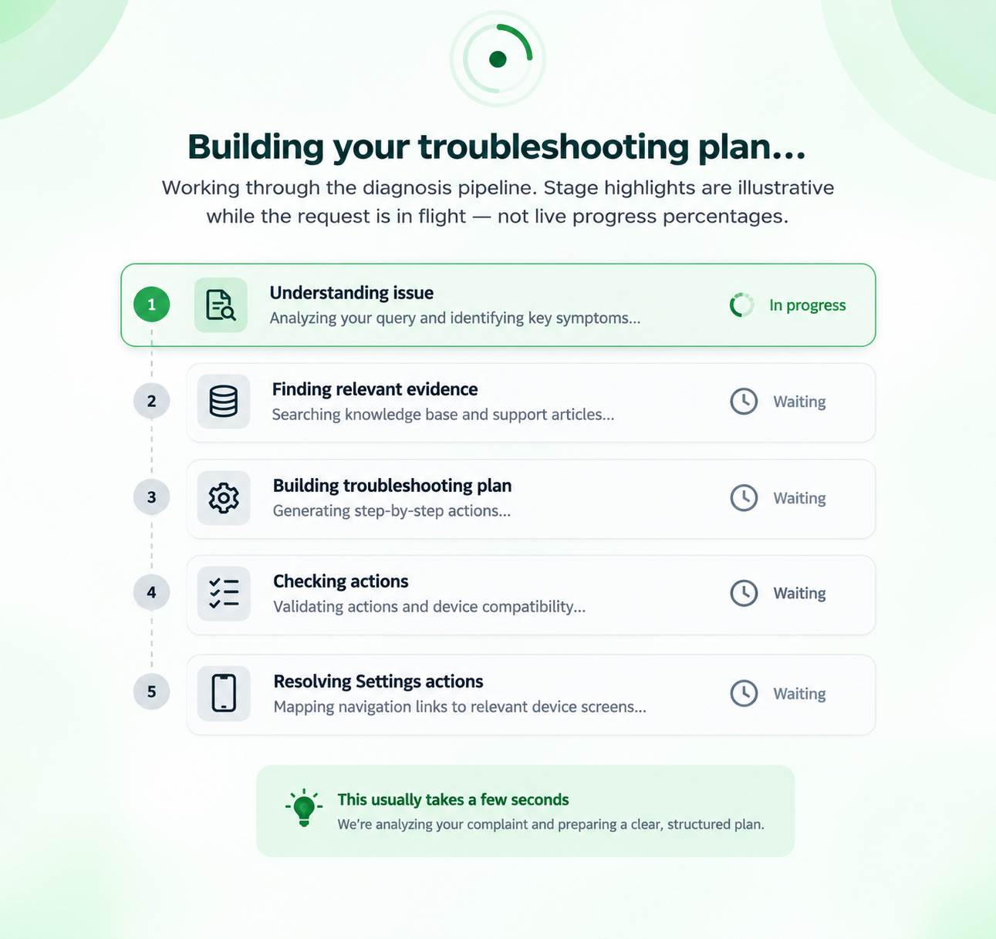
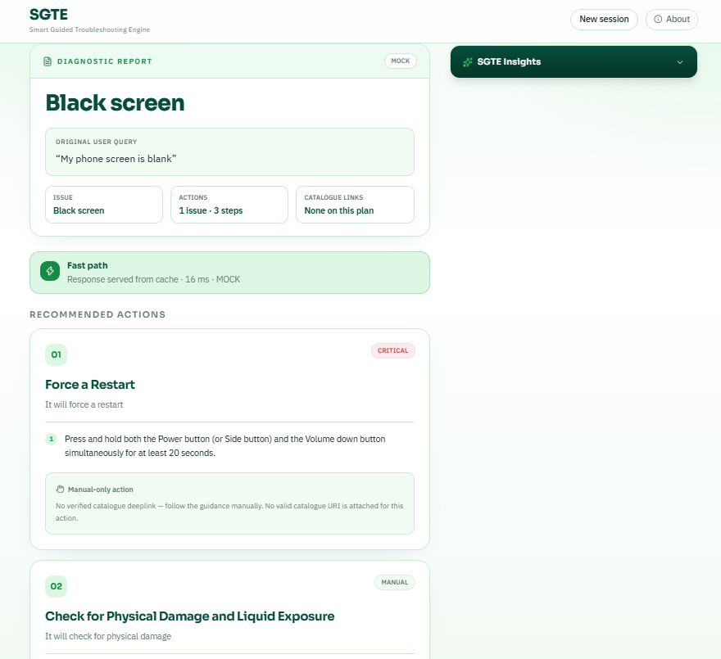
Demo & Product Walkthrough
Enter the Device Complaint
Natural Language input
Process the Complaint
Intelligent Query Processing
Get Troubleshooting Guidance
Structured troubleshooting plan
The user describes the device issue in everyday language
SGTE understands the query, extracts key information and generates a structured plan.
The system generates a clear, step by step plan with actions and explanations

Slide 6

















Tools and tech stack used
Frontend
Backend
API and Query Processing
Retrieval and
Knowledge
Development
and Testing
User Interface
API and Processing
Understanding User Input
React.js Vite
Python FastAPI Pydantic
LLM NLP Query
Provider Enrichment
Dense TF-IDF SIIS
Retrieval Knowledge
Base
Pytest Git Github
Builds a responsive and
interactive interface for
users to enter device
complaints and view
troubleshooting
guidance.
Implements the
troubleshooting pipeline,
handles requests,
validates structured
Data and returns
responses.
Converts informal
complaints into
structured queries and
generates a step-by-step
troubleshooting plan.
Retrieves relevant
troubleshooting
information and maps
device navigation
destinations using the
deep-link catalog.
Tests backend
functionality, tracks
code changes, and
manages the project
repository.

Slide 7








Impact & Use case
Impact
Real-World Use Case
Simplified Troubleshooting
Transforms everyday device complaints into
clear, structured troubleshooting steps.
Display and Screen Issues
A user reports screen flickering, dimness, or a black screen.
Reduced User Effort
Reduces the need to search through multiple
support articles and manually locate settings.
Connectivity Problems
A user experiences Wi-Fi disconnections or Bluetooth
connection issues.
Actionable Guidance
Presents step-by-step instructions and
available navigation links to help users
troubleshoot device issues.
Device Settings Assistance
A user needs help finding the correct display, sound or
accessibility settings.
Faster Repeat Responses
Uses semantic caching to reuse validated
troubleshooting plans for matching queries,
reducing repeated processing.
Application Issues
A user reports an application freezing or behaving
unexpectedly.
Improved Accessibility
Makes technical troubleshooting instructions
easier to understand for users with different
levels of technical knowledge.
Device Functionality Issues
A user experiences problems with notifications, touch
response or other device features.

Slide 8



Innovation highlights, results and limitations
Innovation Highlights
Result
Limitations
Key features that make SGTE unique
Metric | Result
Scenario coverage | 22 predefined troubleshooting scenarios
Phase 79 tests | 73 tests passed
Full test suite | 885 tests passed
Fabricated evidence IDs in scenario overrides | 0
Deep links in scenario override responses | 0
Limited Scenario Coverage
The manually authored scenarios
cover a finite set of specific device
complaints.
Natural Language Understanding
Processes everyday device complaints and
transforms informal queries into structured
technical inputs.
Retrieval Relevance
The relevance of retrieved
information can vary, particularly for
complex or less common symptoms.
Hybrid Retrieval
Combines dense retrieval with TF-IDF and
lexical matching to identify potentially
relevant troubleshooting information.
Incomplete Navigation Support
Verified deep links are not available
for every troubleshooting action.
Structured Troubleshooting
Extracts troubleshooting goals, actions and
individual UI steps to generate organized
guidance.
Generic Guidance
Some complex or multi-symptom
complaints may receive broad or less-targeted recommendations.
Semantic Caching
Reuses validated troubleshooting plans for
matching queries, reducing repeated processing.
Guided Navigation
Maps relevant device screens to available
deep-link catalog entries and organizes
troubleshooting actions.
Key Achievement
Developed a functional troubleshooting
prototype with query processing,
structured guidance, retrieval components
and a web interface.
Production Readiness
The current prototype uses mock-mode configuration and has not been certified for production use.

Slide 9












What’s next
Expand
Troubleshooting
Coverage
Improve AI and
Retrieval
Accuracy
Strengthen
Evidence and
Navigation
Enable
Production
Readiness
Evaluate and
Scale
Evaluate
troubleshooting
accuracy using a
representative test
dataset.
Expand support to
additional devices and
languages.
Support a wider range
of device issues and user
complaints.
Add more device-
specific troubleshooting
scenarios.
Enhance query
understanding for
complex, multi-symptom
complaints.
Improve the relevance
of retrieved troubleshooting
information.
Integrate more
verified troubleshooting
resources.
Expand verified
deep-link coverage for
device settings.
Integrate and
validate a live AI
provider.
Improve reliability,
response consistency
and error handling.

Slide 10




Brownie points slide( differentiation)
Natural-Language First
From Complaint to
Structured Plan
Actionable Device
Navigation
Users describe the problem in their own
words instead of selecting from rigid
diagnostic menus.
Transforms the user's description into an
organized troubleshooting workflow.
Step:
Open Display
Settings
Troubleshooting guidance can be
connected to relevant device screens
through the deep-link catalog, reducing
the need for users to manually search
through settings.
“My screen keeps flickering
and then goes black.”
Complaint Goal Actions UI Steps
Semantic Cache for Faster Repeated Queries
Controlled and Structured Responses
Previously processed queries can use validated cached plans, avoiding unnecessary repeated processing when an appropriate cached result exists.
The pipeline applies response structure, schema validation, action ordering, and output constraints to keep troubleshooting guidance consistent and controlled.
“Wi-Fi keeps disconnecting”
Return validated path
Sematic Cache
(previously processed queries)
Response Schema Action Output
Structure Validation Ordering Constraints

Slide 11
Checklist- Updated on Public GitHub
Working prototype code — public or shared GitHub repo (Y/N) - Y
README with reproducible setup instructions (Y/N) - Y
Demo video, max 5 minutes (YouTube or Drive link) - Y
Presentation file (PPT or PDF) (Y/N) - Y

Slide 12
Thank you
Organised by the Language AI Team and the PRISM Team, Samsung R&D Institute India
Notes:
Closing slide. Add the Google Form URL and a contact email before sharing. Edition 2 organising team for reference: Language AI - Sourabh Tiwari, Gaurav, Sanjeeth Pothireddy, Gorang Maniar; PRISM - Binny Lakra, Prakhar Chandrakar, Vishu Kumar; Kick-off and mentors - Giridhar Jakki, Deepraj Prabhakar Patkar (Language AI), Srimanu Prasad Nagaraju, Ashish Kumar (Tech Strategy).

