Slide 1
Prediction of malaria cases based on weather data using machine learning
Presented By- Nidhi Chavan, Nitesh Tanwer
Supervisor – Dr. Dongyun Nie

Slide 2
INTRODUCTION
Malaria is a life-threatening disease prevalent in tropical and subtropical regions.​
Accurate prediction of malaria incidence is essential for effective resource distribution and intervention planning.​
This study explores the use of machine learning algorithms to predict malaria cases using weather data and historical records.

Slide 3
Problem Statement
Traditional malaria prediction models rely heavily on historical case data and often neglect the influence of environmental factors.
There is an need to develop more accurate and localized predictive models with integrating of weather parameters.
Improved forecasting of malaria cases can lead to better resource allocation and more timely public health interventions.
Limited research explores the use of machine learning techniques for malaria prediction at the district level, focusing on weather parameters.
The ultimate goal is to contribute to more effective malaria control and prevention efforts, reducing the disease burden in affected regions.

Slide 4
Research Questions
How can machine learning models be developed and utilized to accurately predict malaria cases by integrating weather parameters such as temperature, rainfall, and humidity at both global and district levels?
What is the relationship between specific weather parameters and the incidence of malaria in different regions?
Which machine learning techniques are most effective in predicting malaria cases based on weather data?
How does the accuracy of predictive models differ between global and district-level data?

Slide 5
Objectives of the Study
Develop and evaluate machine learning models that accurately predict malaria cases by integrating weather parameters such as temperature, rainfall, humidity and rainfall.
Analyze the relationship between specific weather parameters and malaria incidence at both global and district levels.
Identify and compare the effectiveness of different machine learning techniques for malaria prediction based on weather data.
Improve the accuracy of malaria case predictions, enabling better resource allocation and more timely public health interventions.
Contribute to the existing body of knowledge by filling the research gap in the application of machine learning for malaria prediction at the district level.

Slide 6
Related Research
A study on seasonal variations of malaria cases in children under five years old in Zomba District, Malawi [1] examined how seasonality affects malaria incidence among children under five in the Zomba district of Malawi, focusing on the effects of rainfall, temperature, and humidity. (high correlation with humidity and rising temperatures )
Another study, by Khan and Ajadi [2] revealed a significant inverse relationship between malaria rates and climate factors like annual temperature and precipitation, suggesting complex interactions that may sometimes reduce malaria risk. The Bayesian frame- work used in this study is notable for its ability to account for spatial and temporal dependencies, providing a deeper understanding of the climatic influences on malaria.

Slide 7
Related Research
A study by Endo and Eltahir [3] highlights significant environmental role in influencing malaria transmission. This research underscores the importance of including a broader range of environmental factors, such as wind, in models predicting malaria dynamics, particularly around large water bodies where such factors are more pronounced .
A research conducted by [4] offers insights into predicting malaria incidence effectively in various Sub-Saharan regions. Their research employed the Extreme Gradient Boosting (XGBoost) algorithm to classify malaria incidence as either high or low, depending on climatic conditions.

Slide 8
Reseach Gap
Our study differentiates itself by utilizing district-level data to offer nuanced, localized insights into the complex relationship between weather variables and malaria incidence.​
This granular approach is crucial because malaria transmission can be highly sensitive to local climatic conditions, which can vary significantly even within a single state or district.​
Aanalyzing data at this more detailed level, we can uncover patterns and correlations that might be obscured in broader, aggregated data sets.​
This dual focus provides a more comprehensive understanding of how local weather variations such as temperature, rainfall patterns, and humidity levels and wind interact with malaria transmission dynamics.

Slide 9
Our Plan
1
Data Collection
2
Merging the datasets
3
Data Processing
4
Analysing the data
5
Model Selection

Slide 10
Data Collection
We compiled two datasets for this research project.
First dataset was a regional dataset for the state of Rajasthan.​
We extracted the malaria incidence data from publicly available yearly HMIS (Health Management Information System) reports available from 2010 on ‘data.gov.in’.​[5]
Weather data was extracted from ‘weather.com’[6] for the same region.​
Second dataset was a global dataset with countries as the region .​
Global malaria data was extracted from world health organisation ‘who.int’.​[7]
Weather data for the second dataset was collected from World Data Bank ‘climate knowledge portal’[8]

Slide 11
Data Collection
The HMIS report had various diseases as parameters for all the districts in the state. Of Rajasthan .​
We extracted the data we needed merged it for all the years .​
Once we had the data we started structuring the data as per our requirements.​
All the data collected for weather was also structured the same way and then merged into one.​
We used R for the above mentioned tasks.

Slide 12
Data Collection
Global malaria data was also processed the same way using R.​
Weather data for all the countries was then merged into one whole dataset.​
The district wise dataset for Rajasthan has 9 columns ( District, Parameters, Year, Month, Value, Precipitation, Temperature, Wind, Humidity)​
The global dataset has 9 columns (Indicator, Parent/Location, Location, Period, Value, Precipitation, Temperature, Humidity, Population)

Slide 13
Data Preprocessing
Prior to analysis, rigorous pre-processing of the malaria and meteorological datasets was conducted to ensure data quality and consistency.​
Missing data points in both the malaria and meteorological datasets were addressed using appropriate methods such as imputation or exclusion.​
To facilitate meaningful comparisons and mitigate the influence of varying scales among different variables, normalization techniques were applied to standardize both the malaria and meteorological data.

Slide 14
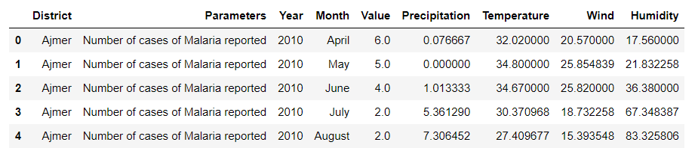
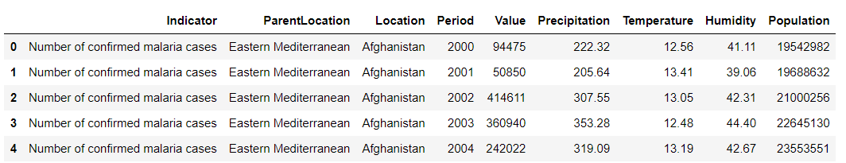
District Dataset
Global Dataset

Slide 15
Correlation Analysis
We employed Spearman’s correlation to evaluate the strength and direction of the association between weather variables and malaria incidence.​
The Spearman correlation’s capacity to handle non-linear connections and ordinal data makes it particularly helpful when working with datasets that contain information on the weather and malaria.​
A Spearman correlation coefficient close to +1 indicates a strong positive association, that is, if one variable increases, the other variable also increase.
A coefficient close to -1 suggests a strong negative association, when one variable increases, the other variable decrease.
A coefficient around 0 implies little to no association between the variables.

Slide 16
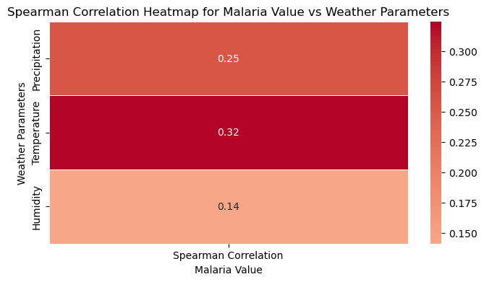
Correlation Analysis
Temperature shows the strongest positive correlation with malaria incidence (correlation value of 0.32), indicating that higher temperatures are moderately associated with an increase in malaria cases.
Precipitation has a moderate positive correlation of 0.25, suggesting that increased rainfall may also contribute to higher malaria cases.
Humidity displays the weakest correlation (0.14), indicating a minor positive relationship with malaria incidence compared to temperature and precipitation.
The analysis underscores the significant role of temperature in influencing malaria transmission, which could become more pronounced with climate change.

Slide 17
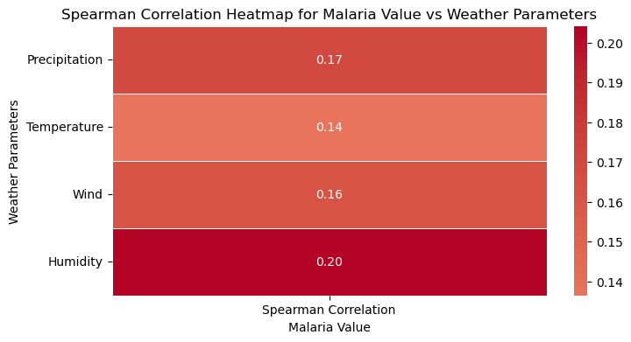
Correlation Analysis
Understand how weather parameters correlate with malaria cases at a more granular, district level.
Alwar and Barmer: Strong to moderate positive correlation with rainfall
Banswara and Baran: Lower correlation or even negative correlation with temperature due to different local factors.
The correlation between weather parameters and malaria incidence varies significantly across districts, emphasizing the need for district-specific analysis and interventions.

Slide 18
Methodology

Slide 19
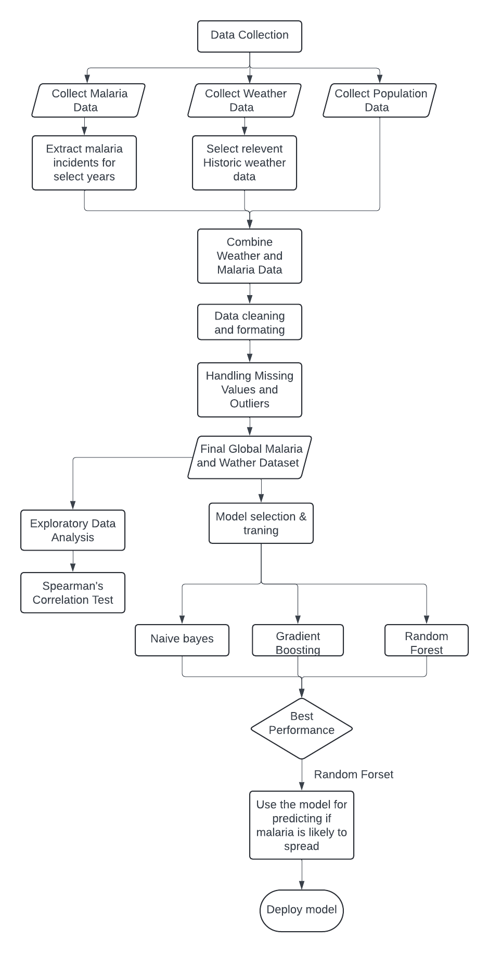
Methodology Flowchart
Global

Slide 20
Model selection (GLOBAL)
Naive Bayes - Probabilistic model based on Bayes’ theorem, assuming feature independence.
Chosen for its simplicity and efficiency as a baseline model.
Gaussian variant used for handling continuous data like temperature and humidity.
Gradient Boosting - Ensemble technique that builds models sequentially, correcting errors iteratively.
Effective at capturing complex relationships between weather variables and malaria incidence.

Slide 21
Model selection (GLOBAL)
Random Forest - Ensemble method constructing multiple decision trees and averaging predictions.
Reduces overfitting by using bootstrapped samples and random feature subsets.
Achieved the highest precision, recall, and F1 score, making it the final model choice

Slide 22
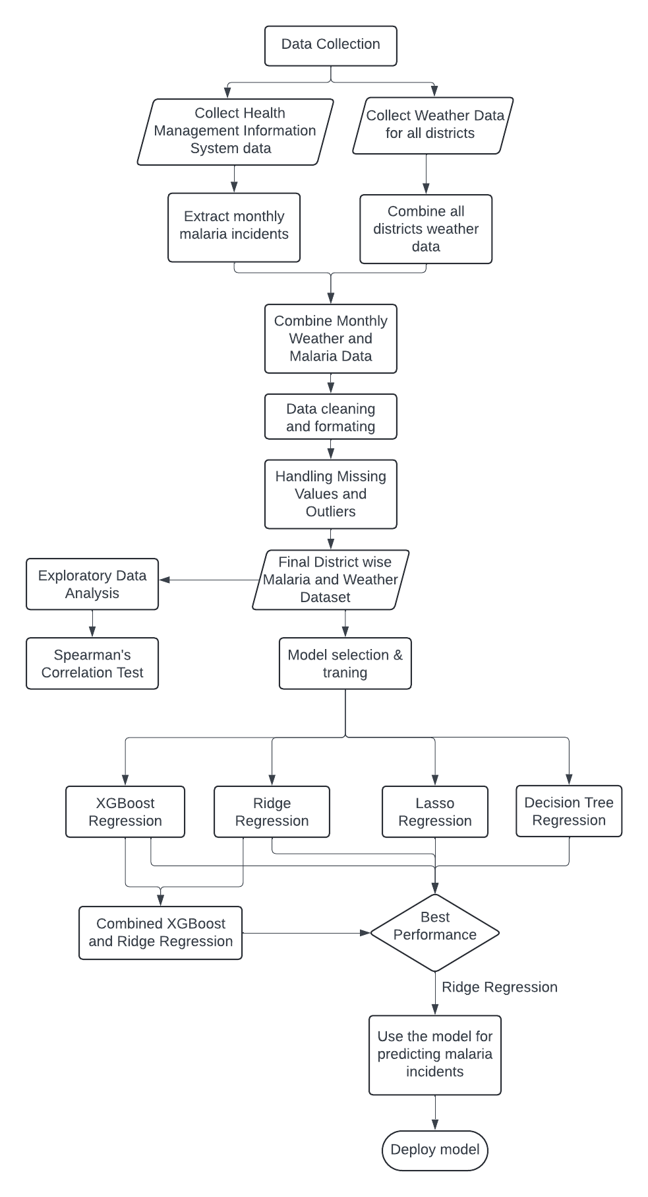
Methodology Flowchart
District

Slide 23
Model selection (DISTRICT)
Linear Regression: Serves as a baseline model for predicting malaria cases.
Lasso Regression: Introduces L1 regularization, aiding in feature selection by shrinking less important coefficients to zero. Balances model accuracy and interpretability by identifying key predictors. Achieves the lowest MAE, indicating high predictive accuracy.
Ridge Regression: Uses L2 regularization to handle multicollinearity and stabilize the model. Distributes coefficient weights more evenly, improving model robustness. Shows strong performance, slightly behind Lasso Regression in accuracy.
XGBoost Regression: Utilizes ensemble learning through gradient boosting. Captures complex, non-linear relationships between climate variables and malaria incidence. Despite its complexity, did not outperform simpler linear models in this study.

Slide 24
Model selection
Decision Tree Regression: Models non-linear relationships by partitioning data based on feature values. Creates a tree-like structure for making predictions. Exhibited the highest MAE.
Ensemble Approach: Combines predictions from multiple models (XGBoost and Ridge Regression).Aims to improve overall accuracy and robustness.
Did not enhance predictive accuracy, suggesting that model combination can introduce complexity without clear benefits.
Key Findings: Simpler linear models like Lasso and Ridge Regression were more effective in this context. Lasso Regression performed best, highlighting the value of feature selection and regularization. Complexity in models (e.g., XGBoost, model combinations) does not always lead to better performance.

Slide 25
Model implementation (global)
The Naive Bayes model achieved an F1 score of 0.68, with a precision of 0.79 and recall of 0.61
The model’s simplicity and efficiency are advantageous, but its assumption of feature independence may have limited its predictive accuracy.
The lower recall indicates that while the model is reasonably good at predicting positive cases when they occur, it misses a significant number of actual cases, which contributes to the moderate F1 score

Slide 26
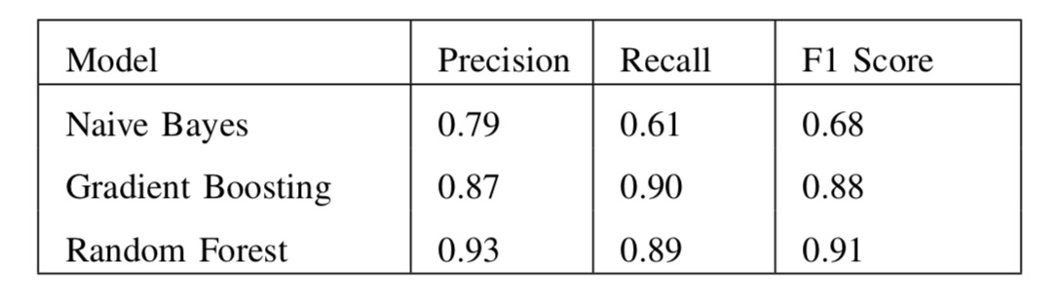
Model implementation (global)
The Gradient Boosting model exhibited a higher F1 score of 0.88, with precision of 0.87 and recall of 0.90.
The high recall indicates the model is effective at identifying most true positive cases, while its high precision shows that it effectively reduces false positives

Slide 27
Model implementation (global)
The Random Forest model achieved the highest F1 score of 0.91, with precision of 0.93 and recall of 0.89.
This superior performance is attributed to the ensemble method’s robustness. Random Forest constructs multiple decision trees and averages their predictions, used with SMOTE to reduce overfitting.

Slide 28
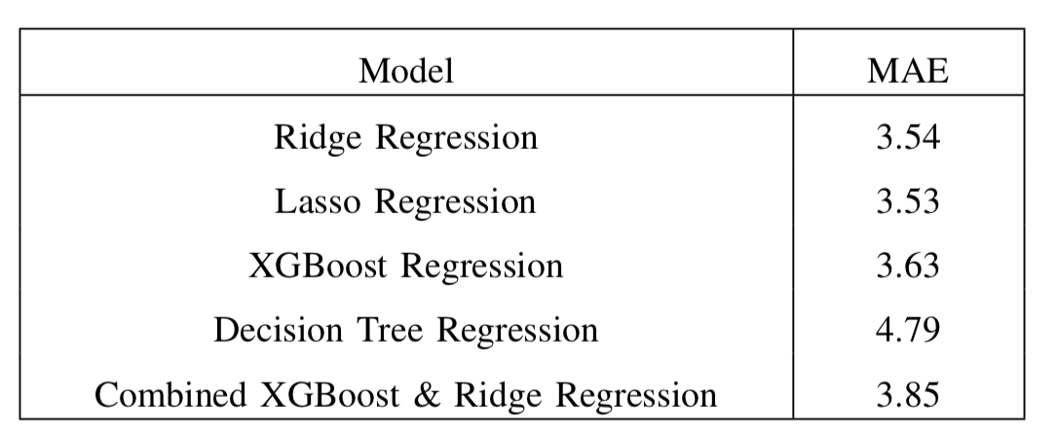
Model implementation (district)
We employed Ridge Regression, Lasso Regression, XGBoost Regression, Decision Tree Regression, and combined model.
The effectiveness of these models was measured using the Mean Absolute Error (MAE).
Lasso Regression achieved the lowest MAE of 3.53, indicating the most accurate predictions for malaria incidence.
Lasso Regression’s superior performance is attributed to its ability to perform both regularization and feature selection.

Slide 29
Model implementation (district)
Ridge Regression, with an MAE of 3.54, also demonstrated strong performance.
Ridge Regression is effective in handling multicollinearity and provides robust predictions, but it does not perform feature selection as Lasso does.
XGBoost Regression yielded an MAE of 3.63.
Although this model is generally powerful for complex datasets, it did not perform as well as the simpler linear models in this case.
Decision Tree Regression, with the highest MAE of 4.79, exhibited the most significant prediction errors.

Slide 30
Model implementation (district)
The combined models, including the combination of XG- Boost and Ridge Regression, produced an MAE of 3.85.
Despite the potential benefits of combining models, this approach did not enhance predictive accuracy and, in some cases, even worsened performance.
This suggests that the combination of models might not always be beneficial and can sometimes introduce additional complexity without clear advantages.

Slide 31
Results and Discussion
Malaria incidence in Rajasthan shows positive correlations with weather parameters: precipitation, temperature, wind speed, and humidity.
Humidity shows the strongest positive correlation with malaria incidence across most districts.
Temperature and precipitation exhibit weak positive correlations overall, with district-specific variations.
Wind speed presents mixed results:
Negative correlations in some districts (e.g., Ajmer, Alwar).
Positive correlations in others (e.g., Barmer).
These variations suggest localized effects of wind on mosquito behavior and malaria transmission.

Slide 32
Results and Discussion
Model Efficacy: Random Forest’s strong performance indicates its robustness in handling the non-linear relationships between weather variables and malaria incidence.
Feature Importance:
Precipitation and Humidity: Identified as the most significant predictors in the model.
These features should be prioritized in predictive models and public health strategies.
Comparison with Previous Studies: The findings are consistent with prior studies, though this study provides a more granular, district-level analysis.

Slide 33
Results and Discussion
Regional Differences
District-Level Analysis:
Revealed significant variation in how weather parameters influence malaria across different locations.
Localized Interventions: These variations underscore the need for tailored public health strategies that address specific local conditions.
Weaker correlations in certain districts suggest the presence of other mitigating factors, such as effective vector control programs or differing socio-economic conditions.

Slide 34
Conclusion
Our Study confirmed that weather parameters are significant predictors of malaria cases, which directly influence mosquito breeding and survival.
The analysis revealed that the impact of weather on malaria varies significantly across different regions.
Some districts demonstrated stronger correlations, indicating that local environmental and socio-economic factors can amplify or mitigate the influence of weather on malaria transmission.
This underscores the importance of considering local contexts when designing malaria control strategies.
The Random Forest model emerged as the most effective in predicting malaria cases based on weather data, highlighting the potential of machine learning in enhancing disease prediction and public health planning.
The model’s ability to identify the most influential weather factors can help prioritize interventions.

Slide 35
Thank You

Slide 36
Refrences
[1] P. L. Hajison, B. W. Mwakikunga, D. P. Mathanga, et al., “Seasonal variation of malaria cases in children aged less than 5 years old following weather change in Zomba district, Malawi,” Malaria Journal, vol. 16, p. 264, 2017. [Online]. Available: https://doi.org/10.1186/s12936-017-1913-x.
[2]A. Arab, M. C. Jackson, and C. Kongoli, “Modelling the effects of weather and climate on malaria distributions in WestAfrica,”MalariaJournal,vol.13,p.126,2014.[Online].Available:https://doi.org/10.1186/1475-2875-13-126.
[3] N. Endo and E. A. B. Eltahir, “Modelling and observing the role of
wind in Anopheles population dynamics around a reservoir,” Malaria
Journal, vol. 17, p. 48, 2018. [Online]. Available: https://doi.org/10.1186/
s12936-018-2197-5.
[4] N. Odu, R. Prasad, and O. Clement, “Prediction of malaria incidence
using climate variability and machine learning,” Informatics in Medicine
Unlocked, vol. 22, p. 100508, 2021. [Online]. Available: https://doi.org/
10.1016/j.imu.2020.100508.

Slide 37
References
[5] Open Government Data (OGD) Platform India, ”Itemwise
HMIS report for all states and districts across
months,” [Online]. Available: https://www.data.gov.in/catalog/
item-wise-hmis-report-all-states-and-districts-across-months?page=1.
[6] Weather and Climate, ”Weather and Climate,” [Online]. Available: https:
//weatherandclimate.com/.
[7] World Health Organization, ”Number of confirmed
malaria cases,” [Online]. Available:
urlhttps://www.who.int/data/gho/data/indicators/indicatordetails/
GHO/number-confirmed-malaria-cases.
[8] World Data Bank, ”Climate Knowledge Portal,” [Online]. Available:
https://climateknowledgeportal.worldbank.org/download-data#
htab-1497.

