Slide 1

MongoDB order with Sort() & Limit() Query
Group No 6
Adhish Shrivastava – as3003
Nidhi Arun Harwani – nh417
Sukumar Gaonkar – sg1425

Slide 2
Creating a database
To create and use a database in MongoDB we use the following syntax:
Mongo (to open the mongo shell on the terminal)
Use CS527
The above command creates a new database if not present, or uses the already created one.

Slide 3
Importing from JSON File
We have used the Fact_Table_Tourney_Compact for our examples.
To import the data from a json file into the MongoDB database, we use the following command on a new terminal where the path is set to the path of the json file.
mongoimport --db dbName --collection collectionName --file fileName.json

Slide 4
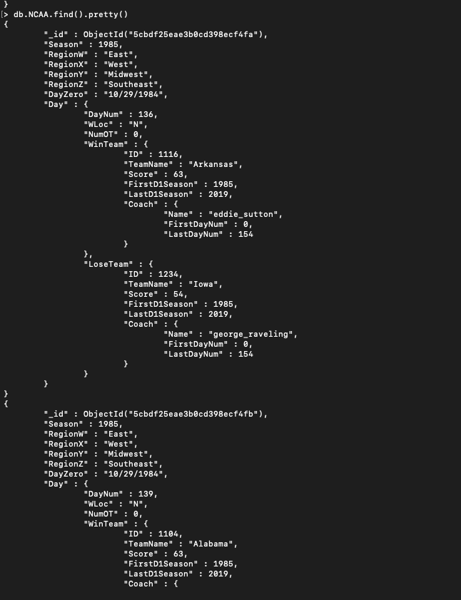
NCAA Collection
Using the following command, we can get all the documents in that collection.
db.NCAA.find().pretty()

Slide 5

Limit() Query
To limit the records in MongoDB, you need to use limit() method.
The method accepts one number type argument, which is the number of documents that you want to be displayed.
For example, we can use the following query to get only one document using limit()
db.NCAA.find().pretty().limit(1)
By changing the number in the limit function, we can decide the number of documents we wish to see

Slide 6

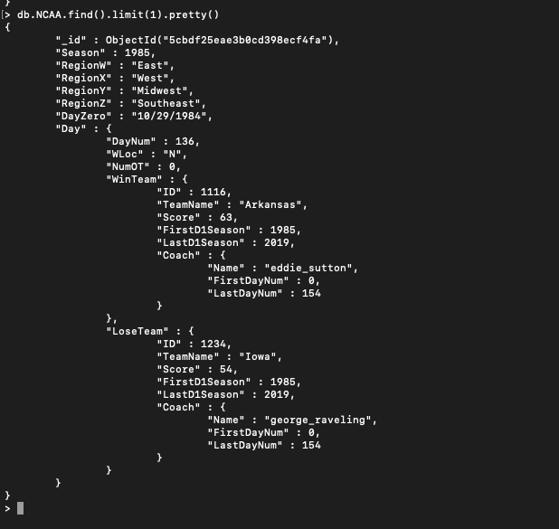


Limit Query Example

Slide 7
Sort() Query
To sort documents in MongoDB, you need to use sort() method.
The method accepts a document containing a list of fields along with their sorting order.
To specify sorting order 1 and -1 are used.
1 is used for ascending order while -1 is used for descending order.
For example, to sort the NCAA documents in descending order of Seasons, we use the following query:
db.NCAA.find().pretty().sort({“Season” : -1})

Slide 8
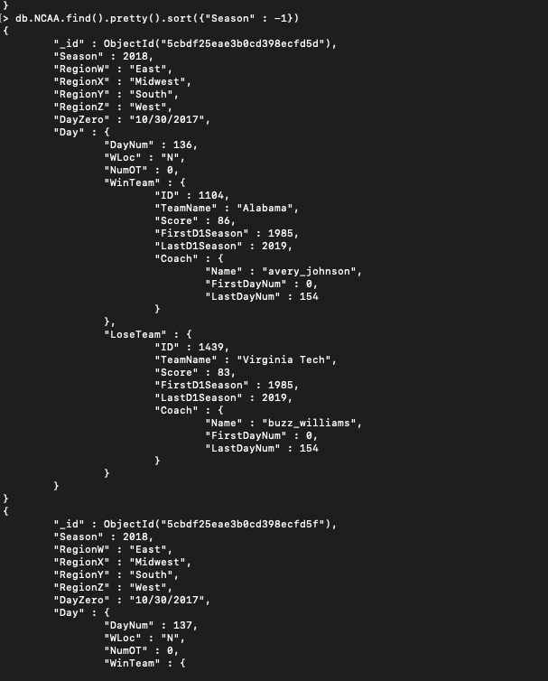
Sort Query Example

Slide 9
Limit and Sort Query together
Now, if we wish to see only the first 5 documents after sorting them in the descending or ascending order, then we can use both limit and sort functions together.
For example, if we want only the first document after sorting them in the descending order of Seasons, it can be done using the following query:
db.NCAA.find().pretty().sort({“Season” : -1}).limit(1)

Slide 10
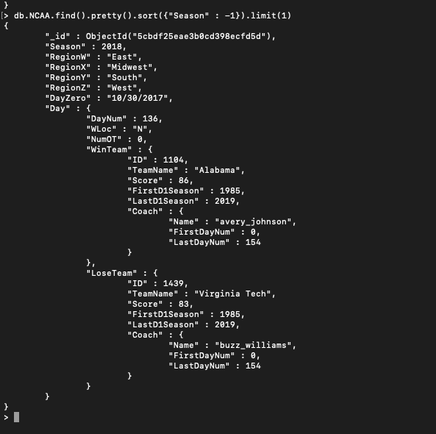
Limit and Sort Query Example

Slide 11
Thank You!

