Slide 1
IoT Gateway
Date: 03rd Jan 2025

Slide 2
Confidentiality Notice
Copyright © 2021 AdiInfi. All rights reserved.
All files, information, diagrams and material contained in this document are copyright by AdiInfi, and may not be duplicated, copied, modified or adapted, in any way without our written permission. This document may contain our service marks or trademarks as well as those of our affiliates or other companies, in the form of words, graphics, and logos. This document is authored by AdiInfi and is AdiInfi intellectual property, including the copyrights in all countries in the world. This document is provided under a license to use only with all other rights, including ownership rights, being retained by AdiInfi. This file may not be distributed, copied, or reproduced in any manner, electronic or otherwise, without the express written consent of AdiInfi.

Slide 3
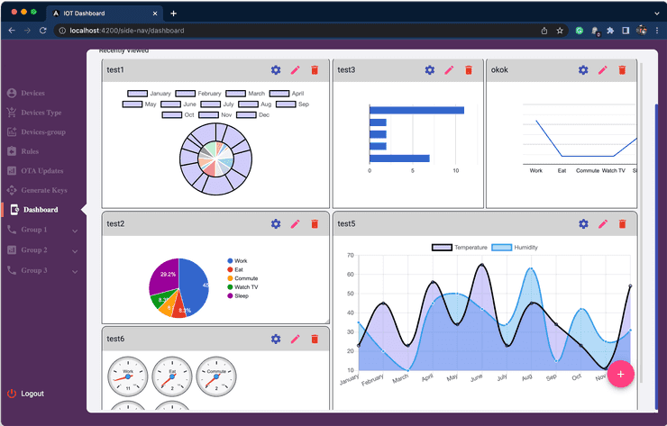















High Level Diagram
Machine Data to Store & Commands to Devices
Database Server
Cloud Layer
Micro Services
MQTT Broker Server
Gateway <—> Web Client DIRECT LIVE DATA TRANSFER
Authentication, Commissioning and Other Required REST APIs
Device F/w OTA APIs and F/w File transfer
Data Reporting and Command to Devices (MQTT)
Users (Web Clients/App)
AdiInfi IoT Gateway
AdiInfi IoT Gateway
AdiInfi IoT Gateway
Ethernet IP/ RS485 based Modbus
Bluetooth Communication For Commissioning / OTA
Controller
PLC
HMI
Controller
PLC
HMI
Controller
PLC
HMI
Commissioning Engineer
Machine
Machine
Machine

