Slide 1
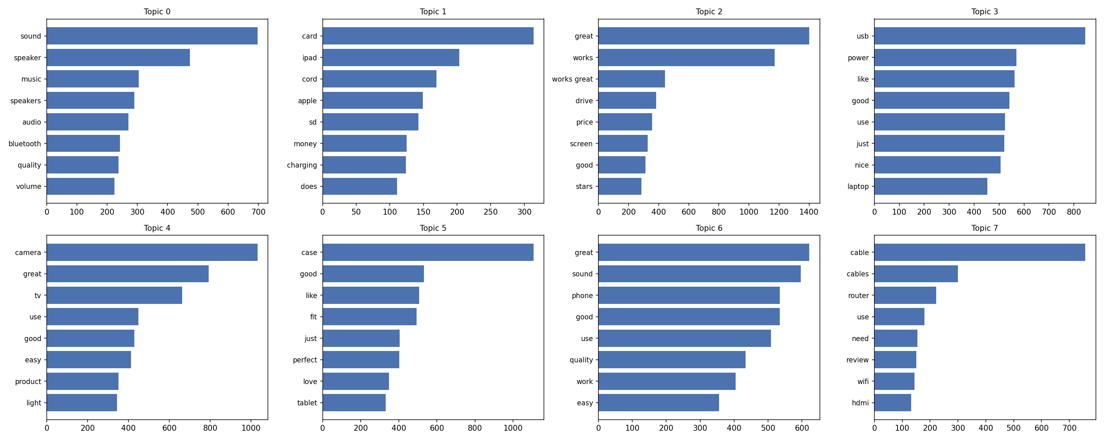
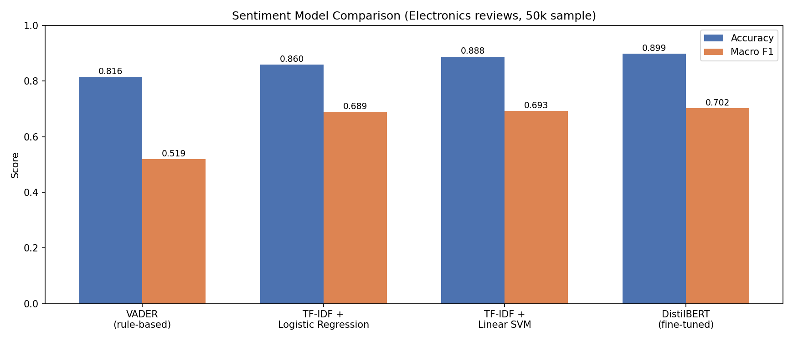
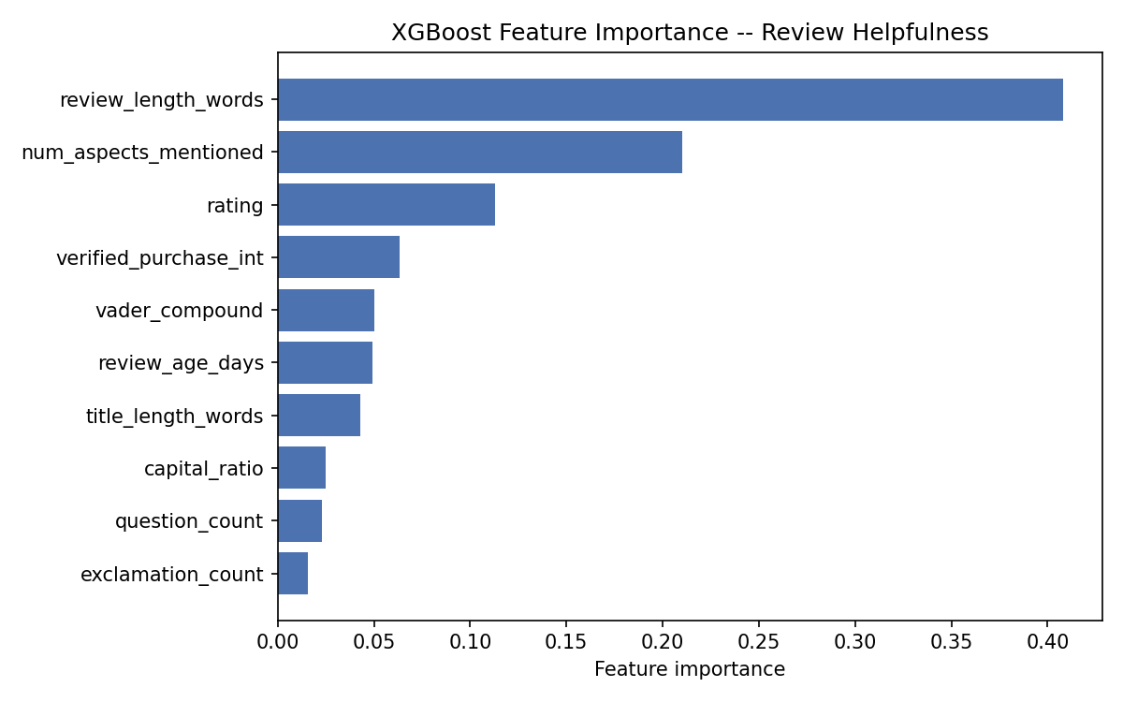
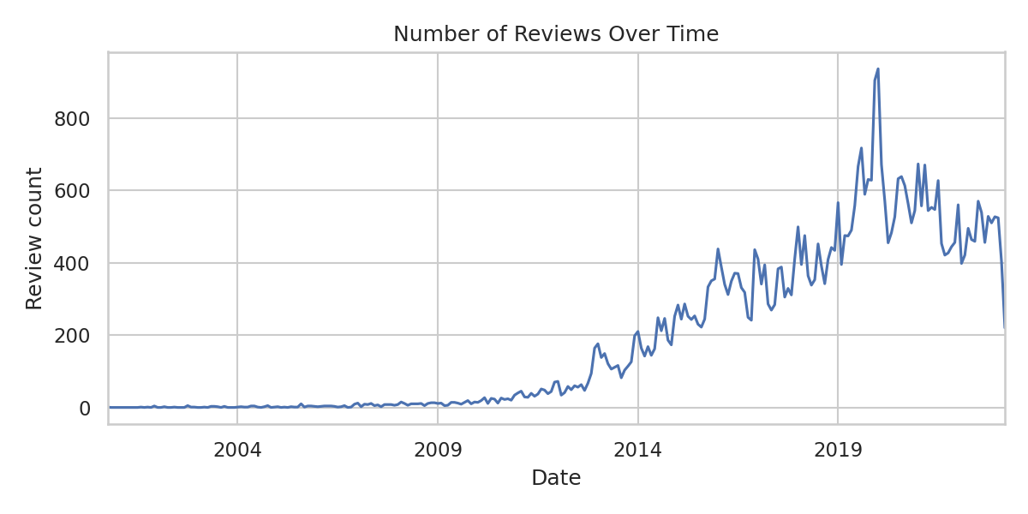
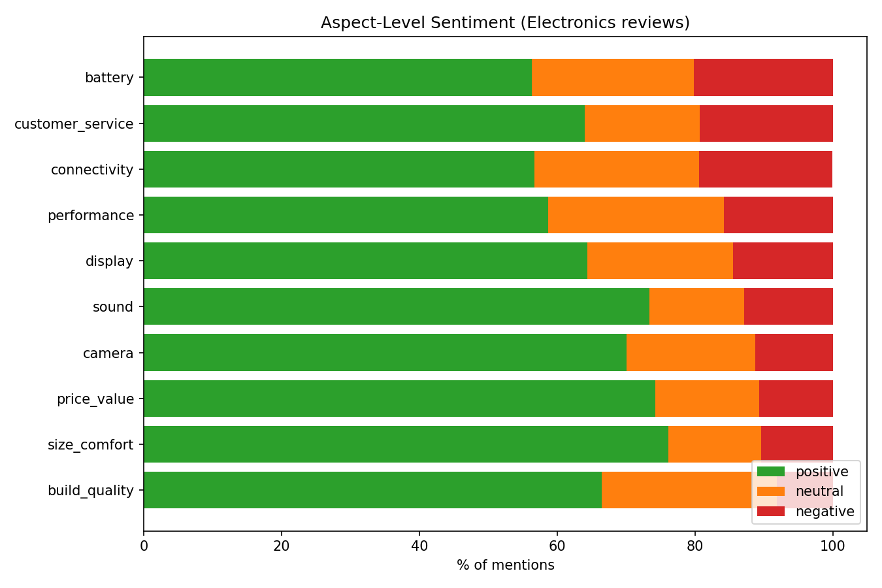
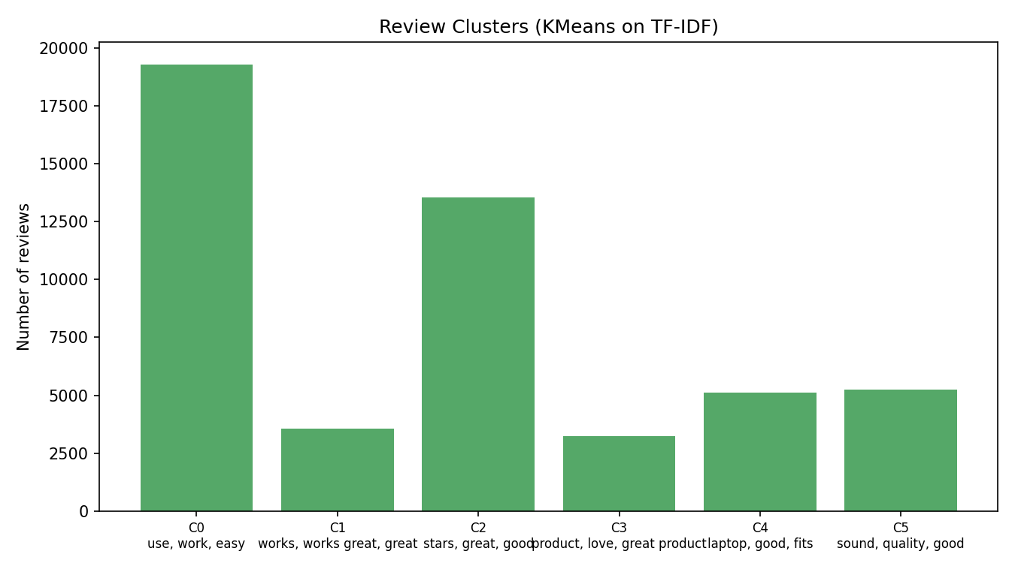
R
ReviewIQ
[Author Name]
[Institution / University]
[Course / Program • 2026]
AI-Based Product Review Intelligence & Consumer Insight System
A multi-model NLP & machine learning pipeline for e-commerce review analytics, built on the Amazon Reviews 2023 dataset (McAuley Lab) — Electronics category.
1
2
3
4
5
6
7
Data Prep
& EDA
Sentiment
Analysis
Topic Modeling
& ABSA
Deep Learning
(BERT)
Advanced ML
(XGBoost/KMeans)
Semantic
Search
RAG
Chatbot
50,000
7
10
8
Reviews Analyzed
ML & NLP Techniques
Product Aspects Tracked
Latent Topics Found
Motivation
Sentiment Analysis
Topic Modeling (LDA)
Review Helpfulness (XGBoost)
Semantic Search & RAG Chatbot
Shoppers face thousands of reviews per product, while companies drown in unstructured feedback. This project builds an end-to-end AI system that reads Amazon Electronics reviews and answers two practical questions: for a buyer — should I buy this? — and for a company — what should we improve?
Three approaches were benchmarked on an identical held-out test split of 10,000 reviews: a rule-based VADER baseline, classical TF-IDF + Logistic Regression / Linear SVM (class-balanced, 1-2 grams, 30K features), and a fine-tuned DistilBERT transformer.
Latent Dirichlet Allocation (8 topics, 1-2 gram count vectors, fit on an 8,000-review subsample and applied to the full corpus) surfaces what reviewers actually discuss: sound & headphones · memory cards & tablets · general praise & value · USB & power accessories · cameras & TVs · cases & fit · phones & headphones · cables, routers & Wi-Fi.
An XGBoost classifier (tuned via randomized search over 15 configurations) predicts whether a review will be marked helpful, from engineered features: review age, title length, verified-purchase flag, punctuation counts, VADER compound score, and number of aspects mentioned.
Every review is embedded with Sentence-Transformers (all-MiniLM-L6-v2, 384-dim, cosine similarity via normalized dot product) for instant nearest-review lookup. A retrieval-augmented chatbot then grounds a local flan-t5-small model in the top-5 retrieved reviews — no external API key required.
Dataset & Preprocessing
Model | Accuracy | Macro F1
VADER (rule-based) | 81.6% | 0.519
TF-IDF + Logistic Reg. | 85.9% | 0.689
TF-IDF + Linear SVM | 88.8% | 0.693
DistilBERT (fine-tuned) | 89.9% | 0.702
70.5%
0.555
70.2%
Source: McAuley-Lab Amazon Reviews 2023 (Hugging Face), Electronics category. 65,552 raw reviews were retrieved, cleaned (URLs/HTML stripped, duplicates and reviews under 3 words removed), sentiment-labeled from star ratings (≥ 4 positive, = 3 neutral, ≤ 2 negative), and stratified-sampled to a final 50,000-review analysis set.
Accuracy
Helpful-class F1
Helpful recall
Q: "Is the battery life good on this streaming device?"
A: Answer generated from 5 retrieved reviews for ASIN B00ZV9RDKK (175 reviews, 4.41★ avg).
Example grounded RAG chatbot exchange.
Top words per topic across the 8 discovered LDA topics.
Interactive Dashboard
80.4%
12.6%
7.0%
A Streamlit application unifies every milestone into two audiences: a Buyer View (product overview, strengths/weaknesses, aspect chart, product comparison, chatbot Q&A) and a Company View (corpus-wide complaint ranking, all model results, per-product deep dive).
Positive reviews
Negative reviews
Neutral reviews
Accuracy & macro-F1 across all four sentiment models.
Aspect-Based Sentiment (ABSA)
Key finding: fine-tuned BERT gives the best overall accuracy and macro-F1, most notably lifting recall on the harder minority classes (negative, neutral) that TF-IDF models under-predict.
Feature importance for predicting review helpfulness.
Buyer View
Company View
Reviews are split into sentences and matched against 10 product aspects (battery, camera, display, sound, performance, build quality, price, connectivity, size/comfort, customer service); VADER scores each matched sentence — 64,134 aspect mentions across 33,257 reviews.
Review Clustering (KMeans)
Review volume in the sampled corpus over time.
Why macro-F1? 80% of reviews are positive, so raw accuracy is misleading on its own — macro-F1 weights all three classes equally, making it the more honest measure of real-world usefulness, which is why both metrics are reported side by side throughout this project.
Aspect sentiment (illustrative)
Objectives
MiniBatchKMeans (k = 6) on a dedicated stopword-filtered TF-IDF space groups reviews by theme. Two clusters are clearly topical (sound/headphones; laptop bags & cases); the rest are dominated by generic praise language — a known limitation of clustering short, repetitive review text.
System Architecture
Classify sentiment with classical ML and a fine-tuned transformer
Discover latent topics and aspect-level opinions automatically
Predict which reviews readers will find helpful
Enable natural-language product Q&A via semantic search + RAG
Ship one dashboard with both a buyer view and a company view
87.3%
53.3%
BERT recall on negative reviews
VADER recall, same class
Positive / neutral / negative share of mentions, by aspect.
Every milestone's outputs — sentiment labels, topics, aspects, embeddings — are cached to disk and loaded lazily by the dashboard, so the buyer and company views stay fast even though five separate models run underneath.
BERT's negative-review recall (87.3%) is a large jump over TF-IDF + SVM (74.9%) and the VADER baseline (53.3%) — the class a business can least afford to miss.
20.2% negative — Battery is the #1 complaint area company-wide.
Conclusion & Future Work
Aspect-based sentiment, sorted by highest negative share.
Six review clusters, sized by review count.
Model Configuration
11,070
10,752
8,327
Engineered Features
The pipeline shows that combining classical ML, deep learning, topic modeling, and retrieval-augmented generation gives both buyers and companies a fuller picture than star ratings alone. Future work: generalize beyond Electronics, scale BERT fine-tuning on GPU, and retrain models continuously as new reviews arrive.
Price/value mentions
Size/comfort mentions
Sound mentions
Preprocessing Pipeline
TF-IDF: unigrams + bigrams, 30,000 features, sublinear term weighting
Class-balanced loss to counter the 80% / 13% / 7% label skew
DistilBERT fine-tuned for 2 epochs, max sequence length 128 tokens
One identical 80/20 stratified split reused across every model
10 Aspects Tracked
Review age (days since the newest review in the corpus)
Title length, exclamation & question mark counts
Verified-purchase flag and capital-letter ratio
VADER compound score and number of aspects mentioned
Reproducibility
Battery, camera, display, sound, performance
Build quality, price/value, connectivity
Size/comfort, customer service
Every milestone is a standalone, runnable Python script
Pinned dependencies in requirements.txt for each project stage
Raw data → cleaned data → models → dashboard, one command apart
Strip URLs, HTML tags, and excess whitespace from raw review text
Remove reviews under 3 words long and exact duplicates
Derive a sentiment label from the star rating (weak supervision)
Stratify-sample by sentiment class down to 50,000 reviews
Limitations
Hyperparameter Search
LDA topics are driven by frequent product nouns rather than deep semantics, and keyword-matched ABSA can miss aspects described in unusual phrasing. Both are reasonable trade-offs for fast, interpretable unsupervised analysis at 50,000-review scale.
Tech Stack & References
Best XGBoost configuration (of 15 randomly sampled, chosen by 3-fold cross-validated F1 on the minority 'helpful' class): 200 trees, max depth 6, learning rate 0.01, 70% row and column subsampling per tree.
Python · scikit-learn · PyTorch / Transformers · XGBoost · Sentence-Transformers · Streamlit · VADER Sentiment
Dataset: Hou et al., “Bridging Language and Items for Retrieval and Recommendation” (McAuley Lab, Amazon Reviews 2023). huggingface.co/datasets/McAuley-Lab/Amazon-Reviews-2023
Contact
[author.email@example.com]
[github.com/your-username/amazon-review-intelligence]
Acknowledgments
Developed independently as an academic machine learning & NLP project, exploring the full pipeline from raw review data to a production-style analytics dashboard.
R
ReviewIQ — 2026

