Slide 1
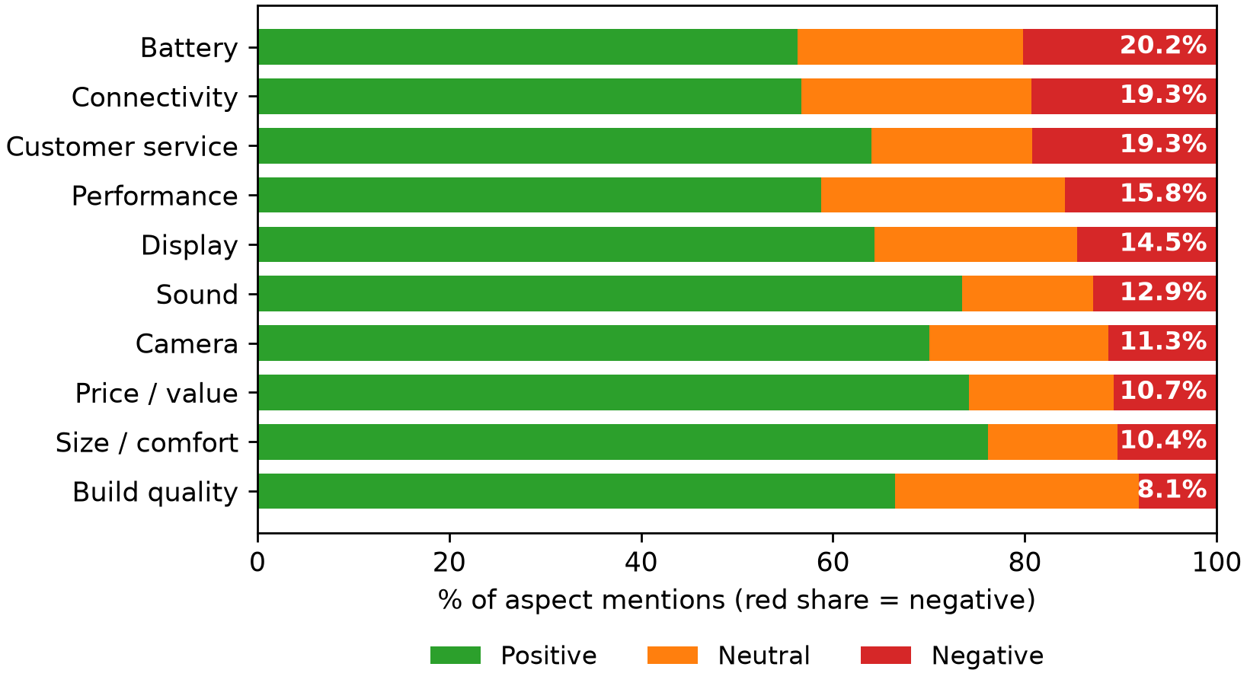
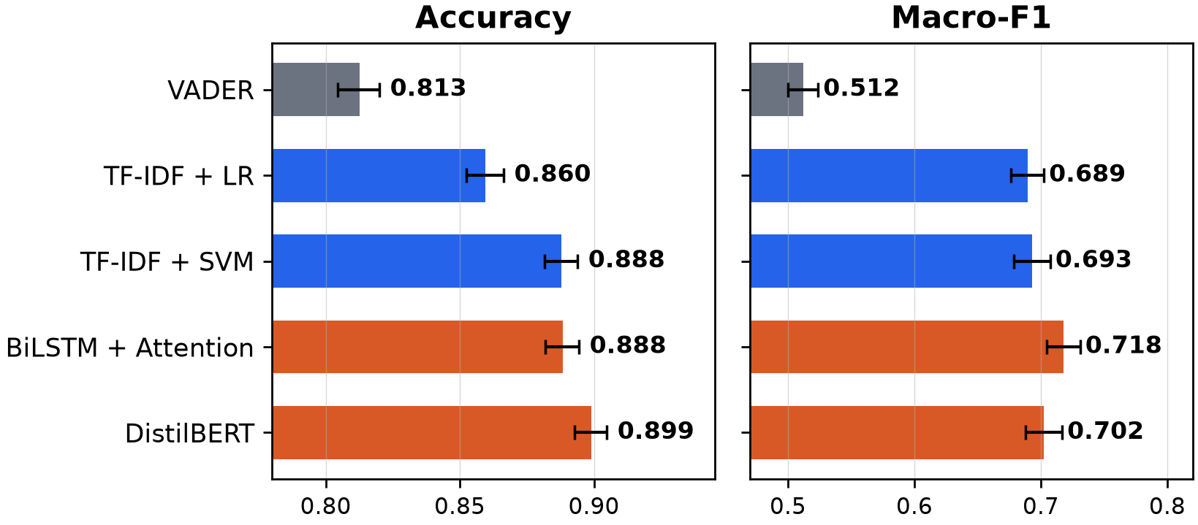
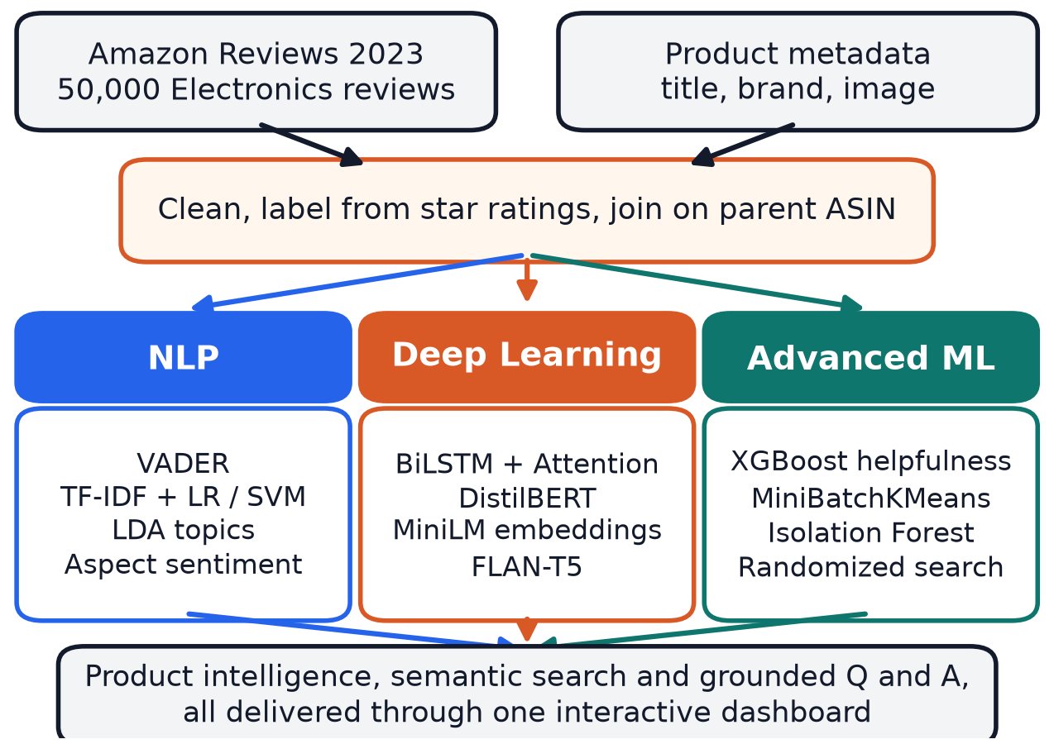
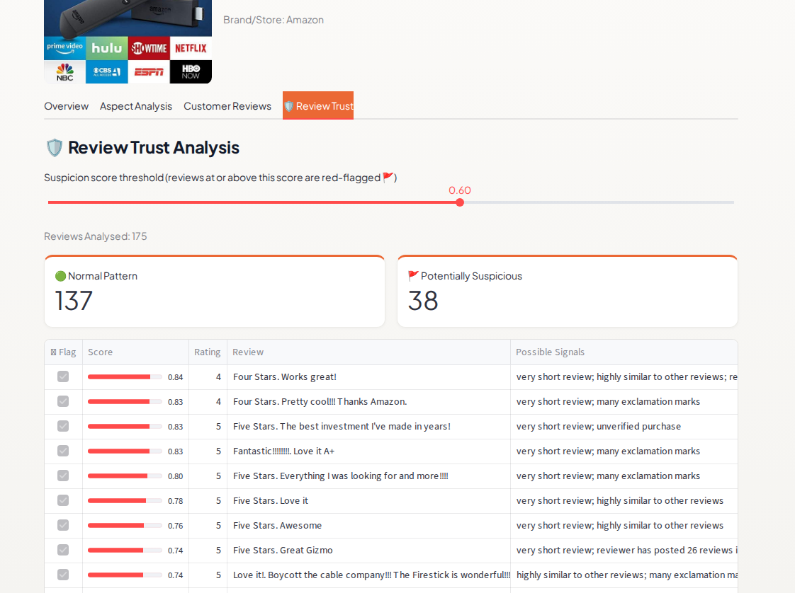
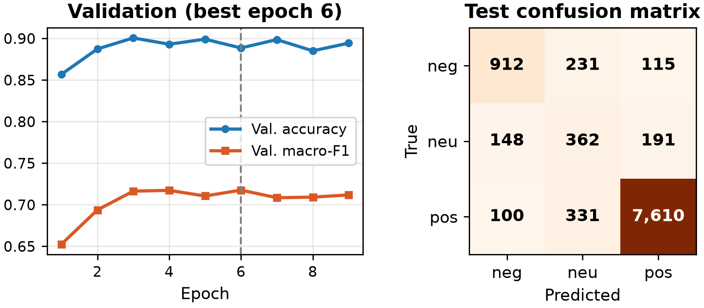
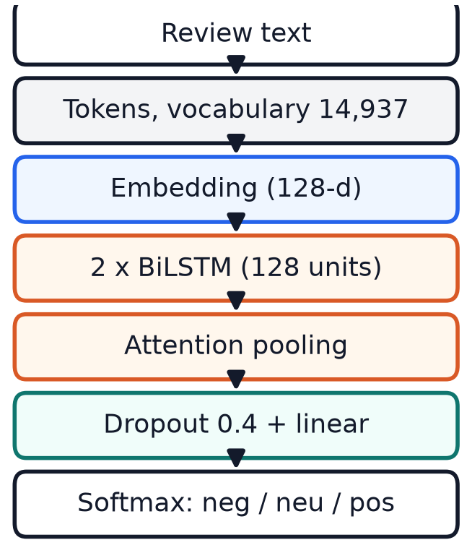
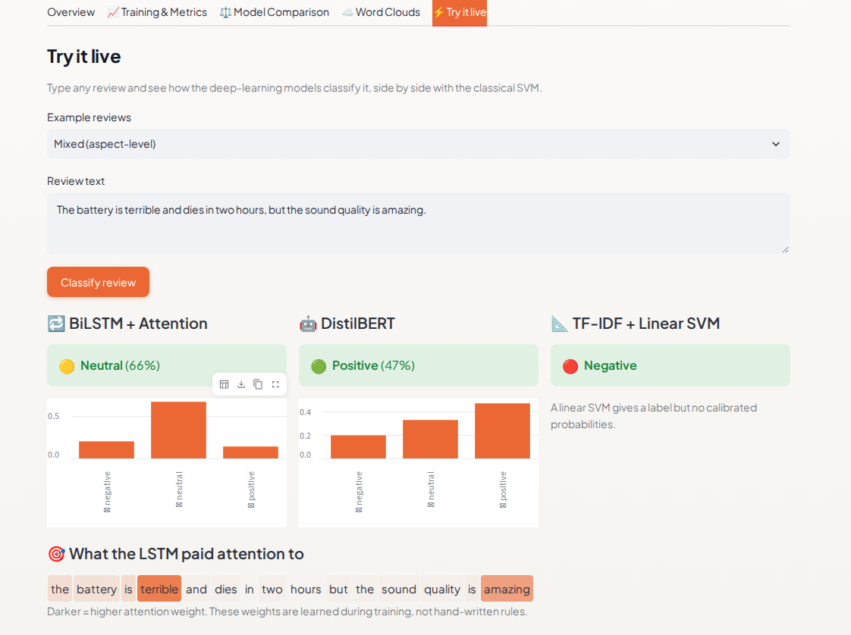
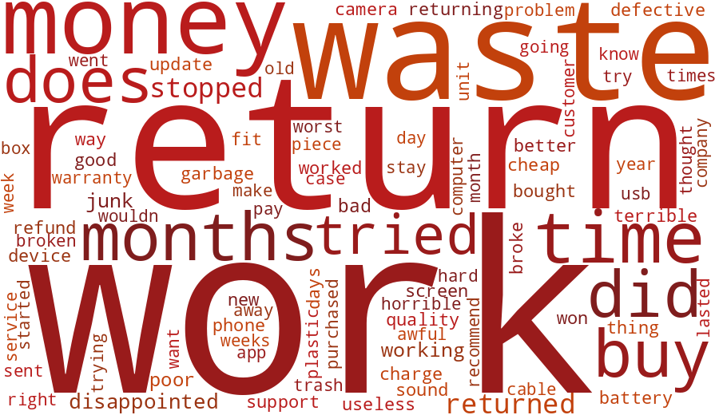
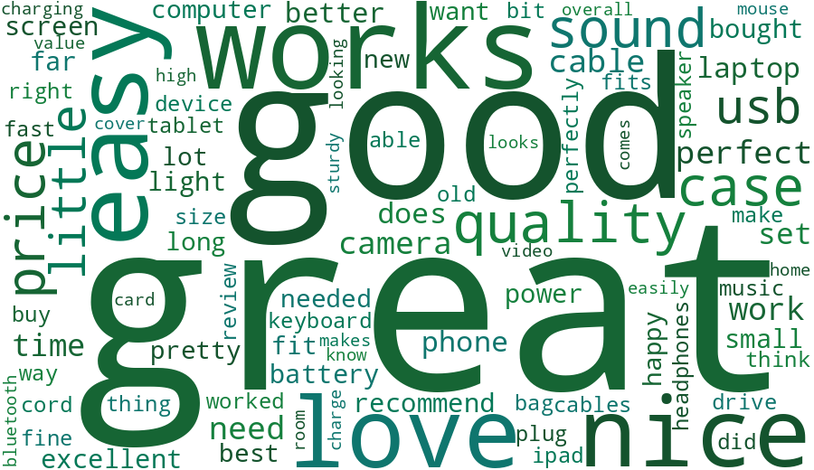
VIDYALANKAR INSTITUTE OF TECHNOLOGY
ReviewIQ
PROJECT TEAM
Nidhi Bhawari
23102A0006
Aarti Sakpal
23102A0007
AI-Based Product Review Intelligence and Consumer Insight System
Gayatri Patil
23102A0016
Prachi Wakode
23102A0020
NLP
Deep Learning
Advanced ML
Guide: Prof. Sneha Annappanavar
Problem and Objectives
Sentiment Results (10,000 test reviews)
Aspect Intelligence
A popular product can have thousands of free-text reviews that nobody can read in full. Buyers ask "should I buy this?"; sellers ask "what should we improve?"
Model | Accuracy | Macro-F1 | F1 neutral
VADER | .813 | .512 | .080
TF-IDF + LR | .860 | .689 | .400
TF-IDF + SVM | .888 | .693 | .382
BiLSTM + Attention | .888 | .718 | .446
DistilBERT | .899 | .702 | .368
Classify review sentiment (positive, neutral, negative) with NLP, deep learning and advanced ML models
Rank complaint areas by aspect (battery, sound, camera)
Score review helpfulness and flag suspicious reviews
Answer product questions from reviews, with evidence
Deliver everything in one interactive dashboard
Battery is the top complaint (20.2% negative mentions), then connectivity and customer service (19.3% each).
Dataset and Preprocessing
50,000
34,365
Grounded Question Answering
Amazon Electronics reviews
products
95% bootstrap intervals. BiLSTM beats the SVM on macro-F1 (+0.025, significant); DistilBERT is best on accuracy.
Product-scoped retrieval (MiniLM, top 5 reviews) plus FLAN-T5, with a similarity floor: weak evidence means "not enough information".
8,883
80 / 7 / 13
97.8%
95.6%
100%
reviewers
% positive / neutral / negative
Ablation: What Drives the Gain?
answerable questions accepted
unanswerable questions declined
off-topic questions declined
Amazon Reviews 2023, cleaned and labelled from star ratings (4-5 positive, 3 neutral, 1-2 negative). Product name, brand and image joined by parent ASIN. One shared 40,000 / 10,000 train and test split.
LSTM variant (3 seeds, mean) | Accuracy | Macro-F1
Full (attention + class weights) | .891 | .722
No class weights | .899 | .709
Mean pooling instead of attention | .889 | .715
Semantic retrieval beat TF-IDF on paraphrased aspect queries (0.54 vs 0.32 aspect-mention rate at 5).
System Architecture
Interactive Dashboard
Class weighting, not attention, drives most of the macro-F1 gain. Without it the LSTM matches DistilBERT's accuracy (.899).
Cost and Speed
26x
57x
13x
fewer parameters than DistilBERT
faster on CPU (975 vs 17 reviews/s)
faster on GPU
Reviews and metadata feed three branches, then product intelligence and grounded question answering.
Training and Errors
Deep Learning Branch
Review Trust: unsupervised Isolation Forest flags 4,999 reviews (10%) as potentially suspicious, with a threshold slider and reasons per review. No fake-review accuracy is claimed.
BiLSTM + Attention trained from scratch: 14,937-word vocabulary, 2 x 128 bidirectional LSTM, 2.57 M parameters, class-weighted loss, about 7 minutes on a laptop GPU.
DistilBERT fine-tuned on 6,000 reviews (CPU).
155 of the LSTM's 1,116 test errors are confident, and many are label noise: the stars disagree with the text.
The Deep Learning Lab page adds training curves, a confusion matrix, word clouds and a live classifier that highlights the words the LSTM attended to.
5 stars, predicted negative: "Piece of junk !!! Poor quality, high price .. it lasted 10weeks"
1 star, predicted positive: "Worked out of the box. love it"
NLP
Advanced ML
What Each Sentiment Sounds Like
Deep Learning Lab: live classifier with attention
VADER lexicon
XGBoost helpfulness, 70.5% accuracy
TF-IDF + LR / SVM
MiniBatchKMeans, k = 6
LDA, 8 topics
Isolation Forest, 10% flagged
Aspect sentiment with evidence
Negative
Positive
Limitations
MiniLM search embeddings
Words weighted by how characteristic they are of each class: "return", "waste", "money" versus "easy", "love", "perfect".
Labels come from star ratings, so some are noisy
Sample is a reviewer-grouped block of one category
DistilBERT saw one-sixth of the LSTM's data
Flagged reviews are anomalies, not confirmed fakes
CONCLUSION
KEY REFERENCES
VIDYALANKAR INSTITUTE OF TECHNOLOGY
NLP, deep learning and advanced ML on one corpus give buyers evidence-linked insight and sellers a ranked list of problems. A BiLSTM trained from scratch is 57x faster than DistilBERT and matches its accuracy once class weights are removed; battery is the most criticised aspect; a similarity floor stops unsupported answers. Future work: full-data DistilBERT, learned aspects, human-annotated subsets, random multi-category sampling.
[1] Hutto and Gilbert, VADER, ICWSM 2014. [2] Hochreiter and Schmidhuber, LSTM, 1997. [3] Sanh et al., DistilBERT, 2019. [4] Chen and Guestrin, XGBoost, KDD 2016. [5] Liu et al., Isolation Forest, ICDM 2008. [6] Reimers and Gurevych, Sentence-BERT, EMNLP 2019. [7] Lewis et al., RAG, NeurIPS 2020. [8] Hou et al., Amazon Reviews 2023, 2024.
Guide: Prof. Sneha Annappanavar
Nidhi Bhawari, Aarti Sakpal,
Gayatri Patil, Prachi Wakode

