Slide 1
VIDYALANKAR INSTITUTE OF TECHNOLOGY
ReviewIQ
AI-Based Product Review Intelligence and Consumer Insight System
NLP | Deep Learning | Advanced Machine Learning
Project Presentation
PROJECT TEAM
UNDER THE GUIDANCE OF
Nidhi Bhawari
23102A0006
Prof. Sneha Annappanavar
Aarti Sakpal
23102A0007
Vidyalankar Institute of Technology
Gayatri Patil
23102A0016
Prachi Wakode
23102A0020
Notes:
Introduce the project, the team and the guide. ReviewIQ turns thousands of unstructured product reviews into answers for buyers and sellers.

Slide 2
Why this project?
Reviews are abundant but unstructured. A single popular product can attract thousands of free-text opinions.
The star average hides the detail. It cannot say that the sound is great and the battery is poor.
Nobody can read everything. Automated analysis is central to e-commerce.
Related tasks are usually studied separately: sentiment, aspects, helpfulness, spam. We combine them on one corpus.
Should I buy this?
Buyers: strengths, weaknesses and evidence, per product
What should we improve?
Sellers: ranked complaint areas across the category
Can I trust these reviews?
Review quality: helpfulness and suspicious-review signals
ReviewIQ | Vidyalankar Institute of Technology
2 / 19
Notes:
A popular product can have thousands of reviews. The star average hides what customers actually say. We built one system that answers three different questions.

Slide 3
Objectives and scope
Objectives
Scope and boundaries
Prepare a clean, labelled corpus enriched with product names, brands and images
Classify sentiment (positive, neutral, negative) with NLP, deep learning and advanced ML models and compare them fairly
Build an LSTM classifier, report its metrics and visualise each sentiment with word clouds
Extract aspect-level sentiment, topics and clusters
Predict helpfulness and flag suspicious reviews
Provide semantic search and grounded question answering with evidence
Deliver everything in one interactive dashboard
One product category: Amazon Electronics
English reviews, 50,000-review working sample
Sentiment labels come from star ratings
Suspicious-review detection is unsupervised: no fake-review accuracy is claimed
Answers come only from the selected product's own reviews
ReviewIQ | Vidyalankar Institute of Technology
3 / 19
Notes:
Seven objectives. The scope is deliberately bounded: one category, a 50,000 review sample, labels from star ratings, and an unsupervised trust score that makes no accuracy claim.

Slide 4
Dataset and preprocessing
50,000
34,365
8,883
80 / 7 / 13
reviews
products
reviewers
% positive / neutral / negative
How the data was prepared
Source: Amazon Reviews 2023 (McAuley Lab), Electronics category
Cleaning: removed missing ratings and very short texts, stripped HTML and URLs, dropped duplicate (reviewer, product, text) records
Labels: stars 4 and 5 positive, 3 neutral, 1 and 2 negative. Weak labels, so macro-F1 is the main metric
Metadata: title, brand and image joined on the parent ASIN (34,364 of 34,365 products matched)
Evaluation: one shared 40,000 train and 10,000 test split for every model
ReviewIQ | Vidyalankar Institute of Technology
4 / 19
Notes:
Amazon Reviews 2023, Electronics. We cleaned, de-duplicated and labelled the reviews, and joined product metadata on the parent ASIN. The sample is a contiguous block of a reviewer-grouped file, which we state as a limitation.

Slide 5
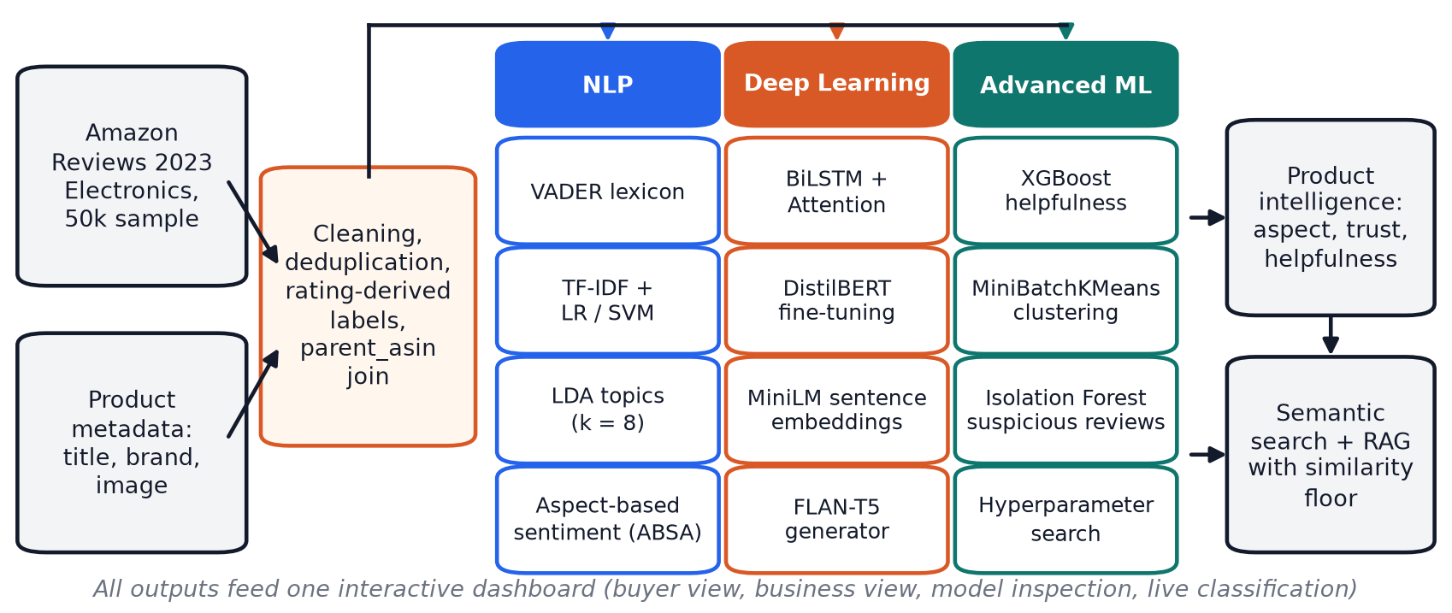
System architecture
Three pillars on one shared corpus: NLP, deep learning and advanced machine learning, fused into product-level intelligence.
ReviewIQ | Vidyalankar Institute of Technology
5 / 19
Notes:
Reviews and metadata are cleaned and joined, then three parallel branches feed product intelligence and a grounded question answering layer, all in one dashboard.

Slide 6
NLP branch
VADER
TF-IDF + LR / SVM
LDA topics
Rule-based sentiment lexicon. Zero-training baseline.
Unigrams and bigrams, 30,000 features, balanced class weights.
8 topics found without labels: audio, storage, cables, cameras, cases and more.
Aspect sentiment
MiniLM embeddings
Why it matters
The same corpus supports both review-level labels and aspect-level insight.
Aspect results explain why a product is rated the way it is.
10 aspects (battery, sound, camera ...). Matched sentences are kept as evidence.
384-d sentence vectors power semantic search and question answering.
ReviewIQ | Vidyalankar Institute of Technology
6 / 19
Notes:
Five NLP components. The lexicon and TF-IDF models are baselines. LDA discovers topics. The aspect module keeps the matched sentences as evidence.

Slide 7
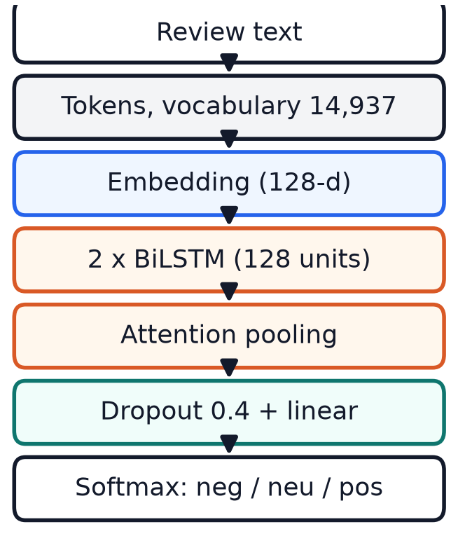
Deep learning: BiLSTM with attention
BiLSTM + Attention (from scratch)
Vocabulary of 14,937 words, 128-d embeddings, 2 x 128 bidirectional LSTM
Attention pooling learns which tokens matter most
Class-weighted loss, early stopping on validation macro-F1
2.57 M parameters, about 7 minutes on a laptop GPU
DistilBERT (fine-tuned)
Pre-trained transformer, fine-tuned on 6,000 reviews on a CPU (about 60 min)
Best raw accuracy, but one-sixth of the LSTM's training data
ReviewIQ | Vidyalankar Institute of Technology
7 / 19
Notes:
We trained a bidirectional LSTM with attention from scratch in PyTorch. DistilBERT was fine-tuned on a small CPU budget. Attention lets the model weight the words that matter.

Slide 8
Advanced machine learning
XGBoost helpfulness
MiniBatchKMeans
Isolation Forest
Target: at least one helpful vote
10 engineered features, incl. aspects mentioned (from ABSA)
15-candidate randomized search, 3-fold CV
70.5% accuracy, helpful-class F1 0.555
Length, aspect count and rating matter most
k = 6 clusters on a separate TF-IDF space
Only 2 clusters are clearly topical (bags and cases; sound and headphones)
The other 4 are generic praise ("works great", "five stars")
A negative finding: LDA is the better topic tool on short, rating-skewed text
Unsupervised: no fake-review accuracy is claimed
Features: very short text, caps, exclamations, verified, account volume, near-duplicate similarity
Flags 4,999 reviews (10%), 36 near-duplicates
Early version flagged long, negative reviews. Fixed with directional features
ReviewIQ | Vidyalankar Institute of Technology
8 / 19
Notes:
XGBoost predicts helpfulness. KMeans is a negative finding that we report honestly. The Isolation Forest is unsupervised and we fixed its features after finding they were backwards.

Slide 9
Semantic search and grounded Q and A
Question
Embed + retrieve
Similarity floor
Answer + evidence
e.g. "Is it good for cutting cable TV?"
MiniLM, top 5 reviews of this product
best similarity at least 0.30?
FLAN-T5 answer, retrieved reviews shown
Why a similarity floor?
Measured effect
Small generators do not reliably follow "say you do not know"
Before the floor, a warranty question got a confident "No" at similarity 0.25
Weak evidence now returns: not enough information
97.8% of answerable questions accepted
95.6% of plausible but unanswerable questions declined
100% of off-topic questions declined
Retrieval beats TF-IDF on paraphrased queries: 0.54 vs 0.32
ReviewIQ | Vidyalankar Institute of Technology
9 / 19
Notes:
The question is embedded, only the selected product's reviews are searched, and if the best similarity is below 0.30 the system says it does not have enough information instead of letting the generator guess.

Slide 10
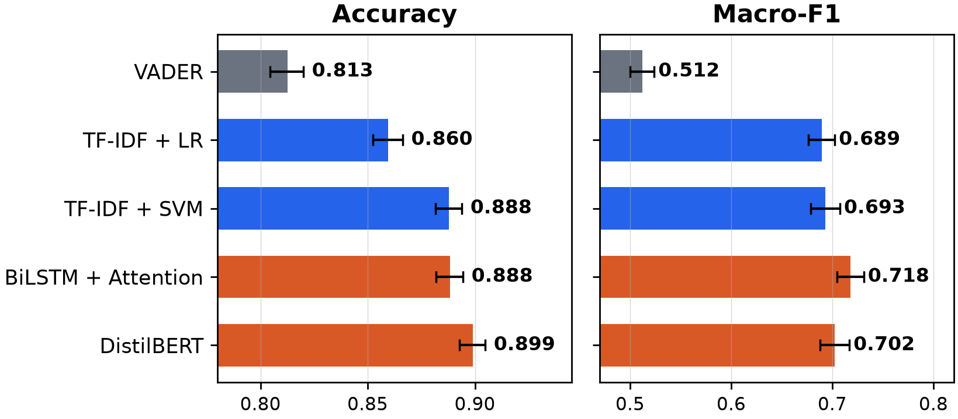
Results: sentiment classification
Model | Accuracy | Macro-F1 | F1 neutral
VADER | .813 | .512 | .080
TF-IDF + LR | .860 | .689 | .400
TF-IDF + SVM | .888 | .693 | .382
BiLSTM + Attention | .888 | .718 | .446
DistilBERT | .899 | .702 | .368
95% bootstrap intervals, 2,000 resamples of the test set.
Neutral is the hardest class for every model: it is 7% of the data and sits between positive and negative.
BiLSTM minus SVM: +0.025 macro-F1 (95% CI +0.010 to +0.039), significant. Accuracy is identical. The gain is on the neutral class.
ReviewIQ | Vidyalankar Institute of Technology
10 / 19
Notes:
All five models are scored on the same 10,000 test reviews. The BiLSTM has the best macro-F1 and DistilBERT the best accuracy. The BiLSTM beats the SVM significantly on macro-F1, but not DistilBERT.

Slide 11
Ablation and cost
What drives the LSTM's gain? (mean of 3 seeds)
26x
Variant | Accuracy | Macro-F1
Full (attention + class weights) | .891 | .722
No class weights | .899 | .709
Mean pooling, no attention | .889 | .715
DistilBERT (reference, 1 run) | .899 | .702
fewer parameters than DistilBERT (2.57 M vs 66.96 M)
57x
faster on CPU (975 vs 17 reviews per second)
Class weights add +0.012 macro-F1 and cost 0.007 accuracy, in every seed. Attention adds only about +0.007. Seed-to-seed spread is about 0.004.
13x
faster on GPU (5,688 vs 451 reviews per second)
ReviewIQ | Vidyalankar Institute of Technology
11 / 19
Notes:
Three variants times three seeds on the same split. Class weighting, not attention, drives most of the macro-F1 gain, and an unweighted LSTM matches DistilBERT accuracy. The LSTM is far cheaper to run.

Slide 12
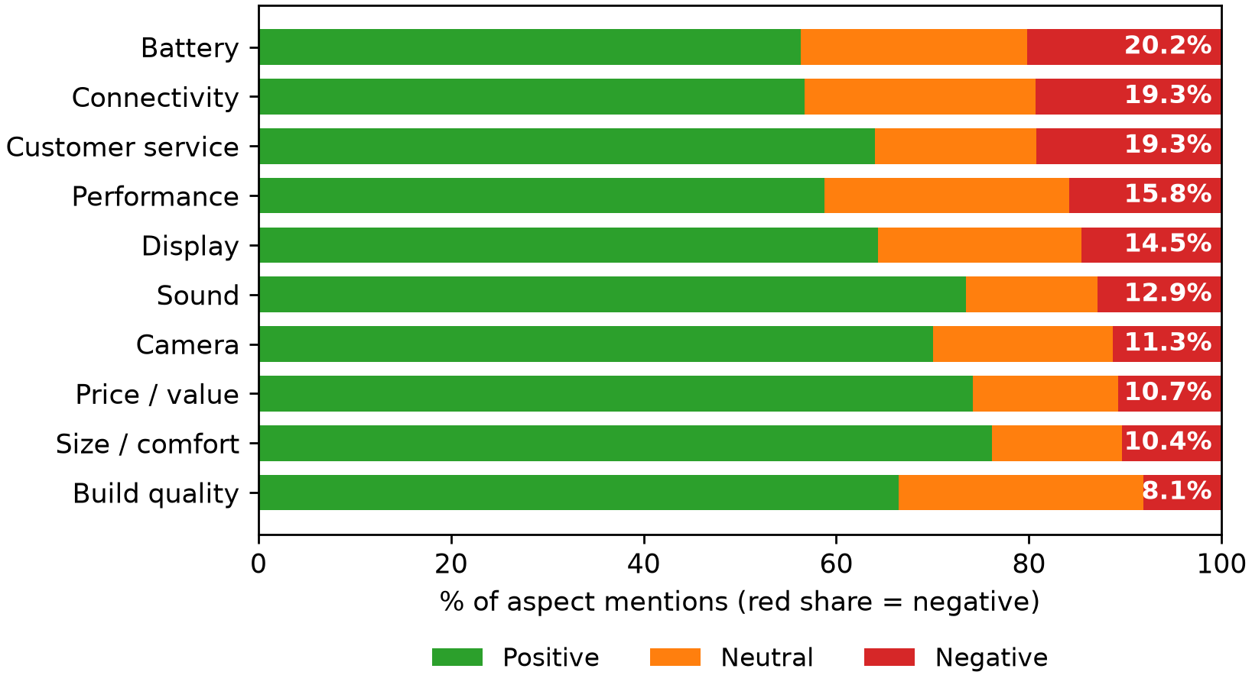
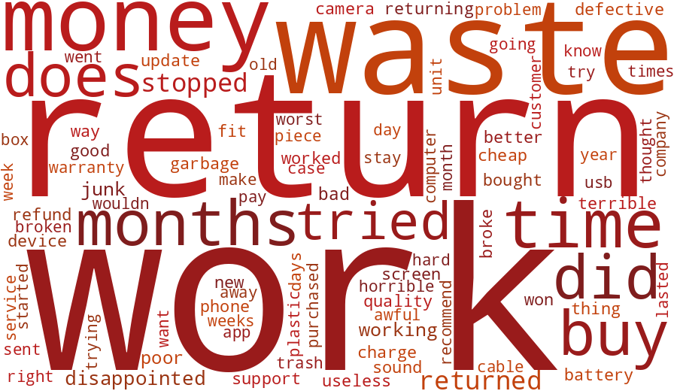
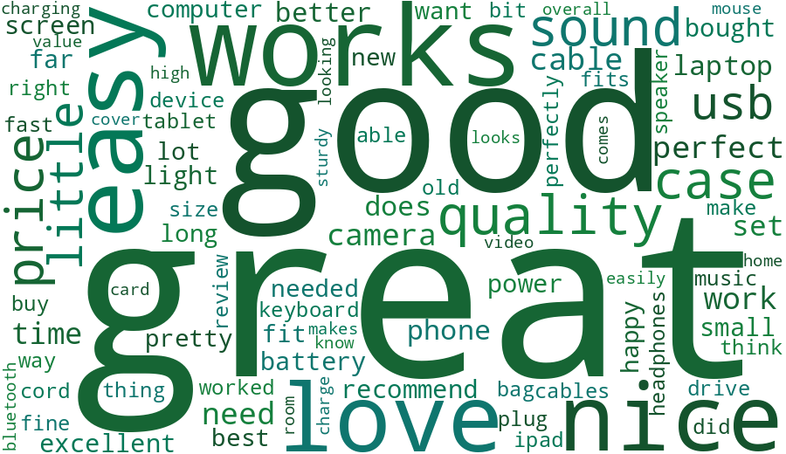
Aspects and the language of sentiment
What each sentiment sounds like
Negative
Positive
Negative: "return", "waste", "money", "stopped", "broke"
Positive: "easy", "love", "nice", "perfect"
Neutral: hedged words such as "okay", "fine", "better"
Battery: 20.2% negative mentions. Connectivity and customer service: 19.3% each. Build quality: 8.1%.
ReviewIQ | Vidyalankar Institute of Technology
12 / 19
Notes:
Battery is the top complaint, then connectivity and customer service. The word clouds weight words by how characteristic they are of each class.

Slide 13
Review quality, trust and error analysis
Helpfulness (XGBoost)
Suspicious reviews
Label noise in errors
70.5% accuracy, precision 0.458, recall 0.702, F1 0.555
Modest because helpfulness depends on exposure, which no review feature captures
The aspect count from the ABSA module ranks second: one component feeds another
4,999 flagged (10%), 36 near-duplicates
Dashboard: threshold slider and a table of flag, score, review and signals
Worded as "potentially suspicious based on automated pattern analysis". Never "fake"
155 of 1,116 test errors are confident
5 stars, predicted negative: "Piece of junk !!! Poor quality, high price .. it lasted 10weeks"
1 star, predicted positive: "Worked out of the box. love it"
The stars contradict the text, so part of the error is label noise
Takeaway: accuracy here measures agreement with star ratings. Some errors are label noise, and flagged reviews are anomalies, not proven fakes.
ReviewIQ | Vidyalankar Institute of Technology
13 / 19
Notes:
Helpfulness is moderately predictable. The suspicious-review score is unsupervised. Our error analysis shows that some model errors are really label noise.

Slide 14
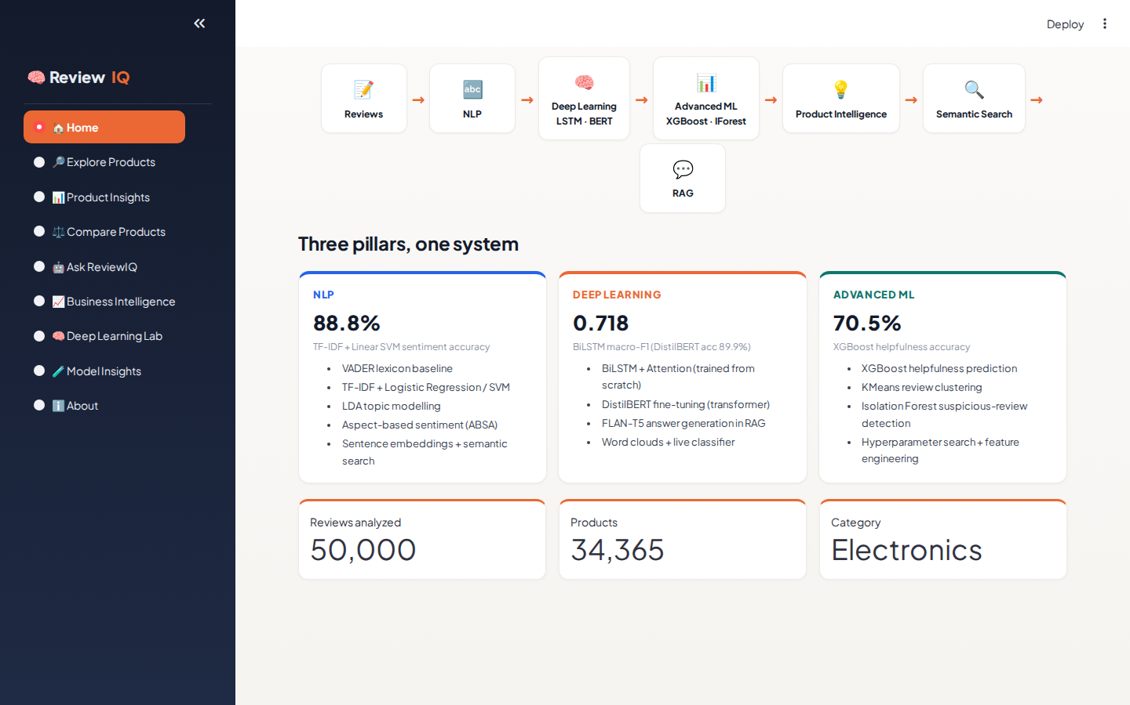
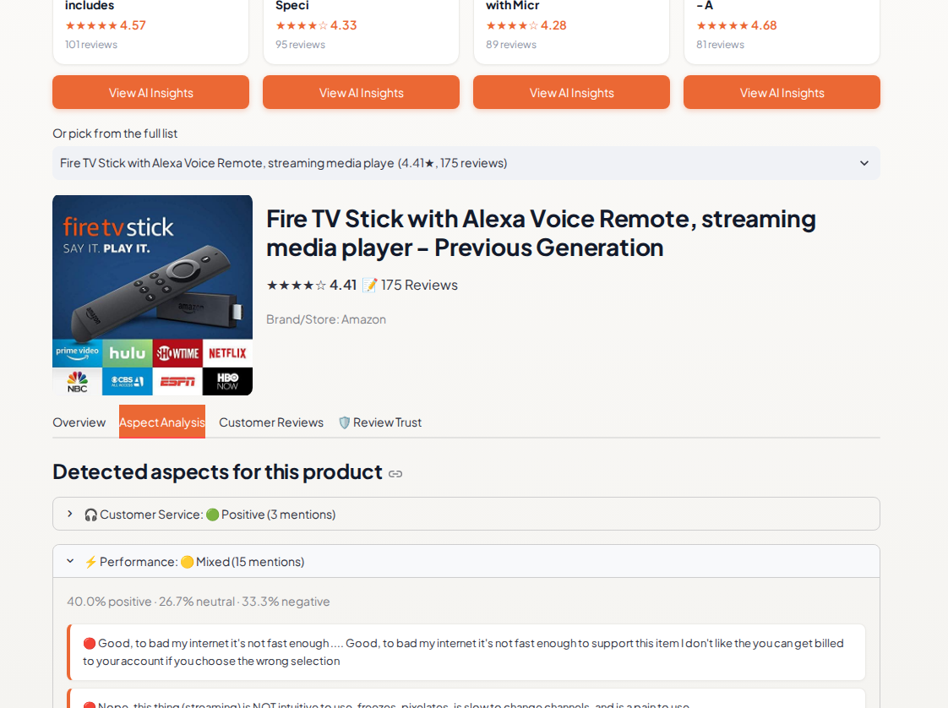
The dashboard (1 of 2)
Home: the three pillars and the pipeline
Product Insights: aspects with supporting evidence
Every insight links to the reviews behind it, so users can check the evidence.
ReviewIQ | Vidyalankar Institute of Technology
14 / 19
Notes:
Nine pages. The Home page shows the three pillars. Product Insights shows a summary, aspect analysis with evidence sentences, filterable reviews with LSTM predictions, and the trust table.

Slide 15
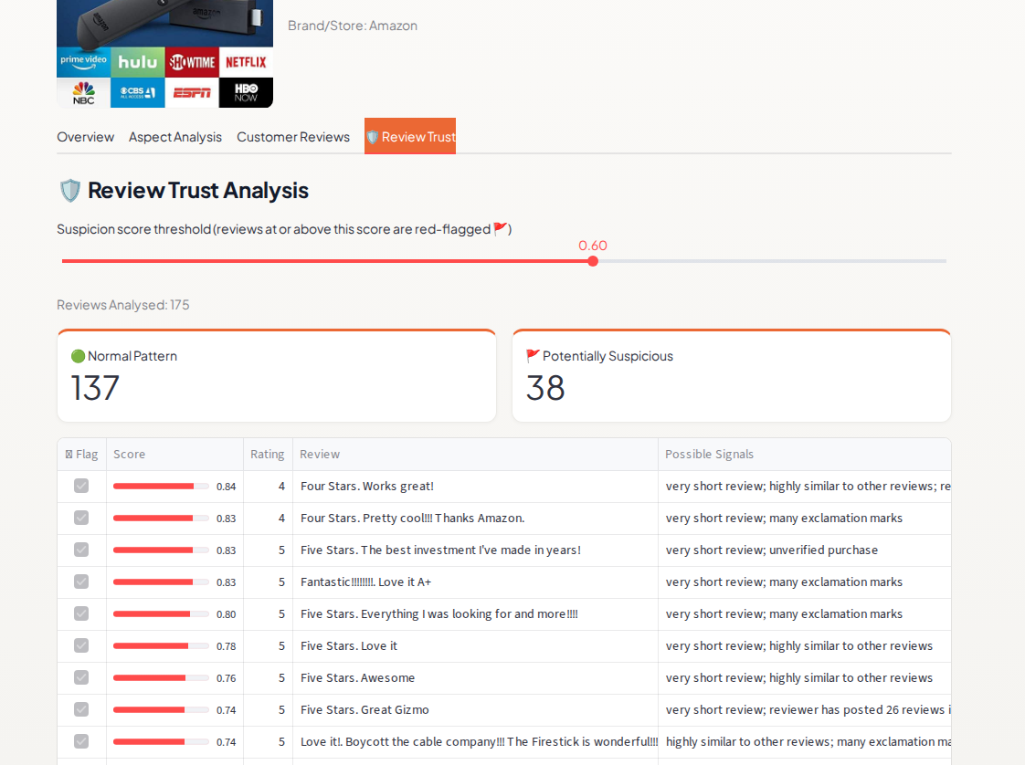
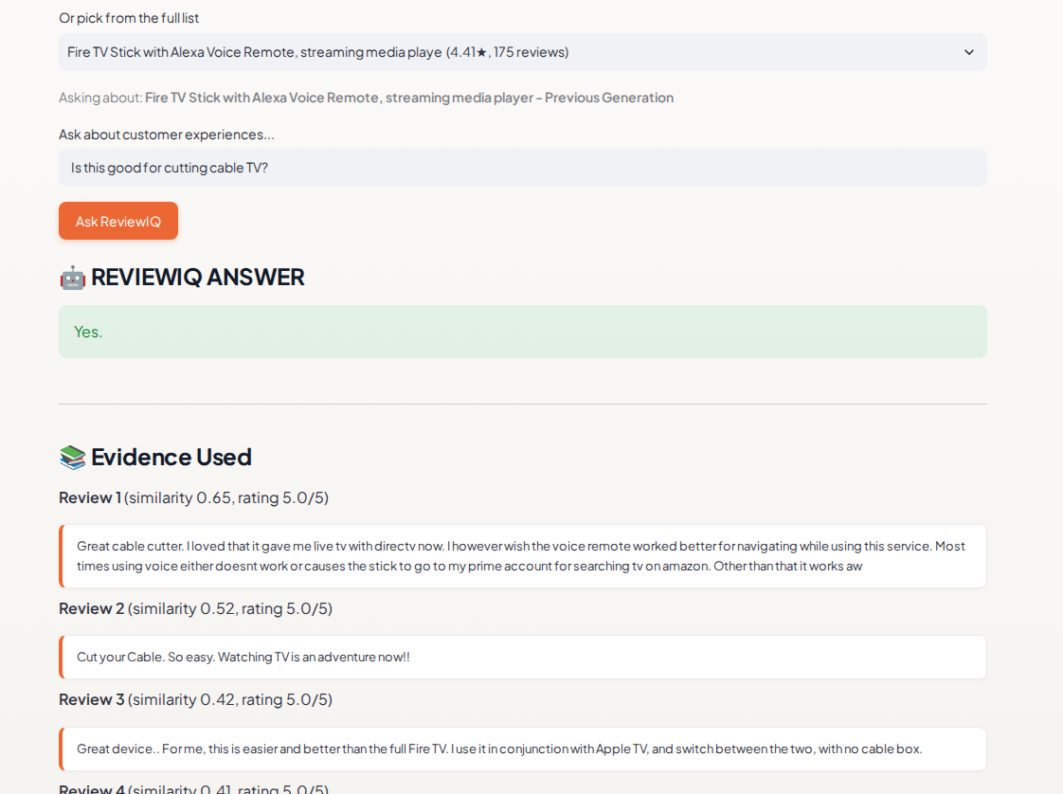
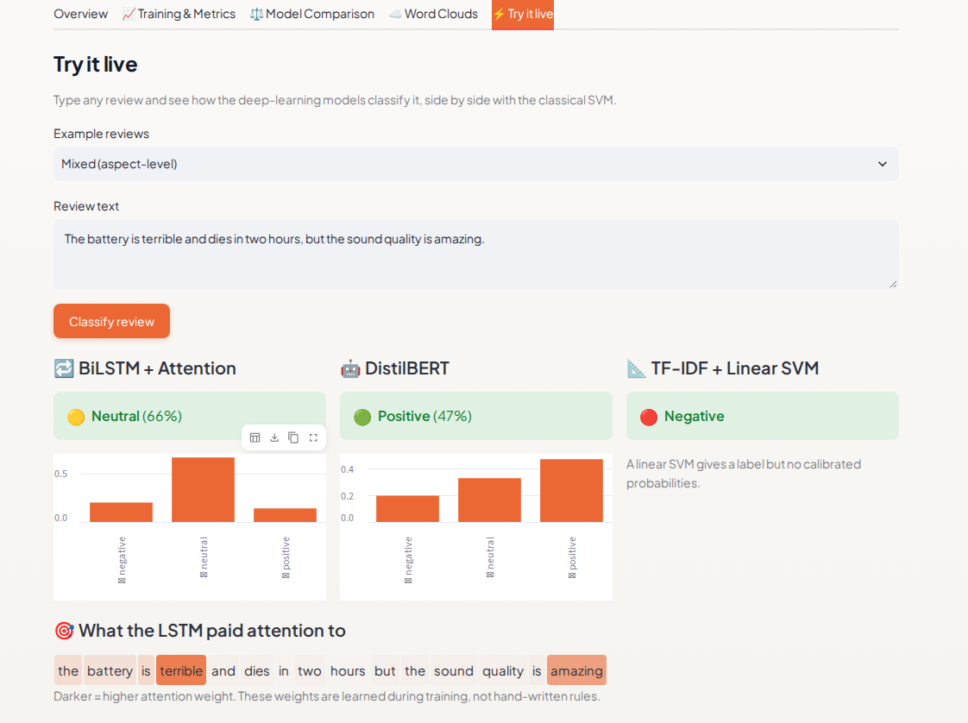
The dashboard (2 of 2)
Review Trust: slider and flag table
Ask ReviewIQ: answer with evidence
Deep Learning Lab: live classifier
Live classifier: the three models can disagree on a mixed review, which is exactly why aspect-level analysis exists.
ReviewIQ | Vidyalankar Institute of Technology
15 / 19
Notes:
Review Trust has the threshold slider and flag table. Ask ReviewIQ answers from one product's reviews and shows its evidence. The Deep Learning Lab has a live classifier comparing three models with attention highlighting.

Slide 16
Problems we found and fixed
Backwards trust features
Ungrounded answers
Raw length and rating flagged long, negative reviews. Switched to directional features and account volume.
A warranty question got a confident "No" at low similarity. Added the similarity floor.
Slow, dimmed pages
Missing product images
VADER features for 50,000 reviews were rebuilt on every click (23 s). Cached.
20 images used an unread field and the fallback link was blocked. Fixed the parser, built-in fallback.
Ignored sidebar clicks
Duplicate navigation
The radio's identity changed each page, so the first click was dropped. Stable key and callbacks.
Streamlit read a folder named pages as its own menu. Renamed it.
ReviewIQ | Vidyalankar Institute of Technology
16 / 19
Notes:
These came from testing and inspection, and they shaped the final design. Mention that we checked results rather than trusting them.

Slide 17
Limitations and future scope
Limitations
Future scope
Labels come from star ratings, so some are noisy
Sample is a reviewer-grouped block of one English category
DistilBERT saw one-sixth of the LSTM's data and no class weights
Aspects use keyword lexicons: implicit aspects and sarcasm are missed
Flagged reviews are anomalies, not confirmed fakes
Answer faithfulness was not measured
Train DistilBERT on the full data with matched class weights
Learned aspect extraction instead of keyword lists
Human-annotated neutral and suspicious subsets
Random sampling across several categories and languages
Evaluate answer faithfulness, try larger generators
Seller view that tracks complaint areas over time
ReviewIQ | Vidyalankar Institute of Technology
17 / 19
Notes:
State the limitations plainly. They are real and they affect how the numbers should be read.

Slide 18
Conclusion
0.718
57x
20.2%
best macro-F1 (BiLSTM), 88.8% accuracy
faster than DistilBERT on CPU
of battery mentions are negative: top complaint
NLP, deep learning and advanced ML on one corpus give buyers evidence-linked insight and sellers a ranked list of problems.
A BiLSTM trained from scratch matches DistilBERT's accuracy once class weights are removed and is far cheaper to run.
A similarity floor makes question answering decline unsupported questions instead of guessing.
Results, limits and fixes are reported honestly, with confidence intervals and an ablation.
ReviewIQ | Vidyalankar Institute of Technology
18 / 19
Notes:
Summarise the three headline findings and what the system delivers.

Slide 19
Thank you
Questions?
ReviewIQ: AI-Based Product Review Intelligence and Consumer Insight System
Nidhi Bhawari
23102A0006
Prof. Sneha Annappanavar
Aarti Sakpal
23102A0007
Project Guide
Gayatri Patil
23102A0016
Vidyalankar Institute of Technology
Prachi Wakode
23102A0020
Notes:
Thank the audience and invite questions.

