Slide 1
SOFTWARE SOLUTIONS FOR LATITUDE MUSIC EVENT 2019
ProP Group 17
Nidhi Sharma – 3233006 (Group lead)
Tra Nguyen – 3467848
Luay Shatara – 3504255
Jharna Chhutari - 3259668

Slide 2
Event highlights
Three kinds of ticket on sale. Buying online is always cheaper than at gate
Regular ticket
VIP ticket (with 20% discount on food, drink, souvenir & loan items)
Group ticket (for a group of 6 people)
Camping spot reservation
By individual (for regular & VIP ticket holder)
By group (for group ticket holder)
Services during event
Shop selling food, drink & souvenir
Vending machine selling snack & non-alcoholic drink
Shop lending items such as camera & charger

Slide 3
Our solutions
Latitude app for employees
Latitude website
Latitude class library
Latitude vending machine for visitors
Database

Slide 4
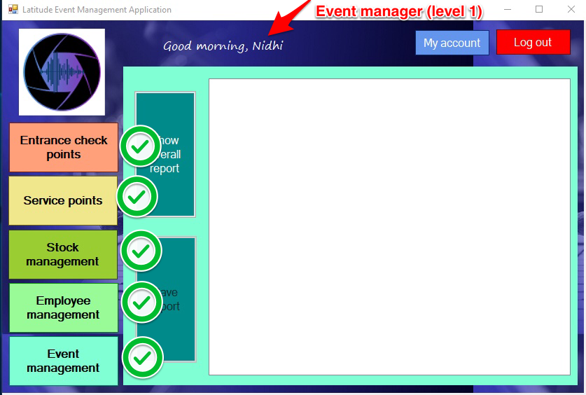
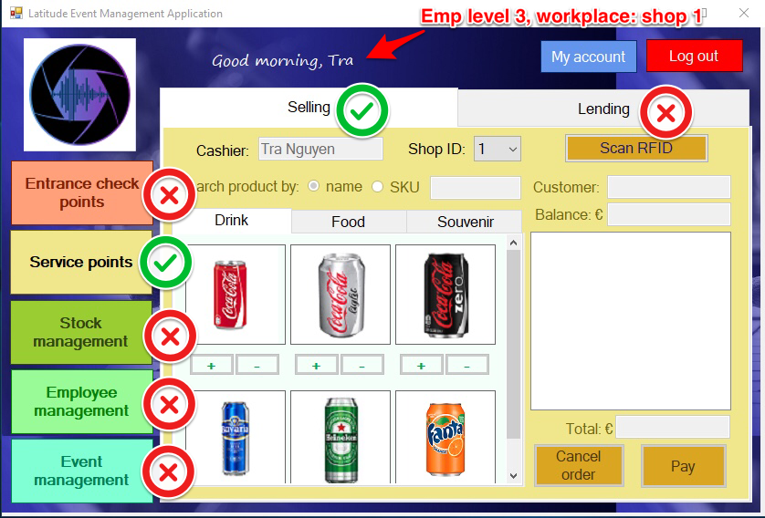
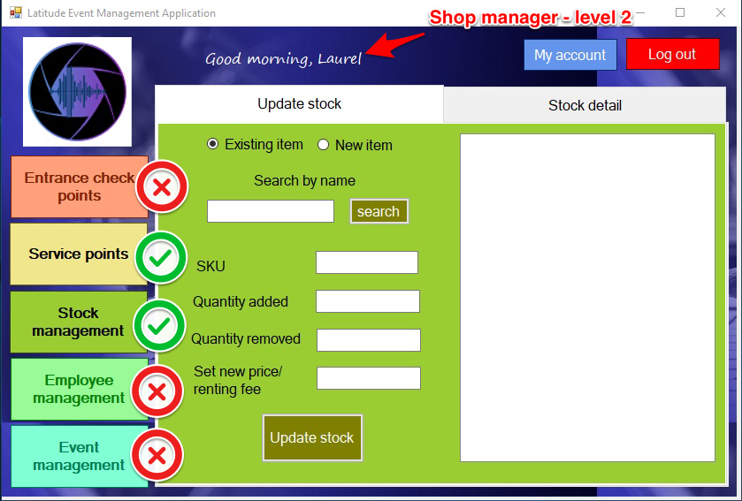
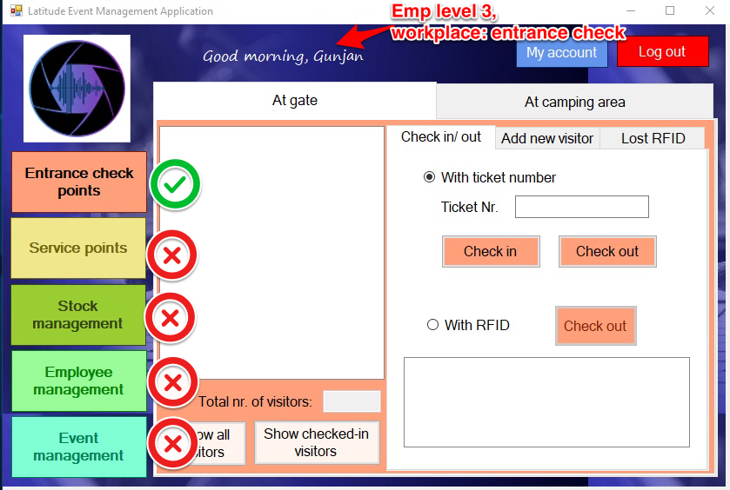
Applications’ remarks
Personalized GUI according to employees’ level & workplace
Visitors’ balance instantly updated after receiving logFile from bank
Shop managers and/ or event managers can adjust price/ renting fee of event items during event. Such changes wouldn’t affect previous orders stored in database
Shop managers and/ or event managers can create new items for sale/ rent. These items would be updated for shops and/ or vending machines

Slide 5
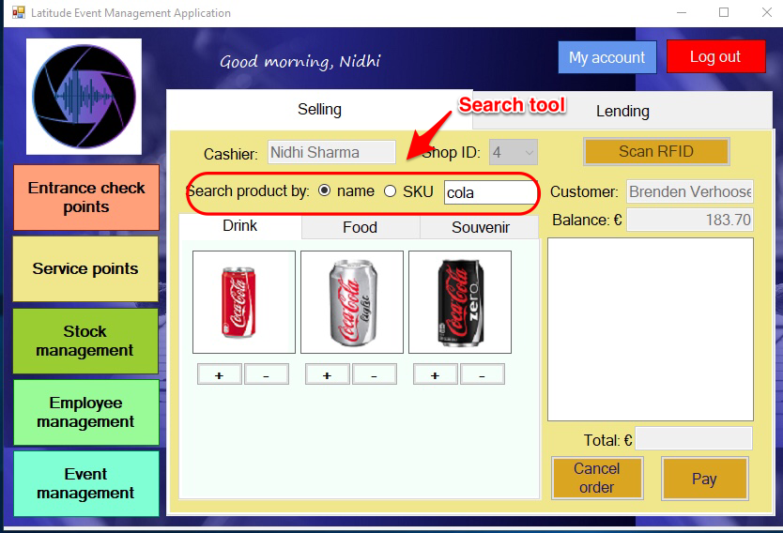
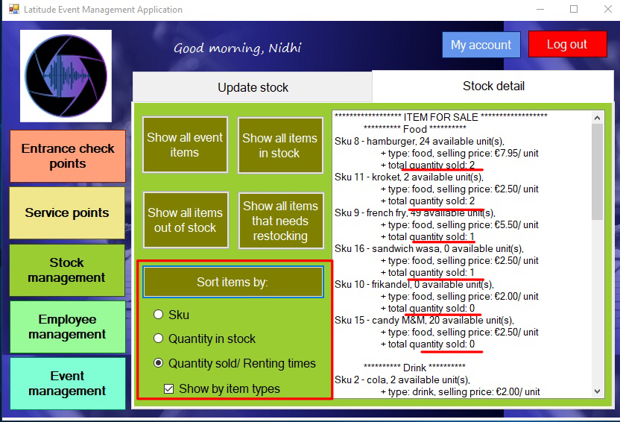
Applications’ remarks
Search tool to help cashier easily find products
Button Add is only clickable if the according item is in stock
Sorting stock by different criteria to help shop managers and/or event managers come up with suitable strategy to maximize revenue

Slide 6
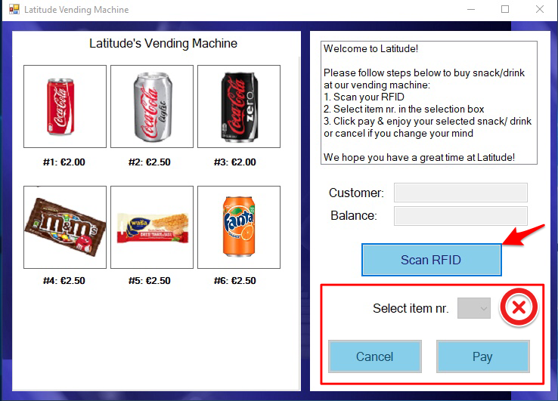
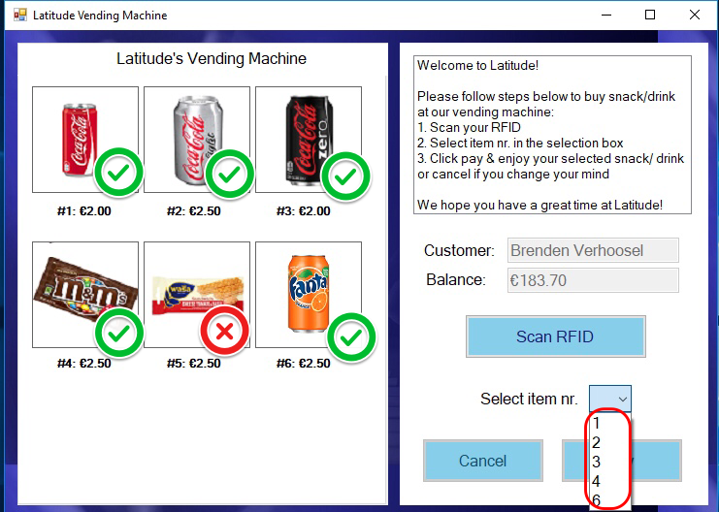
Applications’ remark
VendingMachine (VM) app would be used by visitors at event => help reduce visitor queue & nr. of employees working at shops
Visitors need scan RFID tag before selecting item
Items which are out-of-stock wouldn’t be shown in selection box

