Slide 1
The Flash Card App
(Python Mini Project)
Team Members:
1811024 - Yash Mehta.
1811028 - Nidhi Nair.

Slide 2
Problem Definition
General Block Diagram and its functionalities.
Responsibility Matrix
Link to User Guide.
Screenshots of the project
Conclusion
References
Overview
Cntext

Slide 3
Problem Definition

Slide 4
Design a Desktop Application using Python Tkinter to help children understand the basic Geography of our country India, and also perform basic Mathematics.
The main purpose is that the children can identify and name all the states of India as well as the capital cities of the respective states. It is then followed by a small quiz for better understanding and learning.The app includes basic addition and subtraction of numerics for the children to learn Mathematics.

Slide 5
General Block Diagram
And its functionalities.

Slide 6
States of India
Capitals of the respective States
Maths Module
One by one any of the states of India will be shown on the screen like a Flash card,the person has to identify the State and type his/her answer in the empty box given below
To identify the capitals, any state’s flash card will be displayed followed with multiple choice answers(various capitals). The correct answer has to be chosen by the person.
Random number flash cards will be shown on the screen to perform addition and subtraction. The person has to type his answer in the empty box given below.

Slide 7
Responsibility Matrix

Slide 8
<Responsibilities by group member are represented using “X” >
Task | Yash Mehta | Nidhi Nair
UI :
Design | X | X
Coding | X | X
Testing :
Testing Approach | X | X
Test Cases | X | X
Presentation :
Powerpoint | X | X
Report | X | X
User Manual | X | X

Slide 9
Software Requirements

Slide 10
OS: We will use this Python Module to read our training directories and file names.
Tkinter: tkFileDialogue is a module with open and save dialogue functions.
PIL: ImageTk module contains support to create and modify Tkinter BitmapImage and PhotoImage objects from PIL image.
PIL: Image module provides a class with the same name which is used to represent PIL image. The module also provides a number of factory functions, including functions to load images from files, and to create new images.
PhotoShop: To create Flashcards for numeric and states.
GITHUB :To upload the code and other requirements of the project.
(No hardware modules required for this app)

Slide 11
Links :
User Manual: https://docs.google.com/document/d/1YuH6wAZUz9LCDTSSH4rEb5ACWUW1nJ57snYjFEbc-Ys/edit
Report: https://docs.google.com/document/d/1rJwQQ20RP4rTfgFe7ROUSiTshqYoLB3w2f50hnnY1XQ/edit#
Github: https://github.com/nidhiinair/FlashCard_PythonMiniProject

Slide 12
Screenshots Of the Project

Slide 13
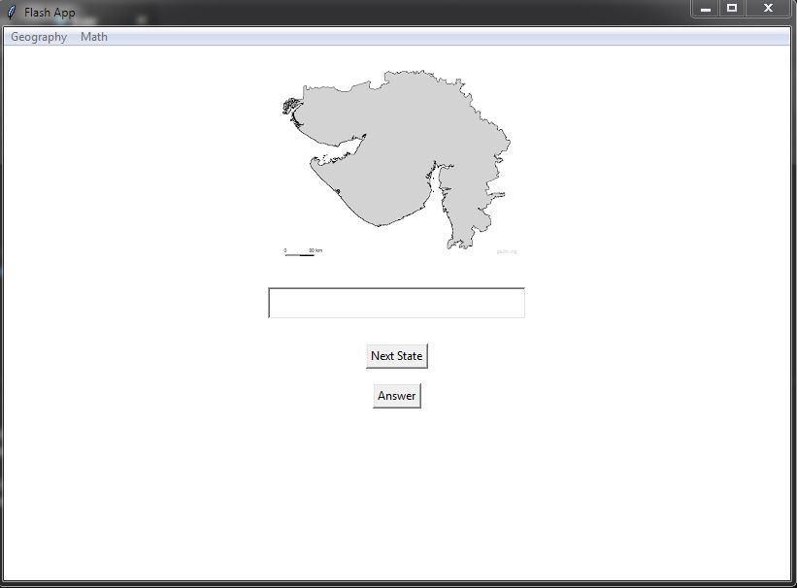
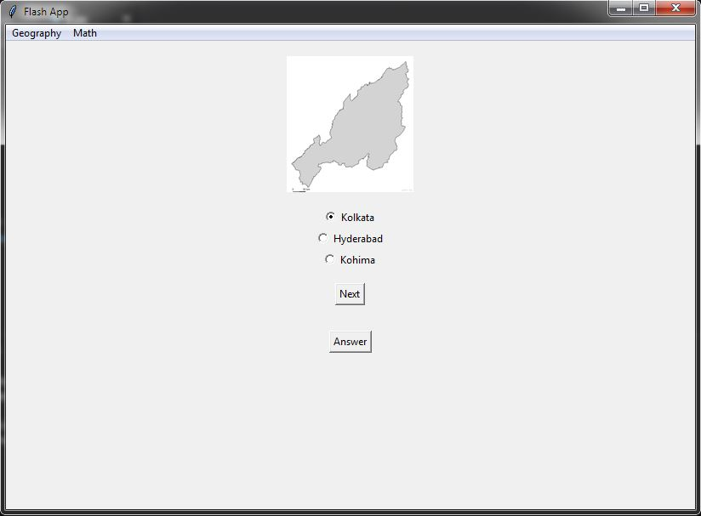
States module
States_capitals module

Slide 14
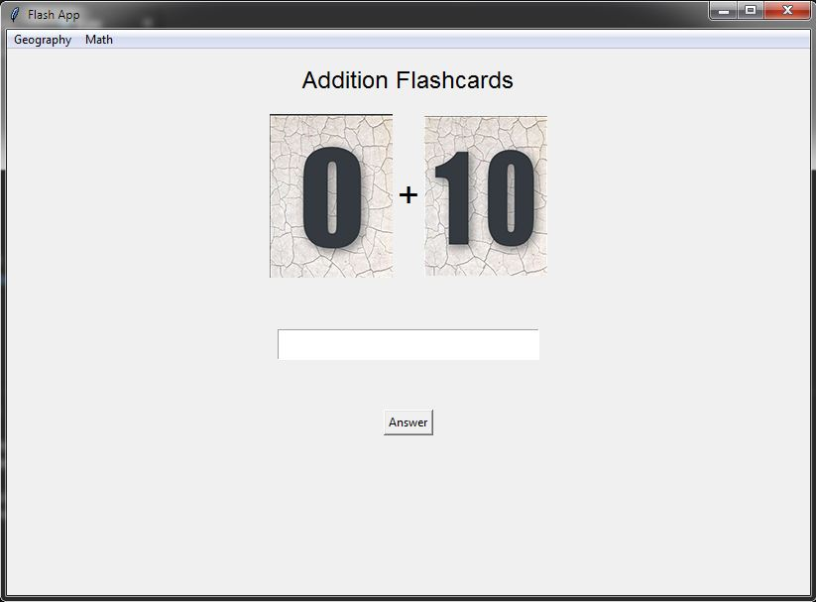
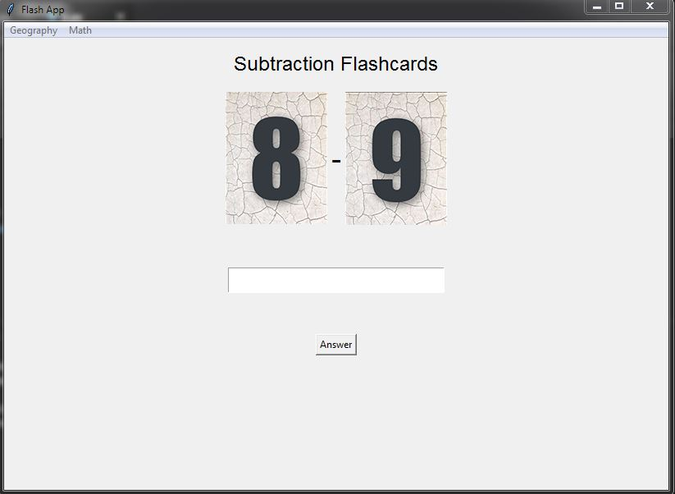
Addition Module
Subtraction Module

Slide 15
Conclusion

Slide 16
Using Python Tkinter we learned to design a basic desktop app for the children to help them solve easy addition and subtraction on numerals ranging from 1-10 and identify states and capital cities of India.This will help the children built a strong foundation for mathematics as well geography.

Slide 17
References
Geeks for Geeks
Photoshop
Python.org
Wikipedia

