Slide 1
Clustering Solar Energy Production Zones
Presented By : Nidhi Patel
This project aims to identify and segment geographical zones based on their solar energy production potential using unsupervised learning techniques. It contributes towards optimized placement and utilization of solar infrastructure, driving sustainable energy planning.

Slide 2
INTRODUCTION
This project involves clustering regions based on their solar energy generation potential using geospatial and production data. The insights can help in better policy-making, resource allocation, and infrastructure planning for renewable energy sectors.

Slide 3
Objective OF The Study
Value Of The Study
Cluster geographical zones based on solar energy production patterns.
Understand regional variability using unsupervised learning.
Provide visual and analytical insights for energy policy planning.
Energy Optimization: Helps in planning solar plant installations efficiently.
Infrastructure Planning: Supports the identification of high/low potential zones.
Sustainability Goals: Assists in regional targeting for renewable energy expansion.

Slide 4
Problem Statement
Challenge: Lack of clear classification of regions based on solar energy output leads to inefficient solar infrastructure placement.
Solution: Using clustering techniques on solar production data to identify and group regions with similar energy generation patterns.

Slide 5
Work Flow
Data collection
Gathering and organizing data to train machine learning models.
Data pre-processing
Preparing and cleaning data to enhance its quality and suitability
Exploratory Data Analysis
Analysing and visualizing data patterns to understand its characteristics
Feature Engineering
Dividing the dataset into training and testing sets to evaluate
Clustering & K-Means
Choosing a suitable machine learning algorithm and optimizing its parameters
Cluster Validation
Assessing the performance of a machine learning model using metrics
Visualization & Insights
From User inputs predicting the outcome
Step 1
Step 2
Step 3
Step 4
Step 5
Step 6
Step 7

Slide 6
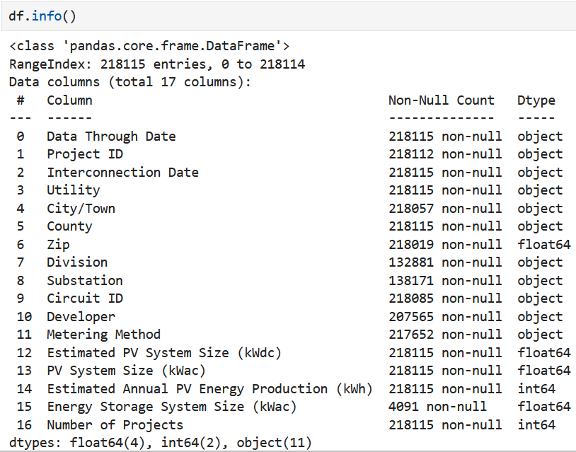
Data Description
Features:
Region_ID, Latitude, Longitude
Daily_Solar_Production (kWh)
Weather_Average, Temperature, Cloud_Cover, Humidity, etc.
Target: No target (Unsupervised learning)
Data covers various geographical zones across timeframes.
Solar Energy Production Zones
Rows : 218115
Columns : 17

Slide 7

Methodology – Preprocessing
Missing Values: Handled using interpolation and domain-specific defaults.
Outliers: Detected using IQR; major outliers removed to stabilize clustering.
Scaling: StandardScaler applied to ensure feature uniformity.
Encoding: Geographic coordinates used directly, no categorical encoding needed

Slide 8
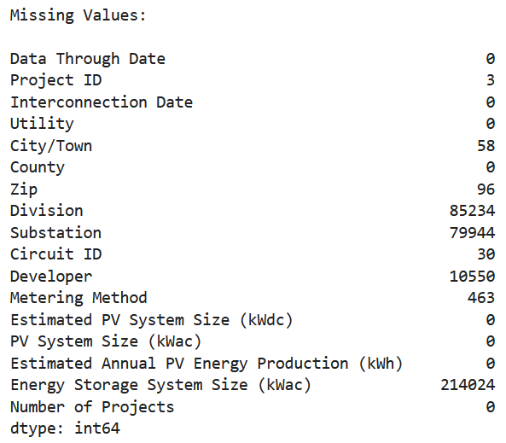
Missing Values Treatment
Index(['Energy Storage System Size (kWac)'], dtype='object’) was dropped the column due to 98% missing values.
Removed the data record which doesn't have Project ID.
Zip - Filled with the mode (most common value) as it's likely categorical
Division - Filled with "Unknown Division" as a placeholder for missing entries
Substation - Filled with "Unknown Substation“
Circuit ID - Filled with "Unknown Circuit“
Developer – Filled with "Unknown Developer“
Metering Method - Filled missing values with "Unknown" for undefined methods
City/Town - Filled missing cities with "Unknown City“

Slide 9
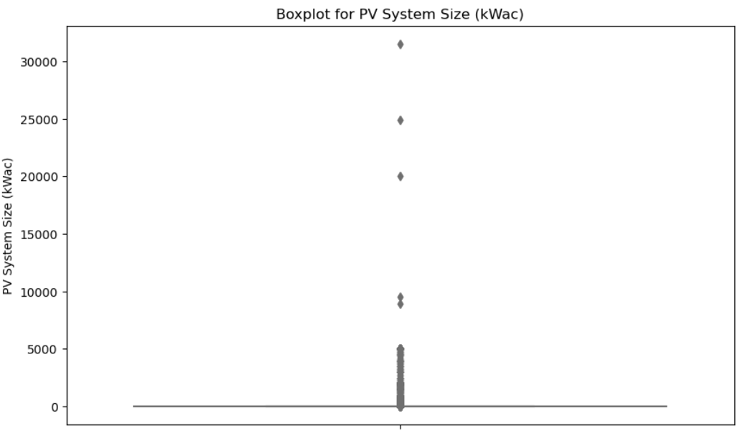
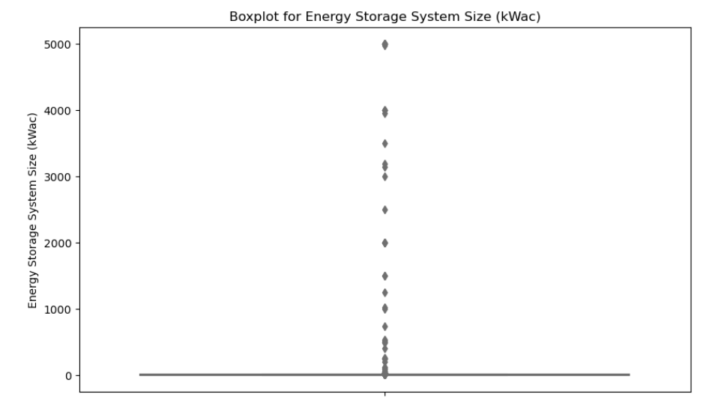
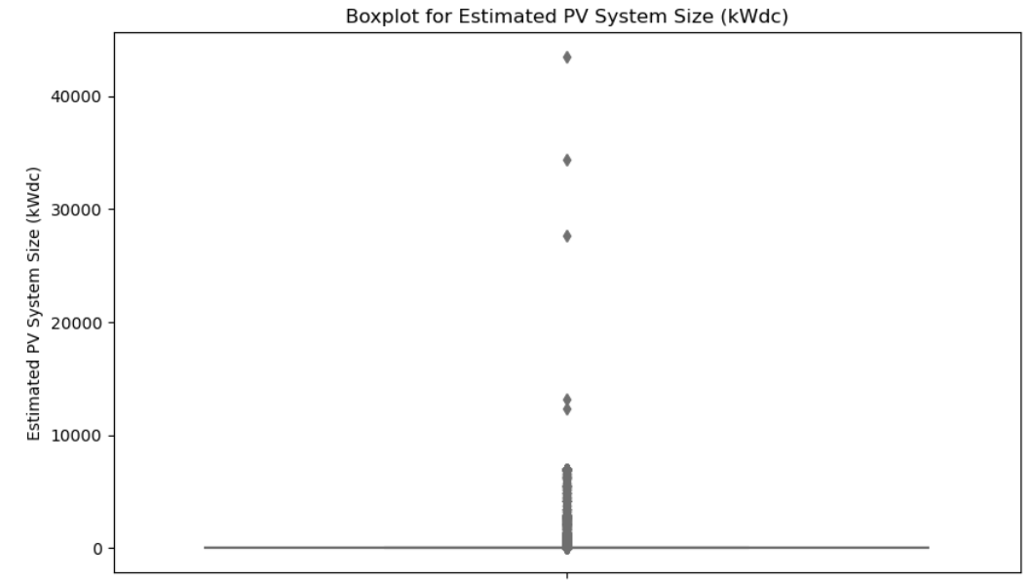
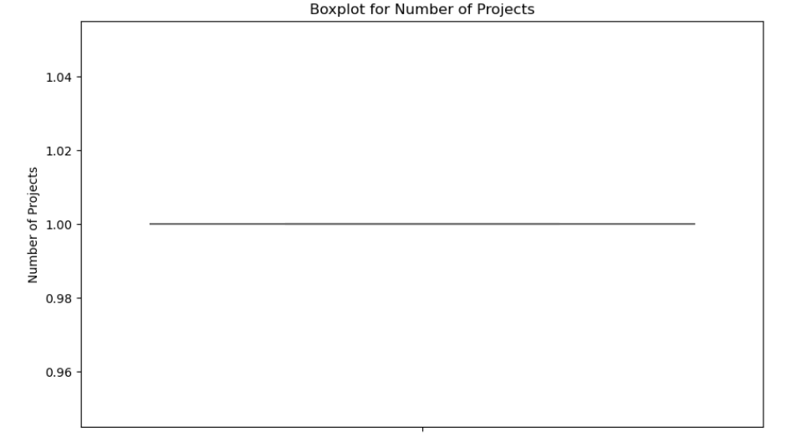
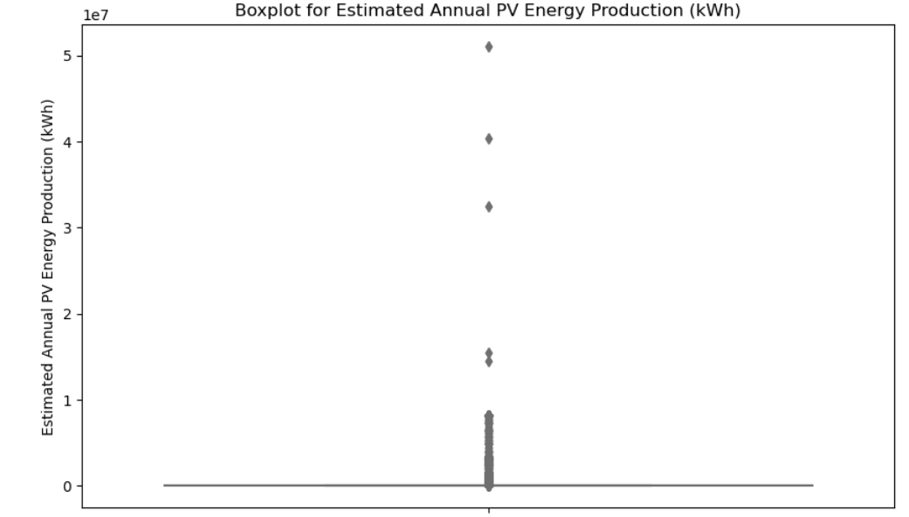
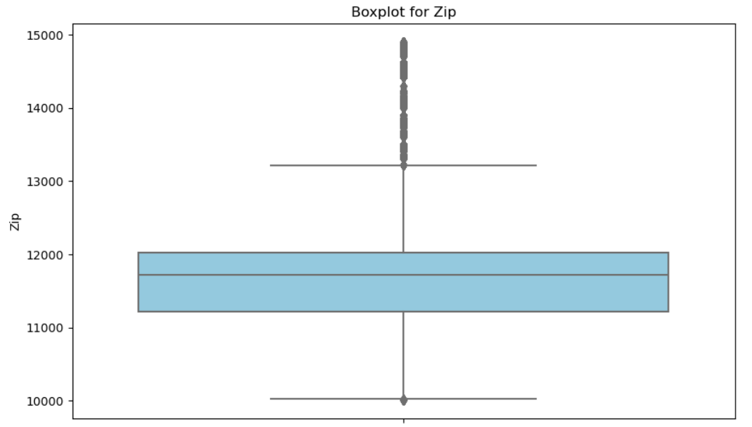
BEFORE OUTLIER TREATMENT

Slide 10
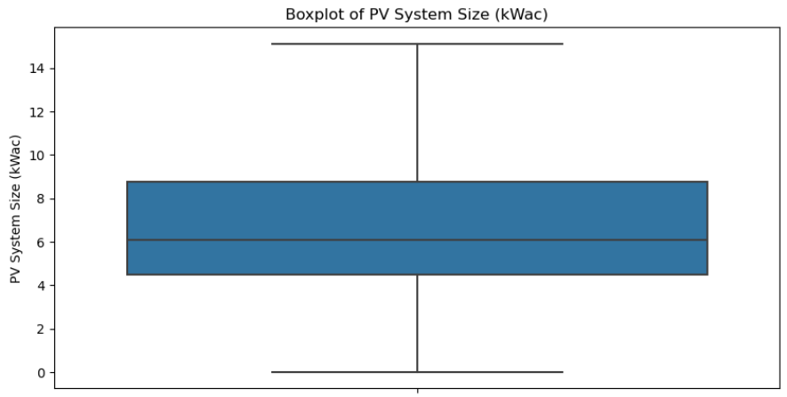

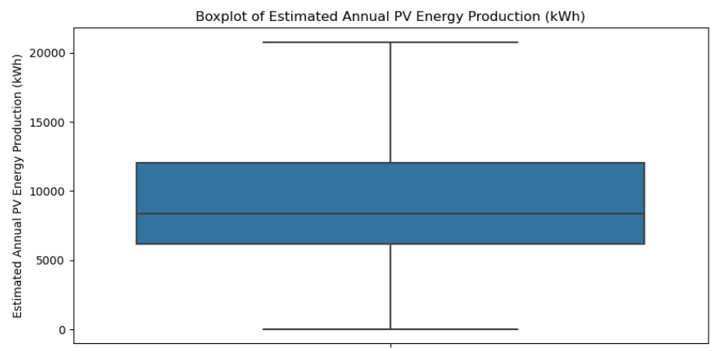
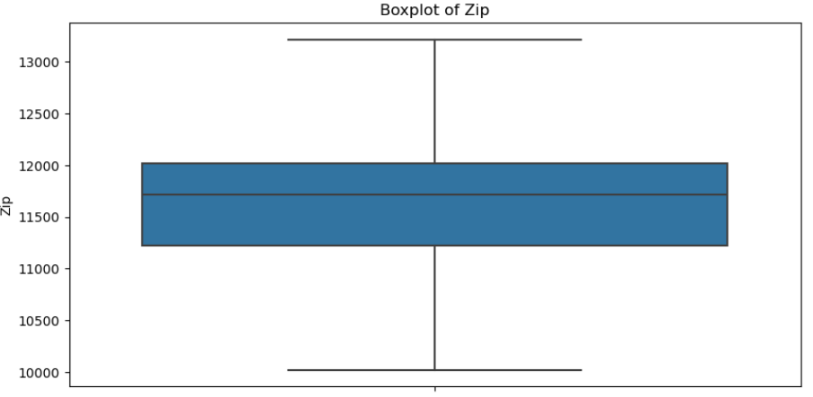
after OUTLIER TREATMENT

Slide 11
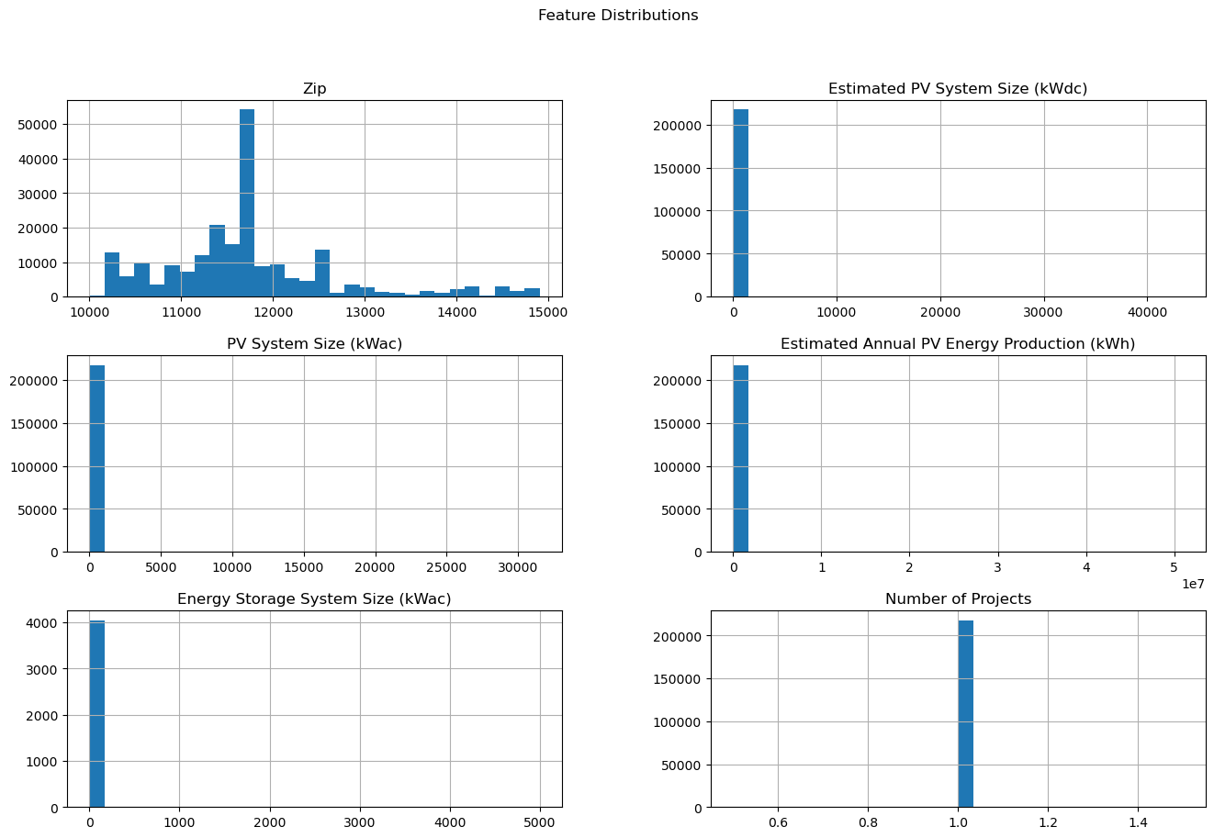
Data Distribution

Slide 12
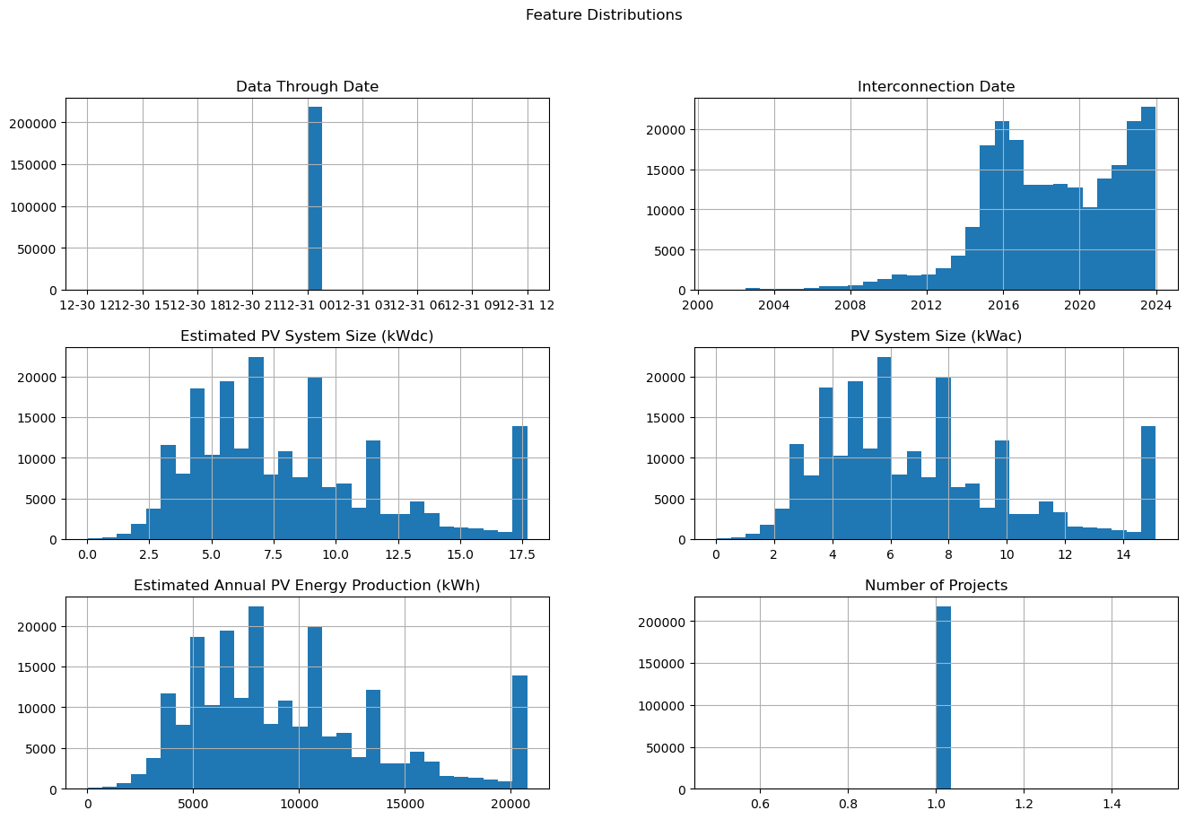
Data Distribution

Slide 13
Feature Engineering
Derived Features:
Mean Daily Production
Production Variability
Solar Efficiency Index (custom metric)
Aggregated Monthly/Seasonal Averages
PCA applied for dimensionality reduction and visualization.

Slide 14
Clustering technique
Algorithm Used: K-Means Clustering
Why K-Means?
Simple, efficient, interpretable for geospatial data.
Cluster Evaluation: Elbow Method and Silhouette Score used to validate cluster numbers.

Slide 15
Elbow Method
Elbow Point identified at k = 4
Inertia significantly decreases until k=4, after which marginal improvements observed.
Optimal number of clusters selected: 4

Slide 16
Cluster Visualization
PCA-Based 2D Cluster Plot
Clear separation of zones into 4 groups.
Color-coded zones represent regions with similar solar production behavior.

Slide 17
Cluster Descriptions
Cluster 1: High production zones with stable weather.
Cluster 2: Medium production with moderate variability.
Cluster 3: Low production, high cloud/humidity influence.
Cluster 4: Extreme variability, possibly unstable for long-term infrastructure.

Slide 18
Evaluation Metrics
Silhouette Score: ~0.48 – indicates moderately well-separated clusters.
Visual Validation: PCA & Geo-plots show meaningful and interpretable groupings.

Slide 19
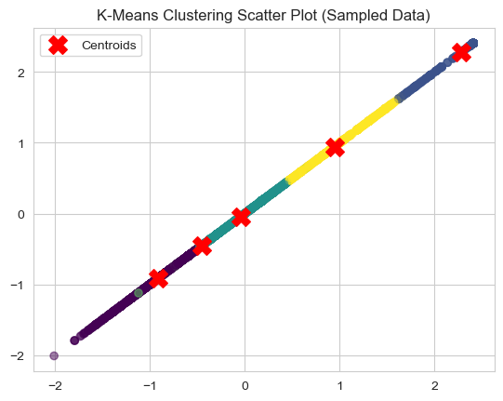
K-Means Clustering Result
DBSCAN has the highest Silhouette Score: 0.6279, indicating better clustering quality than K-Means (0.5032) and Hierarchical Clustering (0.4615).
A higher Silhouette Score (closer to 1) means the clusters are well-separated and dense.

Slide 20
Next Steps
Incorporate more weather data (e.g., solar irradiance).
Explore DBSCAN or hierarchical clustering for spatially-aware grouping.
Build a predictive model for estimating production potential for new regions.
Develop interactive dashboards for stakeholders.

Slide 21
Conclusion
Identified four distinct solar energy production zones.
Provided insights into region-specific energy potential.
Clustering approach adds value for renewable energy policy and planning

Slide 22
Thank You!

