Slide 1





Pvt. Ltd.
Your Gateway to Smarter Networking

Slide 2
Qwiktrace
Founded in 2024 and headquartered in Jaipur, India.
QwikTrace Pvt. Ltd. leads the way in cutting-edge, eco-friendly secure solutions. Our flagship Make in India products—Qwik Connect (SDWAN), Qwik Box, and Qwik Virt (Virtualization) Software — with sustainable network devices designed for SMEs, educational institutions, incubators, and ISPs. QwikTrace's next-gen solutions reduce environmental impact by eliminating the need for multiple vendors and hardware, promoting simplicity and efficiency by optimizing the cost.
The Qwik box (single box), virtualization, and Secure SD-WAN solutions are hardware-agnostic and based on an open-source model, empowering companies to achieve digital transformation while minimizing their carbon footprint. Experience a greener, smarter network solution with QwikTrace.
Overview

Slide 3

Problem
Statement
Organizations face high operational costs and inefficiency due to managing multiple vendors and diverse hardware/software components without a unified management platform.
Complexity in managing multiple vendors.
Diverse hardware and software components.
Lack of a unified management platform.
Inefficiency in overseeing all devices.
Increased operational costs.
Need for a streamlined management process.
Requirement for a comprehensive dashboard for efficient device management.

Slide 4

Solution
Our Approach
Introducing the All-in-One Qwik Box Solution
With our All-in-One Qwik Box Solution, device management has never been easier. Open the box, and step into a simpler, more efficient world.
Single Management Console: Manage all devices from one place.
Unified Hardware: Use a single piece of hardware for device management.
Simplified Dashboard: Easily monitor and control devices through a streamlined dashboard.
Cloud & On-Premises Compatibility: Seamlessly manage devices in both environments.
Increased Efficiency: Reduce complexity & cost & improving device management efficiency.

Slide 5
Products
Qwik Box-Software
SVB
It is a software-based solution supporting multiple applications.
Type 1 Hypervisor.
Hardware Abstraction for underlying resources.
Application Management
Create
Delete
Start/Stop
Pause/Resume
Management Interface : Provides a management interface for administrators to configure, monitor, and manage application and host resources.
Web-based console and API for automation and integration with management tools.
Supporting operating systems, including Linux, Windows, BSD, Fortios, etc.

Slide 6

2
Qwik Box – Empowering Education Networks
An Application-Driven Solution for Seamless Learning
Accelerate Digital Education
Reduce
Costs
Ensure Continuous Exams

Slide 7
2
Challenges Faced by Educators:
Limited App Awareness
Poor Classroom experience
Complex to operate
Very high cost
Internet connectivity issues
Bandwidth limitations
Packet loss and latency
Content upload problems
Video and audio quality issues
Complex
Operations
Disjointed Solution
CHALLENGES
No Cloud
Readiness
High Operation
Cost
Insufficient Bandwidth
Qwik Box Solution
● Qwik Box offers a comprehensive, on-premises & cloud based solution that overcomes these challenges

Slide 8

2
Key Features
Application-Driven Networking: Prioritizes critical educational applications.
On-Premises Deployment: No reliance on external internet.
Integrated Services: Delivers LMS and other essential tools.
Qwik Connect SD-WAN: Connects campuses efficiently
Reliable Connectivity: Ensures consistent network performance.
Optimized Bandwidth: Prioritizes educational applications.
Reduced Latency: Minimizes delays for real-time interactions.
Improved Content Delivery: Ensures smooth video and audio streaming.
Enhanced User Experience: Provides a seamless learning environment.
Zero-touch provisioning in minutes, not days
Complete visibility from single pane of glass

Slide 9
2
Benefits
Centralized Management: Streamline administration tasks.
Enhanced Collaboration: Facilitate real-time interactions between teachers and students.
Improved Learning Outcomes: Create a conducive environment for effective learning.
Improved Performance: Prioritize critical applications for faster response times.
Reduced Costs: Eliminate multiple hardware's & cloud based system.
Enhanced Reliability: Ensure consistent network performance, even in challenging environments.
Simplified Management: Centralized control and management of network resources.

Slide 10
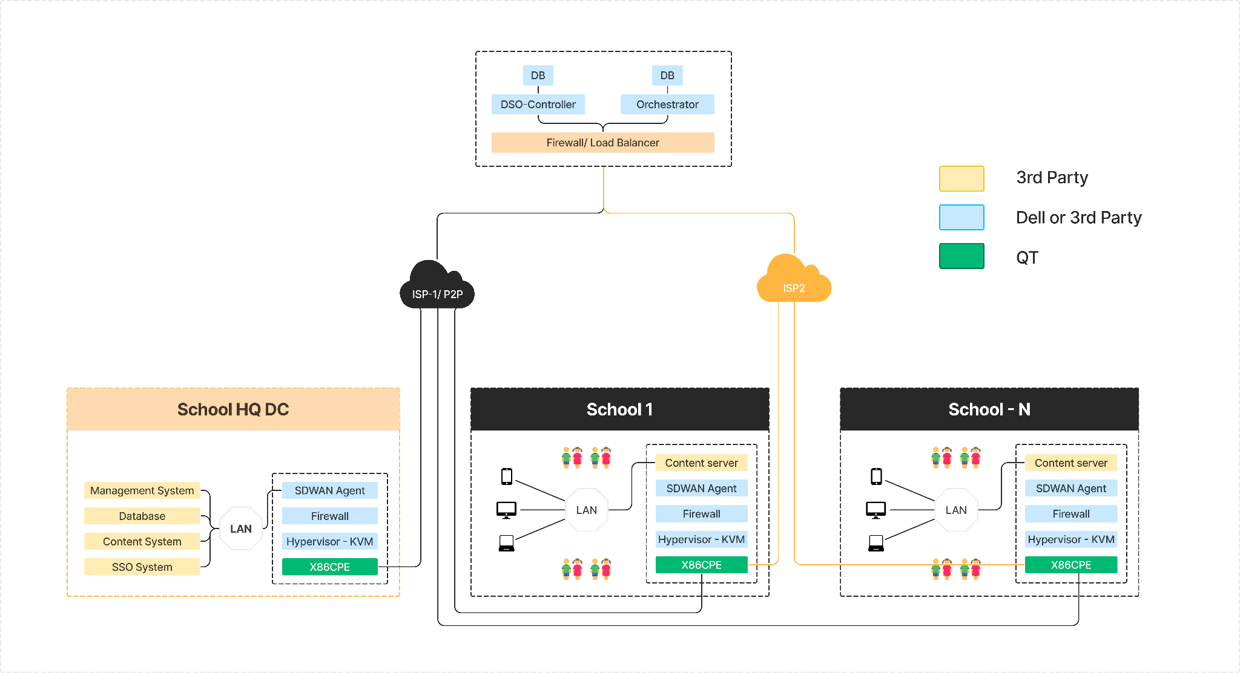
SD WAN ENABLED CONTENT DELIVERY ARCHITECTURE

Slide 11





Qwik Box
Architecture
Content Server is installed in school data centre or hosted in any of the clouds namely private or public cloud
Accelerate Digital Education
School datacentre and its associated/affiliated schools are connected using QT SDWAN Gateway Solution.
Reduce
Costs
Content Server VNF is a 3rd party product provided by the vendor of the school
Ensure Continuous Exams
Authorisation and Authentication of the Content Server Application is done in the central system

