Slide 1
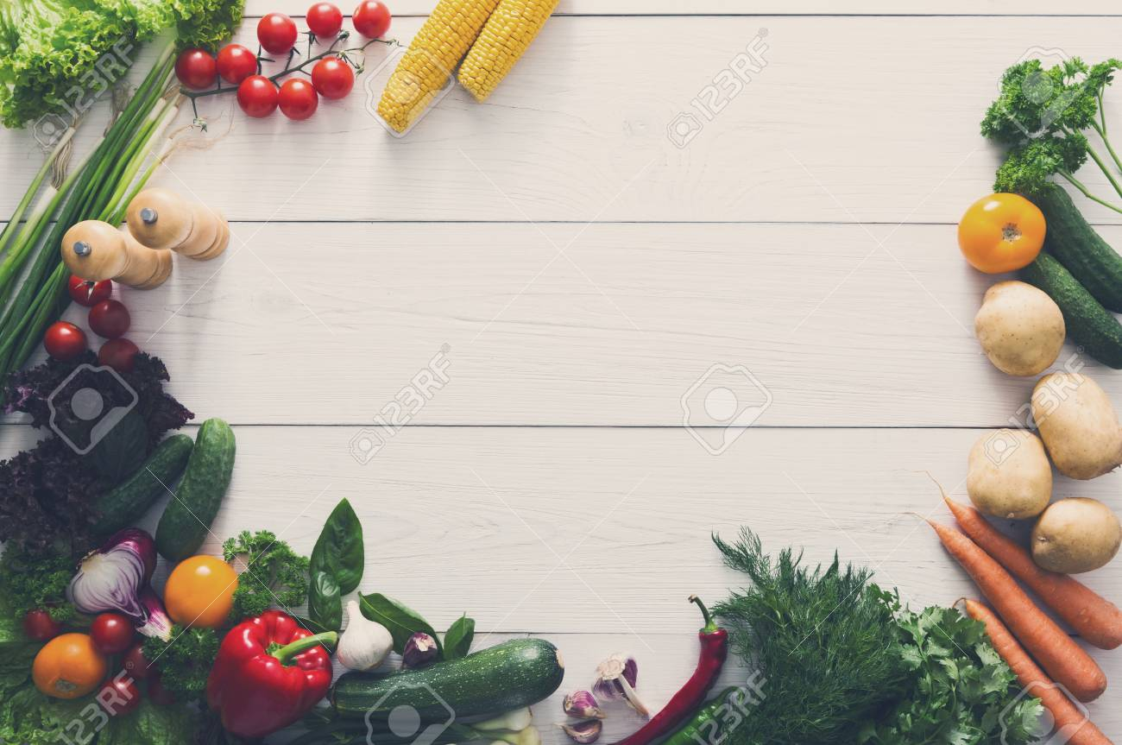
FoodYum
Wait less..Eat More!

Slide 2
Our Mentors
Mahesha Sir
Prof. Nitin
Ajitha Sir
Our Team
Kriti Garg Sahil Khullar
Nidhi Mittal Lokesh
Kartik Attri Sidharth
Kartik Grover

Slide 3
Outline
Topics covered
Journey So far
Idea into Product Design
Routing of pages
Deploying app on Heroku
Our Project(Introduction)
Need
Features
What is ready and what is not
Future

Slide 4
Topics we learned
OOAD(Object-Oriented Analysis and Design)
Html(Hypertext Markup Language)
CSS(Cascading Stylesheets)
Project Ideation
JavaScript
Jquery
NodeJS
MongoDB
ExpressJS
Angular (Yet to be covered)

Slide 5
Project Ideation
Projects decided by dot voting system.
1st screening with 20 projects
2nd screening with 10 projects
Finalised projects

Slide 6
Journey So far..
Started on 13th July
Introdutions on Web app, Data Structures and databases and MEAN Stack(Mongo,Express Angular, Node) .
Worked on “Pharmaceutical case study” for hands on exercise.
OOAD- Object Oriented Analytical Design helps us convert idea into product design.
Divided into different teams for each task to teach the importance of working in teams.
Number of TOOLS were introduced which were new and exciting to use! like asana,yuml,mlab etc.

Slide 7
Journey So far..
Five projects ideas were finalized and each team was given each idea.
“Asana” was introduced.
‘Asana’ helps all of the members to coordinate all the work a team does together. So everyone knows what needs to be get done, who’s responsible for doing it, and when it’s due.

Slide 8
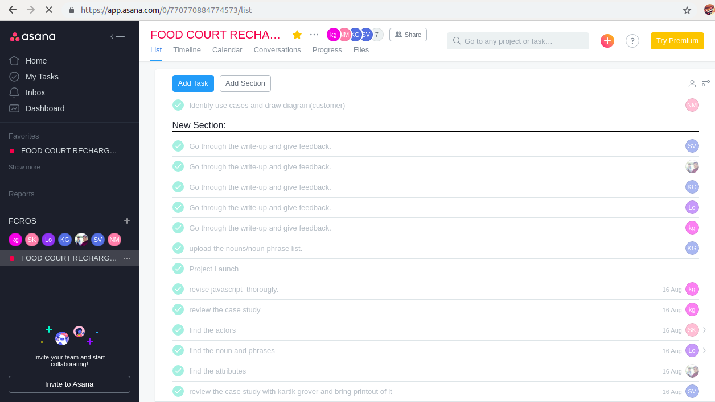
“Asana”: What it looks like?
List of tasks

Slide 9
“Idea” into “Project Design”
Firstly, project description was jotted down, which identified the idea, goals, background, approach, outcomes and other data in a correct and comprehensive manner.
As part of OOAD, we identified following from our project description:
Noun, Noun Phrases , Actors, Use Cases, Classes, Attributes

Slide 10
“Idea” into “Project Design”
Finally, a “Class Diagram” was rendered which is ‘ a static structure diagram that describes structure of system by showing system’s classes and operations and relationships among them’.
“UML” tool was introduced to make class diagrams and use cases diagrams neatly and systematically.

Slide 11
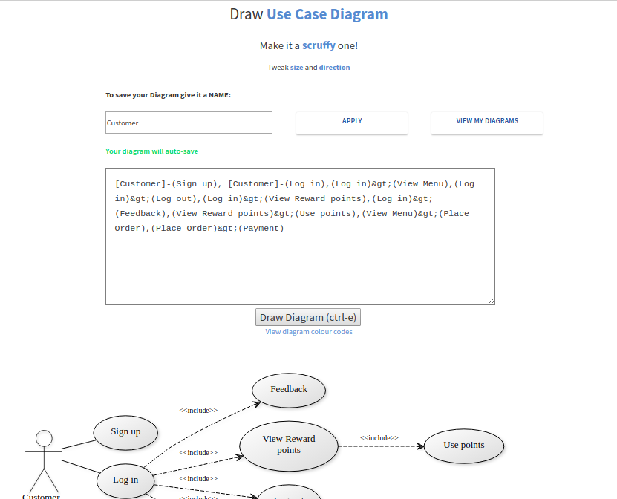
YUML
Draw UML diagrams programatically

Slide 12
Once the Project Document was ready , the next step was to design raw templates(html) for the various pages of the web application.
Added Cascading Stylesheets to style the pages externally.
For backend (server side coding),ubuntu 16.04 LTS was the main O.S ,node,npm,express and mongo were installed for all around support of mean stack.
Url’s were linked/routed accordingly.

Slide 13
Routing of html pages
Linking was done with help of express through nodejs and assigned urls.
ExpressJS is a prebuilt NodeJS framework that helps in creating server-side web applications faster and smarter. Simplicity, minimalism, flexibility, scalability are some of its characteristics and since it is made in NodeJS itself, it inherits its performance as well.
Created routes,controlles,views and models of our project.

Slide 14
Deploying app on Heroku
“Heroku” is a cloud platform that lets us build, deliver, monitor and scale apps, that is the fastest way to go from idea to URL, bypassing all those infrastructure headaches.
We installed GIT and Heroku CLI.. and with few commands ..we deployed our app on heroku.. Our web app is now live!

Slide 15
Creating Database
Mlab
What is mlab?
It is a fully managed cloud database service that hosts MongoDB databases. mLab runs on cloud providers Amazon, Google, and Microsoft Azure, and has partnered with platform-as-a-service providers.

Slide 16
OUR PROJECT Introduction
Foodyum will enable the students to get their order placed easily with this system
and they just have to collect the order thereby by showing their online order receipt.
In this way, we can avoid longer, in fact never ending queues for order and recharge
and hence can save ample time as food is fuel to the body.

Slide 17
Need
In the universities, FoodCourt is the main eating hub. Students just rush to the zone to have a byte and cool down their appetite. But they have to go through a long process and wait in a queue to ease their hunger pangs. During peak hours,the student crowd is so huge that it becomes very difficult to get an order placed and have that food in the limited break time.

Slide 18
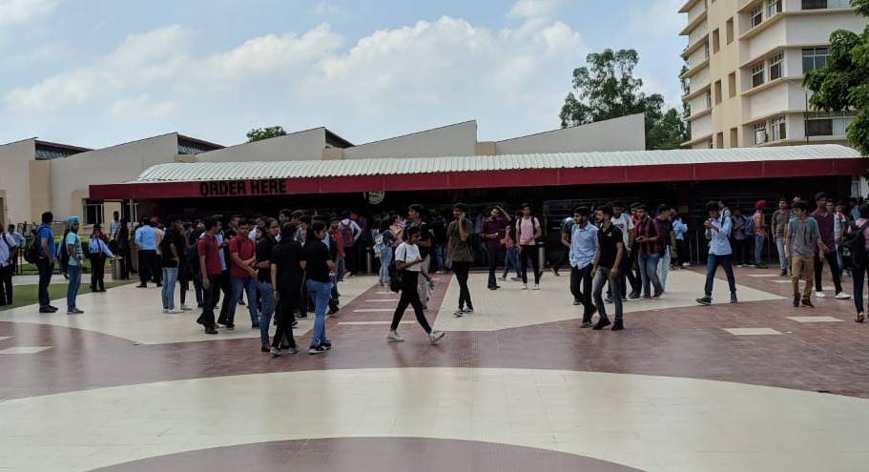
Heavy rush in front of FoodCourt

Slide 19
Why FoodYum?
1. It’s just one click away.
2. It’s fast, easy and comfortable.
3. Give your VALUABLE FEEDBACK to help improving both food and system.
4. No misunderstandings and no frustrations.
5. Online food ordering is opened 24/7.

Slide 20
FoodYum will not only benefit customers but also Square one management team.
As, an online menu is simpler to manage.
Online systems guarantees more customers as people spend more time scrolling through menu.
There will be no mistakes in orders as whole system is automated.

Slide 21
Features
14 urls and 14 ejs templates.
Each franchise’s menu listed on different page.
Have food without cash in hand.
Easy payment through PAYTM.
Allows you to give feedback about food and system.
No need of cards. Thus, Eco-friendly.

Slide 22
What is ready?
Frontend √
Login/Signup √
Menu database √
Schemas √
Manager backend √

Slide 23
What's more needs to be done?
Our plan for next week
Finishing Menus.
PayTM integration
Message integration
Debugging

Slide 24
How much time?
We tried to implement all the basic structure of our web app till now.
The project is on the verge of completion..
Due to bulkiness of the project, we still need 1-2 weeks for fully completion as we are still learning.

Slide 25
Future...Possibilities and Scope
Foodyum will surely reduce wastage of time and the rush in front of the food court.
FoodYum will also ensure great increase in customers:
Thus, Customers will get Exciting deals!
Rewards points- Each customer can earn reward points based on the number of orders placed and thus get great deals!
Lightening Deals- Despite an accurate order taking process - an order often goes wrong, this order could be offered as a lightening deal and offered huge discounts.

Slide 26
Thankyou!
Any Questions?

