Slide 1
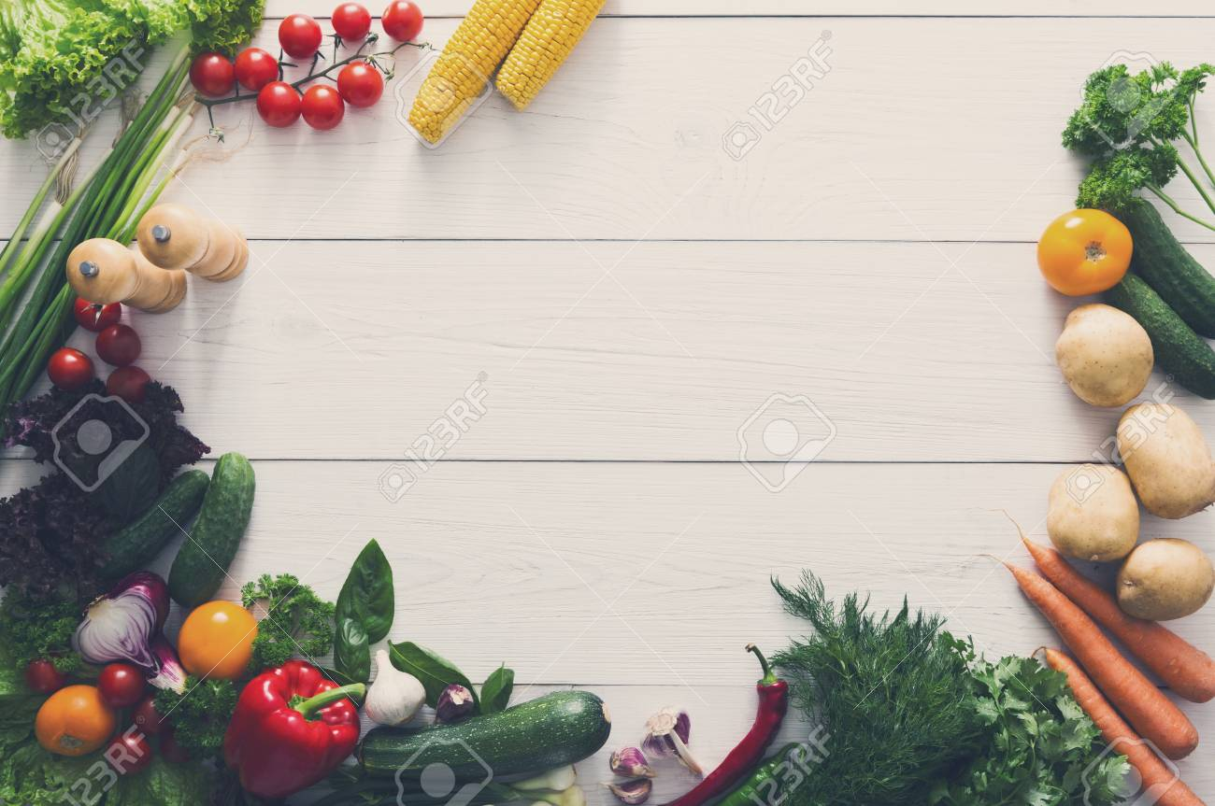
FoodYum
Wait less..Eat More!

Slide 2
Current Problems
Needless Crowding
Waste of precious time
Excessive Staffing
Excessive Infrastructure

Slide 3
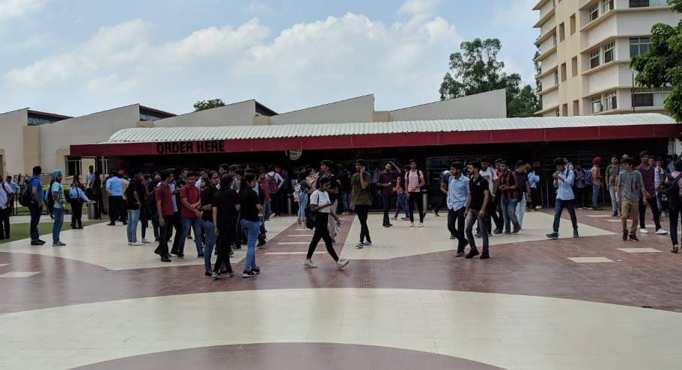
Heavy rush in front of FoodCourt

Slide 4
OBJECTIVES
Avoid long queues in front of food court
Save time of both students and teachers.
No misunderstandings and frustrations.
Give FEEDBACK about food and system.
No need of cards or paper slips.
Easy payment through PAYTM.
Update menu easily with just few clicks.
Promotes DIGITAL INDIA.

Slide 5
Now Let's dive into the world of FOODYUM..
URL: https://food-yum.herokuapp.com/

Slide 6
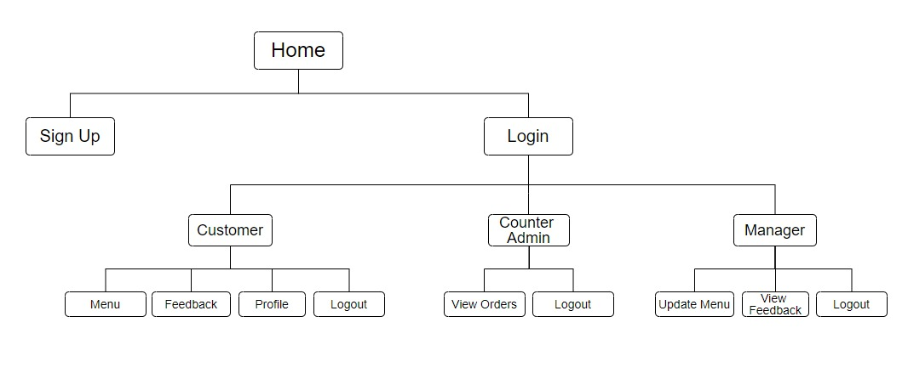
Block Diagram

Slide 7
Road ahead..
FoodYum will ensure great increase in customers:
Thus, Customers can get Exciting deals!
Rewards points- Each customer can earn reward points based on the number of orders placed and thus get great deals!
Lightening Deals- Despite an accurate order taking process - an order often goes wrong, this order could be offered as a lightening deal and offered huge discounts.

Slide 8
Thankyou!
Any Questions?

