Slide 1
🕉
ItihasaVerse
CHOOSE YOUR DHARMA
An Interactive Indian Mythology Decision Engine
Bridging Ancient Wisdom with Modern Web Technology

Slide 2
SLIDE 2 — PROBLEM STATEMENT
What Problem Are We Solving?
📚
Lost Connection to Heritage
1B+
Students and young adults have little to no meaningful exposure to Indian epics like Ramayana beyond passive listening.
Indians with little active
knowledge of epics
🎮
Passive Learning is Ineffective
0
Reading or watching stories does not develop ethical reasoning. People consume mythology without applying its wisdom to real decisions.
Ethical simulation tools
based on IKS
⚖️
Ethical Reasoning Gap
5 min
There is no interactive platform that teaches Dharma — the core of Indian philosophy — through lived, simulated decision-making.
Average engagement with
traditional mythology content

Slide 3
SLIDE 3 — IKS CONNECTION
Indian Knowledge Systems at the Core
Ramayana
Itihas
DHARMA
धर्म
Niti Shastra
Ethics
Karma &
Choices
Purusharthas
4 Goals
ItihasaVerse applies Dharma as an interactive scoring system — every decision earns or loses Dharma points, teaching the Ramayana's ethical framework through lived experience.

Slide 4
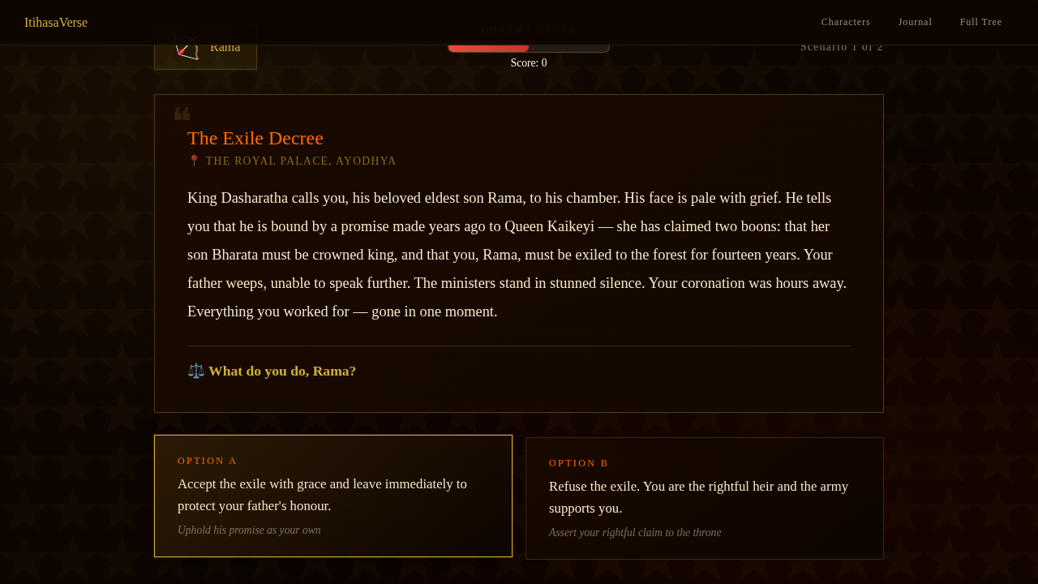
SLIDE 4 — TECHNICAL EXPLANATION
System Architecture & Technologies
🌐
Frontend
Pure HTML5 + CSS3 + Vanilla JS — no framework, zero dependencies
🧠
Game Logic
State machine with 5 characters × 2 scenarios = 10 unique decision trees
📊
Dharma Meter
Dynamic scoring system: +/− points per choice, live bar visualisation
📸 Story Screen – Live Scenario
💾
Persistence
localStorage API — journal entries and history survive across sessions

Slide 5
SLIDE 5 — PROPOSED SOLUTION & MODEL
The ItihasaVerse Model
🎭
📜
⚖️
✨
🕉
📝
›
›
›
›
›
Choose
Character
Read
Scenario
Make
Decision
See
Outcome
Earn
Dharma
Reflect
Journal
5 playable characters
Reflection journal
Rama, Sita, Ravana, Bharata, Vibhishana
Write, edit, delete personal learnings
10 moral dilemmas
Global Decision Tree
Each with 2 choices, Dharma scoring & outcomes
Visual history across all characters played
Alternate history
See what happens if you chose the other path
ItihasaVerse | Indian Knowledge Systems | 2024–25

Slide 6
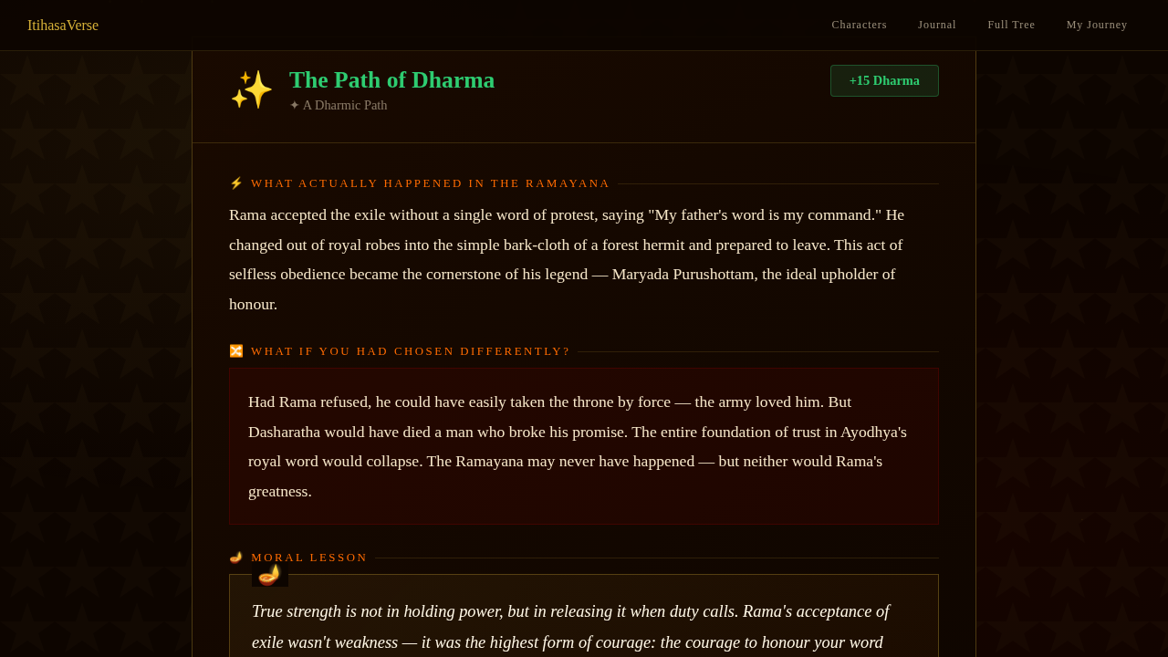
SLIDE 6 — APPLICATION
Real-World Applications
🎓 Education
IKS curriculum tool for schools and colleges — makes ethics tangible through story-based role-play
🏛️ Government
Cultural heritage platforms (IGNCA, NCERT) to promote Ramayana literacy interactively
🧘 Wellness
Self-reflection therapy tool — decision journaling mirrors mindfulness journaling practices
📸 Outcome Screen – Dharma Feedback
🎮 Gaming
Foundation for a full narrative game on Indian epics — Mahabharata, Upanishads expansion possible

Slide 7
SLIDE 7 — OUTCOME & IMPACT
Benefits & Innovation
10
5
∞
100%
Moral
Dilemmas
Playable
Characters
Reflection
Entries
Browser-based
Zero Install
✦ Benefits
✦ Innovation
Makes Indian values personally relatable — not just historical
Teaches consequence-based thinking through simulation
Encourages empathy by letting users inhabit both "hero" and "villain"
First known interactive Dharma scoring engine built on Ramayana
Decision tree visualisation is novel in IKS education tools
Editable reflection journal bridges ancient wisdom and modern journaling

Slide 8
SLIDE 8 — CONCLUSION
Key Takeaway
"ItihasaVerse transforms the Ramayana from a scripture to be read
into a living experience to be lived — where every choice is a lesson
in Dharma, and every player becomes a student of Indian wisdom."
🏹
⚖️
🌿
📖
Ancient wisdom made interactive
Dharma scoring teaches ethics
Decision trees show consequences
Journal enables self-reflection
॥ धर्मो रक्षति रक्षितः ॥
"Dharma, when protected, protects in return."
Thank You

