Slide 1
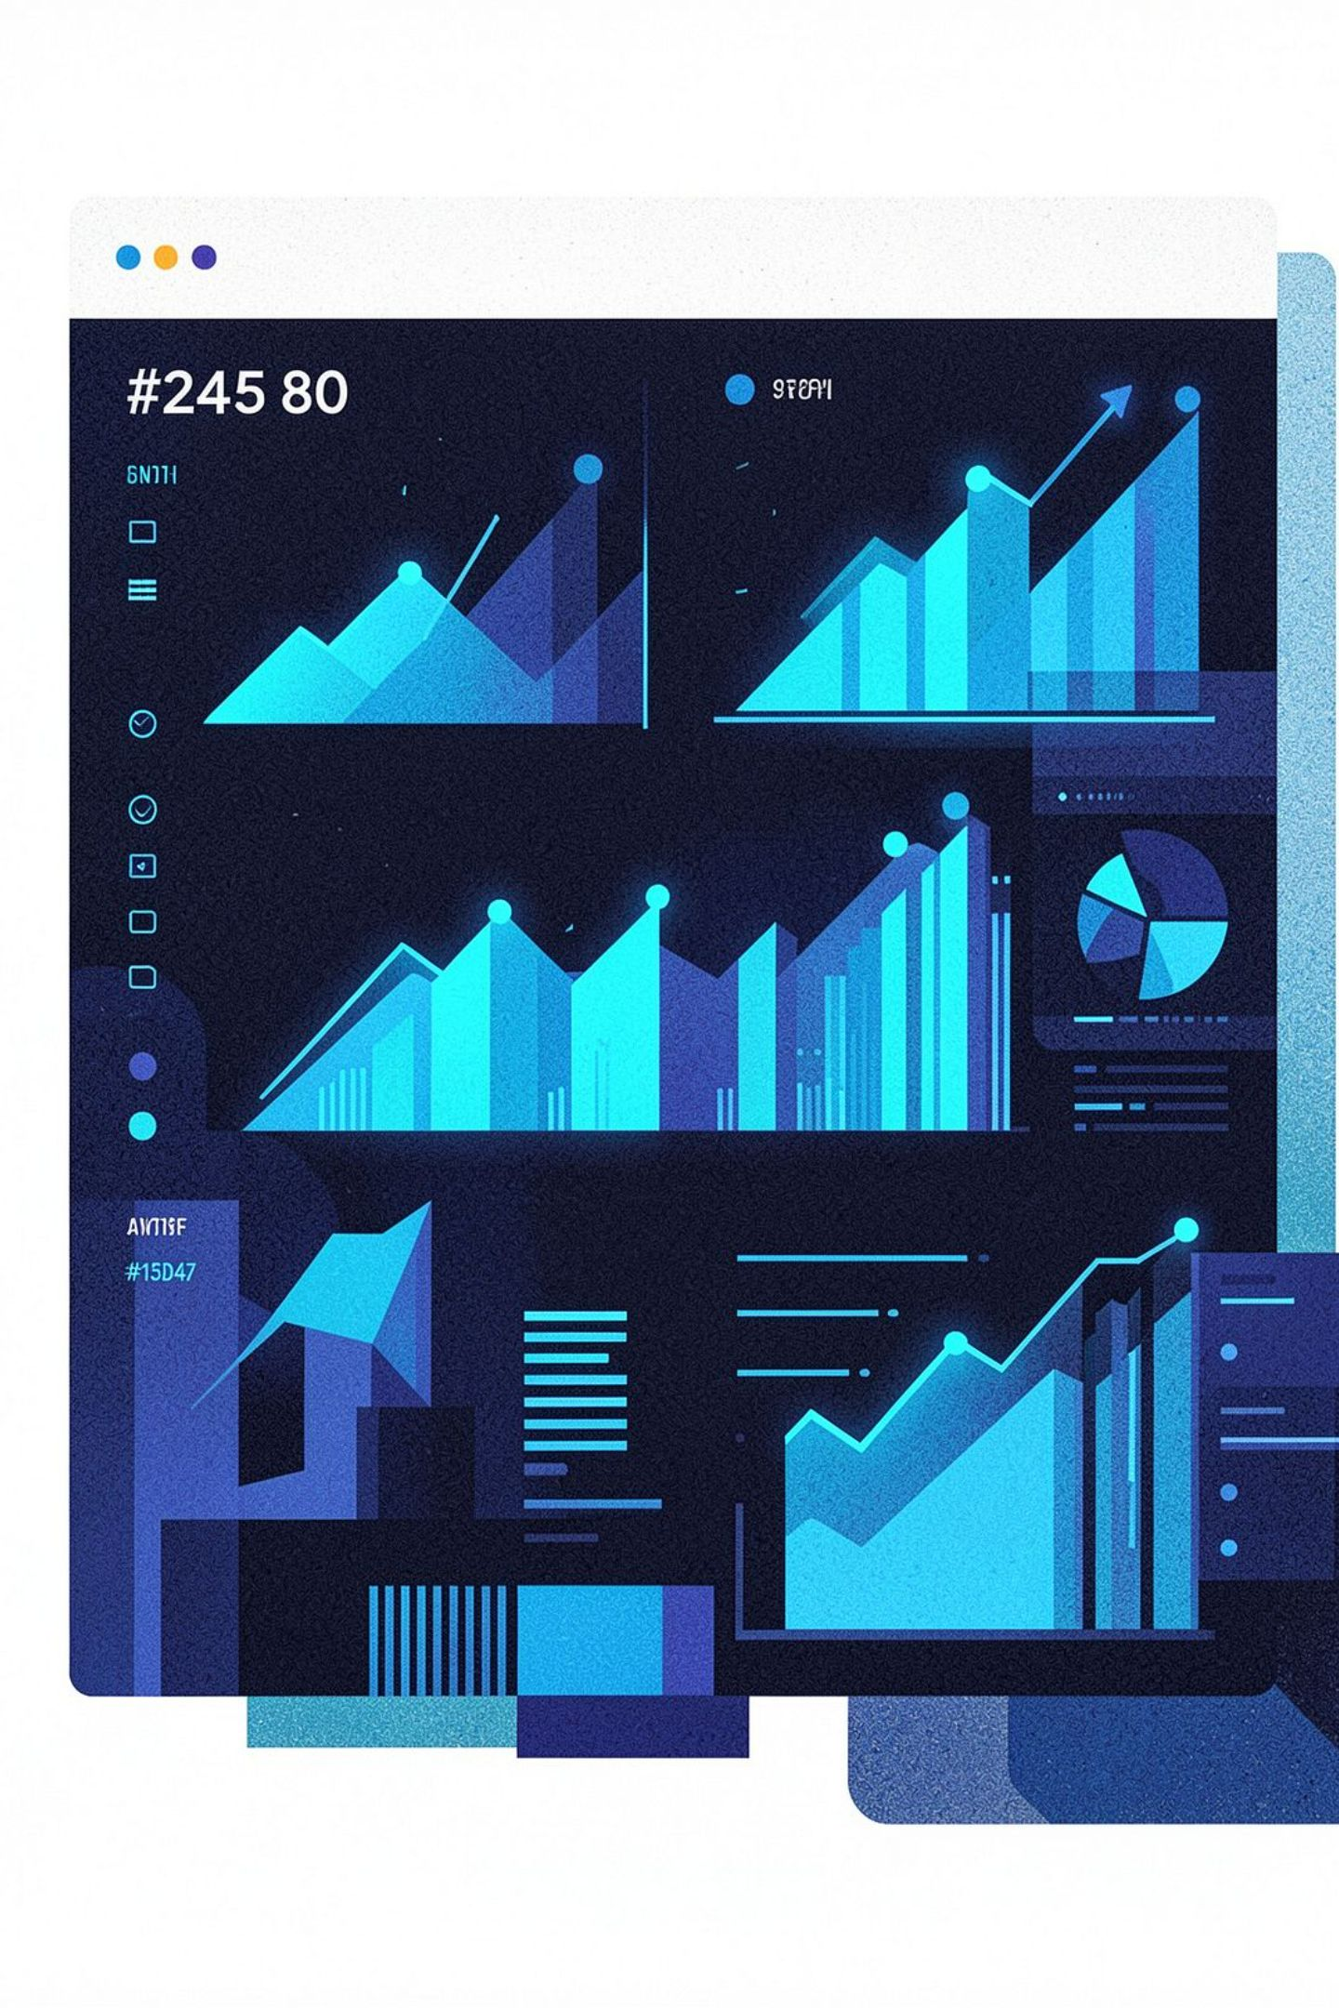
NPS & Feedback Analytics
Understanding customer loyalty through data — from score to insight.

Slide 2

What is NPS?
NPS = Net Promoter Score — a single, powerful metric that measures customer loyalty by asking one essential question:
Customer Groups
Promoters
Score 9–10
"How likely are you to recommend our product/service?"
Score ranges from 0 to 10
Passives
Score 7–8
Detractors
Score 0–6

Slide 3
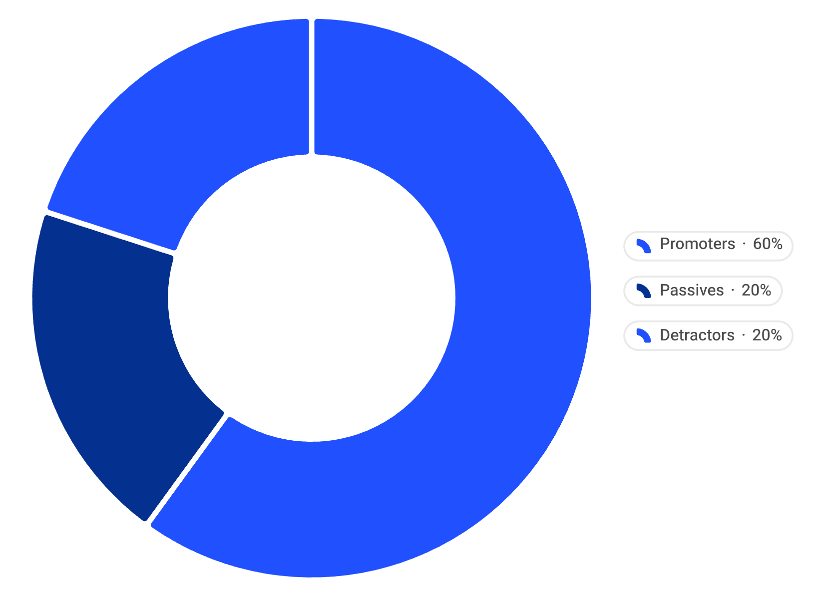

NPS Calculation
Formula
NPS = % Promoters − % Detractors
Example Breakdown
Promoters
Passives
60%
20%
Detractors
20%
Positive NPS
Negative NPS
More happy customers than unhappy ones
More unhappy customers — action required
60 − 20 = NPS of 40

Slide 4


Text Feedback Analysis
Collect Comments
Clean Text
Identify Sentiment
Extract Insights
Cleaning Steps
Real Examples
Remove unnecessary words
Convert to lowercase
Remove punctuation
✅ Positive
❌ Negative
"Fast delivery and excellent service"
"Poor quality and late delivery"

Slide 5

Finding Key Drivers
Promoter Drivers
Detractor Drivers
Good product quality
Fast delivery
Helpful customer service
Easy-to-use application
Reasonable price
Late delivery
Poor product quality
High price
Technical problems
Slow customer support

Slide 6






Basic Analytics Using Python
Simple Process
Python Tools
Customer Data
NPS Score
Pandas
Load and manage records with Pandas.
Calculate satisfaction metrics from surveys.
Manage customer data
NLTK
Text preprocessing
Matplotlib
Create charts
Word Frequency
Find common words
Text Cleaning
Word Analysis
Preprocess comments using NLTK techniques.
Compute frequencies and sentiment indicators.
Most common positive word → "quality" · Most common negative word → "delivery"

Slide 7





Benefits & Conclusion
Understand Opinions
Know exactly how customers feel about your brand
Identify Satisfaction
Pinpoint the reasons customers love your product
Find Complaints
Uncover the root causes of dissatisfaction
Improve & Grow
Enhance products, services, and customer loyalty
NPS shows how customers feel. Text analysis explains why they feel that way. Combining both gives better customer insights.

