Slide 1

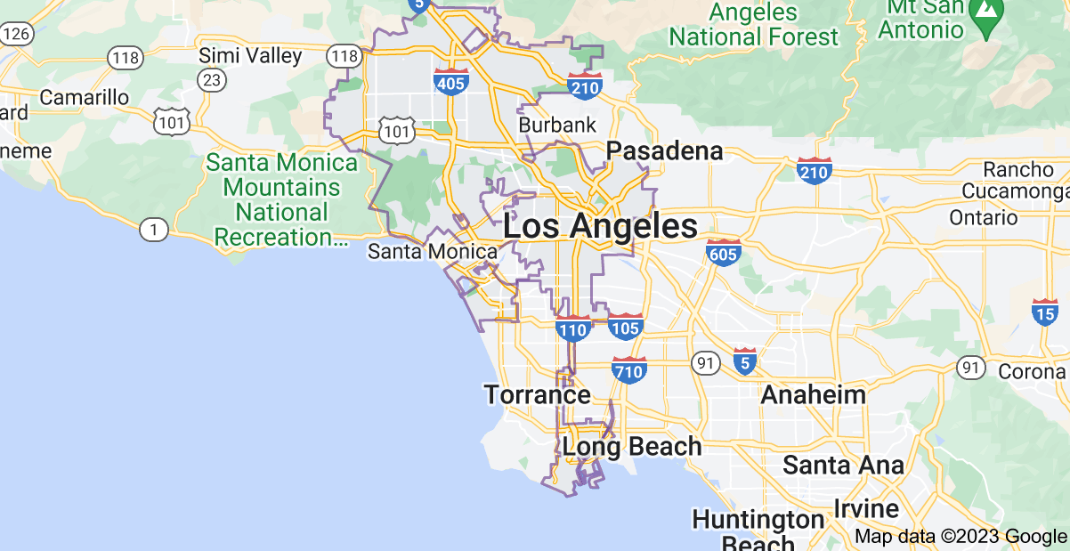
Report a Crime
Search…
Login
Signup
Why You Should Live in LA

Slide 2
Report a crime
Date:
Time:
Location:
…
mm/dd/yy
hh:mm:ss
lon, lat

Slide 3
Edit a crime
Date:
Time:
Location:
…
mm/dd/yy
hh:mm:ss
lon, lat

Slide 4
REmove a crime
Date:
Time:
Location:
…
mm/dd/yy
hh:mm:ss
lon, lat

