Slide 1
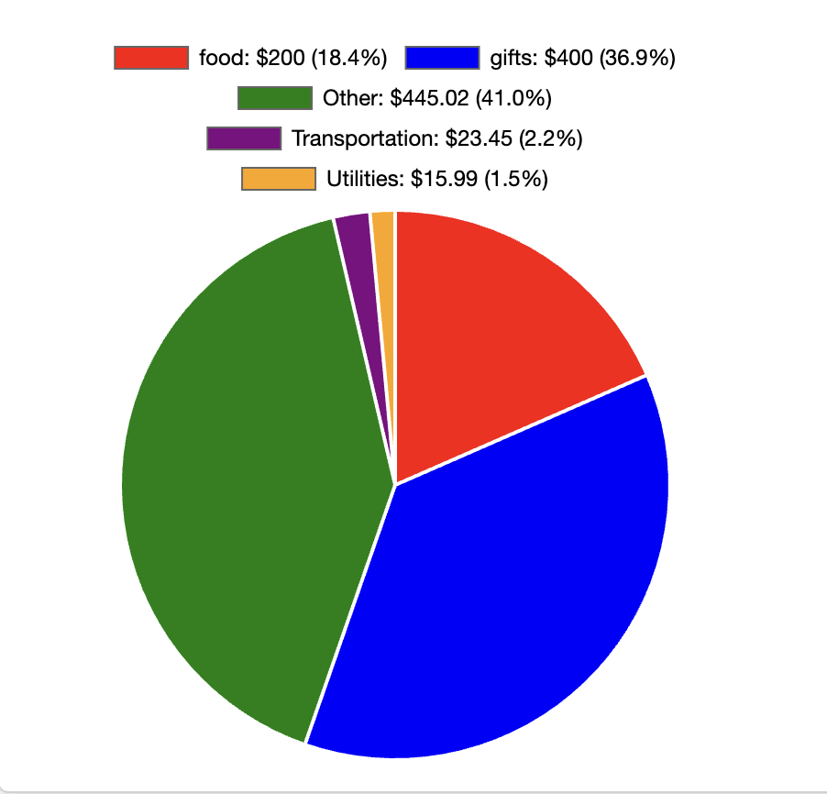


FinTrack
Track Finances Like You're Chatting!
By Nidhi

Slide 2

What is FinTrack?
Project Overview
FinTrack is a web application that enables expense tracking through:
Natural language input ("had $50 dinner" → automatically categorized)
AI-powered insights and expense categorization
Intuitive visualization of spending patterns
Problem Solved: Traditional finance apps require tedious form-filling and manual categorization, leading to user abandonment.

Slide 3
What is FinTrack?
FinTrack is a web app for individuals and small businesses to track income, expenses, and budgets. It uniquely allows users to input transactions in natural language (e.g., "had $50 dinner"), leveraging Google Gemini for seamless processing. Features include interactive financial insights, expense categorization, and real-time visualizations. The application includes features for user management, expense categorization, and real-time insights.

Slide 4
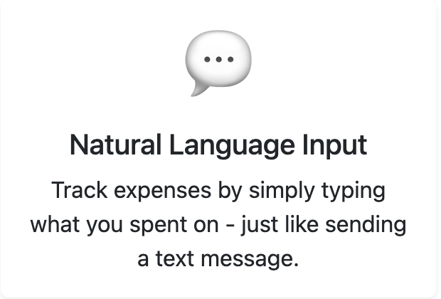




Novelty- The Talking Point
Natural language
Smart Insights
Automatic Categorization
The key novelty of FinTrack lies in its ability to input data in natural language (text)
View trends and get smart personalized suggestions to save
It will automatically categorize your spending

Slide 5


Utility and Target Users
Individuals
Small Businesses
To manage finances
To keep track of cash flow
It provides a platform to gain real-time insights into their financial habits through interactive charts and visualizations
By tracking income, expenses, and budgets, users can make informed financial decisions

Slide 6

Key Features
Natural Language Input
Interactive Dashboard
AI-Driven Insights
Categorization of Expenses
Bulk Upload

Slide 7
Tech Stack
Front-end
Backend
Bootstrap 5
EJS templating
Node.js
Express.js
Database
AI Integration
MongoDB (NoSQL)
Google’s Gemini API for
Natural language processing
Expense categorization
Personalized insights
CSV data processing

Slide 8


Development Challenges
Technical Challenges:
User Experience Challenges:
-AI Response Consistency -Database Structure
-Balancing simplicity with functionality -Providing meaningful insights from limited data

Slide 9
Key Learnings
Design from Customer's point of view (UI and functionality both)
Effective AI integration requires careful prompt design
Designing pages through HTML using CSS is not easy.
Balance required choosing between backend and frontend frameworks. For simplicity, I did not use frontend frameworks like Angular or react.

Slide 10

Thank You

