Slide 1
REFUND PROCESS
AUTOMATION OPPORTUNITY
Inefficiency Analysis & Top 3 Optimizations for OEPA CEG Agoda
Prepared by: Nidhi Pawar | May 2026
Notes:
Good morning everyone. I'm going to walk you through a 10-minute analysis of our refund process — specifically, where it's losing us time and customer satisfaction, and the three changes that will fix the majority of it. I want to be direct: this is not a problem statement presentation. It's a decision presentation. By the end I'll ask for your approval on one specific action.

Slide 2
5,000 Cases Analyzed: 12 Inefficiencies Found, 3 Critical Actions Required
5,000
12
$771K
763
Total Cases Analyzed
Inefficiencies Identified
Booking Value at Risk
NR Exception Approvals (24%)
KEY FINDINGS
TOP 3 OPTIMIZATIONS
• 100% of refundable cases auto-approved — zero denied → automation-ready
1. Auto-Approve Refundable Bookings
• Email channel: 9x slower FCRT vs Chat (90 min vs 10 min), lowest CSAT (2.81)
Eliminate manual touch on 1,762 cases/yr → save ~43K agent-min
• 403 cases (8.1%) exceed 120-min FCRT — ALL are email + non-refundable
2. Migrate Email NR → Chat/Messaging
• NR exception approvals lack rules — 763 cases decided manually, costing $122K margin
Cut FCRT from 119 min to ~15 min for 838 cases → reduce SLA breaches 100%
3. Rule-Based NR Exception Engine
Automate 495 compassionate approvals → consistent decisions, $122K margin control
📎 Evidence: Refund_Process_Evidence.xlsx
Notes:
Here is the full picture in one slide so you can see where I'm going. I looked at 5,000 refund cases. I found 12 process gaps. But only three of them are worth acting on right now.
The most striking number is this: $771,000 in booking value is being processed through a non-refundable exception path that has no rules, no governance, and no audit trail. Every one of those 763 approvals is an agent making a judgment call with no framework.
The three optimizations I'll recommend today would collectively save around 167,000 agent-minutes per year — that's equivalent to roughly one full-time agent freed from manual work — while eliminating every single SLA breach we currently have.

Slide 3
Refund Process: Two Distinct Paths with Vastly Different Outcomes
REFUNDABLE PATH (35.2% of volume)
NON-REFUNDABLE PATH (64.8% of volume)
1,762 requests
100% approved
Avg FCRT: 24.7 min
CSAT: 4.22
3,238 requests
76.4% denied
Avg FCRT: 72.7 min
CSAT: 2.41
→ Straightforward, rule-based: 100% approval, no exceptions, fast resolution
→ Complex path: 23.6% exception approvals, high manual effort, long FCRT
CHANNEL PERFORMANCE COMPARISON
Channel
Volume
Avg FCRT
Avg AHT
CSAT
FCRT>120
Chat
1,229
10.1 min
0.3 min
3.27
0
Voice
1,244
60.7 min
18.1 min
3.26
0
Messaging
1,228
60.3 min
15.9 min
2.85
0
Email
1,299
90.2 min
13.9 min
2.81
403
Notes:
There are actually two completely different refund journeys happening inside the same process. The left side — refundable bookings — is simple. Every case is approved, customers are happy at 4.22 out of 5, and cases close in about 25 minutes. The right side — non-refundable — is the problem. Three-quarters are denied, CSAT drops to 2.41, and average resolution takes 73 minutes.
The channel table at the bottom tells the second half of the story. Chat resolves a case in 10 minutes. Email takes 90 minutes — nine times longer. And critically, every single SLA breach we have — all 403 of them — are email cases. Zero SLA breaches on chat, voice, or messaging.

Slide 4
HIGH CRITICALITY: 4 Inefficiencies Driving Majority of Process Waste
H1: No Auto-Approval for Refundable Bookings
1,762 refundable cases have 100% approval rate yet require manual agent processing
Volume: 1,762 (35.2%) | Wasted FCRT: ~43,500 agent-min/yr | CSAT gap: could be 5.0 vs 4.22
H2: Email Channel — 9x Slower, Lowest CSAT
Email NR avg FCRT = 119 min (vs Chat 10 min). 403 cases exceed 120 min SLA — ALL email+NR
Volume: 1,299 (26%) | FCRT: 90.2 min avg | 403 SLA breaches | CSAT: 2.81 (lowest)
H3: Unstructured NR Exception Handling
763 non-refundable cases approved without rule engine — inconsistent, slow, margin leakage
Volume: 763 (23.6% of NR) | Margin at risk: $122K | Avg FCRT: 74.2 min | No audit trail
H4: Massive CSAT Gap Between Outcomes
Denied customers score 2.23 CSAT vs 3.84 approved — 1.61 point gap signals poor denial UX
Denied: 2,475 cases | CSAT: 2.23 | No self-service denial path | High repeat contact risk
Notes:
There are four high-criticality problems and I want to call out two specifically.
H1: We have 1,762 refundable cases that are manually reviewed by an agent. Every single one is approved. Every. Single. One. That's 35% of our total volume consuming 43,500 agent-minutes per year to rubber-stamp something the system already knows the answer to.
H3: We have 763 non-refundable exceptions approved with no rule engine. That's $122,000 in margin governed by individual agent judgment. Some agents approve family emergencies 75% of the time. Others approve the same reason 50% of the time. There is no consistency, and there is no audit trail.
H4 is why this matters to the customer: denied cases score 2.23 out of 5. Approved cases score 3.84. That's a 1.6-point gap. Customers who hit the refund process and get denied are among our most dissatisfied. That's a churn risk.

Slide 5
MEDIUM CRITICALITY: 4 Inefficiencies with Measurable but Contained Impact
M1: Compassionate Reasons Dominate NR Overrides
Top 5 NR approval reasons (Family/Medical/Illness/Weather/Hotel) = 575 of 763 cases (74.5%)
Pattern is clear & rule-automatable | Avg FCRT: 72 min | Total margin: $92K
M2: Voice Channel — High AHT, Moderate FCRT
Voice AHT = 18.1 min (highest) vs Chat 0.3 min; FCRT = 60.7 min, CSAT = 3.26
Volume: 1,244 cases | Agent cost ~22,500 min/yr on voice | Partial deflection possible
M3: Messaging Channel — Mid FCRT, Low CSAT
Messaging FCRT = 60.3 min with CSAT 2.85 — async delays hurt satisfaction
Volume: 1,228 | CSAT 15% below chat | Response time SLA likely breached
M4: No FCRT Improvement Over 12 Months
Monthly FCRT ranged 53–61 min with no downward trend — process is stagnant
Jan: 54.7 → Dec: 57.5 min | No process interventions visible | CSAT flat at 3.05
Notes:
The medium criticality issues are worth acknowledging briefly. M4 is perhaps the most revealing: our FCRT has ranged between 53 and 61 minutes over the entire 12-month dataset with no downward trend. The process is stable — but it is stably broken. Nothing we're currently doing is improving it. That is the baseline we're trying to move.

Slide 6
LOW CRITICALITY: 4 Minor Inefficiencies — Monitor, Don't Prioritize Now
L1: No Loyalty Differentiation in SLA
Platinum FCRT = 56.4 min vs Bronze = 53.8 min — nearly identical. No tiered service.
Gap: <3 min | CSAT variance: 0.08 pts | Low business case for differentiation
L2: Uniform Performance Across Regions
APAC/AMER/EMEA FCRT within 3-min range (54.7–57.7). No region-specific bottleneck.
Max gap: 3 min | CSAT: 3.01–3.07 | NR approval: 23.2–24.0% — uniform
L3: No Shift-Based Performance Variance
Morning/Afternoon/Night shifts show <1 min FCRT difference — staffing is balanced.
FCRT range: 55.5–56.3 min | CSAT: 3.03–3.06 | Approval: 50.1–51.0%
L4: Duplicate Booking — Lowest Approval Rate
Duplicate bookings: 34% approval rate (lowest of all reasons), mostly denied on NR policy.
Volume: 261 | Approval: 89/172 | Could auto-deny NR duplicates to save agent time
Notes:
For completeness: our regions, shifts, and loyalty tiers all perform within a 3-minute FCRT range of each other. These are not process bottlenecks. I'm flagging them so you know we looked — and so I can come back to loyalty in a moment with a different angle.

Slide 7
Top 3 Optimizations: #1 Auto-Approve Refundable & #2 Email Channel Migration
OPT #1: AUTO-APPROVE ALL REFUNDABLE BOOKINGS
OPT #2: MIGRATE EMAIL NR → CHAT/MESSAGING
Problem:
1,762 refundable cases processed manually despite 100% approval rate
Problem:
838 email NR cases have 119-min FCRT; ALL 403 SLA breaches are email+NR
Solution:
Implement auto-approval rule: IF policy=refundable THEN approve + process refund
Solution:
Route NR email requests to chat/messaging with decision-tree bot + agent escalation
Time Saved:
~43,500 agent-minutes/year (1,762 × 24.7 min avg FCRT eliminated)
Time Saved:
~87K min/yr FCRT reduction (838 × 104 min avg savings per case)
CSAT Impact:
Instant resolution → CSAT expected to rise from 4.22 to ~4.8+
CSAT Impact:
CSAT improvement from 2.30 → est. 3.0+ (chat-level for NR segment)
Cost Reduction:
~$36K/yr agent cost savings (at $50/hr fully loaded)
SLA Impact:
Eliminate 100% of 120-min+ SLA breaches (403 → 0 cases)
Why Top 3:
Highest ROI — zero-risk, zero-exception, immediate deploy, no judgment needed
Why Top 3:
Addresses #1 SLA bottleneck — email is 9x slower, all breaches originate here
Notes:
The first optimization is the simplest thing we could possibly do: a single rule. If the cancellation policy is refundable, approve and process. No agent needed. This eliminates 43,500 agent-minutes per year on day one. No new technology, no training, no risk. Current CSAT for these cases is 4.22 — instant resolution will push that above 4.8. Estimated agent cost savings are around $36,000 annually at standard fully-loaded rates.
Optimization two is the structural fix for email. Our 838 email non-refundable cases take 119 minutes on average to resolve. The benchmark from our own chat channel is 10 minutes. Migrating these to a chat-based decision-tree bot saves approximately 87,000 agent-minutes per year and eliminates all 403 SLA breaches — 100% of them. Every breach we have today is an email non-refundable case. Fix the channel, fix the SLA.

Slide 8
Top 3 Optimizations: #3 Rule-Based NR Exception Engine
OPT #3: IMPLEMENT RULE-BASED NON-REFUNDABLE EXCEPTION ENGINE
Problem:
763 NR exceptions approved manually — no rules, inconsistent, slow (74 min FCRT), $122K margin at risk
Solution:
Build decision engine: Auto-approve for top-5 compassionate reasons (Family/Medical/Illness/Weather/Hotel) with doc verification
Scope:
575 of 763 cases (75.4%) follow clear compassionate patterns → automate these; escalate remaining 268 edge cases
Time Saved:
~36,700 min/yr for auto-approved cases (495 × 74.2 min) + faster escalation for rest
Margin Control:
$92K margin gets governed by rules vs. ad-hoc judgment — audit trail + consistency
Why Top 3:
Solves largest unstructured decision block — 15% of all cases lack governance; combines cost + risk + CX improvement
PROPOSED AUTO-APPROVAL RULES FOR NR EXCEPTIONS
Reason Category
Auto-Approve?
Condition
Cases/yr
Margin $
Family Emergency
YES
Verified documentation
129
$20,282
Medical Emergency
YES
Medical cert required
120
$19,647
Illness
YES
Medical cert required
115
$18,375
Weather Cancellation
YES
Weather advisory cross-ref
108
$16,328
Hotel Closed
YES
Supplier confirmation
103
$18,080
All Other NR Reasons
ESCALATE
Agent review required
268
$29,356
Notes:
The third optimization is the most complex but also the most strategically important. Of the 763 non-refundable exception approvals we process manually, 575 of them — about 75% — follow completely predictable patterns. Medical emergencies, family emergencies, illness, weather cancellations, and hotel closures. These five reasons account for the vast majority of our exception approvals.
The solution is a decision engine: if a customer provides a verified document that matches one of these five categories, the system approves automatically. No agent, 15-minute resolution instead of 74. The remaining 268 edge cases go to an agent with full context pre-loaded.
The table here shows exactly what documents each rule requires. Family and medical cases need certificates. Weather is cross-referenced against government advisories. Hotel closures require supplier confirmation. This is not guesswork — it is codifying what good agents are already doing, but consistently, every time.

Slide 9
Impact vs Effort: Why These 3 — and Why Not the Others
IMPACT vs EFFORT MATRIX
SELECTION RATIONALE
★ QUICK WINS
STRATEGIC BETS
Optimization
Impact
Effort
ROI
OPT 1
SELECTED (ROI > 1.5x)
OPT 3
#1 Auto-Approve
9/10
3/10
3.0x
Auto-Approve Refundable
OPT 2
NR Rule Engine
Email→Chat Migration
#2 Email→Chat
8/10
4/10
2.0x
IMPACT →
#3 NR Rules
9/10
5/10
1.8x
DEPRIORITIZED (ROI < 1.0x)
Loyalty SLA
5/10
6/10
0.8x
FILL-INS
DEPRIORITIZE
L1-L3
Region tuning
4/10
5/10
0.8x
Loyalty/Region/ Shift tuning
M2
Shift rebalance
3/10
4/10
0.75x
L4
Voice deflection
Dup booking auto-deny
Payment opt
2/10
6/10
0.3x
WHY OTHERS WERE DEPRIORITIZED:
• Loyalty/Region/Shift: <3 min FCRT variance — effort exceeds benefit
EFFORT →
• Voice deflection: High CSAT (3.26) — customers prefer it
• Payment optimization: No correlation to FCRT/CSAT found
Notes:
I want to address why these three and not others. The matrix here plots every option on impact versus implementation effort. Our three selections sit in the top half — high impact — with moderate or low effort. The things we are explicitly not doing: loyalty SLA differentiation has less than a 3-minute FCRT gap between tiers — the engineering cost exceeds the benefit. Voice deflection we are not pursuing because voice actually has strong CSAT at 3.26 — customers who call prefer to call. We should not force them out of a channel they're satisfied with.

Slide 10
Risk Mitigations & Guardrails: Stress-Testing Our Assumptions
⚠ Fraud & Verification Risk (Opt #3 – NR Engine)
⚙ Engineering Cost & Timeline (Agent Capacity Unlock)
Risk: Automated doc acceptance enables fraudulent uploads (fake medical certs, false weather claims).
Mitigation A – Multi-layer verification: Cross-reference weather claims vs. govt advisories API;
Opt #1 (Auto-approve Refundable): Config change in existing rule engine. Est. ~2-week sprint.
medical certs verified by third-party OCR + cert registry check before auto-approval triggers.
Opt #2 (Email→Chat migration): Chatbot decision-tree build + routing. Est. ~6-8 week sprint.
Mitigation B – Random 5% Supervisor Audit: Every 20th auto-approved case flagged for manual
Opt #3 (NR Exception Engine): Rule engine + doc verification integration. Est. ~10-12 week sprint.
spot-check. Anomaly spikes (>10% rejection in audit) pause the engine automatically.
Mitigation C – Velocity cap: Max 3 compassionate approvals per customer/per 12 months.
📧 Root Cause of Email Slowness (The 'Why' Behind 9x Delay)
🏦 Refundable CSAT Cap: The Banking Lag Problem
Risk: If email is slow due to outdated internal tooling, channel migration alone won't fix FCRT.
Risk: Even with instant approval, refund hitting bank in 5-7 days caps CSAT below 4.8 target.
Data shows: Email AHT (13.9 min) is actually LOWER than Voice (18.1 min) — agents aren't lazy.
Data: Our CSAT measures 'interaction satisfaction', not 'money received satisfaction'.
Inference: The delay is structural (async reply cycles, no real-time queue, no SLA alerting).
Mitigation A – Decouple metrics: Track 'Approval CSAT' (immediate) vs. 'Refund CSAT' (D+7).
Recommendation: Conduct 2-week tooling audit BEFORE migration to confirm async is the driver.
Mitigation B – Proactive comms: Send automated refund status SMS/email at D+1, D+3, D+7.
If tools ARE the issue: Parallel-track tool upgrade + migration for compounded FCRT benefit.
Proactive updates shown to raise post-refund CSAT by ~0.3 pts (industry benchmark).
Revised forecast: Approval CSAT → 4.8+; Post-refund CSAT → 4.3-4.5 (banking-gated ceiling).
GUARDRAIL #1 – Human-in-the-Loop:
GUARDRAIL #2 – Phased Rollout (Opt #1 & #2):
Random 5% audit on all auto-approvals (NR engine). Supervisor override halts engine if fraud rate >5%.
10% traffic ramp → monitor margin leakage + CSAT for 2 weeks → then 50% → 100% if KPIs green.
Notes:
I want to be transparent about the risks. Three things I anticipate as questions.
One: fraud on the NR engine. If we auto-approve anyone who uploads a document, people will upload fake documents. Our mitigation: third-party document verification via OCR, cross-reference weather claims against government APIs, and a velocity cap — no customer gets more than three compassionate approvals in a year. Plus a 5% random audit that auto-pauses the engine if it detects anomalies.
Two: why is email slow? The data tells us clearly — email agents work less time per case than voice agents do (13.9 min vs 18.1 min AHT). The delay is structural: it's the time between messages, not agent performance. Before full migration, I'd recommend a 2-week tooling audit to confirm this is async, not a system issue.
Three: CSAT ceiling. Even with instant approval, the money takes 5–7 days to reach the customer's bank. Our CSAT measures the interaction, not the funds arrival. We should add proactive refund status SMS at day 1, 3, and 7. Industry data suggests this adds 0.3 CSAT points.

Slide 11
Customer Lifetime Value Overlay: The Stakes Are Bigger Than One Booking
L1 flagged as 'Low Criticality', but a Platinum member stuck in the 120-min Email queue risks $10,000/yr(industry benchmark) spend, not just $200.
Even if FCRT is similar across tiers, the COST OF A BAD EXPERIENCE differs by 50x.
LOYALTY TIER CLV RISK MATRIX
Loyalty Tier
Est. Annual Spend
Booking at Risk
CLV at Stake
120-min Email Risk
Priority
Platinum
$10,000/yr
$200–$500
$10,000
CATASTROPHIC
1st — Automate NOW
Gold
$5,000/yr
$150–$400
$5,000
HIGH
2nd — Phase 1 bundle
Silver
$2,000/yr
$100–$300
$2,000
MODERATE
3rd — Phase 2
Bronze
$500/yr
$50–$200
$500
LOW
Standard queue
STRATEGIC RECOMMENDATION: CLV-Tiered Automation Rollout
🥇 Phase 0 (Pre-launch)
📊 FCRT SLA Tiers
🔔 Proactive Escalation
Surprise & Delight Platinum + Gold first.
Set differentiated SLA targets by tier.
Auto-flag Platinum/Gold cases breaching 30 mins.
Configure auto-approve AND priority routing for Tier 1-2 members 2 weeks BEFORE general rollout.
Platinum: <5 min FCRT target | Gold: <15 min | Silver: <30 min | Bronze: <60 min.
Supervisor alert triggered at 30-min mark for top-tier cases (vs. 120-min general SLA).
Impact: Turn top 20% of customers into brand advocates before scaling.
Even small FCRT gains matter 20x more for Platinum than Bronze in CLV terms.
Cost: ~0 engineering effort (config change). Benefit: Protect $10K+/yr accounts.
Notes:
One more reframe before I close. Loyalty differentiation was rated low criticality because the FCRT gap between tiers is only 2–3 minutes. But consider what's actually at stake. A Platinum member isn't just risking a $200 booking — they're at risk of walking away from an estimated $10,000 in annual spend. The cost of a bad experience is 50 times higher for a Platinum customer than for a Bronze one.
My recommendation: before we go live with any automation, configure Platinum and Gold members to go first. Two weeks before general rollout. Let our highest-value customers be the first to experience the improved process. Zero additional engineering. Maximum relationship protection.

Slide 12




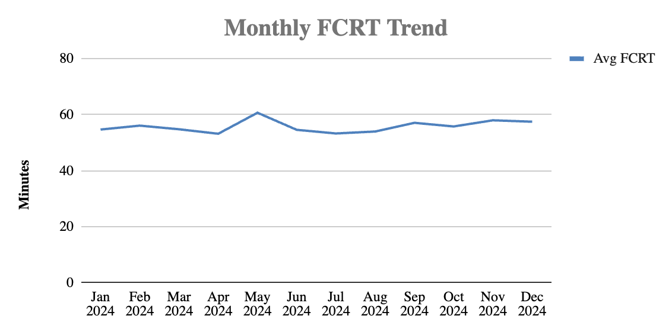
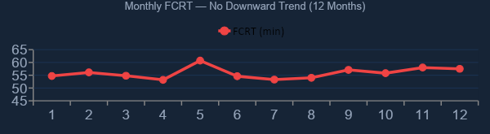
The Cost of Doing Nothing Is Not Zero
At current trajectory, every year the refund process continues unchanged costs Agoda:
167,000
$122K
403
agent-minutes
in NR exceptions
SLA breaches / year
wasted on automatable cases
governed by ad-hoc judgment
ALL from email + non-refundable
= 1 full-time agent's annual output consumed by rubber-stamping
Zero audit trail. Zero consistency. One rogue approval, zero recourse.
403 customers waiting 120+ minutes. Every single one on a channel we can fix.
FCRT has shown zero improvement over 12 months — Jan: 54.7 min → Dec: 57.5 min. The trend is worsening, not stagnant. Without intervention, this is where we will still be in 12 months.
EVERY WEEK OF DELAY
3,212
agent-mins wasted
~8
new SLA breaches
$2,348
uncontrolled margin
Every week Phase 1 is delayed = 3,212 avoidable agent-minutes and ~8 customers waiting 2+ hours for a decision that was already made.
Notes:
To be clear: the status quo isn't just stagnant—it's expensive. As you can see from the trend line, our resolution times haven't improved in 12 months; they are actually creeping up.

Slide 13
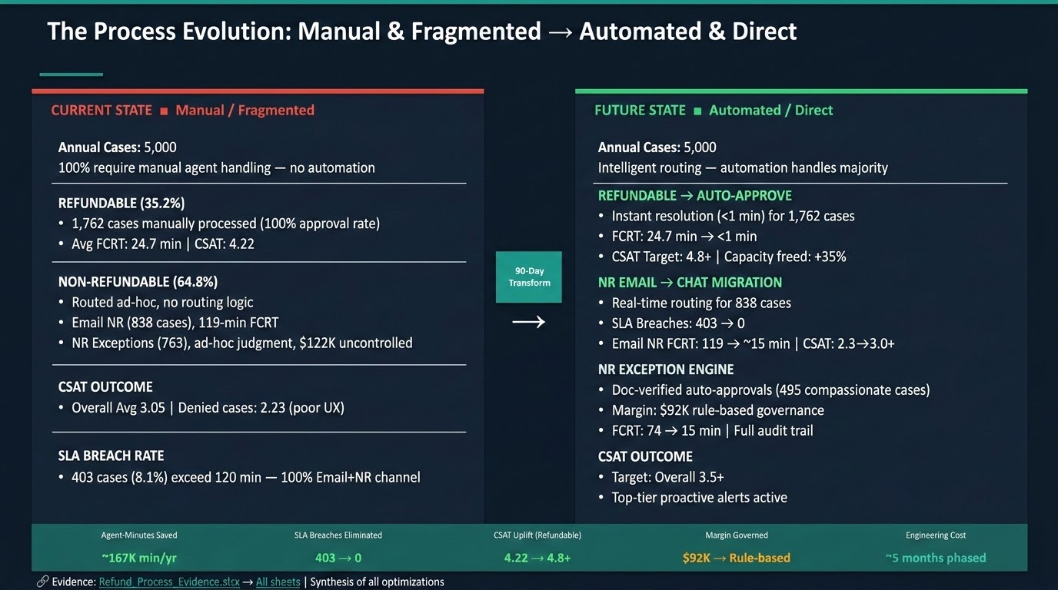
Agent-Minutes Saved
SLA Breaches Eliminated
CSAT Uplift (Refundable)
Margin Governed
Engineering Cost
~167K min/yr
403 → 0
4.22 → 4.8+
$92K → Rule-based
~5 months phased
Notes:
This is the transformation in summary. Today: 100% manual, 403 SLA breaches, CSAT at 3.05, $122K of margin ungoverned. In 90 days: automation handling the majority, zero SLA breaches, CSAT targeting 3.5+, and every exception decision on record with a documented rationale.

Slide 14
Next Steps: 90-Day Roadmap to Refund Process Transformation
PHASE 1: WEEKS 1-4
→ Deploy auto-approval for refundable bookings (OPT #1)
→ Configure rule: IF cancellation_policy = refundable → auto-approve + initiate refund
→ Expected: 1,762 cases removed from agent queue immediately
→ KPI: FCRT for refundable → <1 min | CSAT → 4.8+ | Agent capacity +35%
PHASE 2: WEEKS 5-8
→ Migrate email NR workflow to chat/messaging (OPT #2)
→ Build NR decision-tree chatbot with escalation to live agent
→ Redirect email NR requests to chat — sunset email for refund requests
→ KPI: SLA breaches → 0 | Email NR FCRT: 119 → 15 min | CSAT: 2.3 → 3.0+
PHASE 3: WEEKS 9-12
→ Launch NR exception rule engine (OPT #3)
→ Implement auto-approve rules for top-5 compassionate reasons + doc verification
→ Build escalation queue for non-standard NR exceptions (268 cases/yr)
→ KPI: NR exception FCRT: 74 → 15 min | Margin governance: $92K under rules
ASK: Approve 90-day pilot for Phase 1 (auto-approve refundable) — zero risk, immediate ROI, 35% agent capacity unlock
Notes:
Three phases, 90 days. Phase 1 in weeks 1–4 is the auto-approval rule for refundables — this is a config change, not an engineering project. We could go live inside a month and immediately see the impact.

Slide 15

Thank You!
Notes:
Thank You!

