Slide 1
Customer shopping behavior is loyal, broad, and promotion-sensitive

Slide 2
DATASET
THE BASELINE
Broad coverage
3,900 purchases reveal a steady $59.76 average basket
3,900 purchases across 25 products, 4 categories, and 50 locations
3.75
37
Average rating
Review ratings imputed by product category median
$59.76
Average purchase

Slide 3
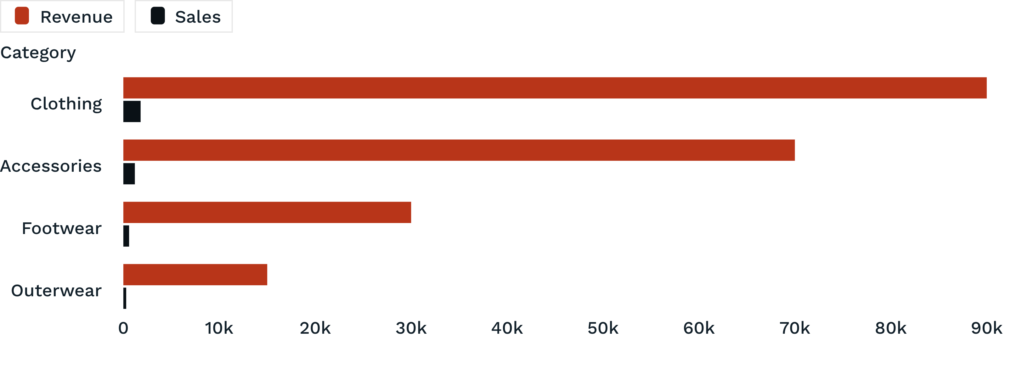
CATEGORY MIX
Clothing drives the business, with accessories close behind
Category performance is concentrated in clothing and accessories, creating a clear merchandising and campaign priority.

Slide 4

LOYALTY & SUBSCRIPTION
Loyal customers dominate the base, but subscriptions lag
3,116
Loyal customers
701
Returning customers
83
New customers
Notes:
Subscribers averaged $59.49 versus $59.87 for non-subscribers. The subscription split is 27% subscribed and 73% did not.

Slide 5
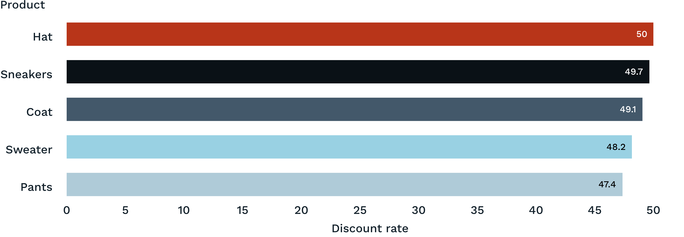
PROMOTION RESPONSE
Discounts attract high-value shoppers, especially in selected products
Discount users can still spend above average, but several products show discount rates near 50%, creating a margin-management opportunity.

Slide 6
QUALITY SIGNAL
Product ratings point to a promotable quality tier
Use highly rated items to anchor campaigns and cross-sell into lower-frequency categories.
3.86
3.84
3.82
3.80
3.78
Gloves
Sandals
Boots
Hat
Skirt

Slide 7
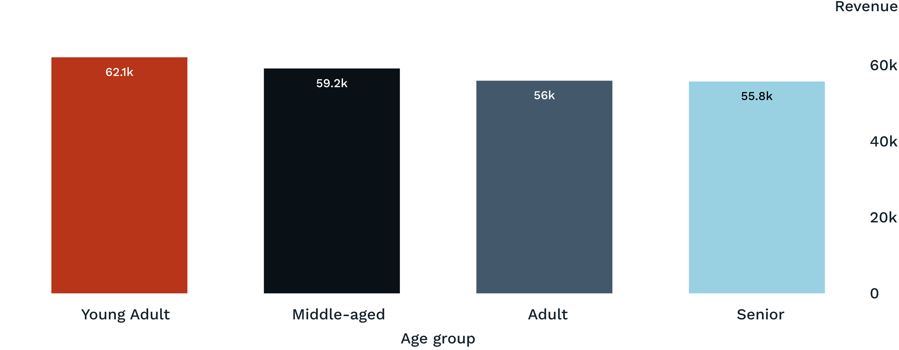
CUSTOMER VALUE BY AGE
Young adults lead revenue, but every age group contributes meaningfully

Slide 8
CONVERSION OPPORTUNITY
Shipping and repeat buying suggest room to improve conversion
Express shipping
$60.48
Speed and convenience are visible value signals.
Average purchase
Standard shipping average purchase: $58.46
Repeat buyers
958
3,476 customers had more than five purchases.
Were subscribers
Make speed and convenience more visible at checkout, then test whether benefits convert loyal repeat buyers into subscribers.

Slide 9
ACTION FRAMEWORK
Turn loyalty into subscription value, not just repeat orders
01
02
03
04
Boost subscriptions
Protect margin
Merchandise the winners
Target the growth pockets
Package exclusive benefits around convenience, access, and shipping.
Review discount depth on high-discount products and target offers more selectively.
Feature clothing, accessories, and top-rated products in campaigns.
Prioritize young adults while tailoring offers for the other age groups.

