Slide 1



Analyzing Agricultural Productivity Across Indian States.

Slide 2

Learning Objectives:
Understand how to use Power BI for data analysis and visualization in agriculture.
Explore key metrics influencing agricultural productivity in Indian states.
Learn to derive insights from agricultural datasets to support policy-making and planning.
Demonstrate practical application of business intelligence tools in the agri-sector.
GOAL

Slide 3
Tools and Technology used :
Power BI – for data visualization and dashboard creation.
Microsoft Excel / CSV files – as a source for agricultural datasets.
DAX (Data Analysis Expressions) – for calculated metrics and custom aggregations.
Power Query – for data cleaning and transformation.
Government/FAO/State Agri Dept Data Portals – as data sources.

Slide 4
Methodology :
Data Collection: Gather agricultural data (crop yield, area sown, productivity, rainfall, etc.) from authentic sources.
Data Cleaning & Transformation: Use Power Query to handle missing values, standardize units, and ensure consistency.
Data Modeling: Establish relationships between tables and define calculated fields using DAX.
Visualization: Create dashboards showing productivity trends, comparisons across states, and crop-wise performance.
Analysis: Use filters, slicers, and drill-downs to uncover patterns and disparities in productivity.

Slide 5
Problem Statement:
Despite India's extensive agricultural activities, there is a lack of dynamic and accessible analytical tools to compare and understand agricultural productivity across states, hindering effective policy formulation and resource allocation.

Slide 6
Solution:
Leverage Power BI to:
Visualize state-wise agricultural productivity in an interactive format.
Compare multiple dimensions like crop type, irrigation, rainfall, and yield.
Enable stakeholders (government, researchers, farmers) to make informed decisions through data-driven insights.
Provide a scalable, real-time dashboard that can be updated with new data over time.

Slide 7
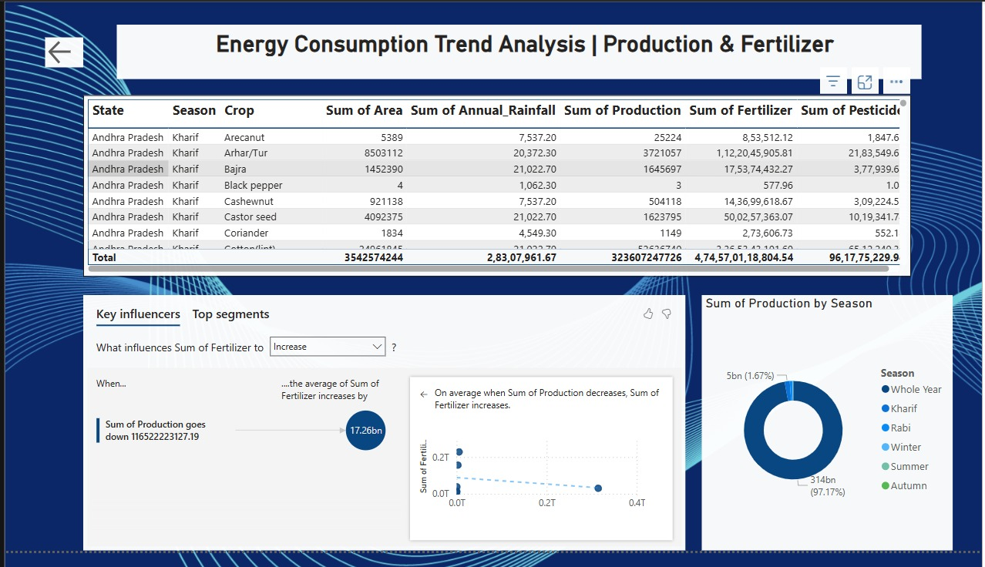
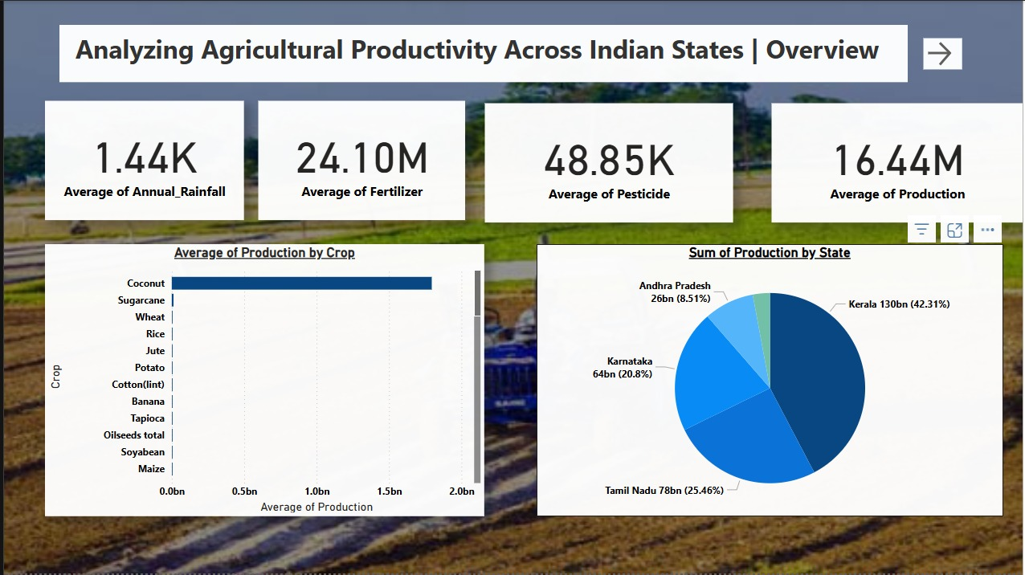
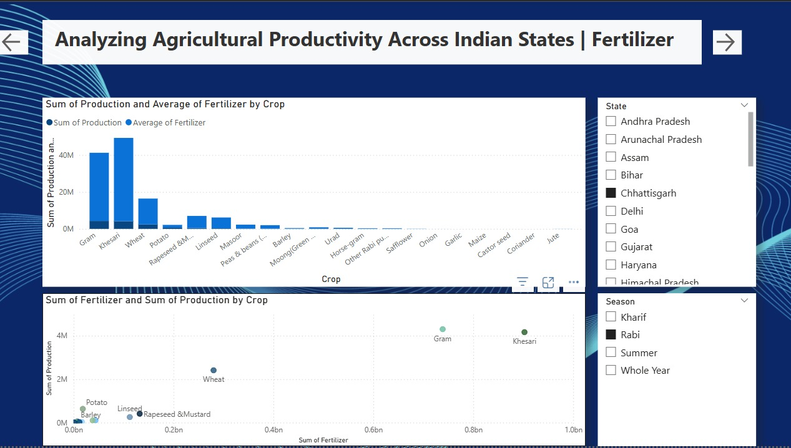
Screenshot of Output:

Slide 8
Power BI proves to be a powerful tool for analyzing complex agricultural data, enabling users to transform raw information into meaningful insights. Its interactive visualizations simplify the process of identifying high and low-performing states, making regional comparisons more intuitive and impactful. This level of analysis is crucial for guiding agricultural reforms, optimizing resource allocation, and implementing targeted interventions where they are most needed. Ultimately, this approach fosters a data-centric agricultural ecosystem, which is essential for promoting sustainable development and ensuring long-term food security.
Conclusion:

