Slide 1
UCS503 • SOFTWARE ENGINEERING
VeriHire
TEAM
AI-Powered Job & Internship Posting Verification
Geet Rawal
1024160012
Nidhish
1024160013
Parvesh Lamba
1024160017
PROGRESS EVALUATION
An explainable ML-assisted platform for assessing suspicious characteristics in job and internship postings.
Faculty Advisor: Dr. Jeelani
15 September 2026

Slide 2
01 / WHY
The problem we're solving
Students can find opportunities easily.
The difficult part is deciding what to trust.
CURRENT GAP
Manual verification is
time-consuming and subjective.
COMMON SUSPICIOUS SIGNALS
• Unrealistic salary or stipend claims
• Registration, application or training fees
• Generic or suspicious contact information
• Urgency / pressure-based wording
• Incomplete company or job information
• Qualification or experience inconsistencies
VeriHire combines a web verification workflow with machine learning and interpretable suspicious signals.
RISK ASSESSMENT
EXPLANATION
HISTORY
ANALYTICS
VERIHIRE • UCS503 | 2/6

Slide 3
02 / PRODUCT FLOW
What VeriHire does
01
02
03
04
POSTING INPUT
ANALYSIS
RISK ASSESSMENT
EXPLAINABLE RESULT
Text / supported URL
Features + ML
Low / Medium / High
Signals + evidence
STUDENT
SYSTEM
DASHBOARD
Check posting • View result • View history
Preprocess • Analyse • Explain
KPIs • Risk distribution • Trends
VERIHIRE • UCS503 | 3/6

Slide 4
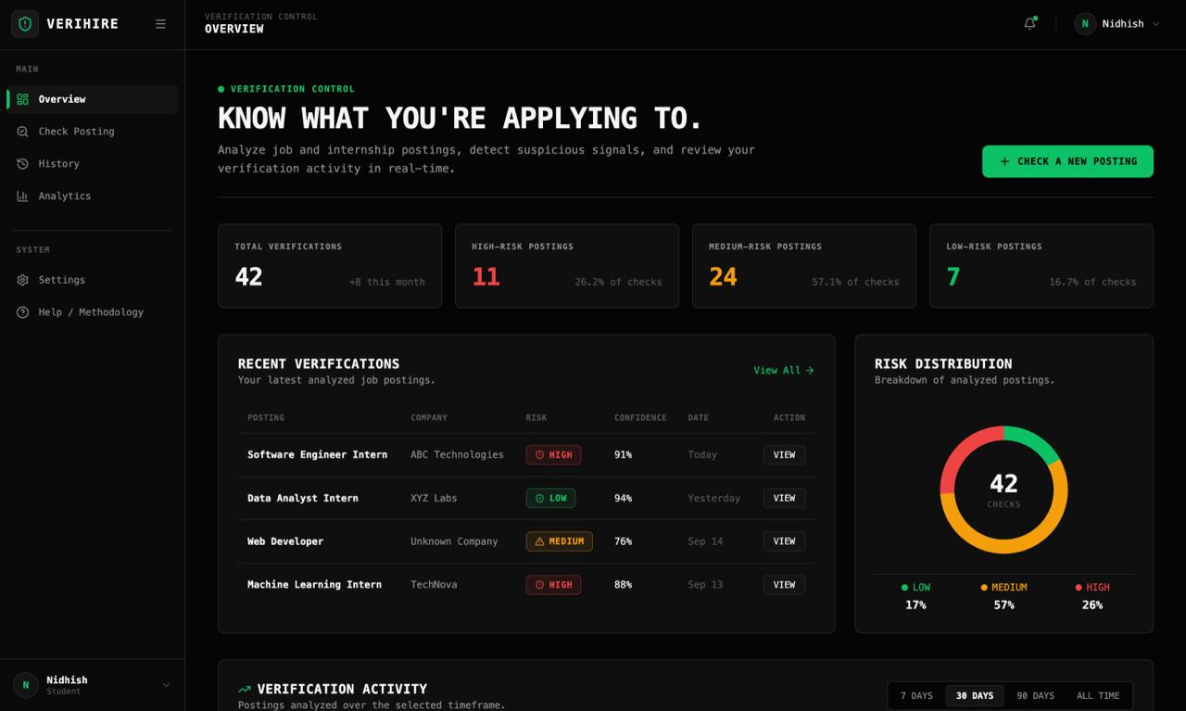
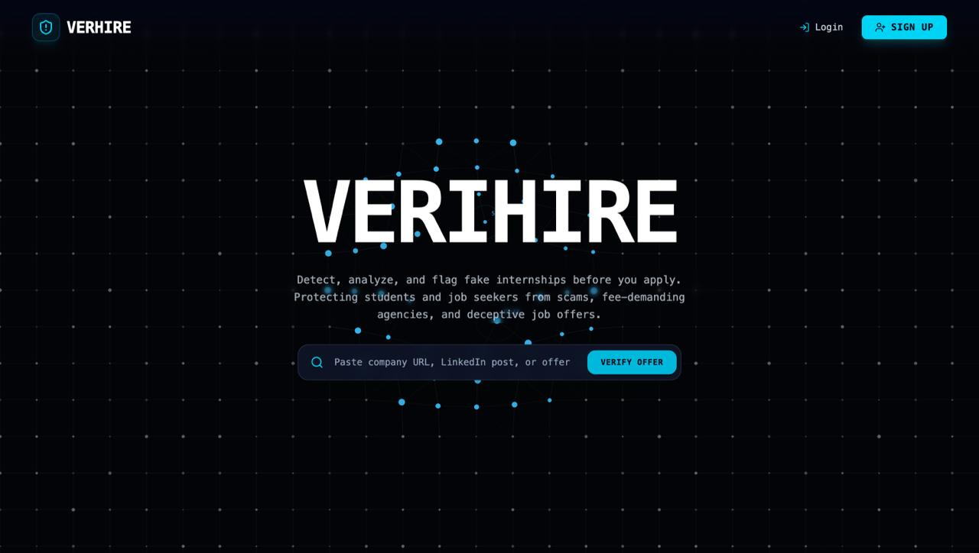
03 / CURRENT PROGRESS
What we've built so far
IMPLEMENTED
IN PROGRESS
• Project scope & requirements
• Use-case and DFD refinement
• React application foundation
• Login / signup foundation
• Constellation-based landing page
• Authenticated dashboard structure
• Dashboard KPIs and risk distribution
• Verification checker
• Verification result interface
• ML data preparation
• Model comparison & validation
• Backend–frontend integration
VERIHIRE • UCS503 | 4/6

Slide 5
04 / MACHINE LEARNING
ML approach & explainability
CURRENT ML DESIGN
USER-FACING RESULT
Posting data
Text + contextual features
LOW
MEDIUM
Feature extraction
Payment • salary • contact • language • completeness
HIGH
Candidate models
Random Forest • Gradient Boosting • other supervised models
+ Model confidence
+ Detected suspicious signals
+ Evidence from the posting
Evaluation
Precision • Recall • F1 • Confusion Matrix
Decision support — not an absolute “fraud / genuine” verdict.
VERIHIRE • UCS503 | 5/6

Slide 6
05 / NEXT MILESTONE
Where we go from here
01
Finish ML data prep
02
Select & validate model
03
Integrate ML inference API
Nidhish
Nidhish
Parvesh
04
Complete checker + result UI
05
History + analytics + testing
06
Deployment & final evaluation
Geet
All
All
Current objective: move from a working product foundation to a validated end-to-end verification workflow.
VERIHIRE • UCS503 | 6/6

