Slide 1
COLLEGE LIBRARY MANAGEMENT SYSTEM · UNIVERSITY PROJECT SEMINAR
KCT LIBRARY — SYSTEM DOCUMENTATION
Unit II of III
Agile Practices &
II
Project Management
Seven sprints, one board, two people — how the Lean/Scrum/Kanban/XP hybrid actually ran.
TEAM
Library Administration
— Product Owner
Library IT
— System Administration
KCT Library · System documentation
deck 2 / 3

Slide 2
AGENDA · UNIT II
What this unit covers
01
FRAMEWORK
The four-way hybrid · roles and ceremonies
02
BACKLOG
Epics and points · story anatomy · estimation
03
EXECUTION
Cadence · velocity · burndown · honesty · Jira · the team
04
PLANNING EVIDENCE
WBS · COCOMO II · risk register · retrospectives
KCT Library
02 / 16

Slide 3
UNIT II · PART 1 · FRAMEWORK
Not one framework — four, each hired for a different job
SCRUM
XP
gives the cadence
gives engineering discipline
• Two-week sprints
• TDD on domain rules
• planning poker & reviews
• refactoring under coverage floors
• retros per sprint
• small releasable increments
• all seven closed
KANBAN
LEAN
gives the desk flow
kills hand-off waste
• Returns, holds and maintenance visualised as queue work
• Story-gated scope
• WIP kept at desk scale
• no speculative build
• every point moves the ledger
Scrum for cadence, XP for engineering discipline, Kanban for desk-flow support work, Lean to kill hand-off waste.
KCT Library
03 / 16

Slide 4
UNIT II · PART 1 · FRAMEWORK
Two people wearing every hat — on a documented calendar
CEREMONY | WHEN | WHO | WHAT COMES OUT
Sprint planning | Day 1 of every sprint | PO + SM | Committed points, poker-sized
Daily stand-up | Daily, 15 minutes | Whole team | Blockers moved to the Kanban desk
Sprint review | Sprint end | Team + library desk staff | Working flow shown on localhost:4000
Retrospective | Sprint end | Whole team | A rule change for the Definition of Done
Backlog refinement | Continuous | Product Owner | Stories sliced to fit one sprint
PO: Library Administration — Product Owner
SM: Library IT — System Administration
A two-person Scrum keeps ceremony overhead lean: the review output is a working desk flow, not a status deck.
KCT Library
04 / 16

Slide 5
UNIT II · PART 2 · BACKLOG
Ten epics, 126 points — the planning ledger
Fibonacci planning-level sizing · 37 stories live under these ten epics
EPIC | SCOPE | PTS
E1 | Foundation, Auth & Access | 11
E2 | Members | 6
E3 | Catalogue & Search (incl. US-37*) | 14
E4 | Copies & Barcodes | 11
E5 | Circulation | 16
EPIC | SCOPE | PTS
E6 | Reservations | 19
E7 | Penalties & Policies | 10
E8 | Recommendations | 13
E9 | Notifications | 13
E10 | Reports, Admin & Release Quality | 13
125 of 126 points were delivered — US-37 (1 pt) was deferred at review rather than dilute the release.
Epic sums reconcile to scope: 58 + 68 = 126 pts planned · 125 pts delivered.
KCT Library
05 / 16

Slide 6
UNIT II · PART 2 · BACKLOG
A story is done only when its acceptance reads like the code
STORY TEMPLATE
ACCEPTANCE CRITERIA · GIVEN / WHEN / THEN
As a [role],
I want [capability],
so that [value].
GIVEN
a copy is returned and its reservation queue is non-empty
WHEN
the librarian completes the return at the desk
ONE REAL HOLD STORY
As a librarian,
I want a returned reserved copy to reach the queued member, so that holds keep their promised order.
THEN
the next member — FACULTY, then FIFO, then ID — moves to READY; the 48 h window opens
AND
a cancelled READY hold re-dispatches: the RES-001 regression pin
Acceptance criteria are written in test language — they become jest specs and Selenium assertions almost verbatim.
KCT Library
06 / 16

Slide 7
UNIT II · PART 2 · BACKLOG
Planning poker on a Fibonacci ladder — disagreement is the point
1
2
3
5
8
13
126
TOTAL SCOPE (PTS)
FIBONACCI STORY-POINT SCALE
WHY THIS WORKS FOR KCT LIBRARY
18
•
Silent first estimates
— no anchoring to the louder hat
•
Coarse scale
— matches real uncertainty, not hours
MEAN POINTS / SPRINT
over seven closed sprints
•
Debate only on gaps
— cards within one step converge
•
Capacity cross-check
— 126 pts over mean 18 is seven sprints
KCT Library
07 / 16

Slide 8
UNIT II · PART 3 · EXECUTION
Seven two-week sprints — 1 Jun to 4 Sep 2026, all closed
1 JUN 2026
4 SEP 2026 · RELEASE v1.0.0
S1
S2
S3
S4
S5
S6
S7
17 pts
16 pts
18 pts
22 pts
13 pts
16 pts
24 pts
S3 slip · RES-001 found
S6 slip · UI-002 found
•
Both slips surfaced in their sprint review
and were recovered the sprint after
•
S4 closed 22 points
— absorbing S3's three carried points inside a healthy sprint
•
S7 closed 24 points
— the strongest sprint, delivered right at the release
Every sprint closed at release — no open sprint was parked when v1.0.0 shipped.
KCT Library
08 / 16

Slide 9
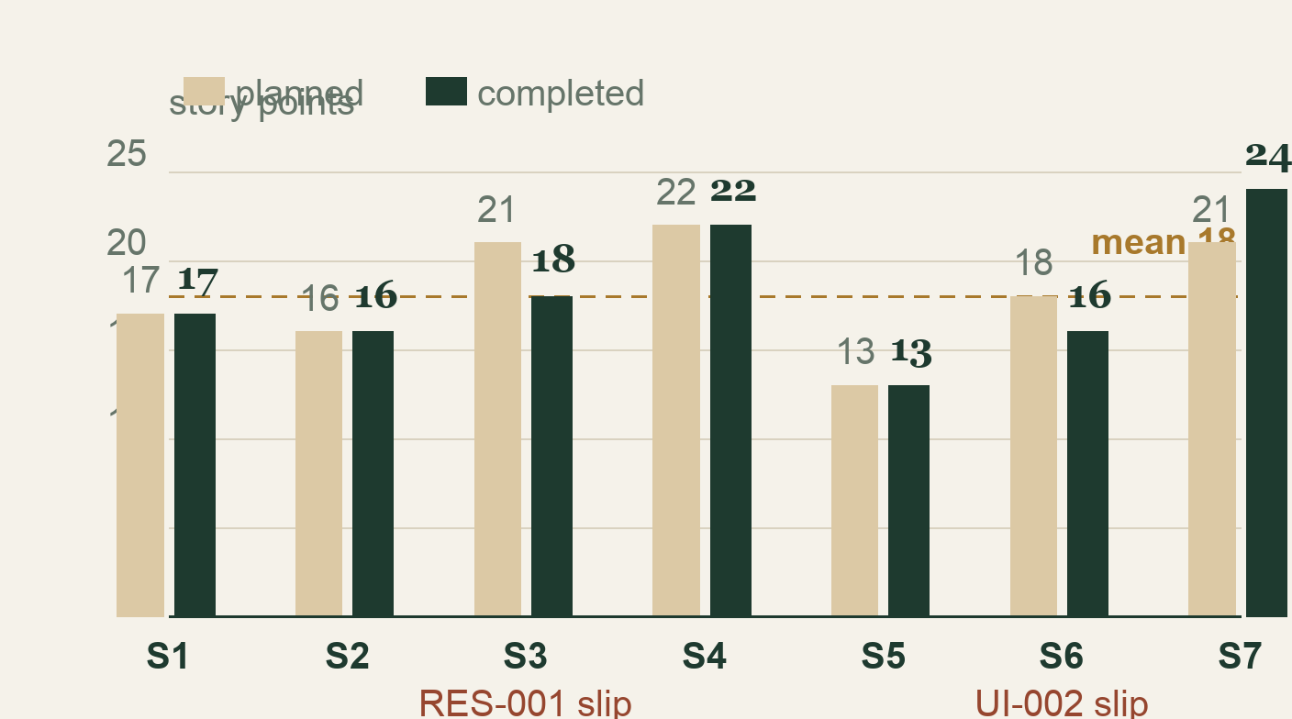
UNIT II · PART 3 · EXECUTION
Velocity held at 18 — and both dips explain themselves
18
MEAN COMPLETED PTS
13–24
SPRINT RANGE
low S5 · peak S7
•
Planned vs completed
tracked every sprint
•
Dips were honest
— found defects, not lost effort
•
Recovery systematic
— next sprint absorbed it
Completed: 17, 16, 18, 22, 13, 16, 24 = 126 pts · Planned: 17, 16, 21, 22, 13, 18, 21
KCT Library
09 / 16

Slide 10
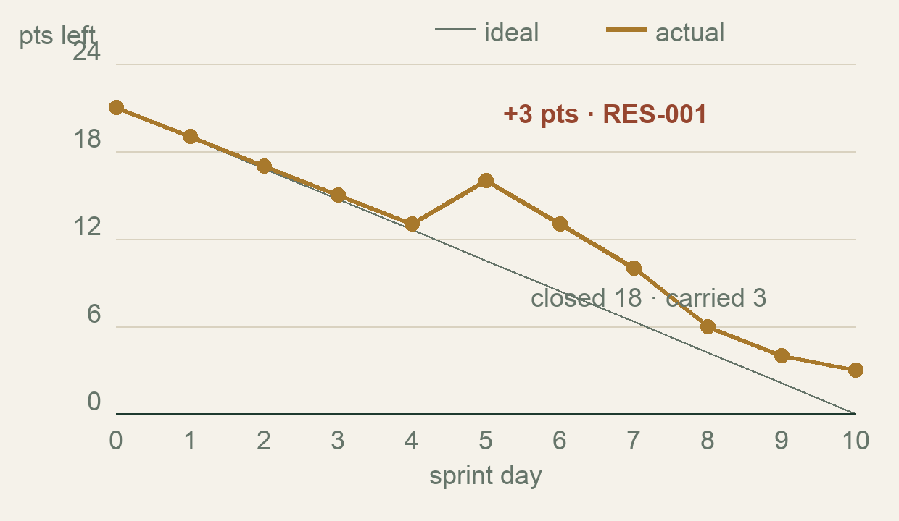
UNIT II · PART 3 · EXECUTION
Sprint 3's burndown tells the only story that matters: truth
READING THE BUMP
•
Planned 21 points
— ideal line runs straight down
•
Day 5: RES-001
— cancelled READY holds can strand a copy
•
+3 points
enter as the regression-safe fix is scoped
•
Closed at 18
— three points carried, openly, to S4
Chart: ideal vs actual points remaining, sprint days 0–10.
A bump you can see is a plan you can trust — hiding it would only move the surprise to the release.
KCT Library
10 / 16

Slide 11
UNIT II · PART 3 · EXECUTION
Carry-over and deferral were decisions, not accidents
US-15 · US-30
US-37 · 1 pt
The standing rule
Carried across sprint boundaries, re-estimated in poker, closed in the next review window.
Deferred at review — the only story that did not reach v1.0.0; recorded on the board, not in a footnote.
A sprint may close with fewer points, never with looser acceptance criteria.
WHAT THE TEAM LEARNED
•
Buffers belong in the plan
— discovery always costs points
•
Deferral is scope control
— it protected the release date
•
Visibility over heroics
— carried stories re-enter poker like new work
KCT Library
11 / 16

Slide 12
UNIT II · PART 3 · EXECUTION
Jira KCT Library is the paper trail — a live, company-managed Scrum board
55
10
37
TOTAL ISSUES
EPICS
STORIES
•
Company-managed Scrum board
— sprints started and completed on schedule
•
All seven sprints
show a sprint-closed event on the board
•
Issue keys run NS-1 to NS-9
— stories, tasks and defects share one ledger
project: KCT Library · Scrum (company-managed)
Board numbers are quoted as text evidence — the live board is available for the seminar walkthrough.
KCT Library
12 / 16

Slide 13
UNIT II · PART 3 · EXECUTION
Two builders, balanced load, one shared finish line
MEMBER | HAT | AREA OF GRAVITY | PTS
Library Administration | Product Owner | Backend · domain · DevOps | 61
Library IT | Scrum Master | Frontend · E2E · docs | 64
TOTAL DELIVERED | — | of 126 points scoped | 125
POINT SPLIT — THE 125-POINT DELIVERED SCOPE
DEFINITION OF DONE (PER STORY)
•
Acceptance criteria proven
at API level, not just visually
WHY THE SPLIT LOOKS LIKE THIS
•
Tests green
— module coverage floor respected (80% target)
Backend and DevOps carry heavier discovery (state machine, store); frontend carries surface area (SPA, receipts, docs). Neither hat outranks: cross-review is baked into DoD.
•
Receipt + barcode path
smoke-checked on a real flow
•
Seed docs updated
so the next sprint starts from truth
•
Shown on localhost:4000
at the sprint review
KCT Library
13 / 16

Slide 14
UNIT II · PART 4 · PLANNING EVIDENCE
WBS to three levels — and a COCOMO II sanity check
1 · KCT Library
COCOMO II · BASIC, ORGANIC MODE
E = a × (KLOC)^b, a=2.4 · b=1.05
E = 2.4 × (1.585 KLOC)^1.05 ≈ 3.9 person-months
1.1 Foundation
auth+RBAC · binary store
1.2 Circulation
loans · holds · fines
1.3 Experience
SPA · receipts · a11y
•
1.585 KLOC
= 1,585 measured LOC of the shipped system
•
Schedule estimate
≈ 3.9 months for the modelled effort
1.4 Quality & release
tests · CI · Docker
•
Actual window
1 Jun – 4 Sep 2026 · two people, 7 sprints
LEVEL 3 · WORK PACKAGES
A Jun–Sep Gantt was maintained over the same window, branch by WBS branch.
e.g. 1.2.3 — the FACULTY-first hold queue: sized in planning poker, exercised in S3.
Estimate vs reality: the model said 3.9 person-months over 3.9 months; two builders landed it in one summer.
KCT Library
14 / 16

Slide 15
UNIT II · PART 4 · PLANNING EVIDENCE
Six risks tracked — the top three changed the code
RISK | IMPACT IF REAL | MITIGATION — LANDED IN CODE
Data corruption | Catalogue lost | Atomic tmp + rename writes, store-tested
Requirement churn | Scope drift, blown date | Story-gated scope; re-entry via poker
Flaky E2E signal | False red, lost trust in CI | Explicit selector rule (E2E-003)
Full register: six risks, owned on the Jira board; these three earned permanent engineering answers.
RETROSPECTIVES THAT ACTUALLY LANDED
•
S2 retro
: selector policy added to DoD after first flake
•
S3 retro
: coverage floor enforced after RES-001 discovery
•
S6 retro
: authenticated-asset fetch rule after UI-002
KCT Library
15 / 16

Slide 16
UNIT II · RECAP
Unit II in four lines
01
The hybrid worked: Scrum cadence, XP discipline, Kanban desk flow, Lean restraint.
02
Seven sprints, mean 18 points — both dips surfaced at review and healed the sprint after.
03
Board, WBS and COCOMO agree with each other: 126 pts scoped, 125 delivered, one deferred.
04
Every retrospective ended as a DoD rule, not a wish.
Process lesson: cadence turns honesty into a habit, not an event.
Delivered v1.0.0 · 4 Sep 2026
Next · Unit III — how this backlog was tested, measured and shipped.
KCT Library
16 / 16

