Slide 1
COLLEGE LIBRARY MANAGEMENT SYSTEM · UNIVERSITY PROJECT SEMINAR
KCT LIBRARY — SYSTEM DOCUMENTATION
Unit III of III
Testing, Quality
III
& DevOps
123 tests, 82% coverage and two Selenium journeys — the evidence behind v1.0.0.
TEAM
Library Administration
— Product Owner
Library IT
— System Administration
KCT Library · System documentation
deck 3 / 3

Slide 2
AGENDA · UNIT III
What this unit covers
01
STRATEGY
The test pyramid · the TDD loop we actually ran
02
BLACK-BOX TECHNIQUES
Equivalence partitioning · boundary values · decision tables
03
EVIDENCE
Selenium journeys · defect ledger · coverage · white-box metrics
04
QUALITY SYSTEM
ISO 25010 · CI/CD · CMMI-3 · the v1.0.0 release ledger
KCT Library
02 / 16

Slide 3
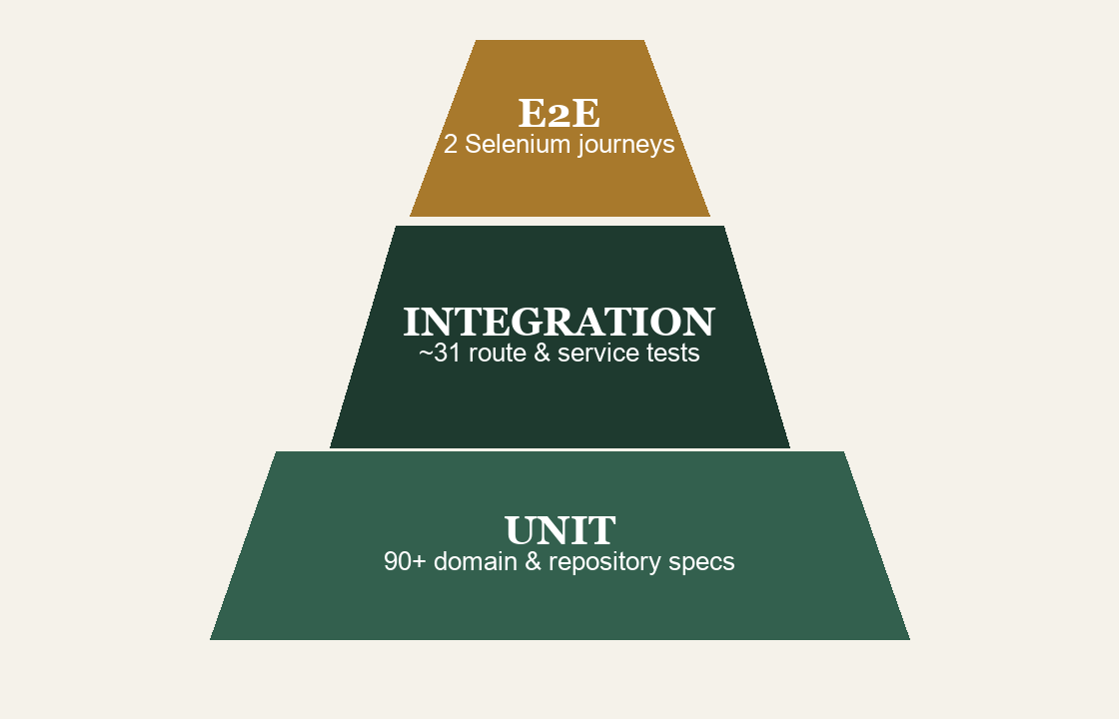
UNIT III · PART 1 · STRATEGY
A pyramid, not a coin flip: 123 tests in six suites
123
AUTOMATED TESTS
all passing
6
JEST SUITES
domain · repos · routes · services
2
E2E JOURNEYS
Figure: test pyramid — counts as shipped at v1.0.0.
Selenium headless Chrome
The split is the strategy: fast specs hold the rules; two slow journeys guard the wiring end to end.
KCT Library
03 / 16

Slide 4
UNIT III · PART 1 · STRATEGY
TDD was real here — the due-date rule is the proof
loop, per story
RED
GREEN
REFACTOR
write the failing spec first
minimum change to pass
clean up under coverage floor
The story: a loan term must end at 23:59, not midnight.
RED
a spec asserted 'due at 23:59:59 on the last day' — it failed against a 00:00 parse.
GREEN
the due-date computation moved to 23:59 in the pure domain layer; suite went green.
PIN
boundary tests at ±1 day now guard the rule — nobody re-breaks it silently.
KCT Library
04 / 16

Slide 5
UNIT III · PART 2 · BLACK-BOX TECHNIQUES
Equivalence partitioning: test classes, not incidents
PARTITION · BORROWER ID | MEMBER OF CLASS | EXPECTED OUTCOME
valid active STUDENT | under 3 books on loan | issue allowed · 14-day term
valid active FACULTY | under 5 books on loan | issue allowed · 30-day term
unknown member code | no matching record | rejected — 404-class guard
valid ID, blocked account | dues at or above 50 rupees | rejected — block guard
•
One representative per partition
— the rest of the class adds no information
•
Partitions came from the FR table
, not from imagination
•
Every guard is a domain function
— so the specs need no mocks
KCT Library
05 / 16

Slide 6
UNIT III · PART 2 · BLACK-BOX TECHNIQUES
Boundary values: policy lives on the edges
BOUNDARY TESTED | VALUE | OUTCOME
renewals count | 1st renewal (of 2) | allowed
renewals count | 2nd renewal — last one | allowed
renewals count | 3rd renewal — over max | refused
due date | returned on due day, 23:59 | 0 rupees fine
due date | returned 1 day late | 1 rupee accrued
fine ceiling | accrual reaching 50 rupees | account blocked
WHY EDGES OVER MIDDLE
•
Off-by-one lurks
: 00:00 vs 23:59 — a real RED
•
2 vs 3 renewals
— the exact policy line per role
•
Reaches 50, passes 50
— block fires once
These pins are the 'preventive maintenance' evidence on the CMMI slide — BVA tests pre-empt whole defect families.
KCT Library
06 / 16

Slide 7
UNIT III · PART 2 · BLACK-BOX TECHNIQUES
One decision table owns the can-issue question
RULE | MEMBER STATUS | UNDER LIMIT | DUES BELOW 50 | COPY AVAILABLE | ISSUE?
R1 | ACTIVE | Y | Y | Y | ALLOW
R2 | ACTIVE | N | Y | Y | REFUSE · LIMIT
R3 | ACTIVE | Y | N | Y | REFUSE · BLOCK
R4 | BLOCKED | — | — | Y | REFUSE · STATUS
R5 | ACTIVE | Y | Y | N (on hold) | REFUSE · QUEUE
•
Five rules, each a one-line spec
in the domain test suite
•
The dashes are real
— blocked members never reach the dues check
•
R5 encodes the hold queue
— the reserved copy waits for READY, not for whoever asks
KCT Library
07 / 16

Slide 8
UNIT III · PART 3 · EVIDENCE
Two Selenium journeys, five steps each, asserted via API
JOURNEY 1 · STUDENT
JOURNEY 2 · LIBRARIAN
1 log in on the SPA (JWT)
1 log in at the desk (JWT)
2 search catalogue · pick a copy
2 scan LIB-CSALG01-001 Code 128
3 place a hold on the ISSUED copy
3 issue loan → state flips to ISSUED
4 copy returns → member is READY
4 receipt + barcode verified
5 fines view shows 7 rupees accrued
5 return → API asserts AVAILABLE + fine
headless Chrome · 5 steps · passing at v1.0.0
headless Chrome · 5 steps · passing at v1.0.0
No screenshot theatre: post-return state is verified through REST responses, not DOM pixels.
KCT Library
08 / 16

Slide 9
UNIT III · PART 3 · EVIDENCE
Three defects found, three durable fixes
RES-001 · THE ONE WORTH TELLING
FOUND
S3 REVIEW
UI-002 · Sprint 6
cancelled READY hold could strand a copy
Symptom — Image tags cannot send JWT for the barcode SVG.
ROOT CAUSE
STATE MODEL
Fix — Authenticated fetch, then paint the SVG from memory.
queue re-dispatch happened only on happy-path return
FIX
DOMAIN
snapshot pre-state · redispatch to next queue member
E2E-003 · Test flake
PIN
Symptom — Autofocus login selector raced page render.
REGRESSION
Fix — Explicit selectors rule written into the Definition of Done.
a spec now replays the cancel path every CI run
Each defect left the codebase stronger than it was before it was found.
KCT Library
09 / 16

Slide 10
UNIT III · PART 3 · EVIDENCE
Statement coverage by layer — with the miss disclosed
target 80%
domain
96.8%
MEASURED
repositories
97.1%
123
routes
85.4%
TESTS PASSING
services
73.9%
6
SUITES
all files: 82.0% stmts · 88.1% lines
•
Blueprint rule met
: three core modules clear the 80% target
•
Services sit at 73.9%
— thin glue; assertions live in domain specs
•
Coverage is a floor
: enforced in CI, discussed in retrospectives
KCT Library
10 / 16

Slide 11
UNIT III · PART 3 · EVIDENCE
White-box: complexity kept in a ledger
2.15
•
Average CC 2.15
— guards stay linear by design
AVERAGE MCCABE CC
•
Peak 14 is deliberate
— redispatch is branchy, pinned by tests
across the backend
•
Halstead effort N × log2 n
— a review smell meter, not a gate
14
MAXIMUM CC — ONE OUTLIER
the hold-redispatch branch from RES-001
Low average complexity is what let a two-person team hold 1,585 LOC and 321 functions in their heads.
KCT Library
11 / 16

Slide 12
UNIT III · PART 4 · QUALITY SYSTEM
ISO 25010: eight characteristics, eight pieces of evidence
CHARACTERISTIC | EVIDENCE IN v1.0.0
Functional suitability | 123 tests · 6 suites · all passing
Reliability | atomic store · state-machine guards
Security | JWT · bcryptjs · RBAC on routes
Usability | keyboard-reachable · reduced-motion
CHARACTERISTIC | EVIDENCE IN v1.0.0
Maintainability | layering · avg CC 2.15 · coverage floor
Portability | Docker images · compose stack
Transferability | seed data + policy documentation
Performance efficiency | in-process JSON reads · single instance
Assessment discipline: a characteristic counts as met only when a shipped artifact proves it — tests, code structure, container files or documented data.
Nothing claimed without a trace: each row above points at a file, a suite or a configuration that exists in the repo.
KCT Library
12 / 16

Slide 13
UNIT III · PART 4 · QUALITY SYSTEM
CI is the referee: lint, jest, coverage, build, ship
install
lint
jest
coverage
vite build
docker
GITHUB ACTIONS · EVERY PUSH AND PULL REQUEST
•
jest + coverage + vite build
run in one workflow file
•
Workflow paths fixed early
— the YAML lives at the repo root
•
Coverage floor enforced in CI
, so a drop fails the build, not a review
FRONTEND IMAGE
BACKEND IMAGE
COMPOSE
multi-stage: build with node, serve static — slim final layer
slim node runtime for the Express 4 API
frontend + backend + shared data volume, one command up
KCT Library
13 / 16

Slide 14
UNIT III · PART 4 · QUALITY SYSTEM
CMMI-3 habits, and four flavours of maintenance
CMMI LEVEL-3 PRACTICES AS RUN
PRACTICE AREA | HOW v1.0.0 MET IT
Organizational Process Focus | cadence reused across all 7 sprints
Project Planning (PP) | WBS + poker estimates + capacity check
Project Monitoring & Control | velocity vs plan; slips recovered fast
Measurement & Analysis | coverage, CC, velocity as metrics
Peer Reviews | cross-review inside Definition of Done
MAINTENANCE TYPES — EACH ALREADY HAPPENED
CORRECTIVE
ADAPTIVE
PERFECTIVE
PREVENTIVE
RES-001 hold stranding
policy term changes absorbed
recommendation reasons added
BVA pins block defect families
KCT Library
14 / 16

Slide 15
UNIT III · PART 4 · QUALITY SYSTEM
Release ledger: v1.0.0 · 4 Sep 2026
v1.0.0
SHIPPED 4 SEP 2026
10 epics · 37 stories · 125 of 126 points · all seven sprints closed
•
Delivered
: catalogue, circulation, holds queue, fines, barcodes, RBAC desks, React SPA, Docker stack
•
Quality at the gate
: 123 tests green · 82.4% stmts / 88.8% lines · 2 E2E journeys passing
KNOWN LIMITS, ON THE RECORD
•
US-37 deferred
— the one point that did not make the date
•
Single instance, JSON store
— a requirement trade-off, made crash-safe
•
Services at 73.9% stmts
— thin glue, asserted where it matters
KCT Library
15 / 16

Slide 16
UNIT III · RECAP
Quality was designed in, not tested on at the end
01
Pyramid economics: fast specs hold the rules, two journeys guard the wiring.
02
EP, BVA and decision tables turned policy into a testable contract.
03
Coverage, CC and ISO evidence were measured, published — misses included.
04
CI, Docker and CMMI-3 habits made v1.0.0 repeatable, not lucky.
Thank you — questions welcome.
Delivered v1.0.0 · 4 Sep 2026
Whole seminar: design in Unit I · process in Unit II · this evidence trail in Unit III.
KCT Library — System Documentation
KCT Library
16 / 16

