Slide 1
HoldOn: how it works
✓
How HoldOn stops a computer scam, step by step.
She can't call for help. HoldOn does.
Notes:
Walkthrough of the live demo, captured from our build at Vibe Sprint Hyderabad.

Slide 2
Who's who
i
Margaret, 74
Sarah
The scammer
Mom. HoldOn is added to her laptop's web browser.
Her daughter. Lives far away. Gets alerts on her phone.
Pretends to be from Microsoft. Wants to control Mom's computer.
1
2
3
4
5
6
7
Set up
Fake warning
Scam app
Phone buzzes
Scam stopped
Scoreboard
Can't hide

Slide 3
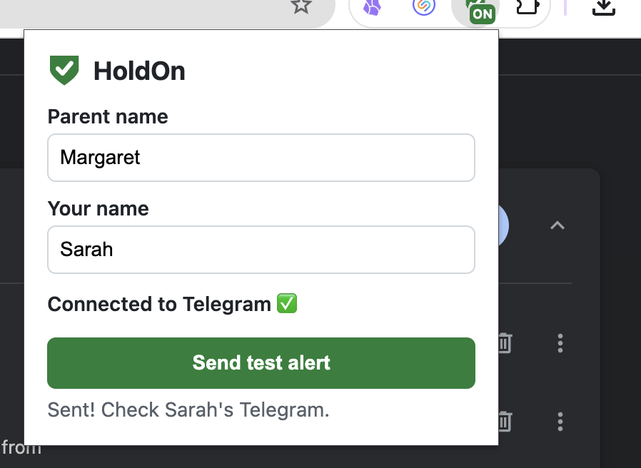

Sarah turns on HoldOn for Mom
1
TAKES 2 MINUTES
Adds HoldOn to Mom's web browser
Types in both their names
Sends a test message to her own phone
Her phone says: "HoldOn is now protecting Margaret."

Slide 4
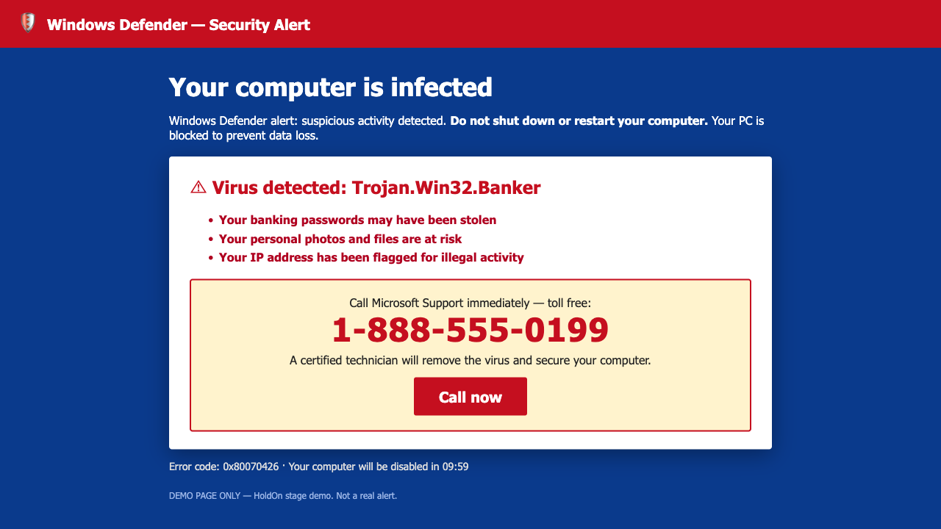
A fake virus warning pops up
2
ON MOM'S SCREEN
A scary page says her computer has a virus and to call "Microsoft"
HoldOn knows this trick and spots the fake
It covers the page: "This warning is FAKE. Do NOT call."
Sarah's phone gets a quiet alert

Slide 5
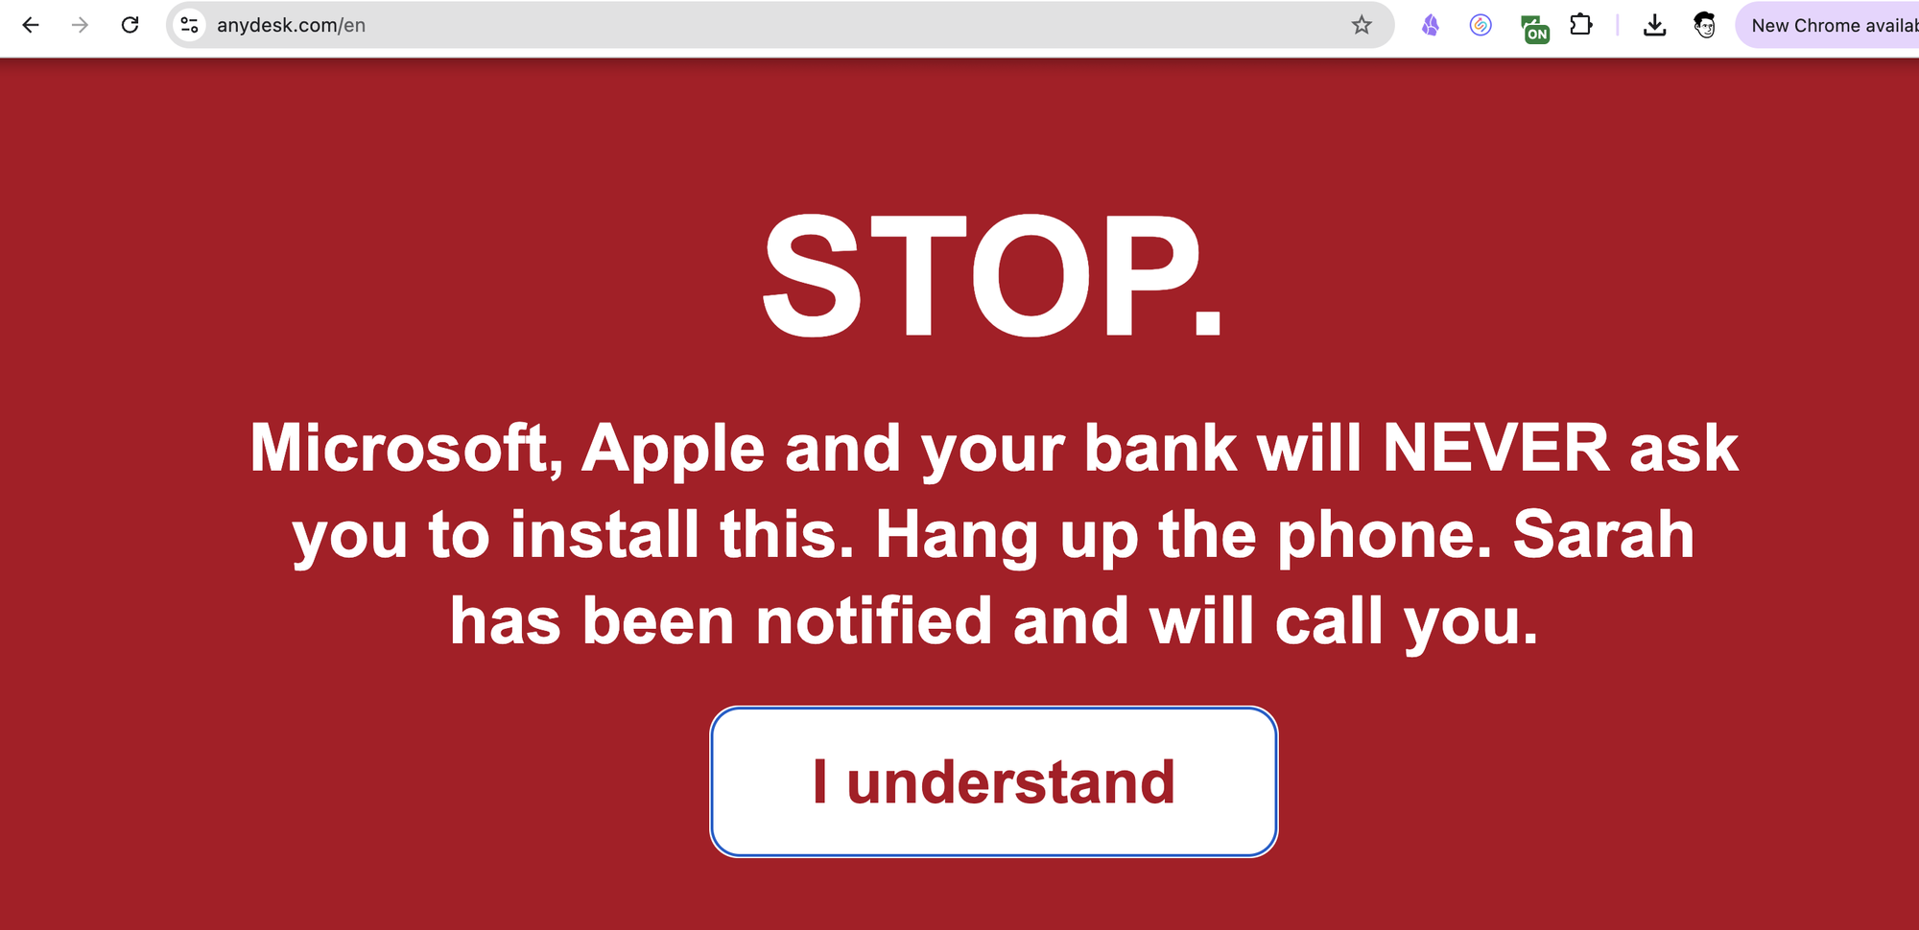
"Install this app." HoldOn: STOP
3
MOST DANGEROUS STEP
The scammer tells her to get AnyDesk, an app that lets him control her computer
HoldOn knows this app and steps in right away
A giant STOP sign she can't miss
"Sarah knows. She will call you."

Slide 6
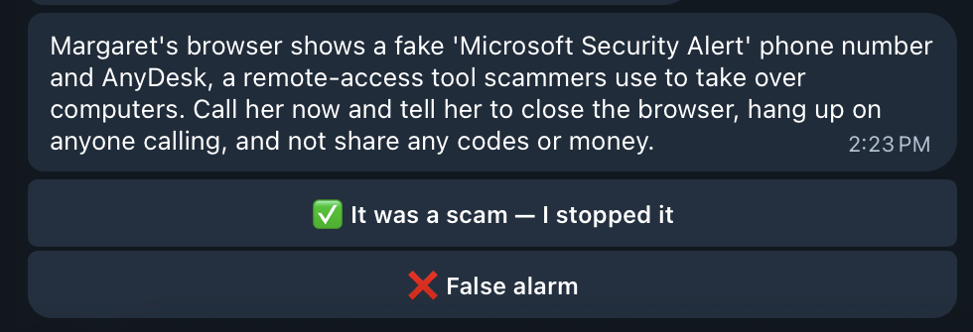
Sarah's phone buzzes
4
ON SARAH'S PHONE
AI explains what happened, in plain words
It tells Sarah exactly what to do
The scammer can't see this message
Help comes from outside the scam

Slide 7
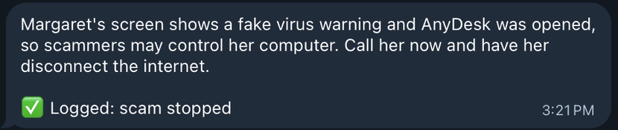
Sarah calls Mom. Scam stopped.
5
ONE TAP
Sarah calls Mom and tells her to hang up
She taps "It was a scam — I stopped it"
HoldOn saves the result: scam stopped
Every alert tells us if HoldOn helped

Slide 8
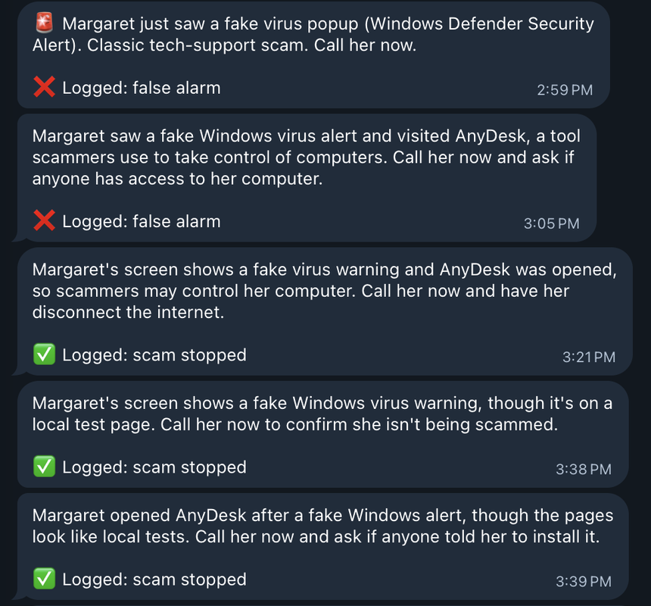
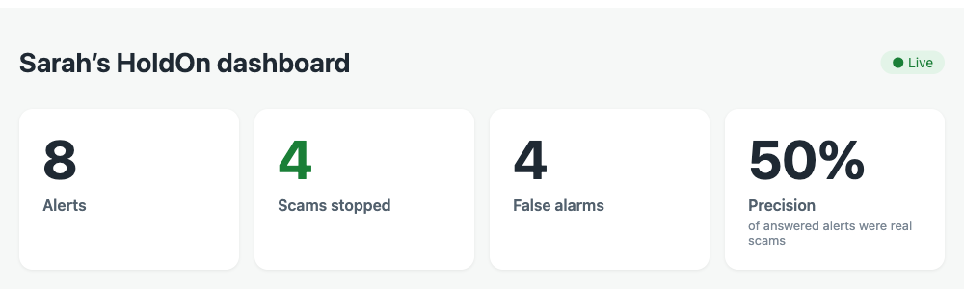
We count every save
6
SARAH'S ANSWERS
THE SCOREBOARD
Counts scams stopped and false alarms (alerts that weren't real scams)
Precision = how often an alert was a real scam
Real numbers from our tests today. Some false alarms were on purpose

Slide 9
Scammer: "Delete HoldOn"
7
CAN'T BE SECRETLY REMOVED
Scammers often tell people to delete safety apps
If HoldOn is removed, it sends one last alert
So Sarah still finds out
⚠️ HoldOn was removed from Margaret's laptop. Scammers often ask victims to do this. Call her now.
The real message Sarah gets on her phone
Deleting HoldOn alerts Sarah too

Slide 10
She can't call for help.
HoldOn does.
HoldOn spots the trick → Mom sees STOP → Sarah's phone buzzes → Sarah calls → Scam stopped
Built in one afternoon with a browser add-on, a small server, AI (Claude) and Telegram

