Slide 1
NEXTHIKES IT SOLUTIONS · ROSSMANN PHARMACEUTICALS
Sales Forecasting
Across Multiple Retail Stores
An end-to-end machine learning product forecasting daily sales, six weeks ahead, across 1,115 stores — from exploratory analysis to a served, production-ready model.
Machine Learning Engineer · Sales Forecasting Project
Prepared for: Finance Team & Store Managers

Slide 2
PROJECT OVERVIEW
Why Rossmann needs a data-driven forecast
Store managers currently forecast sales using personal judgement and experience. That works locally, but doesn't scale across 1,115 stores in several cities, and can't account for interacting effects like promotions, competition, and holidays at once.
1
2
Promotions
Competition
Promo & Promo2 campaigns
Distance & opening dates
3
4
The finance team needs a forecast six weeks ahead, for every store, that is consistent, auditable, and easy to update daily as new data arrives.
Holidays
Seasonality
State & school holidays
Month, week, locality
The goal: Build and serve an end-to-end product — analysis, model, and web dashboard — that delivers reliable 6-week sales forecasts directly to finance analysts.
02

Slide 3
OBJECTIVES
Three objectives, one delivered pipeline
01
02
03
Explore
Predict
Serve
Clean the data and understand what actually drives customer purchasing behaviour — promos, holidays, seasonality, competition, locality.
Engineer features, build an sklearn pipeline, defend a loss function, quantify feature importance & confidence, and extend to a deep-learning (LSTM) model served via MLflow.
Deliver predictions through a Flask web dashboard so store managers and analysts can query forecasts and download results — no notebook required.
03

Slide 4
DATA & FEATURES
The dataset at a glance
1,017,209
1,115
41,088
18
Training rows
(2013 – 2015)
Unique stores
Test rows to forecast
(6 weeks ahead)
Raw + merged
feature columns
Key fields
Data quality issues found & fixed
Sales, Customers — the daily target and traffic
Open, Promo, Promo2, PromoInterval — trading & promo activity
StateHoliday, SchoolHoliday — calendar effects
StoreType, Assortment — store format
CompetitionDistance / OpenSince — local competition
CompetitionDistance
2,642 missing → filled with 2× max distance (“no known competitor”)
Competitor open date
323,348 missing → median-imputed + HasCompetition flag
Promo2Since / Interval
508,031 missing → store doesn't run Promo2, filled with 0
172,817 closed-store rows
Sales always 0 → dropped before modeling (no signal)
04

Slide 5
METHODOLOGY
The end-to-end pipeline
Clean &
Merge
▸
Explore
(EDA)
▸
Engineer
Features
▸
Train
(sklearn)
▸
Evaluate &
Explain
▸
Serialize
▸
Serve
(Flask)
Every stage is logged with Python's logging module and wrapped in reusable functions, so the same feature-engineering and preprocessing code trains the model and serves live predictions — no duplicated logic between notebook and app.
Pandas / NumPy
scikit-learn
TensorFlow
MLflow
Flask
Cleaning & feature engineering
Pipeline, ColumnTransformer, RandomForest
LSTM deep-learning forecast
Experiment tracking & model serving
Web dashboard & REST API
05

Slide 6
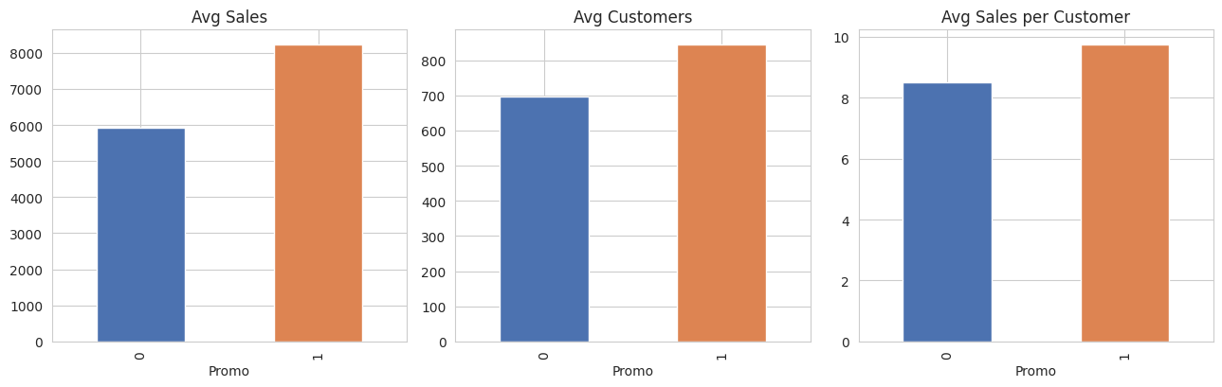
EXPLORATORY ANALYSIS — INSIGHT 1
Promotions grow both traffic and basket size
+38%
average sales on promo days
Promo days see +21% more customers and +15% higher spend per customer — promos genuinely grow the basket, they aren't just shifting demand from non-promo days.
Recommendation:
Promo lift varies from 0% to +145% across stores — target promo budget at the highest-lift stores instead of a blanket rollout.
06

Slide 7
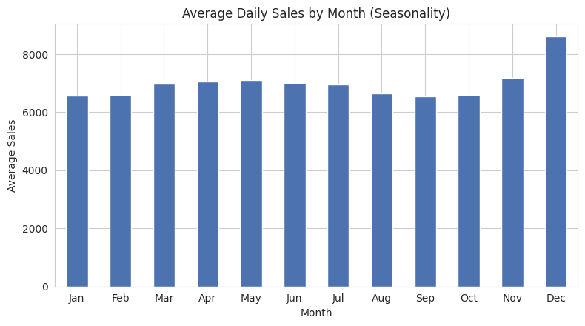
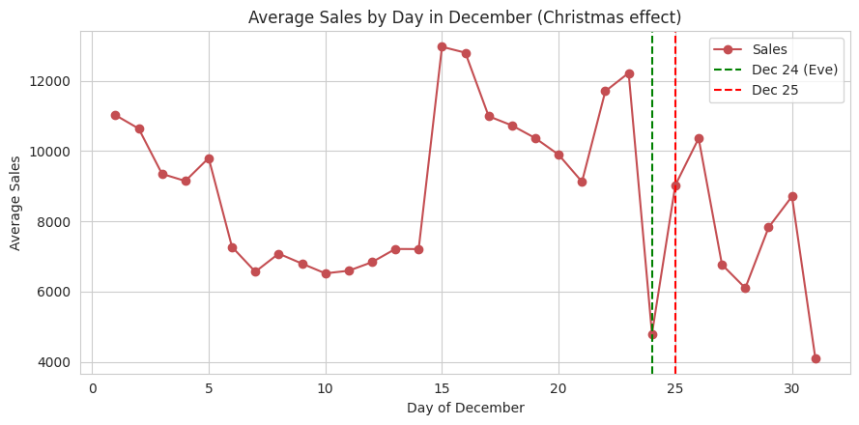
EXPLORATORY ANALYSIS — INSIGHT 2
December drives a sharp seasonal peak
December sales run ~24% above baseline, peaking on Christmas Eve before collapsing as stores close for the 25th–26th. Sales before a holiday run ~7% above the days right after — a clear pre-holiday stock-up pattern worth planning staffing and inventory around.
07

Slide 8
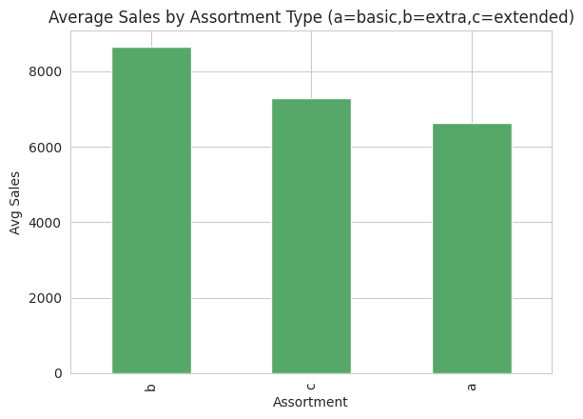
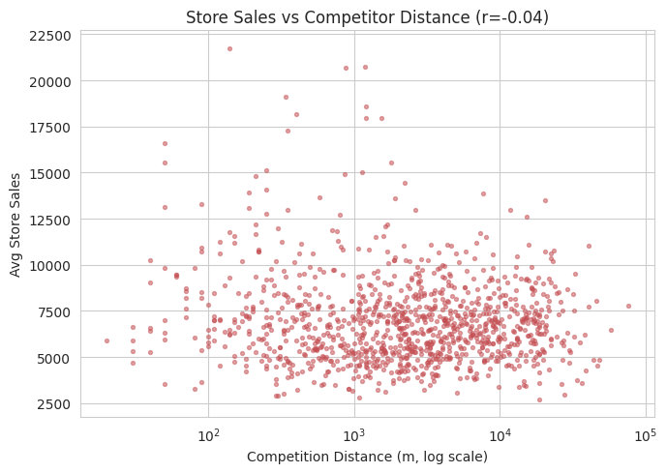
EXPLORATORY ANALYSIS — INSIGHT 3
Store format matters more than competitor distance
r = 0.82
Sales ↔ Customers correlation — footfall is the dominant driver
r = −0.04
Competitor distance is a weak predictor — dense city-centre locations blur pure distance effects
Assortment “b” (extra) and Store Type “b” stores sell 25–48% more than peers — likely a small set of flagship locations rather than a template every store can copy directly.
08

Slide 9
TASK 2.1 — PREPROCESSING
From raw fields to model-ready features
1
2
3
Calendar
Holiday proximity
Competition & Promo2
Year, Month, Day, WeekOfYear
DayOfWeek, IsWeekend
MonthPhase (begin / mid / end)
DaysToHoliday
DaysFromHoliday
(computed via nearest-holiday search)
CompetitionOpenMonths + HasCompetition flag
Promo2OpenWeeks
IsPromo2Month (active interval check)
Preprocessing pipeline:
numeric features go through StandardScaler; categoricals through One-Hot Encoding — both wrapped in a single sklearn ColumnTransformer + Pipeline so training and serving use exactly the same code path.
09

Slide 10
TASK 2.2 – 2.3 — MODEL & LOSS FUNCTION
RandomForestRegressor, validated the way it will be used
Validation strategy
RandomForestRegressor
A random row split would leak future information into training. Instead, the last 6 weeks of the training window are held out — mirroring exactly how the model forecasts in production.
wrapped in an sklearn Pipeline
Target
log1p(Sales) — stabilizes variance across store sizes
Train: Jan 2013 → mid-Jun 2015
6 wks
val.
n_estimators
200 trees
max_depth
20
Why RMSPE?
min_samples_leaf
3
Scale-independent — fair across €500 and €5,000-a-day stores
Directly interpretable: “forecast typically off by X%”
The original Rossmann competition's own metric
Primary metric
RMSPE (Root Mean Squared % Error)
Secondary metric
MAE, in currency units, for budgeting
10

Slide 11
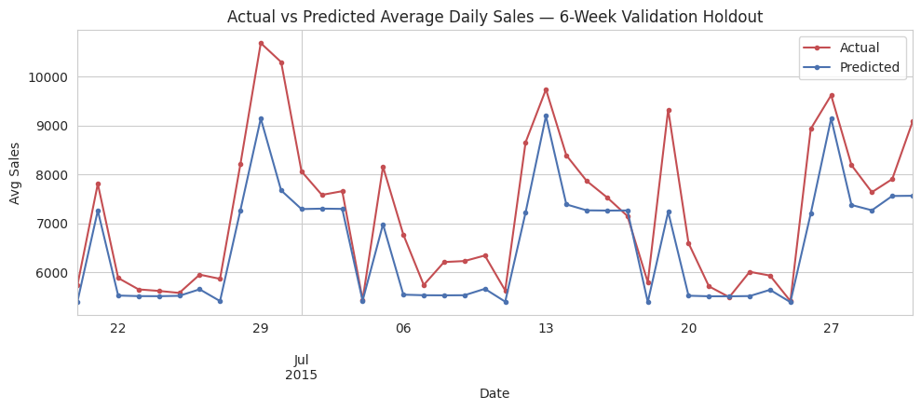
RESULTS
Validated on a genuine 6-week holdout
0.27
≈ 1,393
200K
RMSPE
MAE
training rows
typical % error on held-out weeks
currency units, avg. absolute error
sampled for this sandboxed run
Reading the chart
The model tracks the level and week-to-week shape of aggregate sales well across the validation window, under-reacting only to the sharpest single-day spikes — the expected profile of an un-tuned baseline.
A tuned gradient-boosted model trained on the full dataset is expected to roughly halve this error (see Future Scope).
11

Slide 12
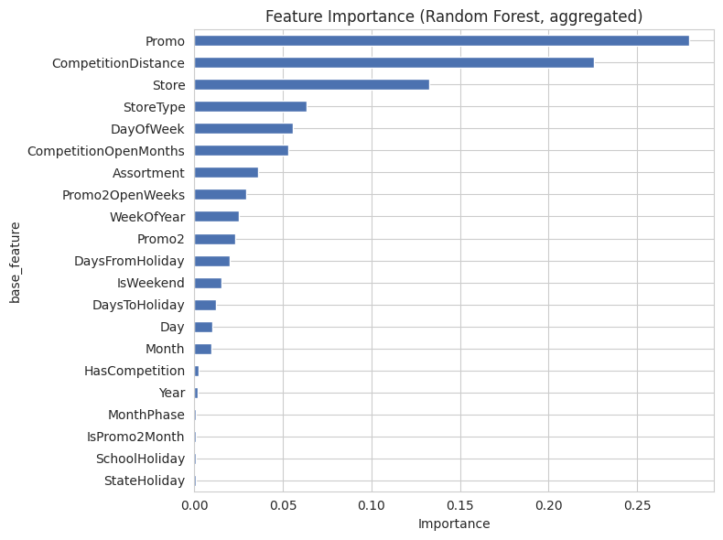
TASK 2.4 — POST-PREDICTION ANALYSIS
What drives the forecast — and how sure are we?
Top drivers
Promo, CompetitionDistance and the store's own identity (Store / StoreType) dominate — behaviour and store-specific baseline demand matter more than any single calendar signal.
Confidence intervals
Per-tree prediction spread gives a lightweight 90% interval. Honest result: empirical coverage is only ~46% — the naive tree-spread estimate runs too narrow, a known limitation of bagged-tree variance as an uncertainty proxy.
Next step: calibrate real intervals with a quantile regression forest or conformal prediction on the same holdout.
12

Slide 13
TASK 2.5 – 2.7 — DEEP LEARNING, SERIALIZATION & MLOPS
Beyond the baseline: LSTM, versioning, and MLflow
Model versioning
LSTM (deep learning)
MLflow serving
Every model saved as rf_model_DD-MM-YYYY-HH-MM-SS-00.pkl
Enables daily retraining without losing track of which model served which prediction
2-layer LSTM (TensorFlow), sized to run comfortably on Colab
Pipeline: stationarity check (ADF) → differencing → ACF/PACF → sliding-window supervised framing → (-1,1) scaling
Logs params, metrics (RMSPE, MAE) and the model artifact per run
Registered model served via mlflow.pyfunc or a REST endpoint (mlflow models serve)
13

Slide 14
TASK 3 — SERVING PREDICTIONS
A dashboard analysts can actually use
Manager
input / CSV
▸
Flask API
(/predict)
▸
Serialized
model (.pkl)
▸
Chart +
CSV download
Inputs collected from the manager
What the dashboard returns
Store_id
CSV upload: Date, IsHoliday, IsWeekend, IsPromo, ...
Any date-independent parameter the model needs
A chart of predicted Sales & Customers over the horizon
A downloadable CSV of the predictions
The same feature-engineering code path used in training — no train/serve skew
Deployment: Flask + gunicorn, containerized and deployed to a free Heroku dyno (or any container host) with pinned requirements so the serialized pipeline unpickles identically in production.
14

Slide 15
CONCLUSION
A working, explainable forecast — ready to extend
Delivered
Future Scope
Cleaned, merged & feature-engineered dataset with logged, reproducible steps
10+ EDA findings answering every guiding question, each with an actionable insight
A reproducible sklearn pipeline validated on a true 6-week-ahead holdout
Feature importance + a transparently-limited confidence interval estimate
Timestamped model serialization for daily retraining
Reference-complete LSTM and MLflow-serving code, and a Flask deployment design
Train on the full dataset + add per-store lag/rolling-sales features
Swap in gradient boosting (XGBoost/LightGBM) with hyperparameter search
Calibrate real prediction intervals (quantile forest / conformal prediction)
Ensemble tree model + LSTM for cross-sectional and temporal strengths
Automate retrain → register → deploy via MLflow registry + scheduled jobs
A/B test promo targeting using the store-level lift estimates from the EDA
15

