Slide 1
Team NAGA By Nidhi, Amber & Alya
Data Exploration & Visualization
Model Selection & Hyperparameter Tuning
Ensemble Learning
Summary

Slide 2
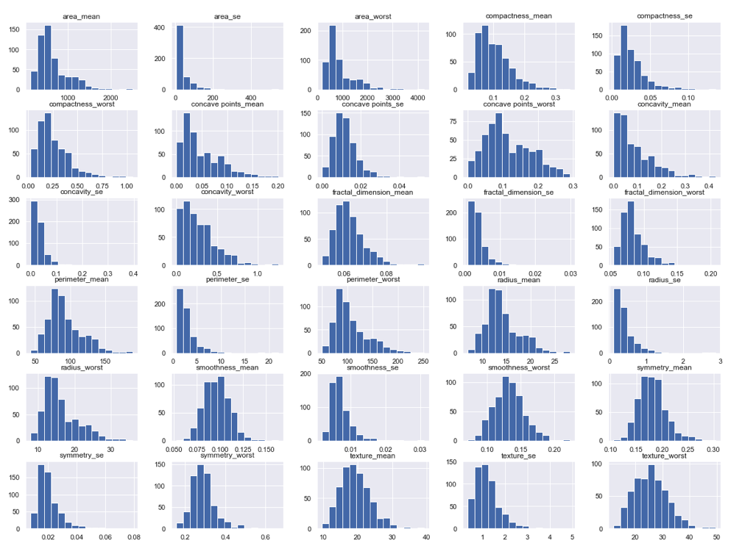
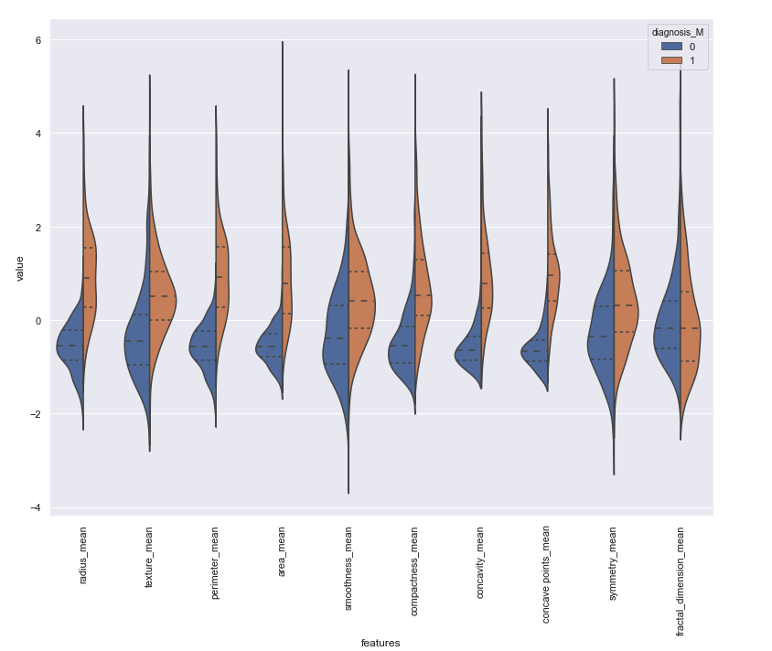
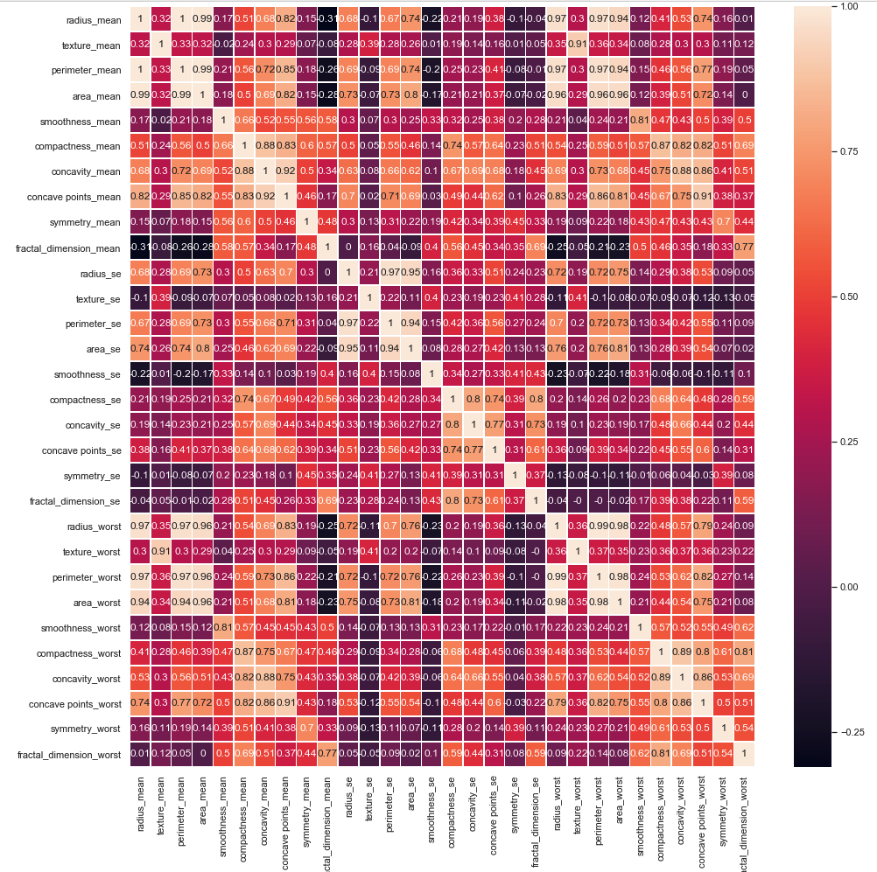
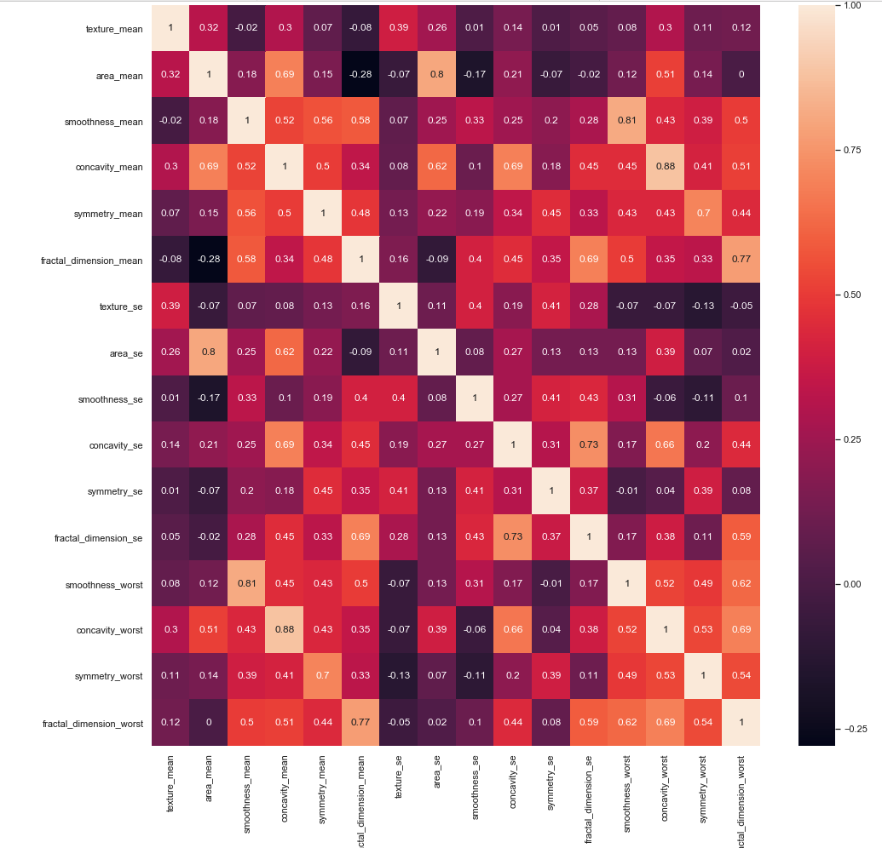
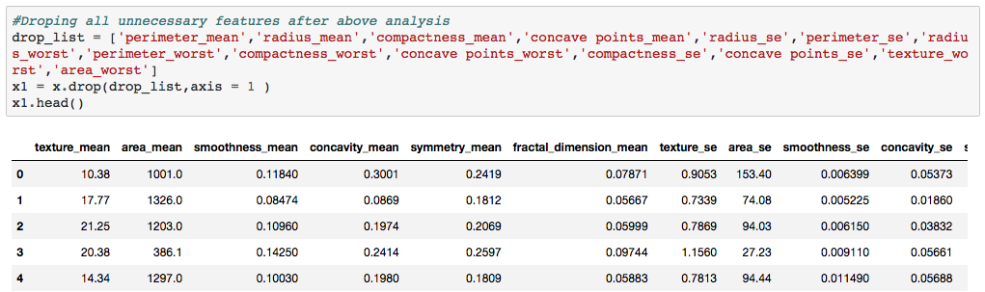
Data Exploration & Visualisation
Plot 3 – Correlation map
Plot1 - Histogram
Plot2 - Violin plot
After dropping 14 features

Slide 3
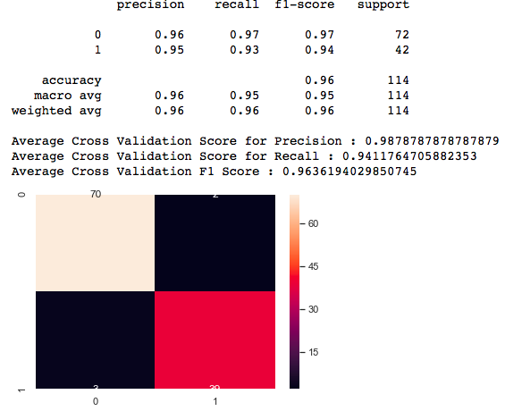
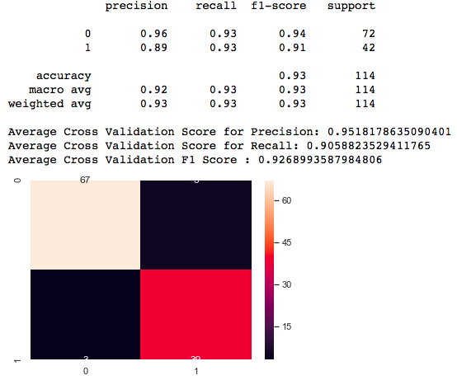
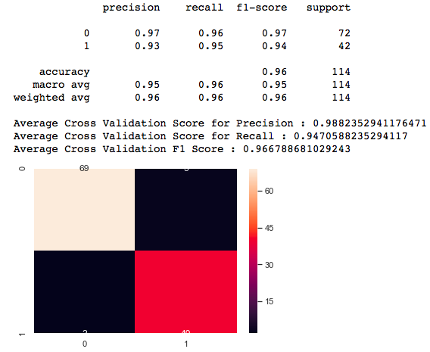
Model Selection
Logistic Regression
Random Forest
SVM
Simple baseline model
Compare results with other models
Tested various other algorithms (KNeighborsClassifier, Naive Bayes etc.)
SVM outputs the highest recall
A faster computational time as actions are parallelizable
Robust to outliers
Handles unbiased data well
Recall: 94.1%
Recall: 90.6%
Recall: 94.7%

Slide 4
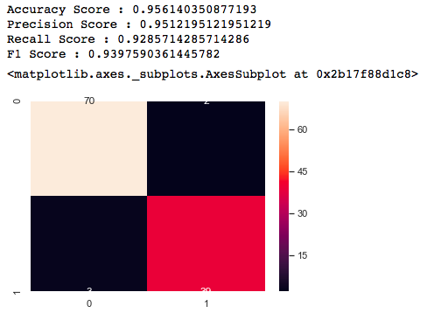

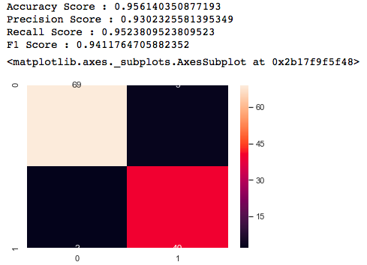
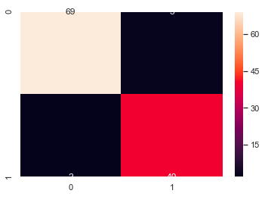
Hyperparameter Tuning (Grid Search)
Logistic Regression
Random Forest
SVM
grid_values = {"C":np.logspace(0,10,1), "penalty":["l1","l2"]}
{'n_estimators': [3, 10, 30, 50], 'max_features': [2, 4, 6, 8, 16]},
{'bootstrap': [False], 'n_estimators': [3, 10], 'max_features': [2, 3, 4]},
params = {'C': [0.1, 1, 10, 100]}
Recall: 92.9%
Recall: 95.2%
Recall: 95.2%

Slide 5
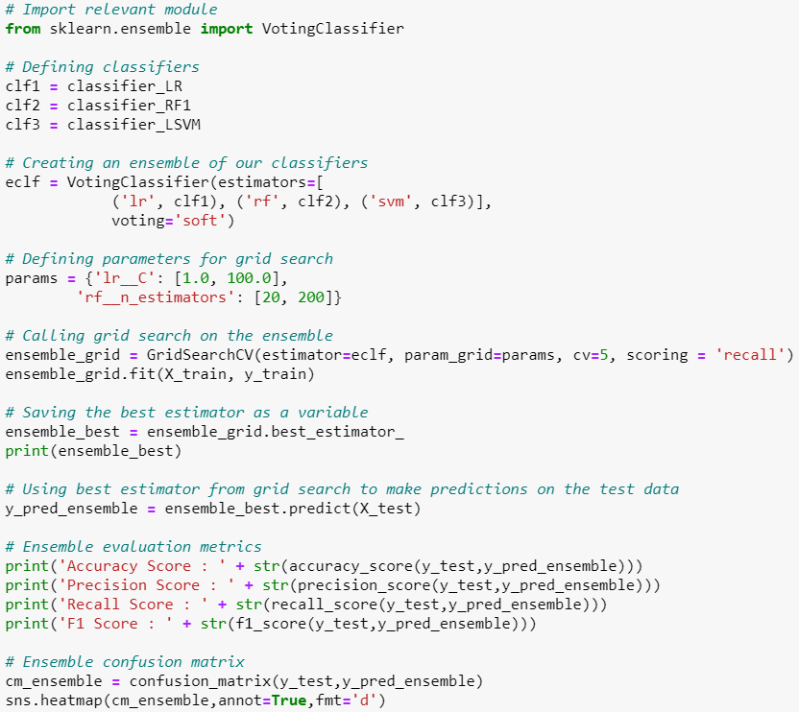
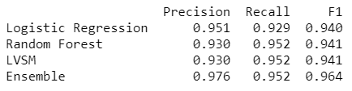
Ensemble Learning
Combines multiple models to increase predictive performance by:
Compensating for weaknesses in / combining strengths of each model
Reducing overfitting as takes an average
We used VotingClassifier
voting=soft
Output is probability of Class 1 (malignant) calculated as average probability across all included classifiers
Ensemble performed best with regard to metrics of interest
High recall minimises false negatives
High precision minimises false positives
High F1 score indicates good balance between precision and recall

Slide 6
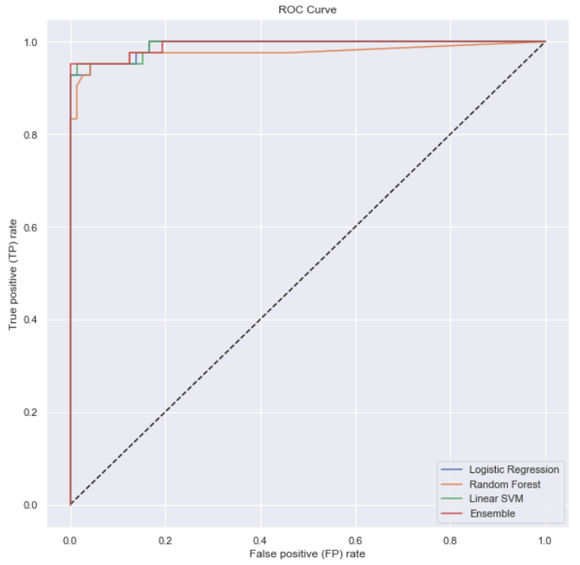
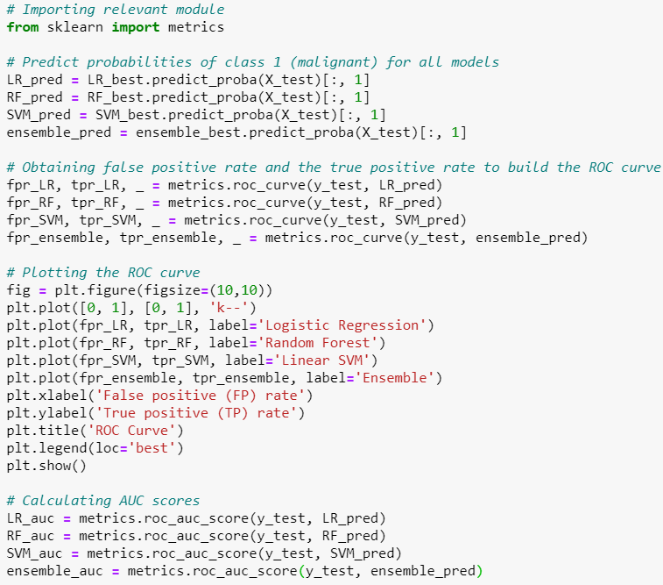
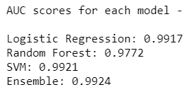

Slide 7
Summary
What Went Well | How We Could Expand / Improve
Range of clear visualisations that allowed us to select features | Could have explored correlation / multicollinearity of features with VIF
In-depth exploration of different methods of feature selection (RandomForestClassifier, PCA, handpicking) | Could have experimented more with KNeighborsClassifier
Our ensemble performed better than each model independently | Could have tried a different ensemble method, e.g. boosting
 | Could have plotted precision-recall curve
 | Could have tried RandomisedSearch instead of GridSearch
 | Could have added an extra layer of machine learning by combining our models with tuned hyperparameters into an ensemble

