Slide 1

MUSIC RECOMMENDATION SYSTEM
Presented By:
Nidhi Singhal (2000681530033)
Shreya Singh (2000681530047)
Umika Khugshal (2000681530052)
Under the Guidance of:
MR. AJAY SAH
Department of Information Technology
Meerut Institute of Engineering & Technology, Meerut (U.P.)
Notes:
₁

Slide 2

Presentation Outlines
Introduction
Research/Study Gap
Problem Statement
Objectives of the study
Methodology
DFD/Flow chart related to study
Technologies to be used
References

Slide 3
Introduction to Recommendation System
What is recommendation system?
A recommendation system assists users by making suggestions for items that are most relevant to them.
It has the ability to predict whether a particular user would prefer an item or not based on the user's profile.
It is a subclass of an information filtering system that uses computerized methods to remove redundant or unwanted information from an information stream before presenting it to a user.

Slide 4
Major types of recommendation system are:-
Collaborative Recommender System
Content Based Recommender System
Knowledge Based Recommender System
Popularity Based Recommender System
Hybrid Recommender System

Slide 5
Why do we need recommendation system?
A recommendation system assists customers in receiving individualized recommendations and helps them in making wise selections besides getting lost in vast possible options over web. For instance, it is used by entertainment-based websites like Spotify and Netflix as well as e-commerce sites like Amazon.

Slide 6
Research Gap
User preferences are always changing, and keeping up with them while maintaining accuracy is a difficult challenge for recommendation systems.
Recommendation systems that are only based on user preferences may make incorrect recommendations since any users intention for exploring a certain item can vary over time hence Content based recommendation are way better as based on current item into consideration.

Slide 7
Problem Statement
Nowadays, recommendation systems are used by every application, although there have been some issues with music recommendation systems due to shifting user preferences. This attempt to create a system for recommending music is based on content-based recommendation, which compares tags assigned to each dataset with each other before producing results. Therefore, the development of recommendation systems would benefit business providers and provide users with a positive experience.

Slide 8
Objectives of the study
This project's objective is to give the user recommendations based on his or her interests and actions about an entity currently into consideration.
To benefit commercial service providers
Provide users with a satisfying experience.

Slide 9
Methodology
The methodology for building this system is fairly simple, an individual can follow the below steps to develop such a recommendation system.
1. Choose a dataset of songs of your choice and requirement usually available on Kaggle.
In this project we used Million songs dataset

Slide 10
Methodology continue.....
2. Apply some pre-processing over data
If more than one csv files of a dataset then merge them together.
Check for Null Values and remove them.
Check for Duplicate Values and Remove if any.
Lemmatize the data.
Merge the columns to form tags for comparison
3. Now tags are converted to vectors and then cosine distance is found and stored in similarity matrics (spars matrix).

Slide 11
Methodology continue.....
4. Creating a Recommend Function which take title of songs as input and then finds its index in dataset afterwards closest value to it is found using similarity matrix.
5. And result is displayed on webpage created using Python .

Slide 12
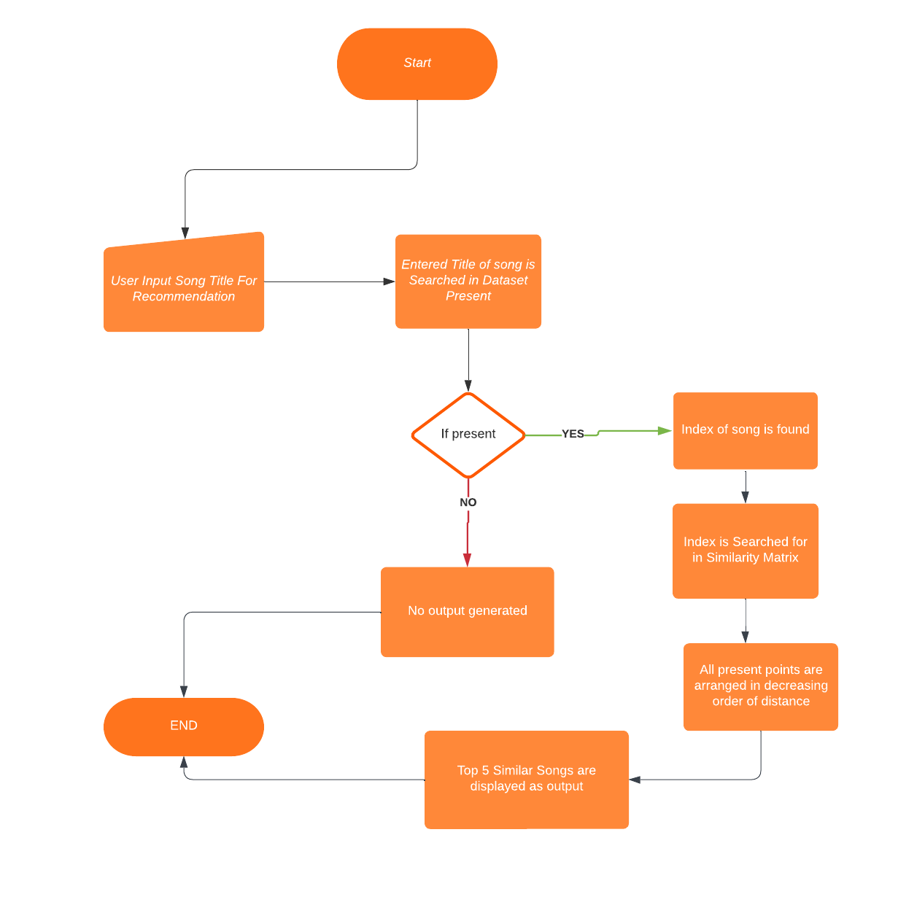
Flow chart

Slide 13
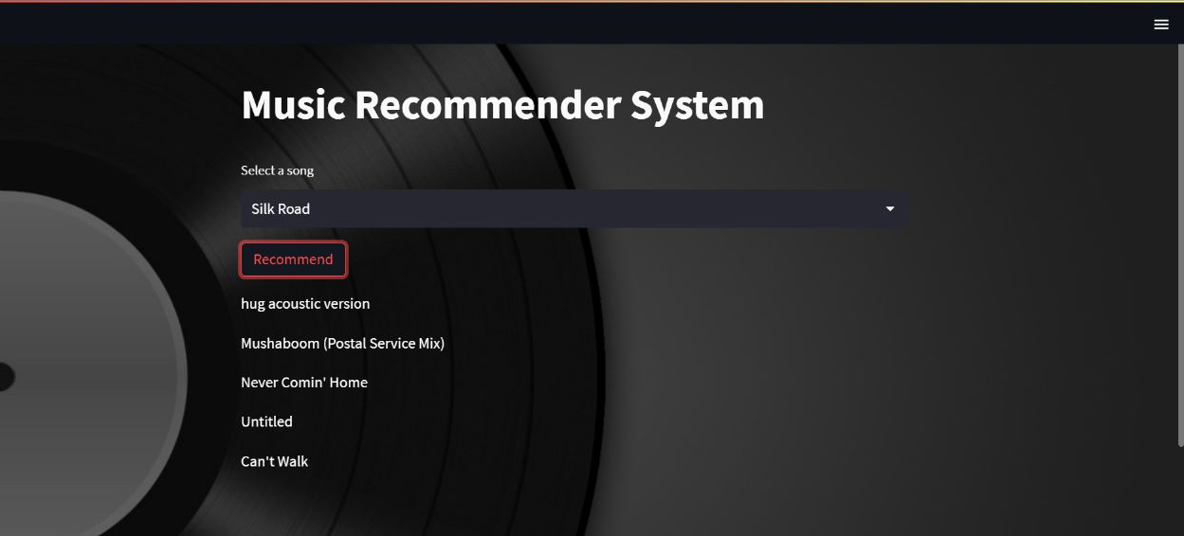
OUTPUT

Slide 14
Technologies to be used
This project will be using the following technology stack:
Python
Machine Learning
Computation over data like Cosine Similarity, Vectorization
Python Libraries like
Pandas , Numpy , Streamlit , Pickle

Slide 15
References
https://jupyter.org/
http://millionsongdataset.com/
https://streamlit.io/
https://github.com/
https://stackoverflow.com/
https://www.nltk.org/
https://www.lucidchart.com/pages/

