Slide 1
PROJECT NAME - PROJECT MANAGEMENT SOLUTION

Slide 2
Diploma in Advance Computing CDAC HYDERABAD
Guided by
Mr. Kale Sandip Shivaji
Presented by: PRN Number
Ms. Bhavana Naikwad 230950320050
Mr. Namit Devidan 230950320051
Ms. Neha Mishra 230950320052
Ms. Nidhi Tidke 230950320053
Mr. Nihar Agrawal 230950320054
Mr. Ronak Nikose 230950320055
Mr. Nomesh Chakole 230950320056

Slide 3
Presentation Overview
Introduction
Technologies Used in Project
Software Used in Project Management Solution
User Modules
Modules Functionality
Home Page
Login Page
Add Projects
All Projects
Assign Project
Future Scope

Slide 4
Introduction
In the fast-paced world of project management, efficient coordination, delegation, and monitoring are paramount for successful project execution. With the advent of modern technologies, the integration of robust software solutions has become indispensable in streamlining these processes.
Welcome to our Project Management Solution – a comprehensive tool designed to empower administrators, team leads, managers, and team members in effectively managing tasks and projects from inception to completion

Slide 5
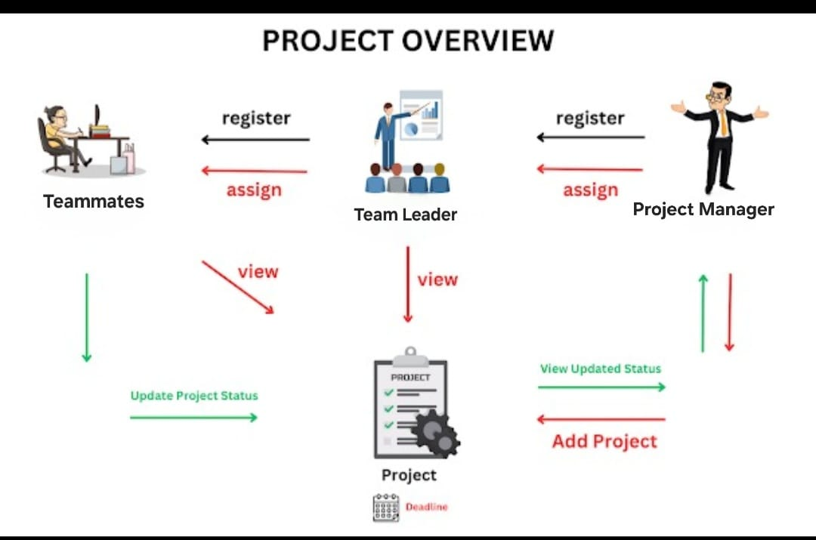

Slide 6
Technologies Used in Project
1. Spring Boot (REST APIS)
2. React JS (Frontend)
3. MySQL for Database
4. Maven for project management
5. Bootstrap (Styling)

Slide 7
Software Used in Project Management Solution
1. STS (Spring Tool Suite)
For developing backend of our project using Spring Boot, we have used STS (Spring Tool Suite) or Eclipse Ide. But yes, we can use other IDEs also like Intellij Idea, NetBeans, etc.
2. VS Code (Visual Studio Code)
For developing our frontend of our project using react JS, we have used VS Code (Visual Studio Code).
3. MySQL Command Line Client
For efficient querying , storing and manipulation of our Project's information, we have used MySQL Command Line Client. MySQL Workbench can also be used.

Slide 8
User Modules in Project Management Solution
The project basically has three user modules:
1) MANAGER MODULE
2) TEAM LEADER MODULE 3) TEAM MEMBER MODULE

Slide 9
Module Functionality
1) User Authentication Module:
The registration and Login system has been added so that only authenticated users (Project Manager & Customer) can perform their functionalities.
2) Manager Module:
Register Manager, View Managers, Delete Manager, Change Password.

Slide 10
3) Team Leader Module:
Register Teammate, View Teammate, Delete Teammate, Change Password. 4) Project Module:
Add Project, View Project, Assign Project to Team Leader, Assign Project To Teammate, Update Project Status.

Slide 11
Project Management Solution : Our Project Management Solution, built using React JS and Spring Boot, simplifies project coordination for managers, team leaders, and teammates.
With three core modules, it ensures smooth task delegation and progress tracking:
Manager Module : Managers initiate projects, set deadlines, and assign tasks to team leaders based on their expertise. They oversee project progress and can register new team leaders when needed.

Slide 12
Conti.
2. Team Leader Module : Team leaders manage tasks within projects, assigning them to teammates as necessary . They monitor deadlines and collaborate with team member for efficient project completion .
3. Team Member Module : Team Member view assigned tasks and deadlines, updating statuses upon completion . They communicate with team leaders and collaborate with colleagues as required.

Slide 13
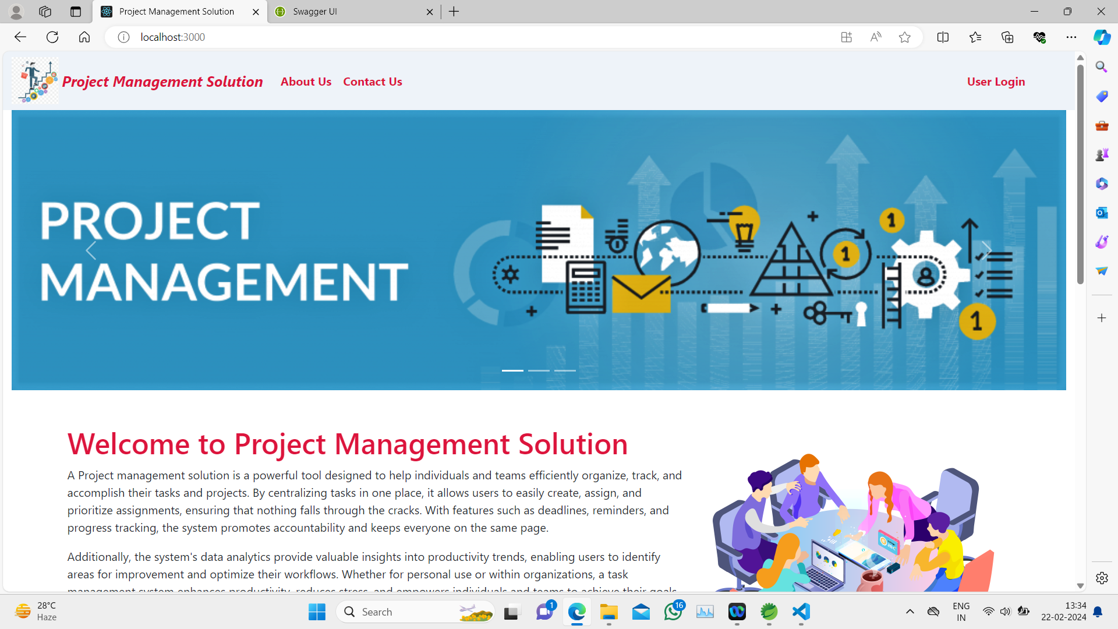
Home Page

Slide 14
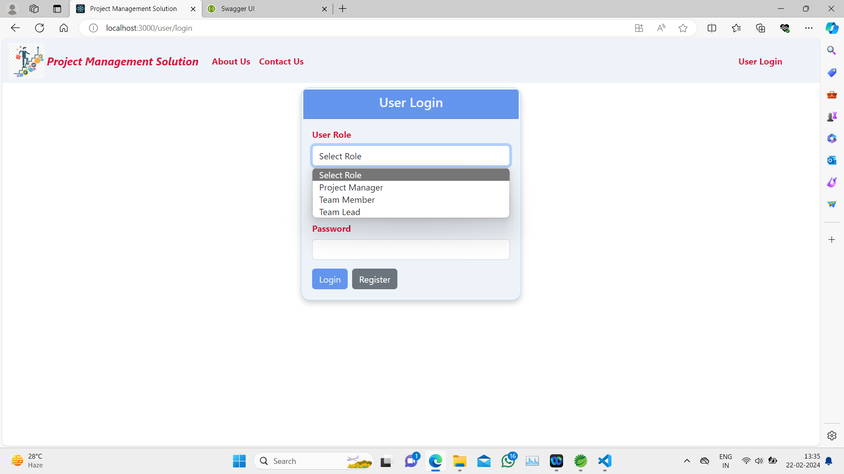
Login page

Slide 15
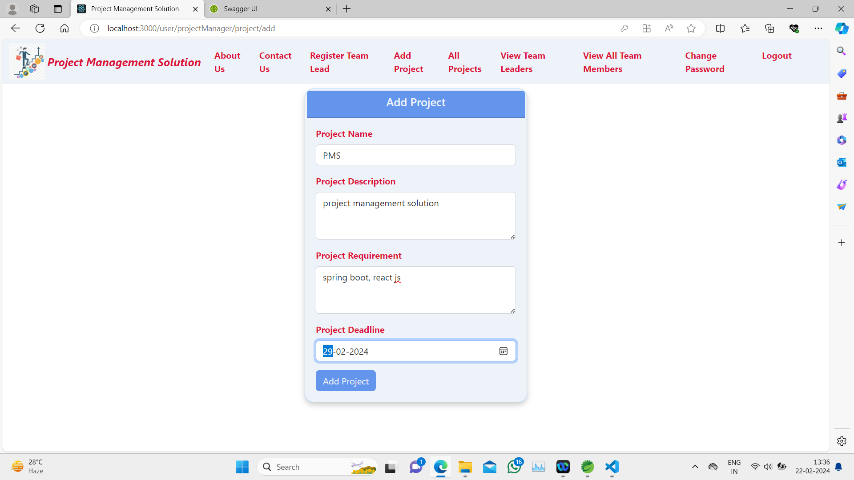
Add Project

Slide 16
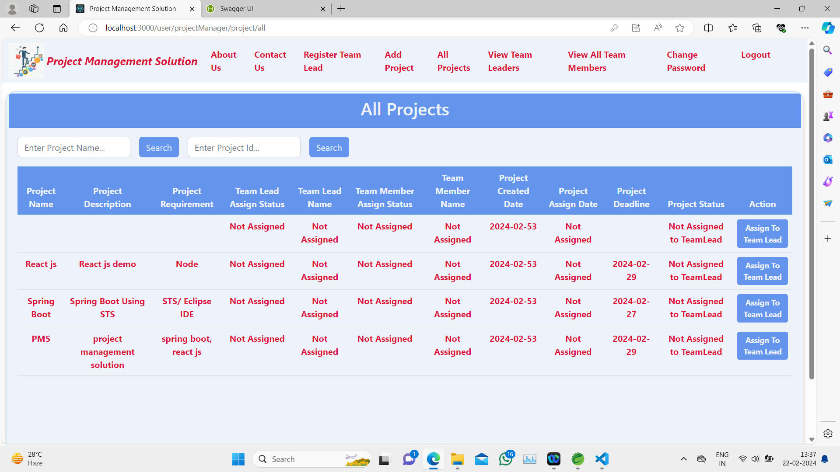
All Projects

Slide 17
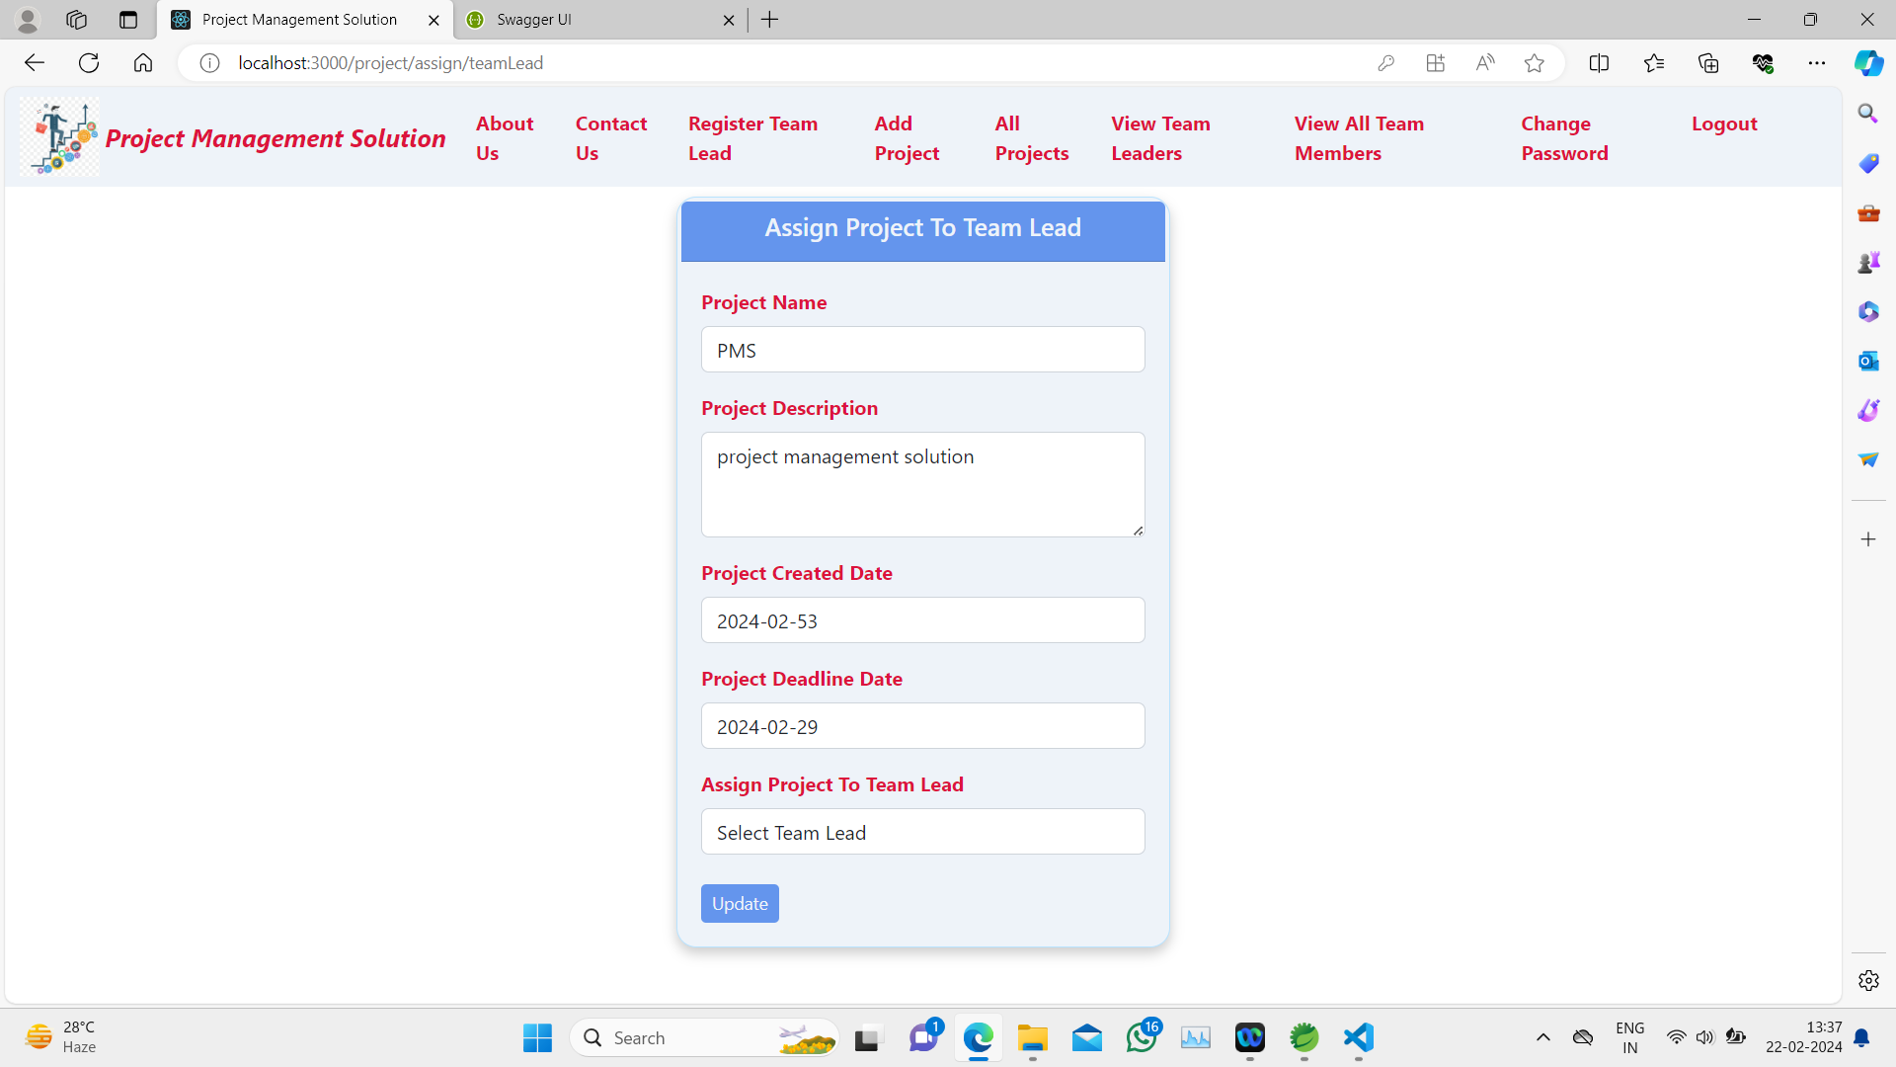
Assign Project

Slide 18
FUTURE SCOPE :
Mobile App Development: Extend to native mobile platforms.
Blockchain Integration: Ensure secure and transparent project management.
Advanced Analytics: Provide actionable insights from project data.
Enhanced User Experience: Focus on UI/UX refinement.
Globalization: Support multiple languages and localization.
Continuous Improvement: Regularly update and innovate features.
AI and Automation: Implement AI for task automation and risk prediction.

Slide 19
END

