Slide 1
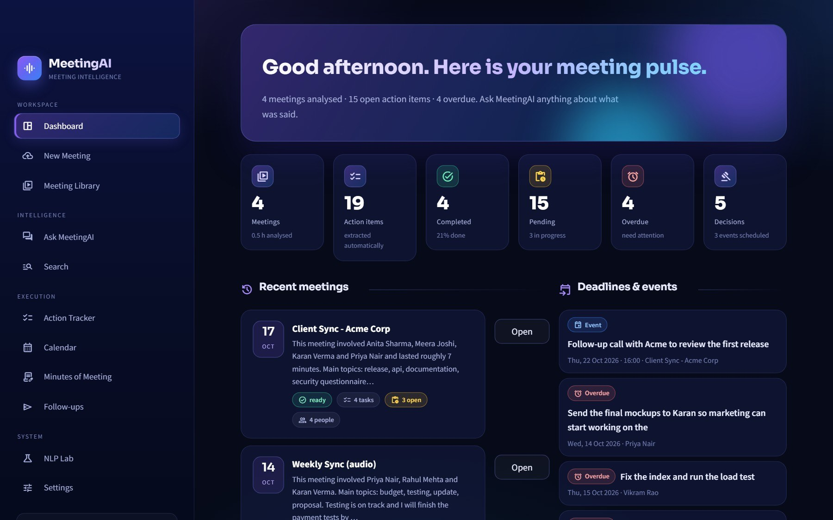
|||
MeetingAI
MEETING INTELLIGENCE
HYBRID NLP + LLM · PROJECT PRESENTATION
Turn every meeting
into decisions,
tasks and answers
Upload a recording or transcript - get speaker names, a summary, action items with owners and deadlines, a calendar, chat and ready-to-send minutes.
TEAM
Live app: gd4n8x8sjkkxmdhfptkc9m.streamlit.app
Nidhi Tiwari A033
Dhruvi Devalia A044
Jivesh Gawde A057
Yashika Parmar A061
Notes:
Introduce the team and the project in one sentence: MeetingAI listens to a meeting (audio or transcript) and turns it into who-said-what, a summary, action items with owners and deadlines, decisions, calendar events, a chat you can ask questions to, and professional minutes. It is live on Streamlit Community Cloud.

Slide 2
AGENDA
What we will cover
1
The problem and our idea
2
Why hybrid NLP + LLM
Why meetings lose information
Each part does what it is best at
3
Architecture and pipeline
4
The NLP core
From upload to saved results
Classifier, rules, confidence gateway
5
LLM layer and validation
6
Speakers, search and chat
Free models, checked by code
Names on voices, grounded answers
7
The product
8
Engineering decisions
Screens, minutes, e-mail, calendar
Assumptions, security, deployment
MeetingAI · Project Presentation
2
Notes:
Eight parts, roughly in the order the data flows through the system: problem, idea, architecture, NLP, LLM, speakers/search, product, and engineering decisions.

Slide 3
1 · THE PROBLEM
Important things get lost in meetings
Who owns it?
By when?
"Who was going to send that report?" - nobody remembers, so nobody does it.
"What deadline did we agree on?" - three people, three different answers.
What was decided?
Notes cost time
"Did we decide to hire the agency?" - someone re-watches an hour of video to find out.
Minutes by hand take hours; plain transcription tools only give a wall of text with "Speaker 1".
OUR RULE When MeetingAI does not know something it says so: owner = Unassigned, deadline = Not specified, answer = not found. It never invents names or dates to look clever.
MeetingAI · Project Presentation
3
Notes:
Everyone has been in the meeting where nobody remembers who owned the follow-up. Our rule from day one: when the system does not know, it says so instead of guessing.

Slide 4
2 · THE SOLUTION
MeetingAI: an assistant that attended every meeting
Transcribe
Who said what
Summarise
Audio / video to timestamped text (Whisper)
Real names on every voice via pyannote
Overview, key points, topics, conclusions
Action items
Decisions & events
Ask AI
Owner, deadline, priority, evidence quote
Detected, dated and put on a calendar
Chat over every meeting, with sources
Search
Minutes (MoM)
Follow-ups
Keyword + meaning across all meetings
Edit, download Word / PDF, e-mail
Reminders drafted - sent only after approval
MeetingAI · Project Presentation
4
Notes:
Walk through the nine capabilities quickly - each one has its own screen later in the deck. Stress that everything runs on free tiers.

Slide 5
2 · THE SOLUTION
The user journey: five steps
1 Upload
2 Wait
3 Review
4 Ask & track
5 Share
Drop a recording or paste / upload a transcript. Optionally add a title, date and tags.
The pipeline transcribes, labels speakers, extracts insights and indexes everything.
Read the summary, fix any "Needs review" item, name the anonymous voices.
Chat or search across meetings; manage tasks on the tracker and calendar.
Generate minutes, download Word / PDF, e-mail them, send follow-ups.
USER STAYS IN CONTROL A demo meeting set can be loaded from Settings, so every page has data to explore. Confirmation is always required before anything leaves the app (e-mail, follow-ups).
MeetingAI · Project Presentation
5
Notes:
This is what a user actually does. Everything between step 1 and step 3 happens automatically in the pipeline we explain next.

Slide 6
3 · DESIGN IDEA
Why hybrid: classical NLP + free LLMs + code checks
1 · Classical NLP first
2 · LLM only if unsure
3 · Code verifies
▸ Fast, free, runs offline
▸ TF-IDF + Naive Bayes + rules
▸ Scores every sentence
▸ Explainable: reason codes
▸ Weak on nuance
▸ One batched call, not one per sentence
▸ Writes summaries and answers
▸ Understands context and wording
▸ Can hallucinate if unchecked
▸ Rate-limited, can fail
▸ Quote must exist in the transcript
▸ Owner must be a real person
▸ Dates computed by our code
▸ NLP + LLM agree = 0.95 confidence
▸ Failures become 'Needs review'
RESULT The clear-cut cases cost nothing (no API call). Uncertain cases go to the LLM in a single batch. Everything the LLM says is checked against the transcript. If no LLM key is configured the app still works - the NLP result is shown and uncertain items are marked Needs review.
MeetingAI · Project Presentation
6
Notes:
This is the central design decision. LLMs alone are impressive but can invent things; classical NLP alone is explainable but rigid. We use each for what it is best at and let plain code verify the result.

Slide 7
1
Architecture and pipeline
Four layers, fourteen steps, one rule: pages draw, core thinks.
Notes:
Section divider.

Slide 8
SYSTEM DESIGN
Architecture: four simple layers
1 · PRESENTATION - STREAMLIT APP (APP.PY · VIEWS/ · UI/)
Dashboard
New Meeting
Library
Meeting
Ask AI
Search
Tracker
Calendar
Minutes
Follow-ups
NLP Lab
Settings
calls
2 · APPLICATION LOGIC - CORE/ (PURE PYTHON, NO UI CODE)
parsing.py
stt.py · diarize.py
nlp.py · dates.py
gateway.py
speakers.py
txt · vtt · srt · docx · pdf
Whisper · pyannote · voiceprints
rules · Naive Bayes · dates
confidence checkpoint
name suggestions
llm.py · llm_tasks.py
pipeline.py
rag.py
mom.py · mailer.py · ics.py
followups.py · db.py
free-LLM router · prompts
orchestrates + validates
index · search · chat
minutes · e-mail · calendar
reminders · all SQL
SQL · vectors
HTTPS
3 · STORAGE (DATA/ FOLDER)
4 · EXTERNAL FREE SERVICES (OPTIONAL · API KEYS)
SQLite + FTS5
ChromaDB
uploads/
Groq
Gemini
OpenRouter
meetings · tasks · chats
semantic vectors
recordings
pyannoteAI
AssemblyAI
SMTP
RULES views/ draw, core/ thinks · db.py is the only SQL writer · every external service is optional and has a fallback.
MeetingAI · Project Presentation
8
Notes:
Read it top to bottom. The UI layer calls pure-Python modules in core/. core/ reads and writes SQLite and ChromaDB, and optionally calls free external APIs. Nothing in core/ imports a Streamlit page and only db.py writes SQL.

Slide 9
PIPELINE
What happens to one meeting: 14 steps
1
2
3
4
5
6
7
Upload
Read
Transcribe
Who spoke
Segments
Sentences
Classify
file + options
parse or FFmpeg convert + chunk
Whisper, word timestamps
pyannote diarization
speaker-labelled lines
split · clean · time
TF-IDF + NB + rules
8
9
10
11
12
13
14
Gateway
LLM (if unsure)
Validate
Merge
Save
Index
READY
4 trust questions
batch adjudication + summary
quote · owner · date
NLP + LLM de-duplicate
SQLite + FTS5
ChromaDB chunks
all pages use new data
BLUE / TEAL = INPUT & SPEECH
VIOLET / AMBER / PINK = INTELLIGENCE
RED / GREEN = TRUST & STORAGE
Steps 3-4 are skipped for text transcripts that already contain speaker names.
Classical NLP decides first; the LLM is called once per meeting batch only for uncertain items.
Nothing is saved until it passes validation; saved data feeds every page.
MeetingAI · Project Presentation
9
Notes:
Steps 3 and 4 only apply to audio/video - a text transcript skips them. Steps 7-10 are the NLP + LLM heart of the project and are explained in detail in the next sections. The whole thing runs automatically after one click.

Slide 10
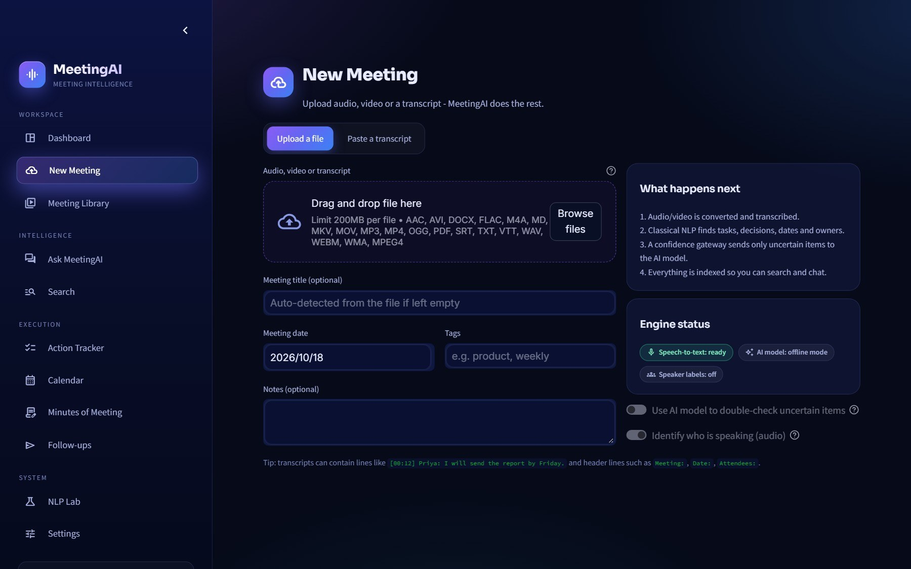
PIPELINE · UPLOAD
Step 1-2: input and transcription
▸ Accepted files mp3 · wav · m4a · mp4 · mkv · txt · vtt · srt · docx · pdf
▸ FFmpeg converts to 32 kbps mono and cuts 10-minute chunks - small enough for free API limits
▸ Speech-to-text Groq Whisper (whisper-large-v3-turbo) with word-level timestamps; AssemblyAI as alternative
▸ Transcripts parsed straight into speaker segments - names kept if the file has them
▸ Duplicate guard the same file is never processed twice
New Meeting page - drop a file or paste a transcript
WHY CHUNKS Free speech APIs cap upload size; chunking keeps every meeting length workable and lets us retry one piece instead of everything.
MeetingAI · Project Presentation
10
Notes:
Show the upload screen. Emphasise the chunking decision: free API plans limit file size, so audio is compressed to 32 kbps mono and cut into 10-minute pieces - speech quality is unaffected.

Slide 11
2
The NLP core
What is trained, how a sentence is scored, and when the LLM is allowed to step in.
Notes:
Section divider.

Slide 12
NLP · TRAINING AND SETUP
Training: the classifier is built at start-up
190
110
100
210
action sentences
"Priya will send the report by Monday"
decision sentences
"We decided to launch on the 15th"
question sentences
"Can you review the draft?"
discussion sentences
"The beta has been running well"
610 template sentences (seed 42) -> vectorise -> train -> cache
seed_data.py
TF-IDF
Naive Bayes
Model cached
templates × names, topics, dates - generated with a fixed seed
unigrams + bigrams: words and short phrases
MultinomialNB, alpha = 0.3 (gentle smoothing)
st.cache_resource - trained once per server start
ASSUMPTION Template sentences stand in for a real labelled corpus. Reason: none exists for our domain and free hosting forbids heavy training. They give a working, explainable baseline.
HOW WE CHECK IT NLP Lab evaluates the model on 42 separate hand-written test sentences (accuracy, per-class report, confusion matrix) - visible in the app.
MeetingAI · Project Presentation
12
Notes:
There is no separate training job. When the app starts it generates 610 template sentences, trains the model in about a second and caches it. Be honest about why: no labelled meeting corpus is available, so templates give a working baseline, and the NLP Lab measures it on 42 hand-written sentences that are NOT in the training set.

Slide 13
NLP · CLASSIFICATION
Scoring one sentence: two experts, one fused score
Rule expert
weighted regex cues: will · by Friday · we decided; hedges: maybe · might
Sentence
Fusion
Candidate
"Priya will send the project report by Monday."
0.5 × NB + 0.5 × rules
× 0.8 if hedged
class · score · margin
kept if score ≥ 0.33
Statistics expert
TF-IDF + Naive Bayes trained on 610 sentences
THEN, FOR EACH CANDIDATE, THREE EXTRACTORS FILL IN THE DETAILS
Owner finder
Deadline finder (dates.py)
Event finder
"I" = speaker · "Priya will..." = Priya · "we" or nothing = Unassigned
"by Monday" -> real date · "soon" -> Not specified (never guessed)
meeting / review words + a date or time -> calendar event
MeetingAI · Project Presentation
13
Notes:
Each sentence is judged by a rules expert (weighted regex cues such as 'will', 'by Friday', 'we decided') and a statistics expert (Naive Bayes). Their scores are averaged 50/50 because Naive Bayes alone is over-confident. Hedged language ('maybe', 'might') multiplies the score by 0.8.

Slide 14
NLP · EXTRACTION
Owners and deadlines: confidence for every guess
OWNER CONFIDENCE
DEADLINE RESOLVER (dates.py)
Case
Conf.
Result
Phrase in the sentence
What happens
Known participant named
0.95
owner = that person
"by Monday", "next Friday"
converted to a calendar date
Name not in participant list
0.88
owner kept, flagged
Explicit dates / times
parsed as written
"We" (shared)
0.90
nobody → Unassigned
"soon", "ASAP", "later"
no date: Not specified
No owner words at all
0.50
Unassigned
Date from a neighbouring sentence
lower confidence -> checked
Pronoun only (he / she)
0.40
Unassigned
Why a confidence per field?
Deterministic dates
Honest by design
A sentence can be clearly a task (score 0.9) while its owner is a guess (0.4). Separate numbers let the gateway judge each part.
A rule-based resolver, not an LLM, produces dates: the same phrase always gives the same date relative to the meeting date.
An unknown owner shows Unassigned and a vague deadline shows Not specified - never a guess.
MeetingAI · Project Presentation
14
Notes:
Every extracted owner and date carries its own confidence. The gateway later uses these numbers to decide whether to trust the NLP or ask the LLM. Note that vague deadlines are deliberately left empty.

Slide 15
NLP → LLM HANDOVER
The confidence gateway: trust, or ask for help
all pass
Candidate
Q1 · Score
Q2 · Margin
Q3 · Owner
Q4 · Deadline
ACCEPT
from the classifier
score ≥ 0.80
winner leads by ≥ 0.15
owner conf. ≥ 0.85
not from neighbour · exact ≥ 0.85
no LLM cost
fail
fail
fail
fail
NOT SURE · a reason code is logged (e.g. LOW_CLASS_MARGIN, OWNER_UNCERTAIN)
LLM configured -> ONE batched call
No LLM available
Sentence + context sent together. If the LLM says task or decision: kept (method LLM fallback, confidence ≥ 0.85) and validated. If it says 'neither': dropped (LLM_REJECTED).
Score ≥ 0.55: kept and marked Needs review. Below that: not added to the tracker. The decision is still logged.
KEY IDEA Failing is not rejecting. A failed check means 'the classical result is not trustworthy enough on its own'.
MeetingAI · Project Presentation
15
Notes:
This is the heart of the hybrid. Four yes/no questions are asked about every candidate. If all four pass, the classical result is accepted for free. If any fails it simply means 'not sure' - not 'wrong' - and the item is sent to ONE batched LLM call. With no LLM configured, items scoring at least 0.55 are kept but marked Needs review.

Slide 16
NLP → LLM HANDOVER
The gateway on real sentences
Sentence
Score
Owner
Date
Gateway result
"Priya will send the project report by Monday."
0.98
0.95
0.95
all four pass → accepted, no LLM
"Please book the conference room."
0.87
0.50
-
Q3 fails (OWNER_UNCERTAIN) → LLM, else Unassigned
"Maybe we should consider hiring another developer."
low
-
-
hedged → not a task
"We need to fix the login bug soon."
0.85
0.90 ("we")
0.60 vague
accepted; owner Unassigned, deadline Not specified
REASON CODES STORED FOR EVERY DECISION (analysis_log)
CLASSICAL_ACCEPTED
LOW_CLASSIFICATION_CONFIDENCE
LOW_CLASS_MARGIN
OWNER_UNCERTAIN
DEADLINE_FROM_NEIGHBOUR
HEDGED_LANGUAGE
LLM_CONFIRMED
LLM_REJECTED
MISSING_EVIDENCE
ASSUMPTION 0.80 / 0.15 / 0.85 / 0.85 are sensible starting values, not optima - all four are sliders in Settings and testable in the NLP Lab.
MeetingAI · Project Presentation
16
Notes:
Walk through the four rows. Row 2: the sentence is clearly a task (score 0.87) but there is no owner word, so Q3 fails and the LLM is asked. Row 4: 'we' means nobody specific, and 'soon' is vague, yet that does not fail Q4 on purpose - an LLM cannot invent a date that was never said.

Slide 17
3
LLM layer and validation
Free models do the language work - code checks everything they say.
Notes:
Section divider.

Slide 18
LLM · RELIABILITY
A router over free LLMs
Valid JSON / text → pipeline validation
one automatic repair attempt if the JSON is malformed
ok
Request
Groq
429 / error
Gemini
429 / error
OpenRouter
summary · adjudicate · answer · polish
llama-3.3-70b → 8b
fastest free tier
2.5 flash → flash-lite
first for long transcripts
:free models
all failed
Model retired?
Rate-limited?
All providers failed
discover_model() asks the provider for a current free model
45-second cool-down, then the next provider
classical NLP result is shown; items marked 'Needs review'
MeetingAI · Project Presentation
18
Notes:
No single free service is reliable enough, so llm.py tries providers in order. A rate limit (HTTP 429) puts a provider on a 45-second cool-down and the next is tried. Gemini is preferred for very long transcripts because of its large context window.

Slide 19
LLM · TASKS AND PROMPT RULES
What the LLM is actually asked to do
Call
Purpose
Analysis (per transcript chunk)
Summary, key points, topics, conclusions + independent task / decision / event suggestions
Merge (long meetings)
Combine chunk summaries into one coherent summary
Adjudication (one batch)
"Is each uncertain sentence a task, a decision, or neither?"
Answer
Grounded chat and search answers from retrieved evidence only
Naming / polishing (optional)
Speaker-name evidence, friendlier follow-up wording
Verbatim quotes
Copied date phrases
JSON only
Every task, decision and event must include an exact quote from the transcript.
The LLM copies "next Friday"; our dates.py converts it. LLMs are bad at calendar arithmetic.
Structured output that can be parsed and checked; one repair attempt if it is malformed.
MeetingAI · Project Presentation
19
Notes:
The LLM is never trusted as an authority - it is a language engine. The prompts force it to quote the transcript verbatim and to copy date phrases rather than compute dates; that is what makes mechanical validation possible.

Slide 20
LLM · VALIDATION
Never trust an LLM blindly: the validation layer
Exact quote exists?
fuzzy-match against the transcript (82 / 92)
no match → dropped · MISSING_EVIDENCE
LLM output
Owner is a real person?
Trusted results
participant or named in the transcript
else Unassigned + needs review
tasks · decisions · events (JSON)
saved with method, confidence and evidence
Date computed by code?
LLM copies "next Friday"; dates.py converts it
phrase must occur near the quote
Agrees with classical NLP?
yes → confidence 0.95 (NLP + LLM agree)
conflict → CONFLICTING_EXTRACTIONS
RESULT Anything that fails a check is dropped or saved as 'Needs review' - it never silently becomes a fact.
MeetingAI · Project Presentation
20
Notes:
pipeline.py checks everything the LLM returns against the real transcript before saving. This is why the system is safe to rely on: a hallucinated task has no matching quote and is dropped.

Slide 21
4
Speakers, data, search and chat
Names on every voice, a two-store memory, and answers that cannot be made up.
Notes:
Section divider.

Slide 22
SPEAKERS
Names on every voice: pyannote speaker identification
Audio file
Whisper (Groq)
text + word timestamps
Align
Speaker-labelled transcript
word midpoint inside a speaker turn
"Speaker 1: I'll send it Monday"
pyannote
who spoke when: Speaker 1, 2...
THREE WAYS TO TURN "SPEAKER 1" INTO "PRIYA" - YOU ALWAYS CONFIRM
1 · Voice profiles
2 · Clues in the conversation
3 · Type it yourself
▸ Save a 5-30 s clip once (voiceprint)
▸ pyannoteAI matches it in later meetings
▸ Match threshold 60 (adjustable)
▸ Opt-in, deletable any time
▸ Self-intro "I'm Priya" (weight 3)
▸ Being addressed "Priya, can you..." (1.2)
▸ Being thanked "Thanks Priya" (0.9)
▸ Elimination; optional LLM check
▸ Who-is-who panel plays a sample
▸ Shows evidence and attendees
▸ Apply the name to the whole meeting
▸ Names are used in tasks and minutes
MeetingAI · Project Presentation
22
Notes:
Whisper gives words with timestamps but not speakers; pyannote gives speaker turns but not words. We align them: each word goes to the speaker turn that contains its midpoint. Names are then suggested from three sources, and the user always confirms.

Slide 23
DATA AND STORAGE
Where the data lives: SQLite + ChromaDB
meetings · every other table is linked by meeting_id
ChromaDB (data/chroma)
▪ transcript chunks, ~110 words
▪ decisions and tasks as vectors
▪ cosine similarity
▪ ONNX MiniLM-L6-v2, 384 dimensions
▪ no PyTorch needed → fits ~1 GB RAM
Transcript
Insights
Documents
Chat & people
▪ segments
▪ segments_fts (keyword index)
▪ summaries
▪ tasks
▪ decisions
▪ events
▪ analysis_log (reason codes)
▪ mom (minutes)
▪ followups
▪ email_log
▪ chat_sessions
▪ chat_messages
▪ voiceprints
▪ settings
WHY SQLITE FTS5 Keyword search with stemming: "deploying" finds "deployed". Zero server to run.
BACKUP Free hosting disks are temporary, so Settings → Data & backup exports everything as a zip and restores it.
MeetingAI · Project Presentation
23
Notes:
Two stores, each for what it does best. SQLite is the source of truth for structured data and also provides FTS5 keyword search. ChromaDB stores meaning vectors for semantic search. We deliberately avoid Postgres/Supabase to stay free and self-contained.

Slide 24
SEARCH AND CHAT
Chat and search that cannot make things up (RAG)
Semantic search
"Not found"
ChromaDB meaning vectors
no LLM call made
no
Your question
Query router
Keyword search
Fuse (RRF)
Relevance gate
tasks · decisions · events · summary · phrase
SQLite FTS5, stemmed
rank fusion, k = 60
sim ≥ 0.28 or 50% words
Structured facts
tasks · decisions · events · summaries
yes: ranked evidence
LLM answers
Verify
Answer + sources
from retrieved evidence ONLY
citations exist · numbers found in evidence
saved in chat history
MeetingAI · Project Presentation
24
Notes:
Retrieval-augmented generation with two safety gates. Hybrid retrieval combines meaning search and keyword search with Reciprocal Rank Fusion. A relevance gate refuses to answer, without calling the LLM, if nothing relevant was retrieved. Finally citations are verified against the evidence.

Slide 25
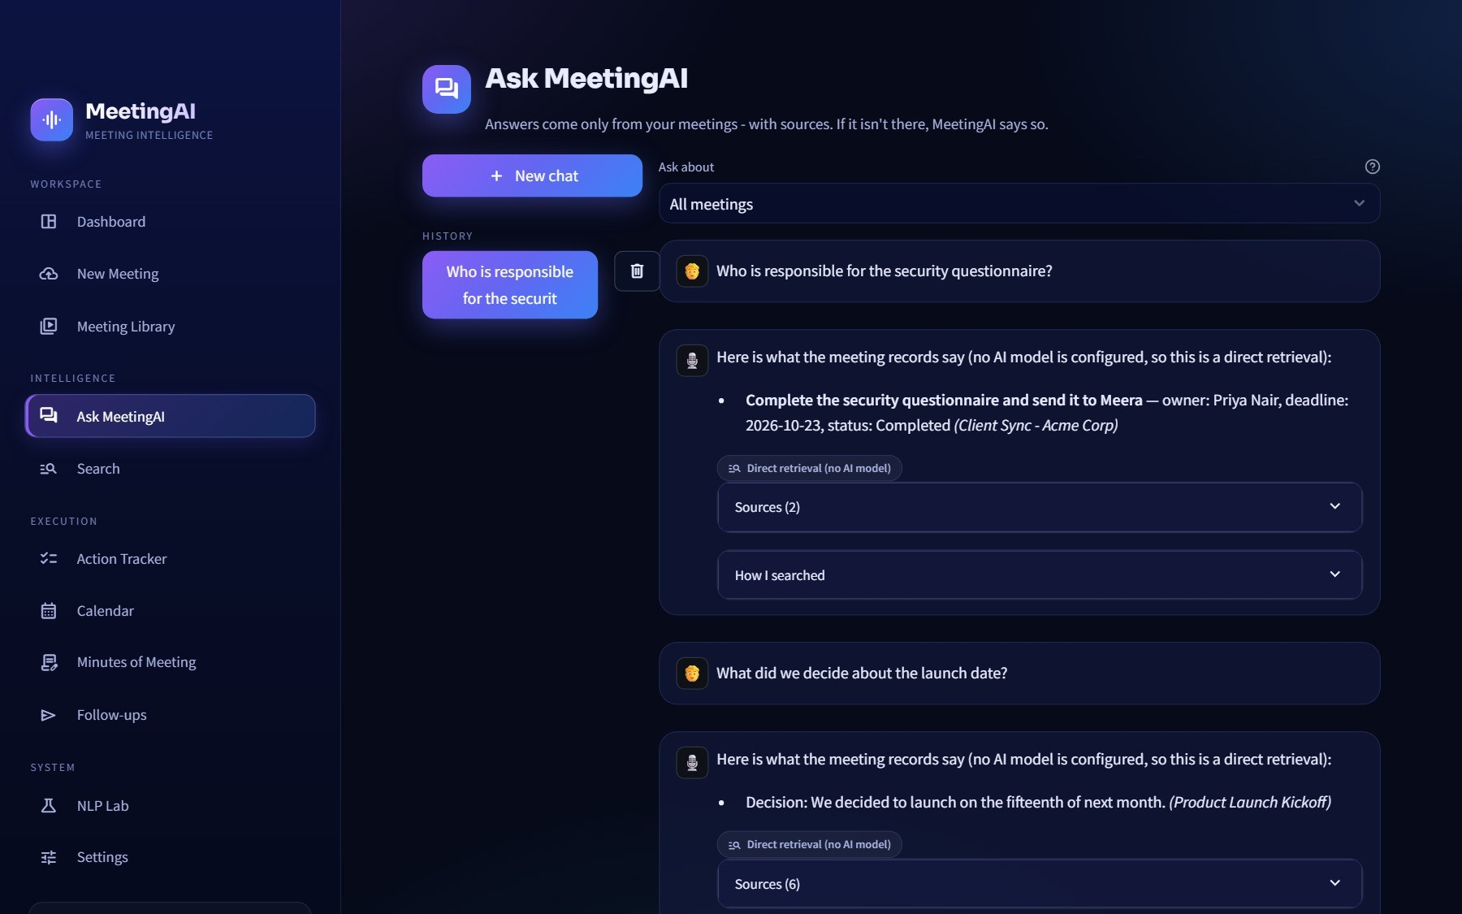
SEARCH AND CHAT
The query router: the right tool for each question
FIVE INTENTS
Tasks
"Who is responsible for the report?" → tracker table
Decisions
"What did we decide?" → decisions table
Events
"When is the next review?" → calendar data
Summary
"Summarise the kickoff" → stored summary
Phrase
"Who said budget?" → hybrid search + LLM
Ask MeetingAI - answers cite their source meeting and quote
HONEST If the transcripts do not say, the answer is "not found" - the LLM is not asked to guess.
MeetingAI · Project Presentation
25
Notes:
Not every question needs retrieval. 'Who is responsible for the report?' is answered straight from the tasks table; 'Who said budget?' uses hybrid search. Routing by intent makes answers faster and more accurate.

Slide 26
5
The product
A tour of the screens - dashboard to minutes - and everything that can leave the app.
Notes:
Section divider.

Slide 27
PRODUCT TOUR
Dashboard: your meeting pulse
WHAT YOU SEE
1
Six pulse tiles
meetings analysed, action items, completed, pending, overdue, decisions - at a glance
2
Recent meetings
each with status, source and how it was analysed (NLP / LLM)
3
Deadlines & events
upcoming and overdue items pulled from every meeting
4
Charts below
tasks by status, owner and priority
Sidebar → Dashboard
MeetingAI · Project Presentation
27
Notes:
Start the live demo here. Show that the numbers are real data from the processed meetings.

Slide 28
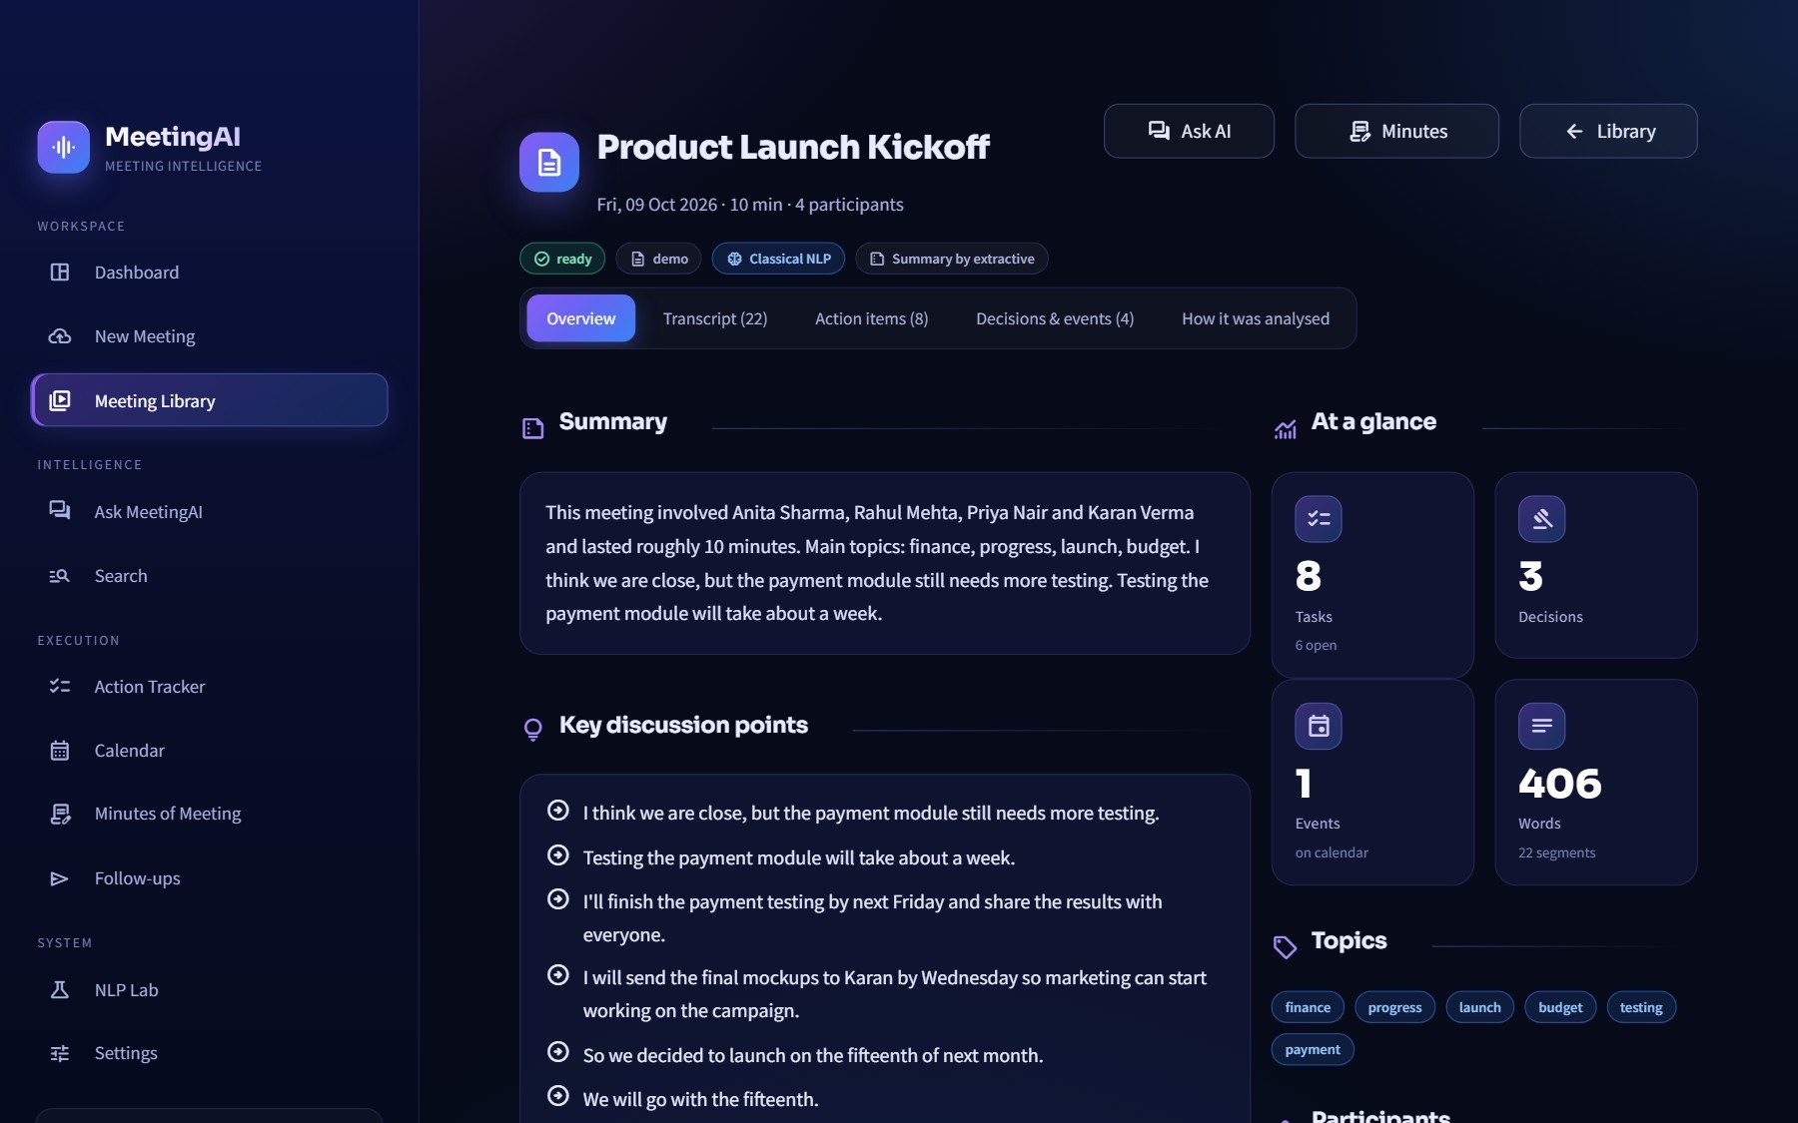
PRODUCT TOUR
Meeting overview: summary and structure
WHAT YOU SEE
1
Tabs
Overview · Transcript · Action items · Decisions & events · How it was analysed
2
Summary
overview, key discussion points, conclusions and topics
3
At a glance
counts of tasks, decisions, events and speakers
4
Mode badges
shows which engine produced the result - classical NLP, LLM or both
Sidebar → Meeting Library → open a meeting
MeetingAI · Project Presentation
28
Notes:
The 'How it was analysed' tab is the transparency feature - it shows the gateway reason codes for this meeting.

Slide 29
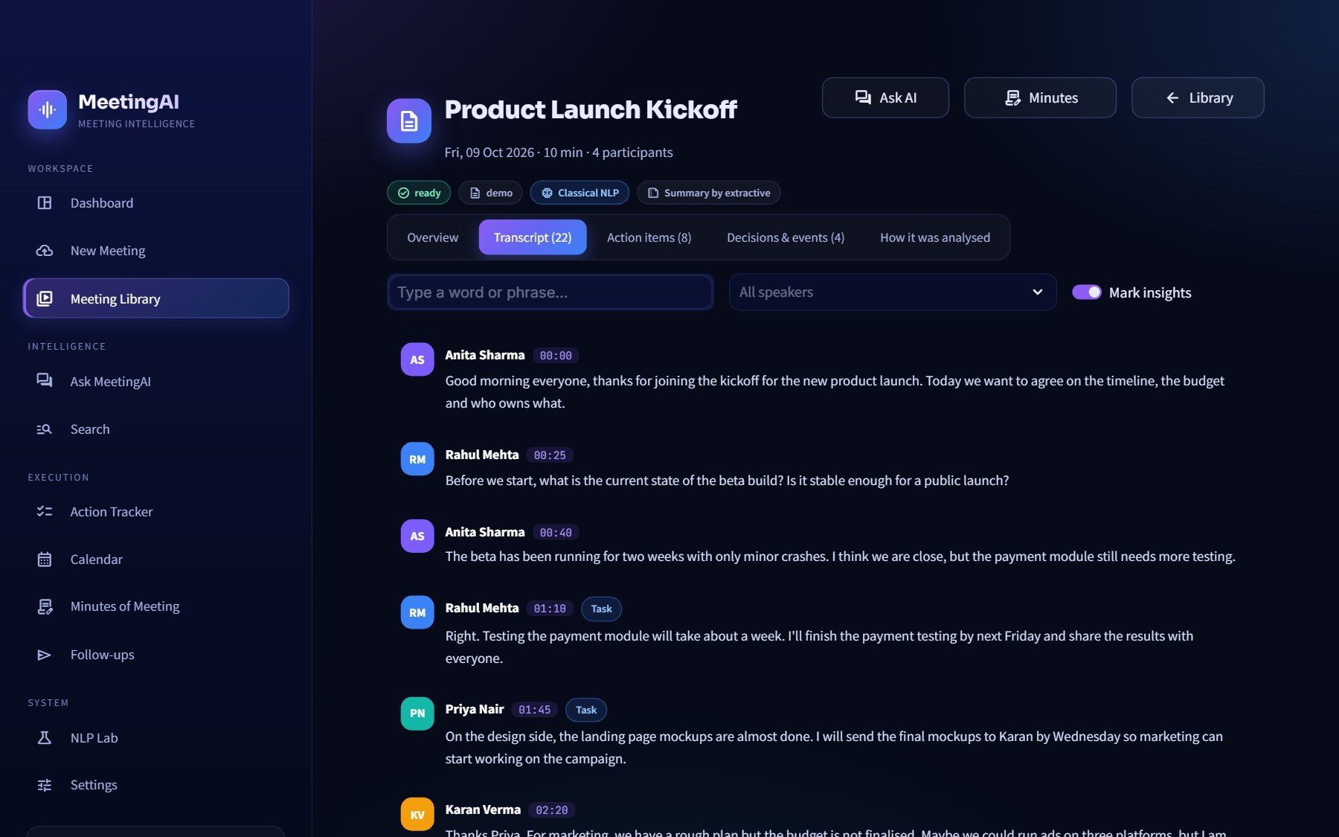
PRODUCT TOUR
Transcript with names on every line
WHAT YOU SEE
1
Speaker names + time
every line shows who said it (Anita, Rahul, Priya...) and when
2
Search and filter
find a word or show only one speaker
3
Mark insights
lines that became tasks or decisions are tagged in place
4
Evidence
every extracted item links back to its original line
Meeting → Transcript tab
MeetingAI · Project Presentation
29
Notes:
This is the pyannote feature - names rather than 'Speaker 1'.

Slide 30
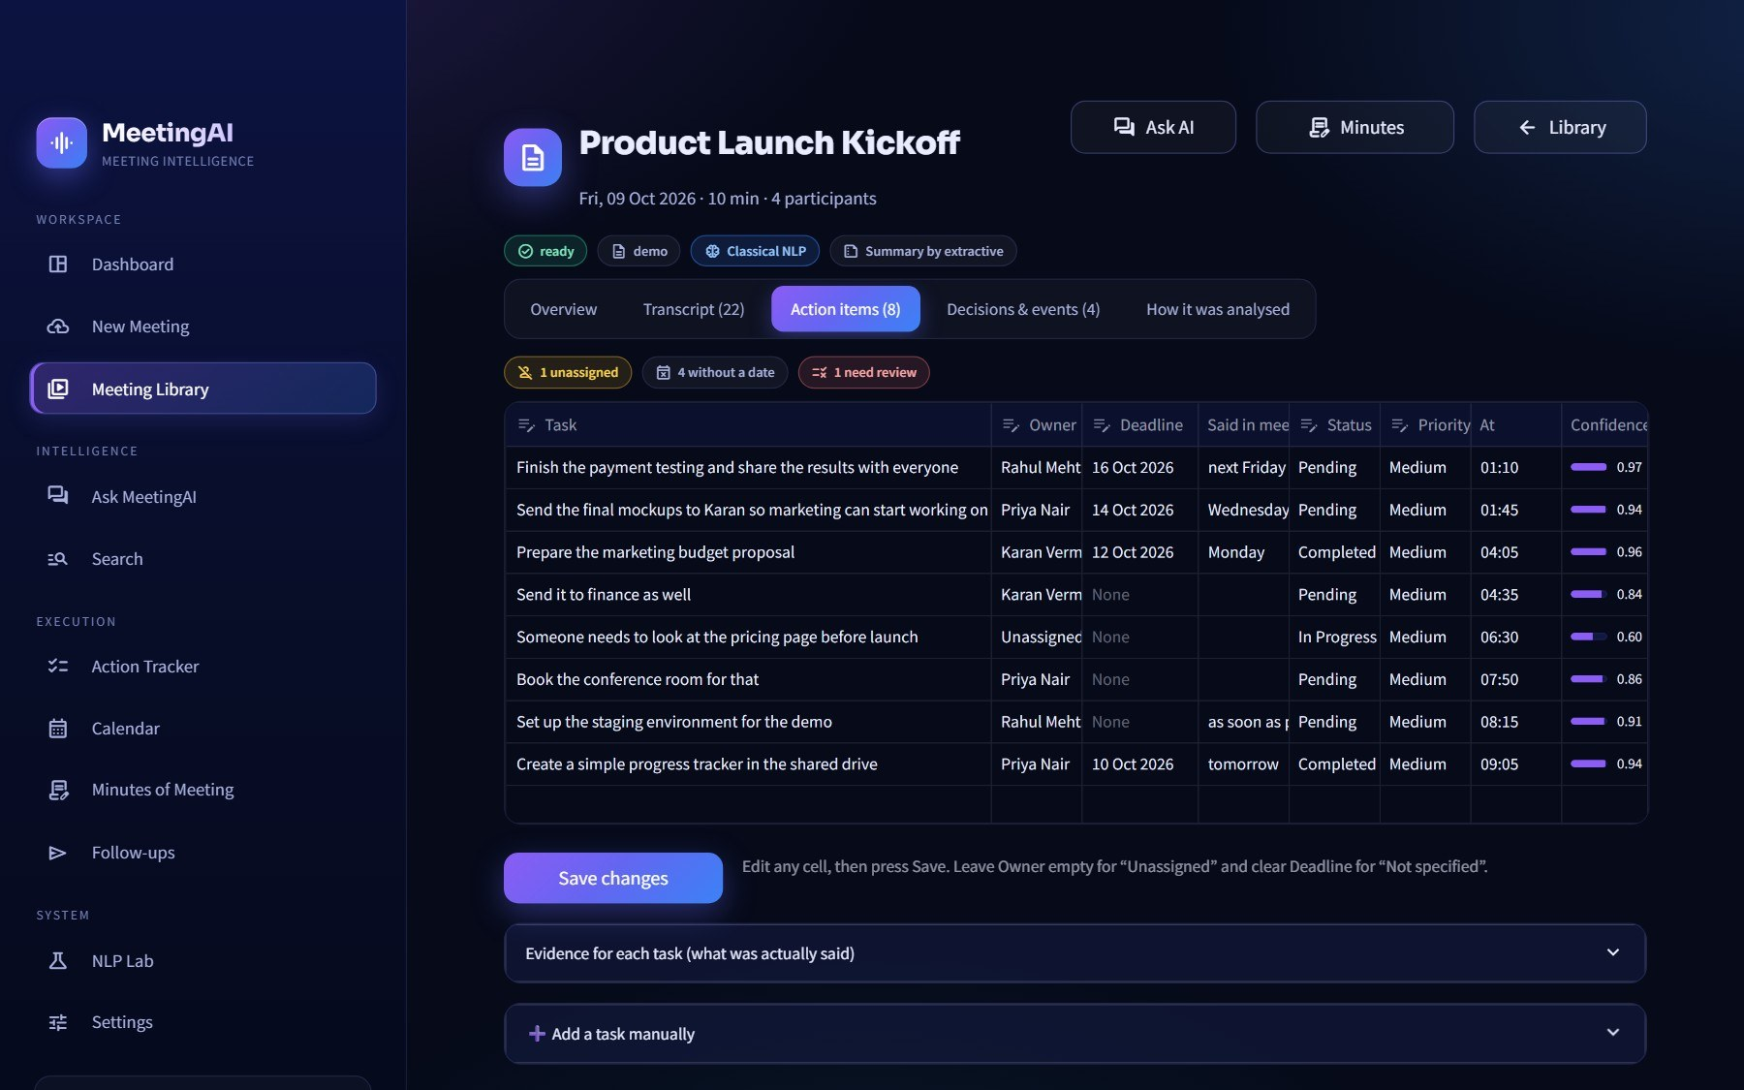
PRODUCT TOUR
Action items with owner, deadline and evidence
WHAT YOU SEE
1
Structured task
what, who (owner), by when (deadline), priority, status
2
Method badge
NLP · LLM fallback · NLP + LLM agree - you see how it was found
3
Confidence + quote
the exact sentence from the transcript is attached as evidence
4
Needs review
uncertain items are flagged, never silently trusted
Meeting → Action items tab
MeetingAI · Project Presentation
30
Notes:
Point at one task and show its evidence quote and method badge.

Slide 31
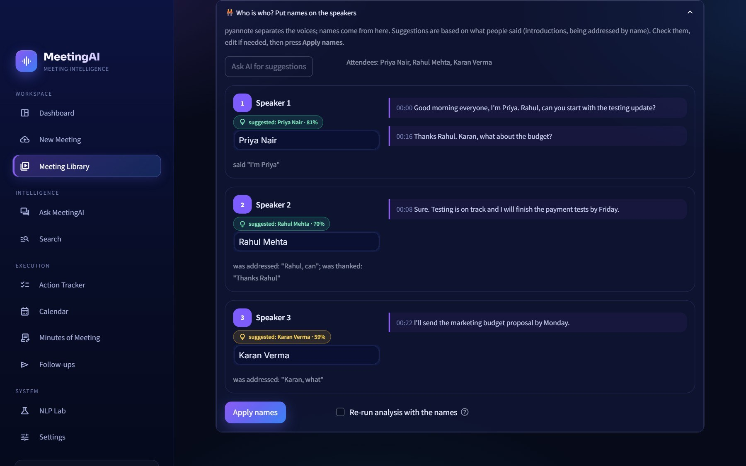
PRODUCT TOUR
Who is who: naming the voices
WHAT YOU SEE
1
Anonymous voices
Speaker 1, Speaker 2... each with sample lines and talk time
2
Suggestions with evidence
e.g. 'introduced themselves as Priya' - you accept or change
3
Type a name
apply it to the whole meeting in one click
4
Remember this voice
optional voiceprint so future meetings are named automatically
Meeting → Who is who panel
MeetingAI · Project Presentation
31
Notes:
Names are only applied after the user confirms.

Slide 32
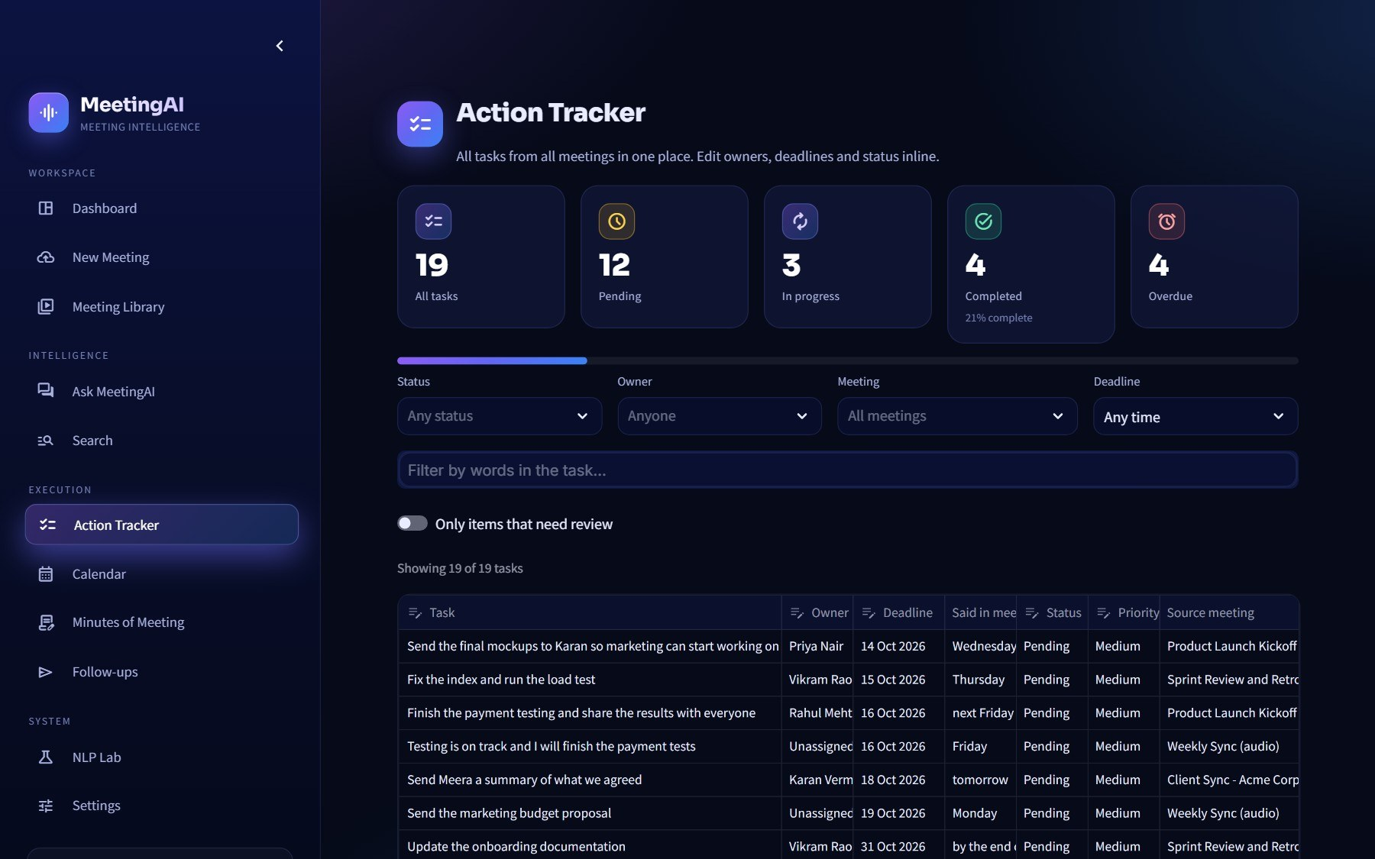
PRODUCT TOUR
Action tracker: everything to do, in one place
WHAT YOU SEE
1
Summary tiles
total, pending, in progress, done, overdue
2
Filters
by owner, status, priority, meeting or text
3
Overdue highlighted
deadlines already past are called out
4
Update in place
change status or owner; edits are saved
Sidebar → Action Tracker
MeetingAI · Project Presentation
32
Notes:
Tasks from every meeting appear here.

Slide 33
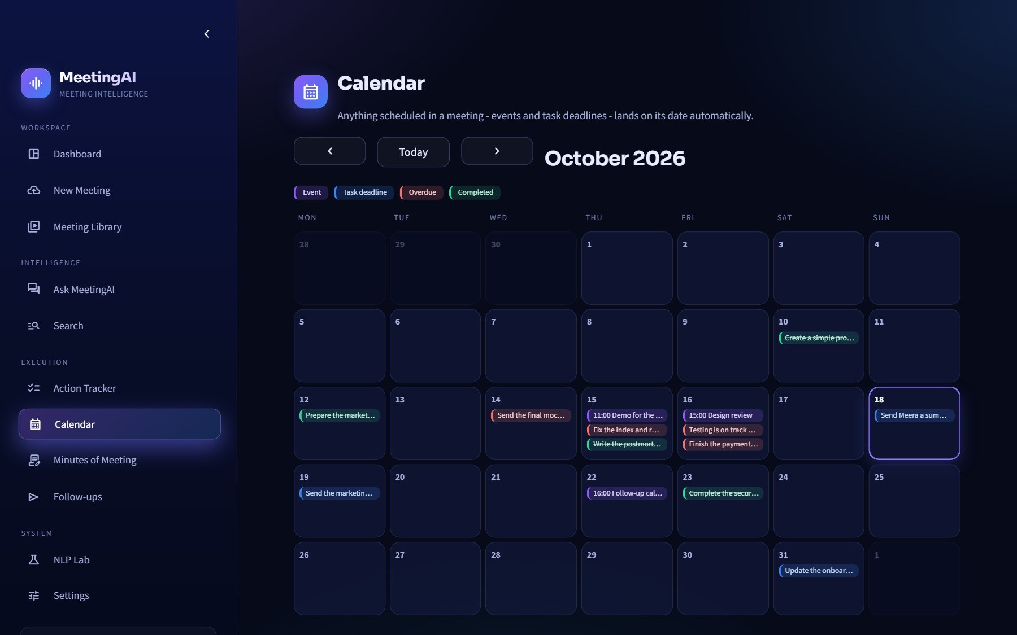
PRODUCT TOUR
Calendar: deadlines and events
WHAT YOU SEE
1
Month grid
deadlines and events from all meetings
2
Agenda list
chronological view with overdue items first
3
Add to your calendar
.ics file or Google Calendar link
4
No sign-in needed
no OAuth and no stored tokens - works with any calendar
Sidebar → Calendar
MeetingAI · Project Presentation
33
Notes:
ASSUMPTION: links and .ics files instead of OAuth - simpler, safer, works everywhere.

Slide 34
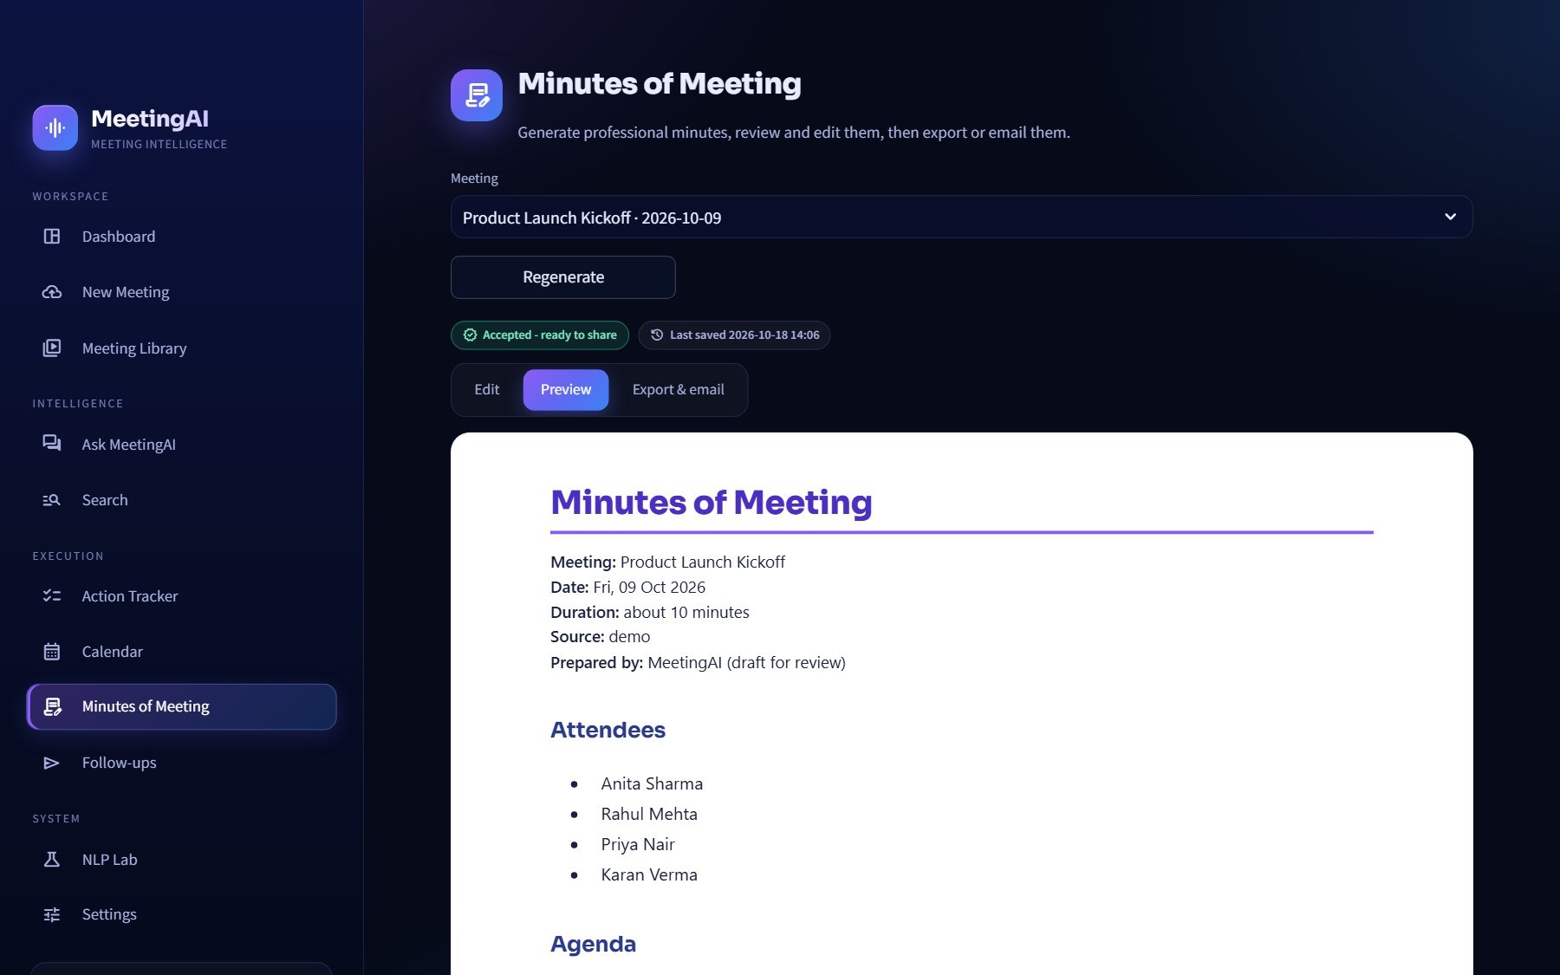
PRODUCT TOUR
Minutes of Meeting, generated on request
WHAT YOU SEE
1
Generated on demand
the user reviews before anything is shared
2
Professional layout
attendees, agenda, decisions and an action table
3
Edit and preview
change the Markdown, see the formatted result
4
Exports
Markdown, HTML, Word (.docx) and PDF
Sidebar → Minutes of Meeting
MeetingAI · Project Presentation
34
Notes:
Minutes are generated only when asked - a deliberate choice so nothing is shared unreviewed.

Slide 35
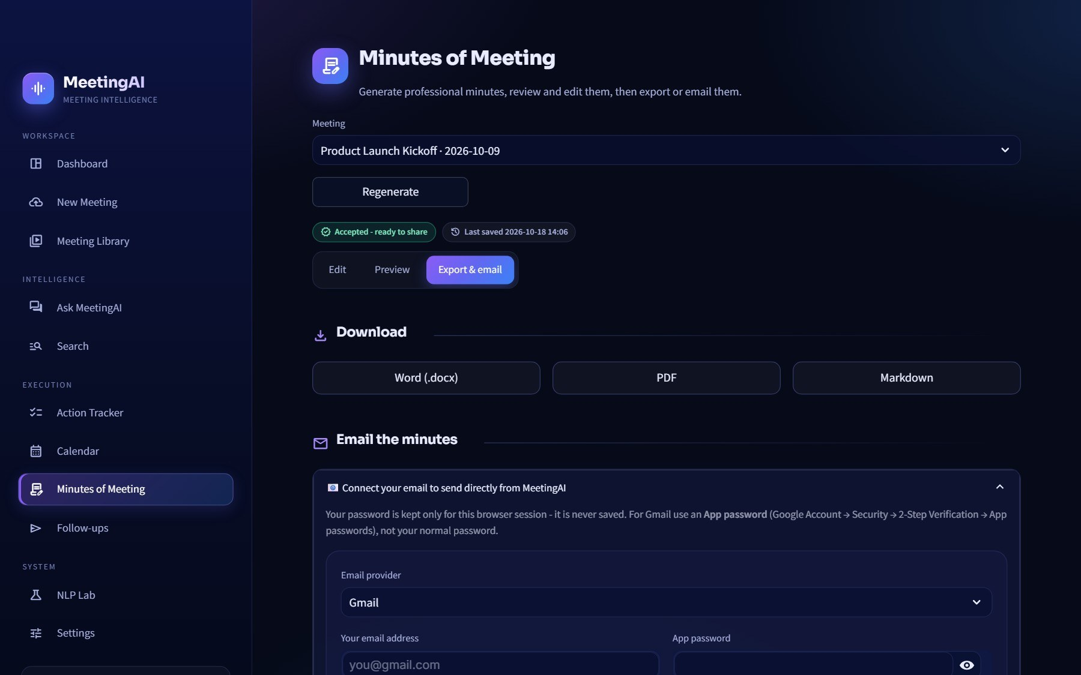
PRODUCT TOUR
Send the minutes by e-mail from the app
WHAT YOU SEE
1
Download
Word, PDF or Markdown in one click
2
Inline e-mail
enter recipients and send directly over SMTP
3
Or open a draft
a prefilled mail in your own mail app (mailto)
4
Confirmation first
nothing is sent until the user clicks
Minutes of Meeting → Export & e-mail
MeetingAI · Project Presentation
35
Notes:
SMTP details are typed in Settings or stored as secrets - never in the database.

Slide 36
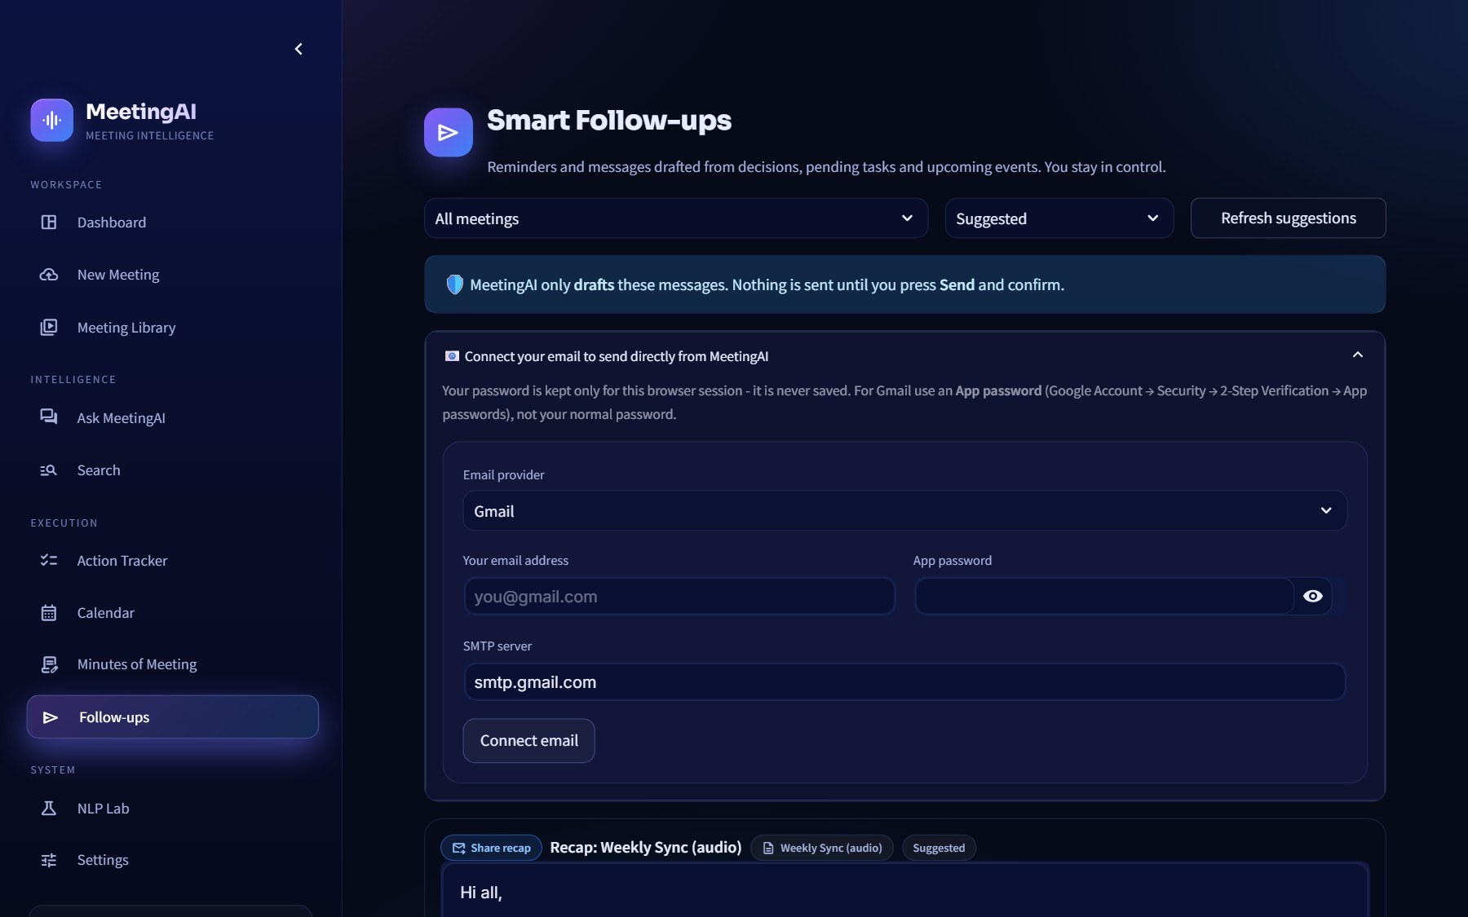
PRODUCT TOUR
Smart follow-ups: reminders drafted for you
WHAT YOU SEE
1
Suggested follow-ups
reminders for pending tasks and a recap for the team
2
Edit before sending
optional LLM polish for friendlier wording
3
One click to send
or open as a draft; every send is logged
4
Never automatic
the user is always the one who sends
Sidebar → Follow-ups
MeetingAI · Project Presentation
36
Notes:
Safety principle: side effects need an explicit click.

Slide 37
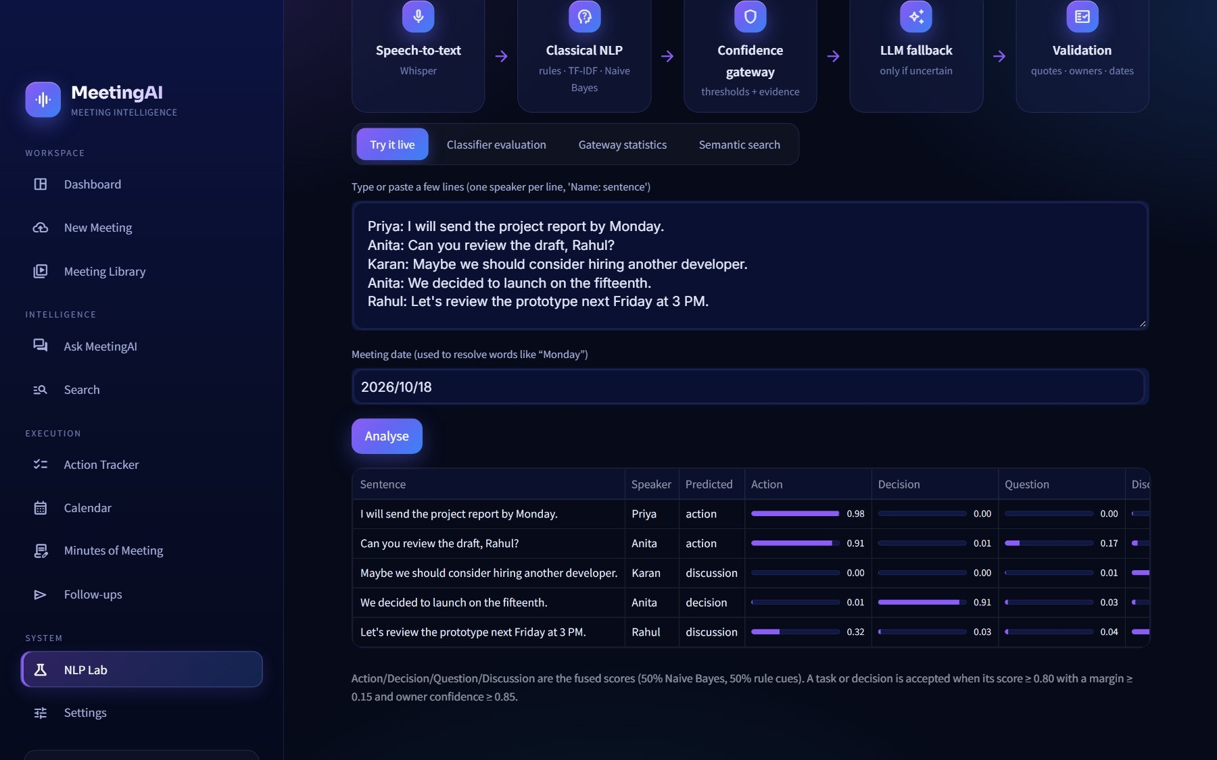
PRODUCT TOUR
NLP Lab: see the classical NLP at work
WHAT YOU SEE
1
Try it live
paste any text, see each sentence's class, score, owner, date
2
Evaluation
accuracy, per-class report and confusion matrix on 42 test sentences
3
Gateway log
every decision with its reason code
4
Threshold simulator
see how changing the gateway values would change results
Sidebar → NLP Lab
MeetingAI · Project Presentation
37
Notes:
This page is what makes the project NLP-centric rather than 'just an LLM wrapper'.

Slide 38
6
Engineering decisions
Technology, assumptions with reasons, security and deployment.
Notes:
Section divider.

Slide 39
TECH STACK
Technology and why we chose it
Interface
Storage & search
Classical NLP
Streamlit · custom CSS theme · Plotly charts
SQLite + FTS5 · ChromaDB · ONNX MiniLM
scikit-learn TF-IDF + Naive Bayes · rule cues · rapidfuzz · own date resolver
Why: Fast Python UI with free hosting
Why: No server, no cost, small memory
Why: Small, fast and explainable
Speech & speakers
Free AI models
Documents & delivery
FFmpeg · Whisper (Groq) · pyannoteAI / pyannote · AssemblyAI
Groq Llama 3.3 · Gemini 2.5 Flash · OpenRouter :free
python-docx · ReportLab · SMTP · .ics · Streamlit Cloud
Why: Names on voices without a GPU
Why: Three providers behind one router
Why: Word / PDF minutes, e-mail, calendar
MeetingAI · Project Presentation
39
Notes:
Every choice answers the same constraints: free to run, fits in about 1 GB of memory, and easy to deploy. For example ONNX embeddings instead of PyTorch, and hosted pyannoteAI instead of a local GPU model.

Slide 40
HONEST ENGINEERING
Assumptions and decisions (1/3): the NLP numbers
Gateway thresholds 0.80 / 0.15 / 0.85 / 0.85
Fusion 50 / 50 and hedge × 0.8
Sensible starting values, not measured optima. Owner and deadline are held to a higher bar than the label because a wrong owner or date does more harm than a wrong class. All are sliders in Settings.
Naive Bayes alone is over-confident; rules keep scores honest. A hedged sentence ("maybe") is rarely a firm commitment, so its score is reduced.
Template training data (610 sentences)
Candidate floor 0.33 / review floor 0.55
No labelled meeting corpus exists for our domain and free hosting rules out heavy training. Templates give an explainable baseline, measured on 42 separate test sentences.
A low floor keeps recall so the gateway can judge borderline sentences. Without an LLM, only items scoring 0.55+ are kept, marked Needs review.
MeetingAI · Project Presentation
40
Notes:
Every assumption is documented with its reason and where to change it. The full table of 23 assumptions is in section 16 of the written report.

Slide 41
HONEST ENGINEERING
Assumptions and decisions (2/3): trusting the output
Vague deadlines stay empty
Free-model names will change
"Soon" or "later" has no date. An LLM cannot invent one that was never said, so the field shows Not specified - and this deliberately does not fail the gateway.
Free catalogues are renamed or retired often. The router carries defaults, allows overrides in secrets, and discovers a working model on its own.
Chunks ~110 words, RRF k = 60
Relevance gate 0.28 / 50% word overlap
Short enough to be specific, long enough for context; k = 60 is the standard Reciprocal Rank Fusion constant, a safe default.
Conservative on purpose: a wrong confident answer is worse than "not found". Below the gate no LLM call is made at all.
MeetingAI · Project Presentation
41
Notes:
Every assumption is documented with its reason and where to change it. The full table of 23 assumptions is in section 16 of the written report.

Slide 42
HONEST ENGINEERING
Assumptions and decisions (3/3): platform choices
Calendar through links and .ics, not OAuth
Temporary disk on free hosting
No stored tokens, nothing to revoke, works with any calendar app.
A persistent database would be a paid service, so Settings → Data & backup exports and restores everything as a zip.
Synchronous processing, minutes on request
English-language focus
Free hosting has one process and no worker queue. Minutes are generated only when asked so the user reviews before sharing.
Models, cue patterns and seed sentences are English. Other languages would need new cue patterns and training sentences.
MeetingAI · Project Presentation
42
Notes:
Every assumption is documented with its reason and where to change it. The full table of 23 assumptions is in section 16 of the written report.

Slide 43
TRUST
Security, privacy and honesty by design
Keys stay secret
Password gate
Confirm before acting
Never in the database or the repository - Streamlit secrets or typed into Settings (session only).
APP_PASSWORD protects a public deployment; compared in constant time.
E-mails and follow-ups go out only after an explicit click; calendar items are links the user clicks.
Data is just data
Voice privacy
Says "I don't know"
Transcripts and LLM output cannot trigger actions and must pass validation.
Voiceprints only for people who agreed, deletable any time. Per-meeting switch turns LLM use off.
Unassigned · Not specified · Not found · Needs review - never a guess.
WHAT LEAVES THE MACHINE only when configured: audio → Groq / pyannoteAI (or AssemblyAI); transcript text → Groq / Gemini / OpenRouter.
MeetingAI · Project Presentation
43
Notes:
Security here is mostly about not doing unrequested things. Keys never reach the database or repository; side effects need a click; and the system says 'I don't know' rather than inventing.

Slide 44
DEPLOYMENT
Deployment: free on Streamlit Community Cloud
You
push
GitHub
auto
STREAMLIT CLOUD CONTAINER (ABOUT 1 GB RAM)
git push
Meeting-AI- · main
Python app
app.py · core/ · views/ · ui/ ← requirements.txt + packages.txt (FFmpeg)
Browser / phone
HTTPS
SQLite + FTS5
ChromaDB
your streamlit.app address
data/meetingai.db
data/chroma · ONNX MiniLM
EXTERNAL FREE APIS
Temporary disk
Secrets box
Groq
Gemini
OpenRouter
API
wiped on restart → Settings backup / restore
GROQ · GEMINI · PYANNOTEAI · SMTP · APP_PASSWORD
pyannoteAI
AssemblyAI
SMTP
LIVE APPLICATION
SOURCE CODE
FREE-TIER FACTS
gd4n8x8sjkkxmdhfptkc9m.streamlit.app
github.com/nidhitiwari23/Meeting-AI-
~1 GB RAM · sleeps when idle · temp disk
MeetingAI · Project Presentation
44
Notes:
The deployment flow is just git push. Streamlit Cloud installs requirements.txt (Python) and packages.txt (FFmpeg), runs app.py, and redeploys on every push. API keys live in the app's Secrets box.

Slide 45
SUMMARY
MeetingAI in numbers
14
610
4
processing steps per meeting
template sentences train the classifier
gateway questions guard every item
3
12
Free
free LLM providers behind one router
pages in the app
to run: free tiers only
THE TAKEAWAY
▸ Classical NLP first, LLM only where unsure, plain code verifies everything the LLM says
▸ Names on every voice, tasks with owners and deadlines, decisions, events, chat and ready-to-send minutes
▸ Honest by design: it says "Not specified" or "Not found" rather than guessing
MeetingAI · Project Presentation
45
Notes:
Close with the numbers and the three-line takeaway.

Slide 46
Thank you
Questions? Try it live - upload a meeting and ask it anything.
LIVE APPLICATION
https://gd4n8x8sjkkxmdhfptkc9m.streamlit.app/
SOURCE CODE
https://github.com/nidhitiwari23/Meeting-AI-
TEAM
Nidhi Tiwari A033
Dhruvi Devalia A044
Jivesh Gawde A057
Yashika Parmar A061
Notes:
Invite questions. The live app and the source code are linked here.

