Slide 1
Speed-up your sites with
web-page pre-fetching using Machine Learning
Developed by: Nidhi Patel
ID: 19CEUBS151
Internal Guide: Dr. Malay S. Bhatt
External Guide: Mr. Prashant Kumar
Organization Name: Institute for Plasma Research

Slide 2
01
Introduction
02
Implementation
Table of Contents
03
Analysis & Design
04
Testing
05
Conclusion & Bibliography

Slide 3
01
Introduction

Slide 4


Motive of the Project
PROBLEM
SOLUTION
Higher page load time is one of the major concerns for any web sites.
Web-page pre-fetching using Tensorflow tooling in ML to implement powerful solution for web sites to improve page load times.

Slide 5


What/Why is TensorFlow?
It is an end-to-end open source platform for Machine Learning.
It makes work easy for us to create Machine Learning models for desktop, mobile, web, and cloud.
For Web application, it provides TensorFlow.js to create new machine learning models and deploy existing models with JavaScript.
Python

Slide 6
02
Implementation

Slide 7





Overview of the Implementation
Get site data from Google Analytics
Deploy solution in your web application with Angular
04
01
03
02
Train custom model using a TFX pipeline & Create a client side deployable TensorFlow.js model
Data preparation and pre-processing with BigQuery and Dataflow

Slide 8
01.
Google Analytics
Stores each page visit as an event, providing key aspects such as the page name, visit time, and load time.
This data contains everything I need to train my model.
04
01
03
02

Slide 9
02.
04
01
Google BigQuery & Dataflow
03
02
Data Preparation and pre-processing
By leveraging existing support for exporting the Google Analytics data to a large scale cloud data store called BigQuery.
Provide processed data after 24 hours.

Slide 10
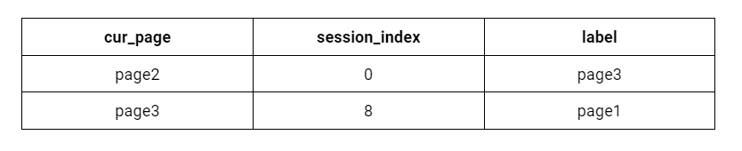
03.
Training Features
04
01
Model training using a TFX pipeline & deploy this model in my web application so it can be used to make live predictions when users visit my website.
03
02

Slide 11
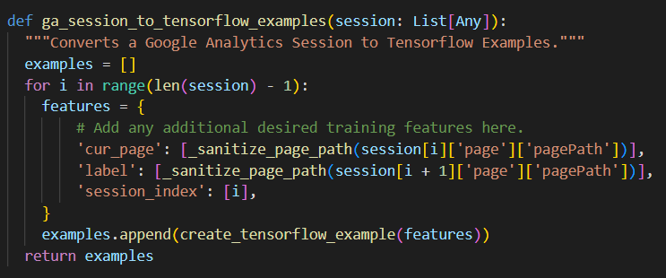
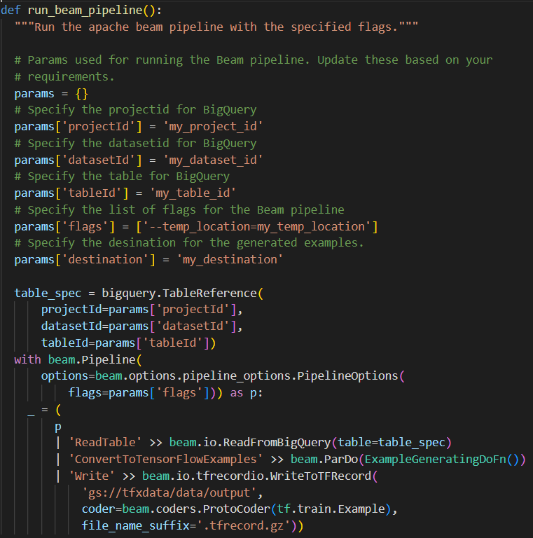
Function for Training Data
Function to run Apache Beam Pipeline with Specified flags

Slide 12
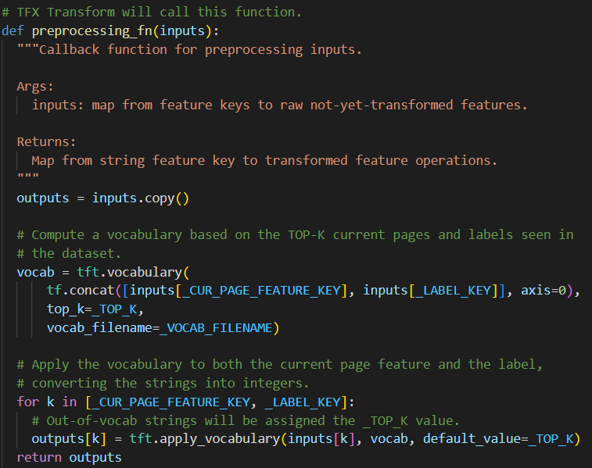
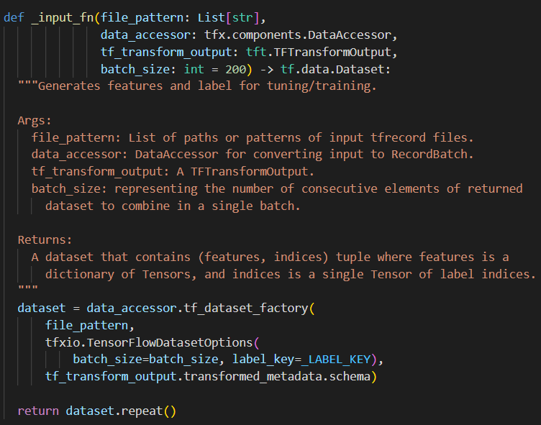
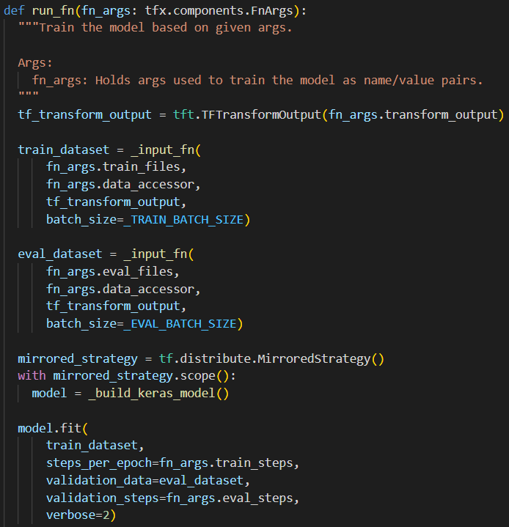
Preprocessing Function defines the operations that should be performed on the data
Input Function generates features and lable for training
Run Function defines the main model and how it is to be trained

Slide 13
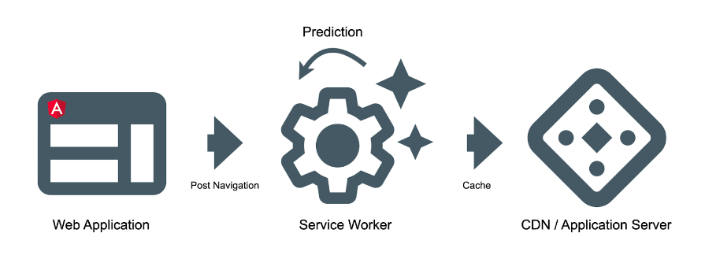
04.
On each navigation, I will query the model and prefetch the resources associated with the pages that are likely to be visited in the future by the user.
04
01
03
02

Slide 14
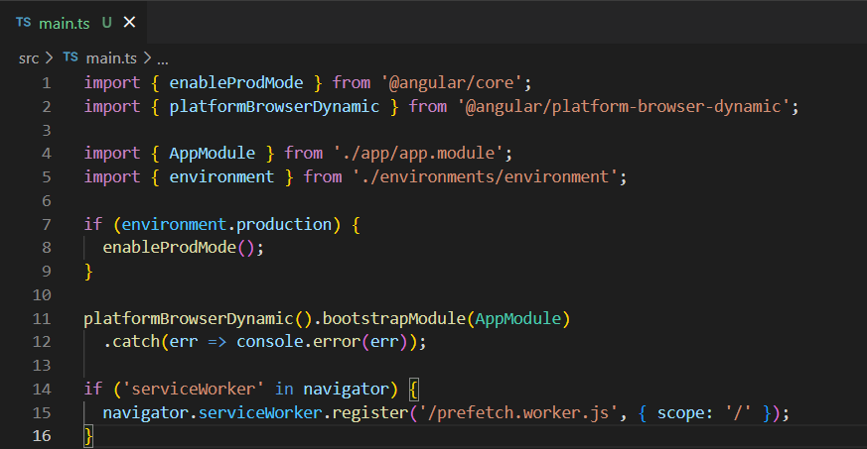
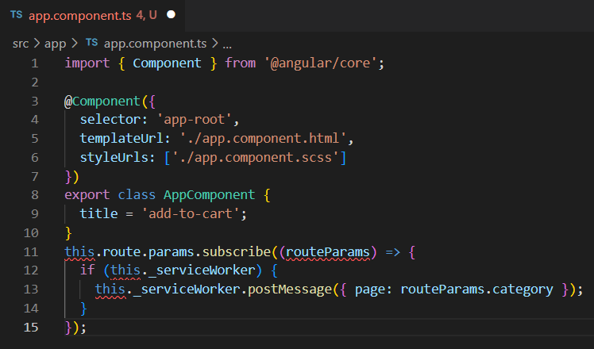
main.ts file of the angular web application where I load Service Worker
In app.components.ts file, I watch for changes of the parameters of the URL

Slide 15
03
Analysis & Design

Slide 16
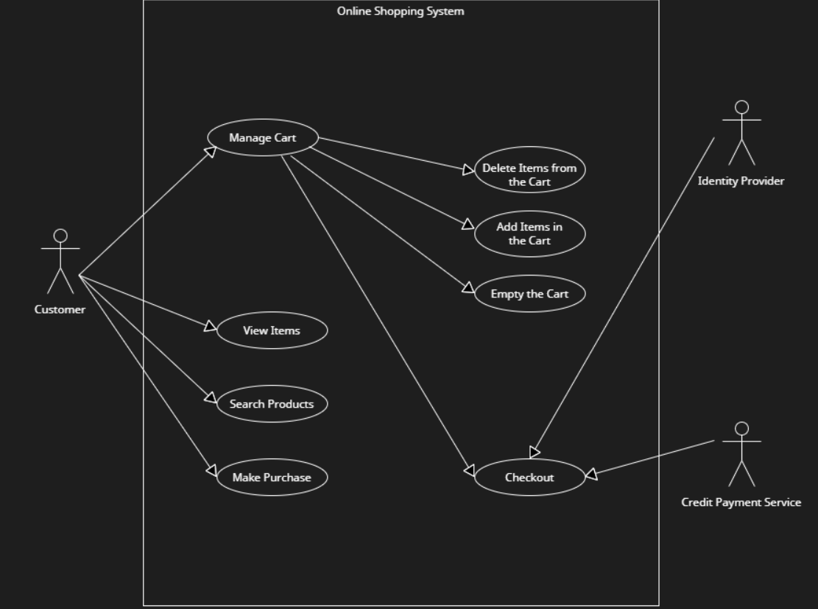
01. Use Case Diagram

Slide 17
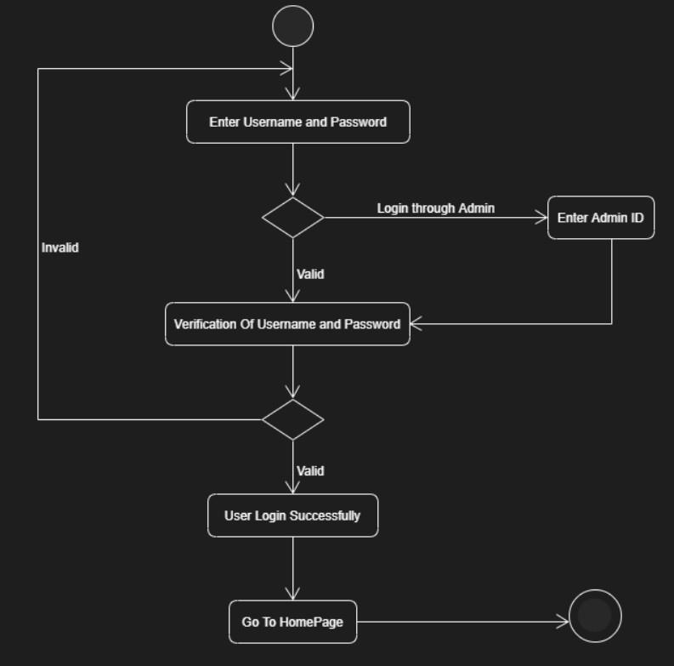
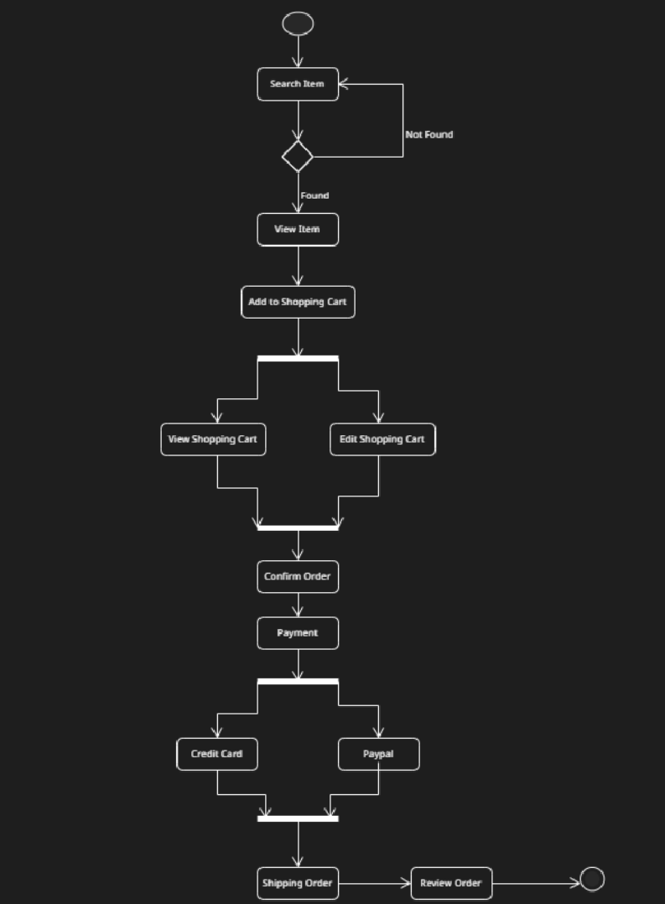
02. Activity Diagrams
Login
Add-To-Cart

Slide 18
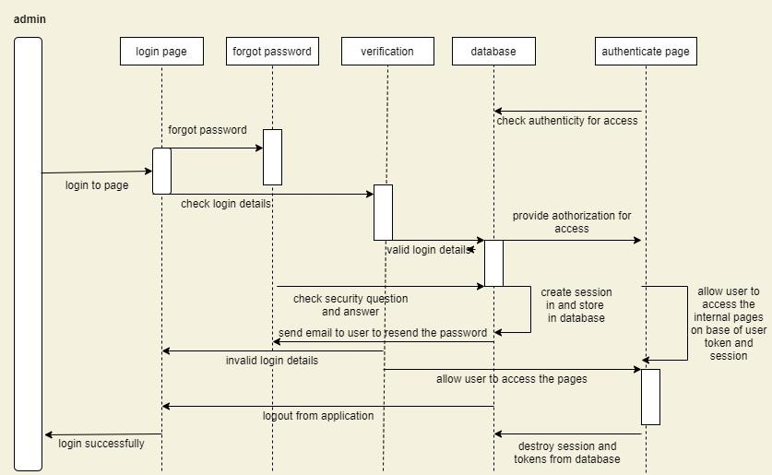
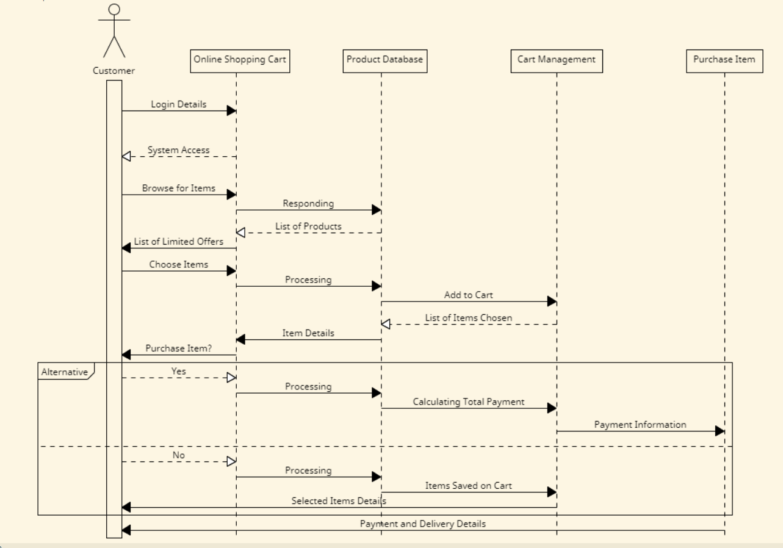
03. Sequence Diagrams
Admin
Customer

Slide 19
04
Testing

Slide 20
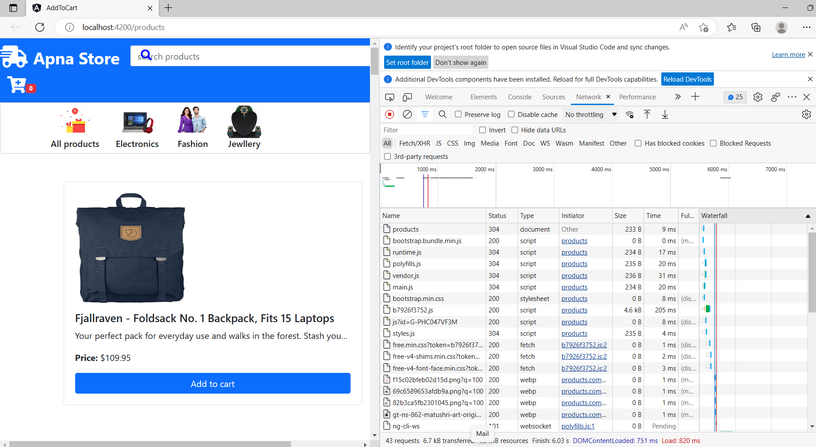
Screen-shots illustrate improved page load times with machine learning based predictive prefetching implemented.
Enter title
This Template Is Designed By Zuo An,It Will Help You Make You Report Easy And Fast.

Slide 21
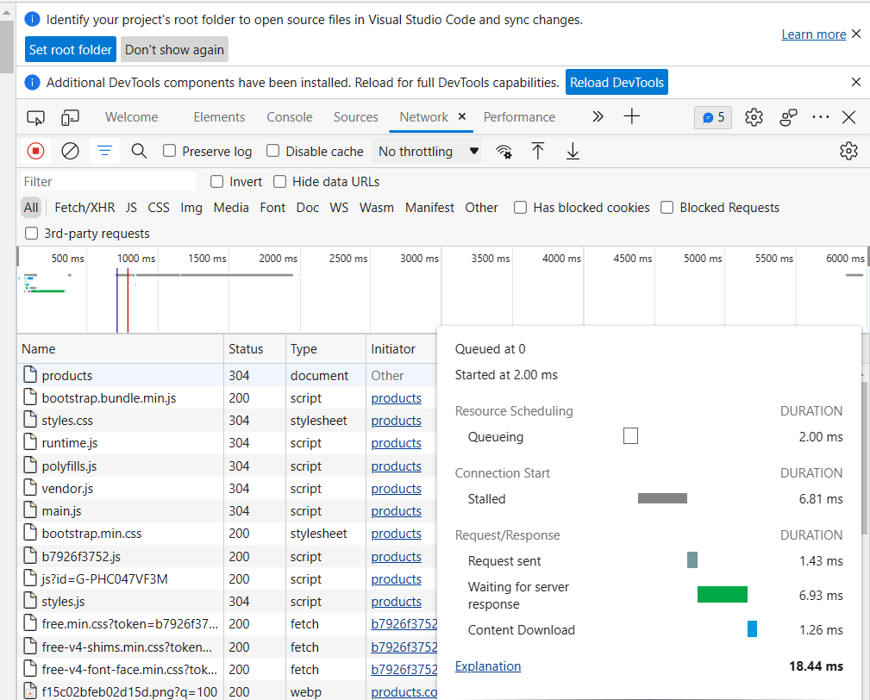
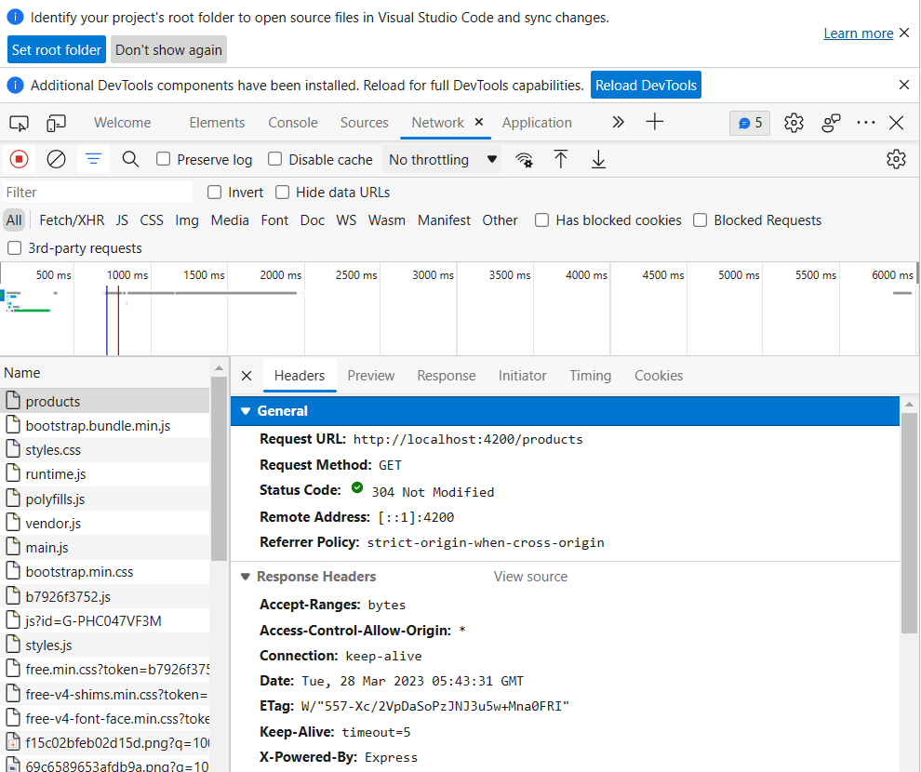
Enter title
This Template Is Designed By Zuo An,It Will Help You Make You Report Easy And Fast.
Detailed Information of particular data
Information of Headers for data

Slide 22
05
Conclusion & Bibliography

Slide 23
Conclusion & Limitation
I successfully implemented improved page load times with the help of TensorFlow in Machine Learning.
Prefetching a number of pages ahead of time can make sense for users on a great WiFi connection.
I implemented this project for very small web application, can extend this to improve page load times for large scale applications.

Slide 24


Bibliography
https://www.tensorflow.org/tutorials
https://towardsdatascience.com/how-to-deploy-tensorflow-models-to-the-web-81da150f87f7
https://developers.google.com/analytics
https://cloud.google.com/bigquery
https://stackoverflow.com/
https://docs.python.org/3/
https://www.google.com/
https://angular.io/
https://angular.io/guide/service-worker-intro
https://blog.bitsrc.io/prefetching-links-using-service-workers-d9f6babfd0b
https://developer.chrome.com/docs/devtools/network/

Slide 25
THANK YOU
Any Questions ?

