Slide 1

Downloaded Music Player
— —
Collins Pearson, Peyton Moore, Skye Nidiffer, William Quesinberry

Slide 2
Overview & Features
Library Page
Music Player
Audio Editor
Explore Tab
Settings Tab

Slide 3
Languages & Frameworks
React Native, Expo Go, a variety of modules, Javascript, CSS, etc.

Slide 4
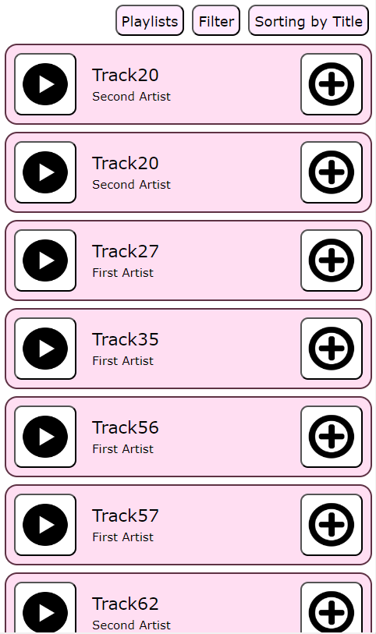
Library Tab
Playing songs
Sorting the Library
Can sort by Title, Artist, and Album name
Filtering the Library
Can filter by Artist and Album name
Using playlists
Can create and rename from Playlists tab
Can add/remove from the right-hand button on a track

Slide 5
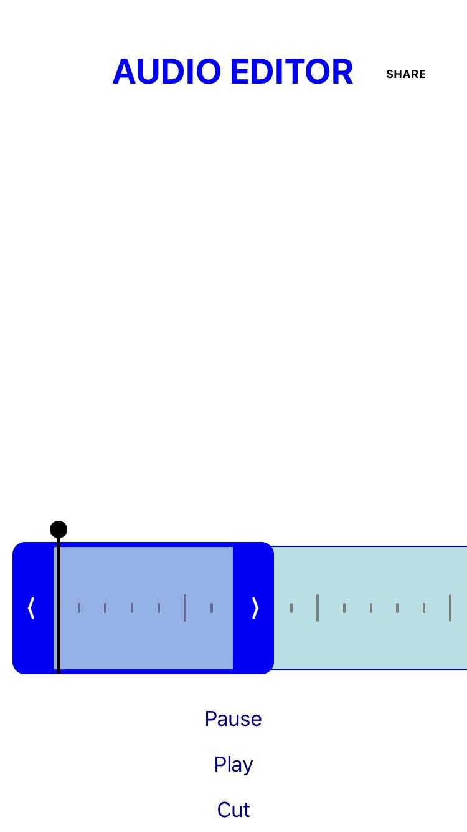
Editor Tab
Audio Editor
Shares audio to phone files
Scrubbing through audio to edit

Slide 6
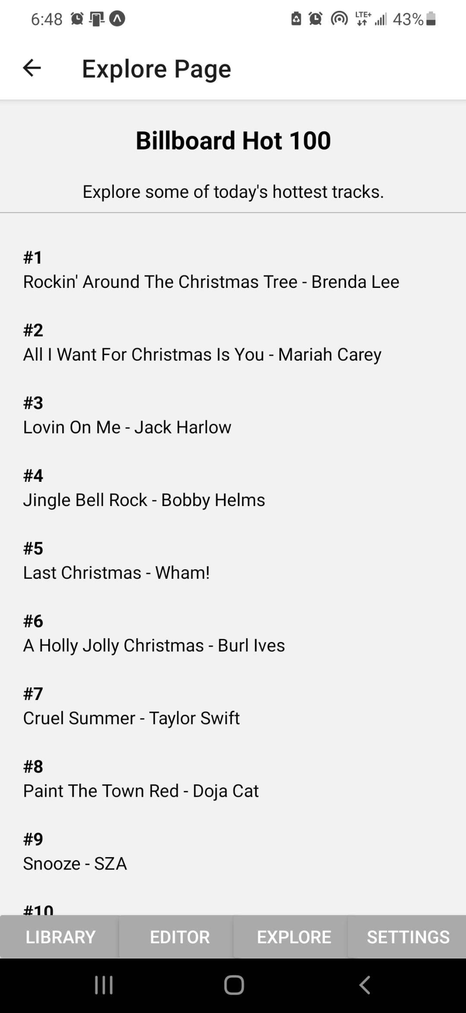
Explore Tab
Pulls top 100 songs from Billboard Hot 100
User can scroll through to see what songs are trending

Slide 7
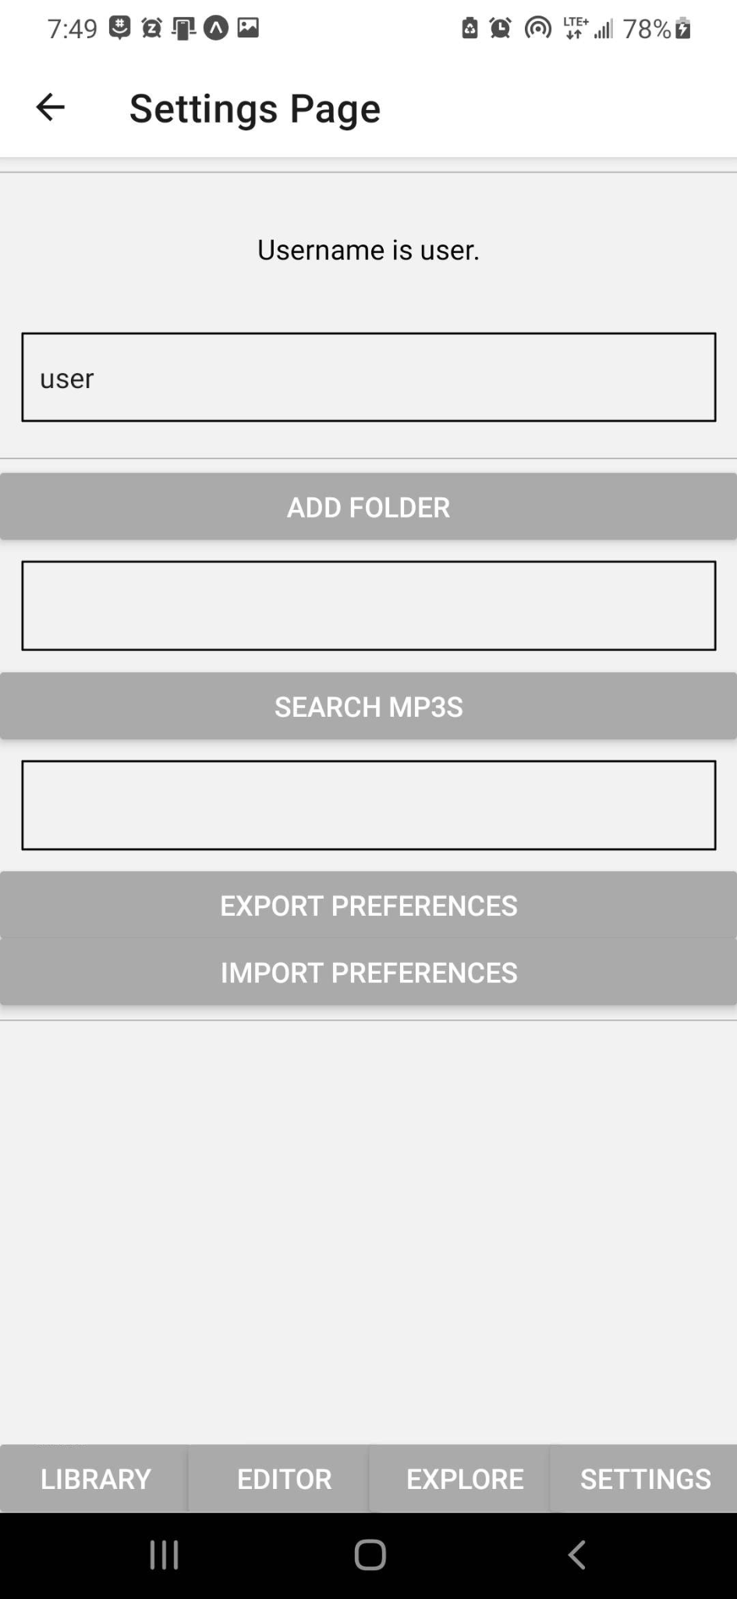
Settings Tab
Allows user to set username, add folders to search through, import and export preferences

Slide 8
Demo

