Slide 1
DevOps and Infrastructure as Code
Prepared by :
Gowtham R Naik
Assistant professor
CSE Department

Slide 2
Introduction
DevOps is a cultural and technical approach that unites software development (Dev) and IT operations (Ops) so teams can deliver software faster, more reliably, and with continuous feedback.
DevOps is not a single software; it’s a way of working supported by a set of tools that automate the software delivery pipeline.
DevOps is a combination of Development (Dev) and Operations (Ops). It is a set of practices, tools, and cultural principles that helps software development and IT operations teams work together to develop, test, deploy, and maintain software faster and more reliably.

Slide 3
In traditional software development:
Developers → Write Code → Testing → Operations → Deployment
This can lead to delays, communication gaps, and deployment errors.
With DevOps:
Plan → Code → Build → Test → Release → Deploy → Operate → Monitor → Feedback
The process is continuous and automated, allowing teams to release software frequently.

Slide 4
What DevOps is
Culture + Practices + Tools: DevOps isn’t just a toolchain; it’s a way of working that emphasizes collaboration, shared ownership, automation, and constant feedback between developers, operations engineers, QA, and often security.
End-to-end responsibility: Instead of “Dev writes code, then throws it over the wall to Ops,” a DevOps mindset means both sides care about the entire lifecycle—from planning and coding to deployment, monitoring, and improvement.
Automation at the core: DevOps teams automate repetitive work—building, testing, deploying, and managing infrastructure—so humans focus on design, problem-solving, and learning from production.
Continuous flow: Practices like CI/CD (Continuous Integration/Continuous Delivery) enable small, frequent changes instead of rare, risky “big-bang” releases.

Slide 5
Why DevOps exists
DevOps emerged as a response to real problems in traditional software delivery:
Siloed teams caused friction:
  Developers wanted fast change and new features.
  Operations wanted stability and minimal risk.
  With separate goals and poor communication, releases became slow, error-prone, and blame-heavy.
  Market pressure for speed and quality:
  As businesses went digital, customers expected frequent updates, high availability, and quick fixes. The old “waterfall” or heavily siloed models couldn’t keep up without sacrificing reliability.
Need for reliable, repeatable delivery:
Manual deployments and “snowflake” servers (each configured differently by hand) led to “works on my machine” issues and production outages. DevOps promotes automation, standardization, and Infrastructure as Code to make environments consistent and changes predictable.

Slide 6
Feedback and learning:
By integrating monitoring, logging, and metrics into the delivery pipeline, teams get rapid feedback on what’s working in production and can iterate quickly. This closes the loop between building software and running it.
In short, DevOps exists to resolve the tension between speed and stability by changing how people work together and by automating the software delivery pipeline so organizations can innovate continuously without breaking things.

Slide 7
What DevOps is · Dev vs Ops gap · DevOps culture and mindset · Benefits to an organization · DevOps team model
DevOps is a way of working that brings development and operations teams together to build, test, release, and maintain software more quickly and reliably. It combines people, processes, and automation so software can be delivered with fewer delays and fewer errors.
Main idea
Development creates the software.
Operations runs and supports it.
DevOps connects both sides so they share responsibility across the full software lifecycle.

Slide 8
DevOps culture is a set of practices that reduce the barriers between developers, who want to innovate and deliver faster, and operations, who want to guarantee the stability of production systems and the quality of the system changes they make.
DevOps culture is also the extension of agile processes (Scrum, XP, and so on), which makes it possible to reduce delivery times and already involves developers and business teams.
However, they are often hindered because of the non-inclusion of Ops in the same teams.

Slide 9
DevOps Lifecycle
The DevOps lifecycle is a continuous, iterative loop that guides how software is planned, built, tested, released, deployed, operated, and monitored.
Plan – Define requirements, priorities, and goals.
Code – Developers write and commit code in version control (e.g., Git).
Build – Compile/package code into artifacts (binaries, containers).
Test – Run automated and manual tests (unit, integration, security, etc.).
Release – Prepare a validated build for deployment (approvals, scheduling).
Deploy – Push the release to staging/production, often via CI/CD.
Operate – Run and maintain the live system (patches, scaling, incidents).
Monitor – Collect logs, metrics, and user feedback; feed insights back into Plan.

Slide 10
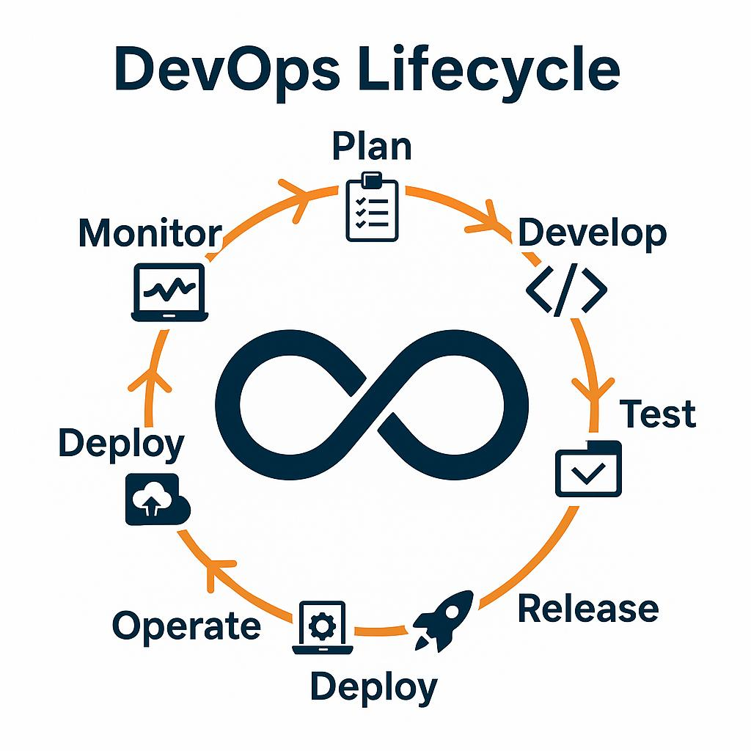

Slide 11
Simple Example
Suppose a college develops a Student Attendance Management System.
Without DevOps:
Developers write new attendance features.
Testers manually test the application.
The operations team manually deploys it to the server.
If an error occurs, the process may have to start again.

Slide 12
Without DevOps:
Developers write new attendance features.
Testers manually test the application.
The operations team manually deploys it to the server.
If an error occurs, the process may have to start again.

Slide 13
With DevOps:
Developer writes the attendance feature.
Code is uploaded to GitHub.
GitHub Actions/Jenkins automatically builds the application.
Automated tests are executed.
Docker packages the application into a container.
The application is automatically deployed to a server/cloud.
Monitoring tools check whether the application is running correctly.
Feedback is sent back to developers for improvements.

Slide 14
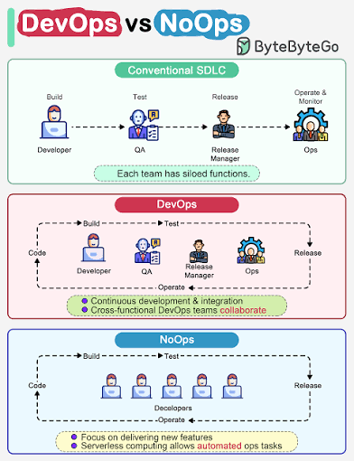

Slide 15
Getting started with DevOps
To facilitate this collaboration and to improve communication between Dev and Ops, there are several key elements in the processes that must be put in place, as shown here:
More frequent application deployments with integration and continuous delivery (called CI/CD).
The implementation and automation of unitary and integration tests, with a process focused on behavior-driven design (BDD) or test-driven design (TDD).
The implementation of a means of collecting feedback from users.
Monitoring applications and infrastructure.

Slide 16
The DevOps movement is based on three axes:
The culture of collaboration:This is the very essence of DevOps – the fact that teams are no longer separated by silos specialization (one team of developers, one team of Ops, one team of testers, and so on).
Processes: To expect rapid deployment, these teams must follow development processes from agile methodologies with iterative phases that allow for better functionality, quality, and rapid feedback.

Slide 17
Process is divided into several phases:
A. Planning and prioritizing functionalities
B. Development
C. Continuous integration and delivery
D. Continuous deployment
E. Continuous monitoring
These phases are carried out cyclically and iteratively throughout the life of the project.
3. Tools: The choice of tools and products used by teams is very important in DevOps.

Slide 18
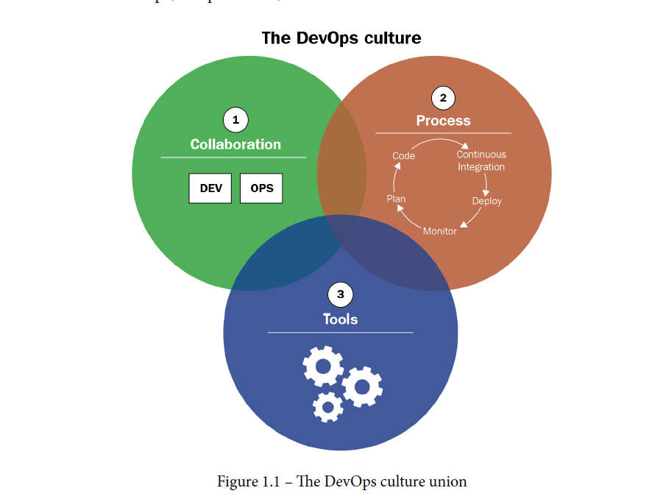
The following diagram illustrates the three axes of DevOps culture – the collaboration between Dev and Ops, the processes, and the use of tools:

Slide 19
The benefits of establishing a DevOps culture within an enterprise are as follows:
1• Better collaboration and communication in teams, which has a human and social impact within the company
2. Shorter lead times to production, resulting in better performance and end user satisfaction
3. Reduced infrastructure costs with IaC
4. Significant time saved with iterative cycles that reduce application errors and automation tools that reduce manual tasks, so teams focus more on developing new functionalities with added business value.

Slide 20
A typical DevOps toolchain includes:
Plan & Track: Jira, GitHub Projects, Azure Boards – to manage work and link it to code.
Code & Version Control: Git via GitHub, GitLab, Bitbucket – where both application code and infrastructure code live.
Build & CI (Continuous Integration): Jenkins, GitHub Actions, GitLab CI, CircleCI – automatically build and test on every commit.
Artifact/Container Registry: Docker Hub, GitHub Container Registry, JFrog Artifactory, ECR – store build outputs and container images.
Deploy & CD (Continuous Delivery/Deployment): Jenkins, GitHub Actions, GitLab CI, Argo CD, Harness – automate releases to staging/production.

Slide 21
Infrastructure as Code (IaC): Terraform, Pulumi, AWS CloudFormation – define servers, networks, databases as code.
Configuration Management: Ansible, Chef, Puppet – configure what runs inside servers/VMs.
Containers & Orchestration: Docker, Kubernetes, Helm – package apps and run them consistently at scale.
Security (DevSecOps): Snyk, Trivy, SonarQube, OWASP ZAP – scan code, dependencies, and containers for vulnerabilities.
Observability (Monitor & Respond): Prometheus, Grafana, Datadog, Splunk, New Relic – track performance, errors, and usage; alert on issues

Slide 22
"DevOps is the union of people, processes, and products to enable
continuous delivery of value to our end users."

Slide 23
Implementing CI/CD and continuous deployment
CI/CD, there are three practices:
• Continuous integration (CI)
• Continuous delivery (CD)
• Continuous deployment

Slide 24
CONTINUOUS INTEGRATION
CI is an automatic process that allows you to check the completeness of an application's code every time a team member makes a change. This verification must be done as quickly as possible.

Slide 25
Implementing CI
To set up CI, it is necessary to have a Source Code Manager (SCM) that will centralize the code of all members. This code manager can be of any type: Git, SVN, or Team Foundation Version Control (TFVC). It's also important to have an automatic build manager (CI server) that supports continuous integration, such as Jenkins, GitLab CI, TeamCity, Azure Pipelines, GitHub Actions, Travis CI, and Circle CI.

Slide 26
1. Integrating all the commits is the starting point of the CI process
This process, which is executed by the CI server, needs to be automated and triggered at each commit. The server will retrieve the code and then do the following:
Build the application package – compilation, file transformation, and so on
Perform unit tests (with code coverage)

Slide 27
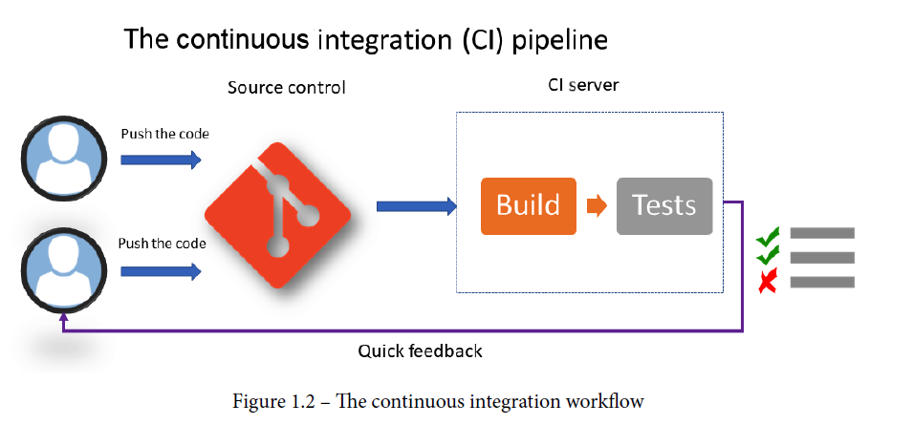
Implementing CI
The code being pushed into the SCM by the team members and the build and test being executed by the CI server. The purpose of this process is to provide rapid feedback to member

Slide 28
Continuous Delivery CD
Once continuous integration has been completed, the next step is to deploy the application automatically in one or more non-production environments(a software setup used for building, testing, and staging applications before they are released to real users), which is called staging. This process is called continuous delivery (CD).

Slide 29
Unlike CI, CD aims to test the entire application with all of its dependencies. This is very visible in microservice applications composed of several services and APIs;
CI will only test the microservice under development, while once deployed in a staging environment, it will be possible to test and validate the entire application, as well as the APIs and microservices that it is composed of.

Slide 30
The tools that are set up for CI/CD are often used with other solutions, as follows: •
A package manager: This constitutes the storage space of the packages generated by CI and recovered by CD. These managers must support feeds, versioning, and different types of packages. There are several on the market, such as Nexus, ProGet, Artifactory, and Azure Artifacts.
• A configuration manager: This allows you to manage configuration changes during CD; most CD tools include a configuration mechanism with a system of variable

Slide 31
In CD, deploying the application in each staging environment is triggered as follows:
It can be triggered automatically, following a successful execution in a previous environment. For example, we can imagine a case where the deployment in the pre-production environment is automatically triggered when the integration tests have been successfully performed in a dedicated environment.
It can be triggered manually, for sensitive environments such as the production environment, following manual approval by the person responsible for validating the proper functionality of the application in an environment.

Slide 32
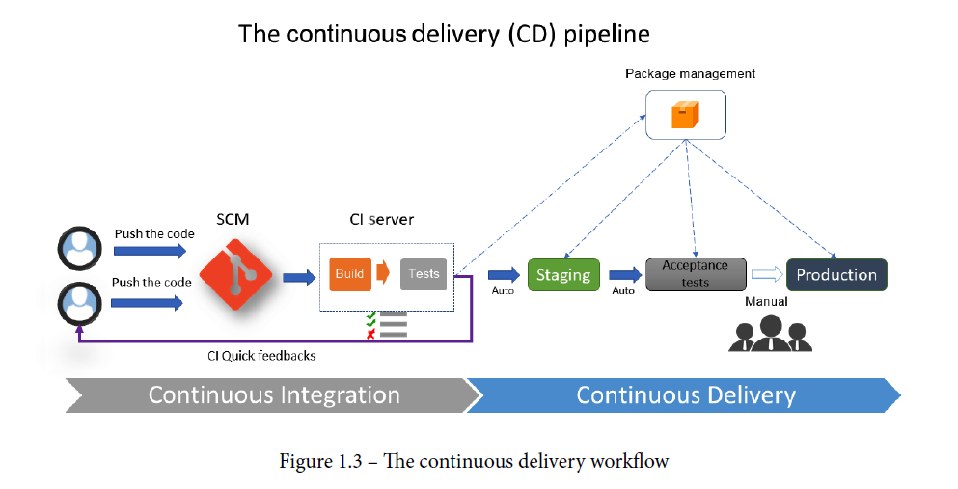
The preceding diagram clearly shows that the CD process is a continuation of the CI process. It represents the chain of CD steps, which are automatic for staging environments but manual for production deployments. It also shows that the package is generated by CI and stored in a package manager, and that it is the same package that is deployed in different environments.

Slide 33
Continuous deployment
Continuous deployment is an extension of CD, but this time, with a process that automates the entire CI/CD pipeline from the moment the developer commits their code to deployment in production through all of the verification steps.
This practice is rarely implemented in enterprises because it requires a variety of tests (unit, functional, integration, performance, and so on) to be covered for the application

Slide 34
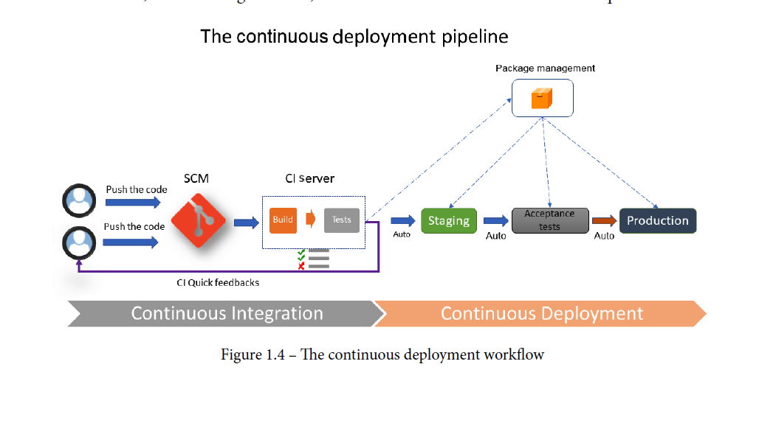
The preceding diagram is almost the same as that of CD, but with the difference that it depicts automated end-to-end deployment.
CI/CD processes are therefore an essential part of DevOps culture, with CI allowing teams to integrate and test the coherence of its code and to obtain quick feedback regularly. CD automatically deploys on one or more staging environments and hence offers the possibility to test the entire application until it is deployed in production.
Finally, continuous deployment automates the ability to deploy the application from commit to the production environment

Slide 35
Understanding IaC practices, The evolution of the DevOps culture
IaC is the process of writing the code of the provisioning and configuration steps of infrastructure components, which helps automate its deployment in a repeatable and consistent manner.

Slide 36
The benefits of IaC
• The standardization of infrastructure configuration reduces the risk of errors.
• The code that describes the infrastructure is versioned and controlled in a source
code manager.
• The code is integrated into CI/CD pipelines.
• Deployments that make infrastructure changes are faster and more efficient.
• There's better management, control, and a reduction in infrastructure costs.

Slide 37
IaC languages and tools
Scripting types:These are scripts such as Bash, PowerShell, or others that use the different clients (SDKs) provided by the cloud provider.
Declarative types: These are languages in which it is sufficient to write the state of the desired system or infrastructure in the form of configuration and properties.
Programmatic types:For a few years now, an observation has been made that the two types of IaC code, which are of the scripting or declarative languages, are destined to be in the operational team.

Slide 38
The IaC Topology
In a cloud infrastructure, IaC is divided into several typologies:
Deploying and provisioning the infrastructure
Server configuration and templating
Containerization
Configuration and deployment in Kubernetes

Slide 39
Continuous Integration and Continuous Delivery: CI/CD principles
CI covers the early stages: commit, build, and automated testing.
CD covers packaging, staging, approval, and production deployment.
Monitoring closes the loop by feeding issues and performance data back into the next development cycle.

Slide 40


Slide 41
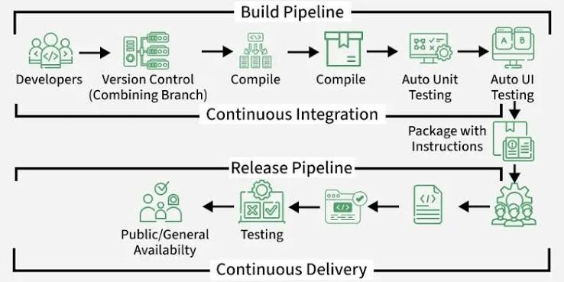

Slide 42
DevOps Activity | Example Tools
Version Control | Git, GitHub
Build | Maven, Gradle
CI/CD | Jenkins, GitHub Actions
Testing | Selenium, JUnit
Containerization | Docker
Orchestration | Kubernetes
Cloud | AWS, Azure, Google Cloud
Monitoring | Prometheus, Grafana

