Slide 1
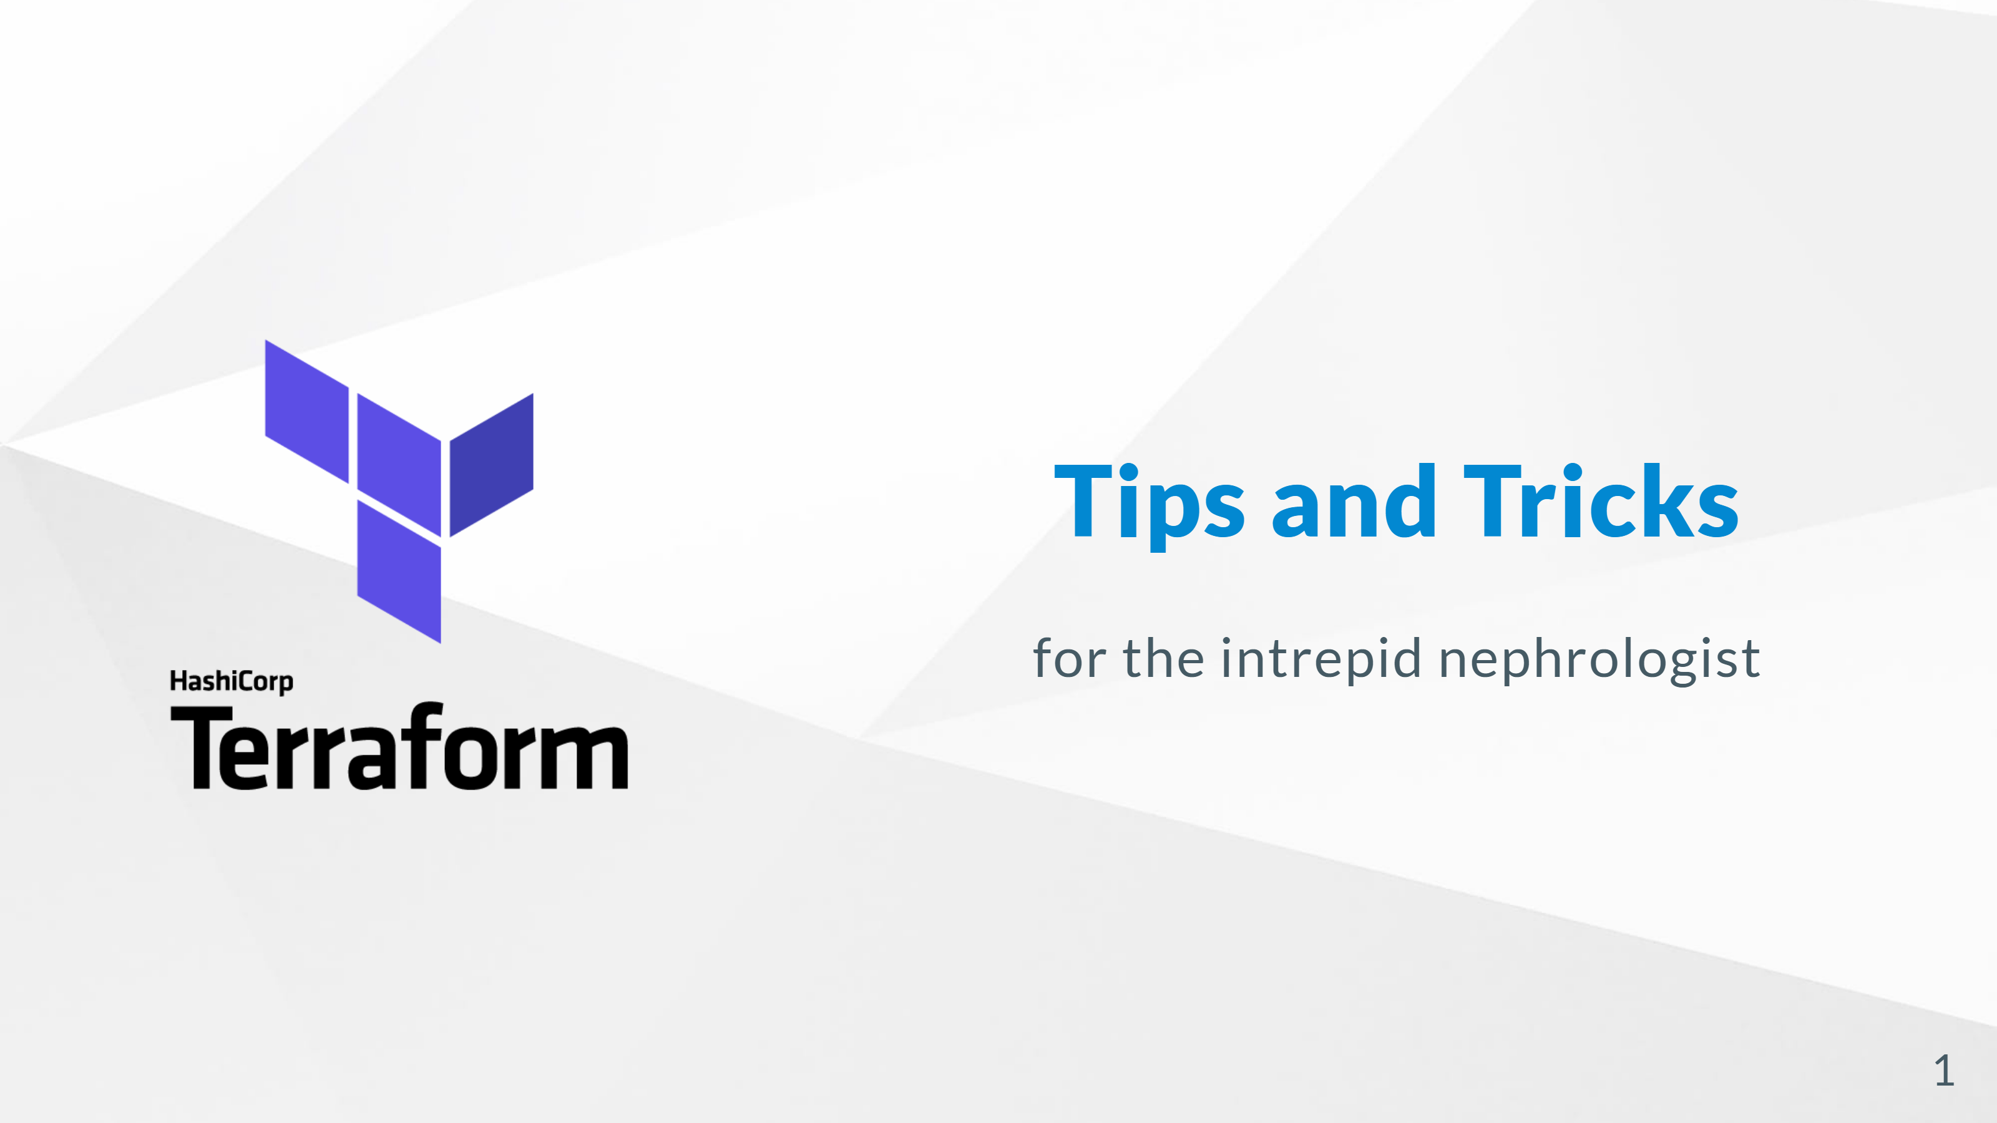

Slide 2
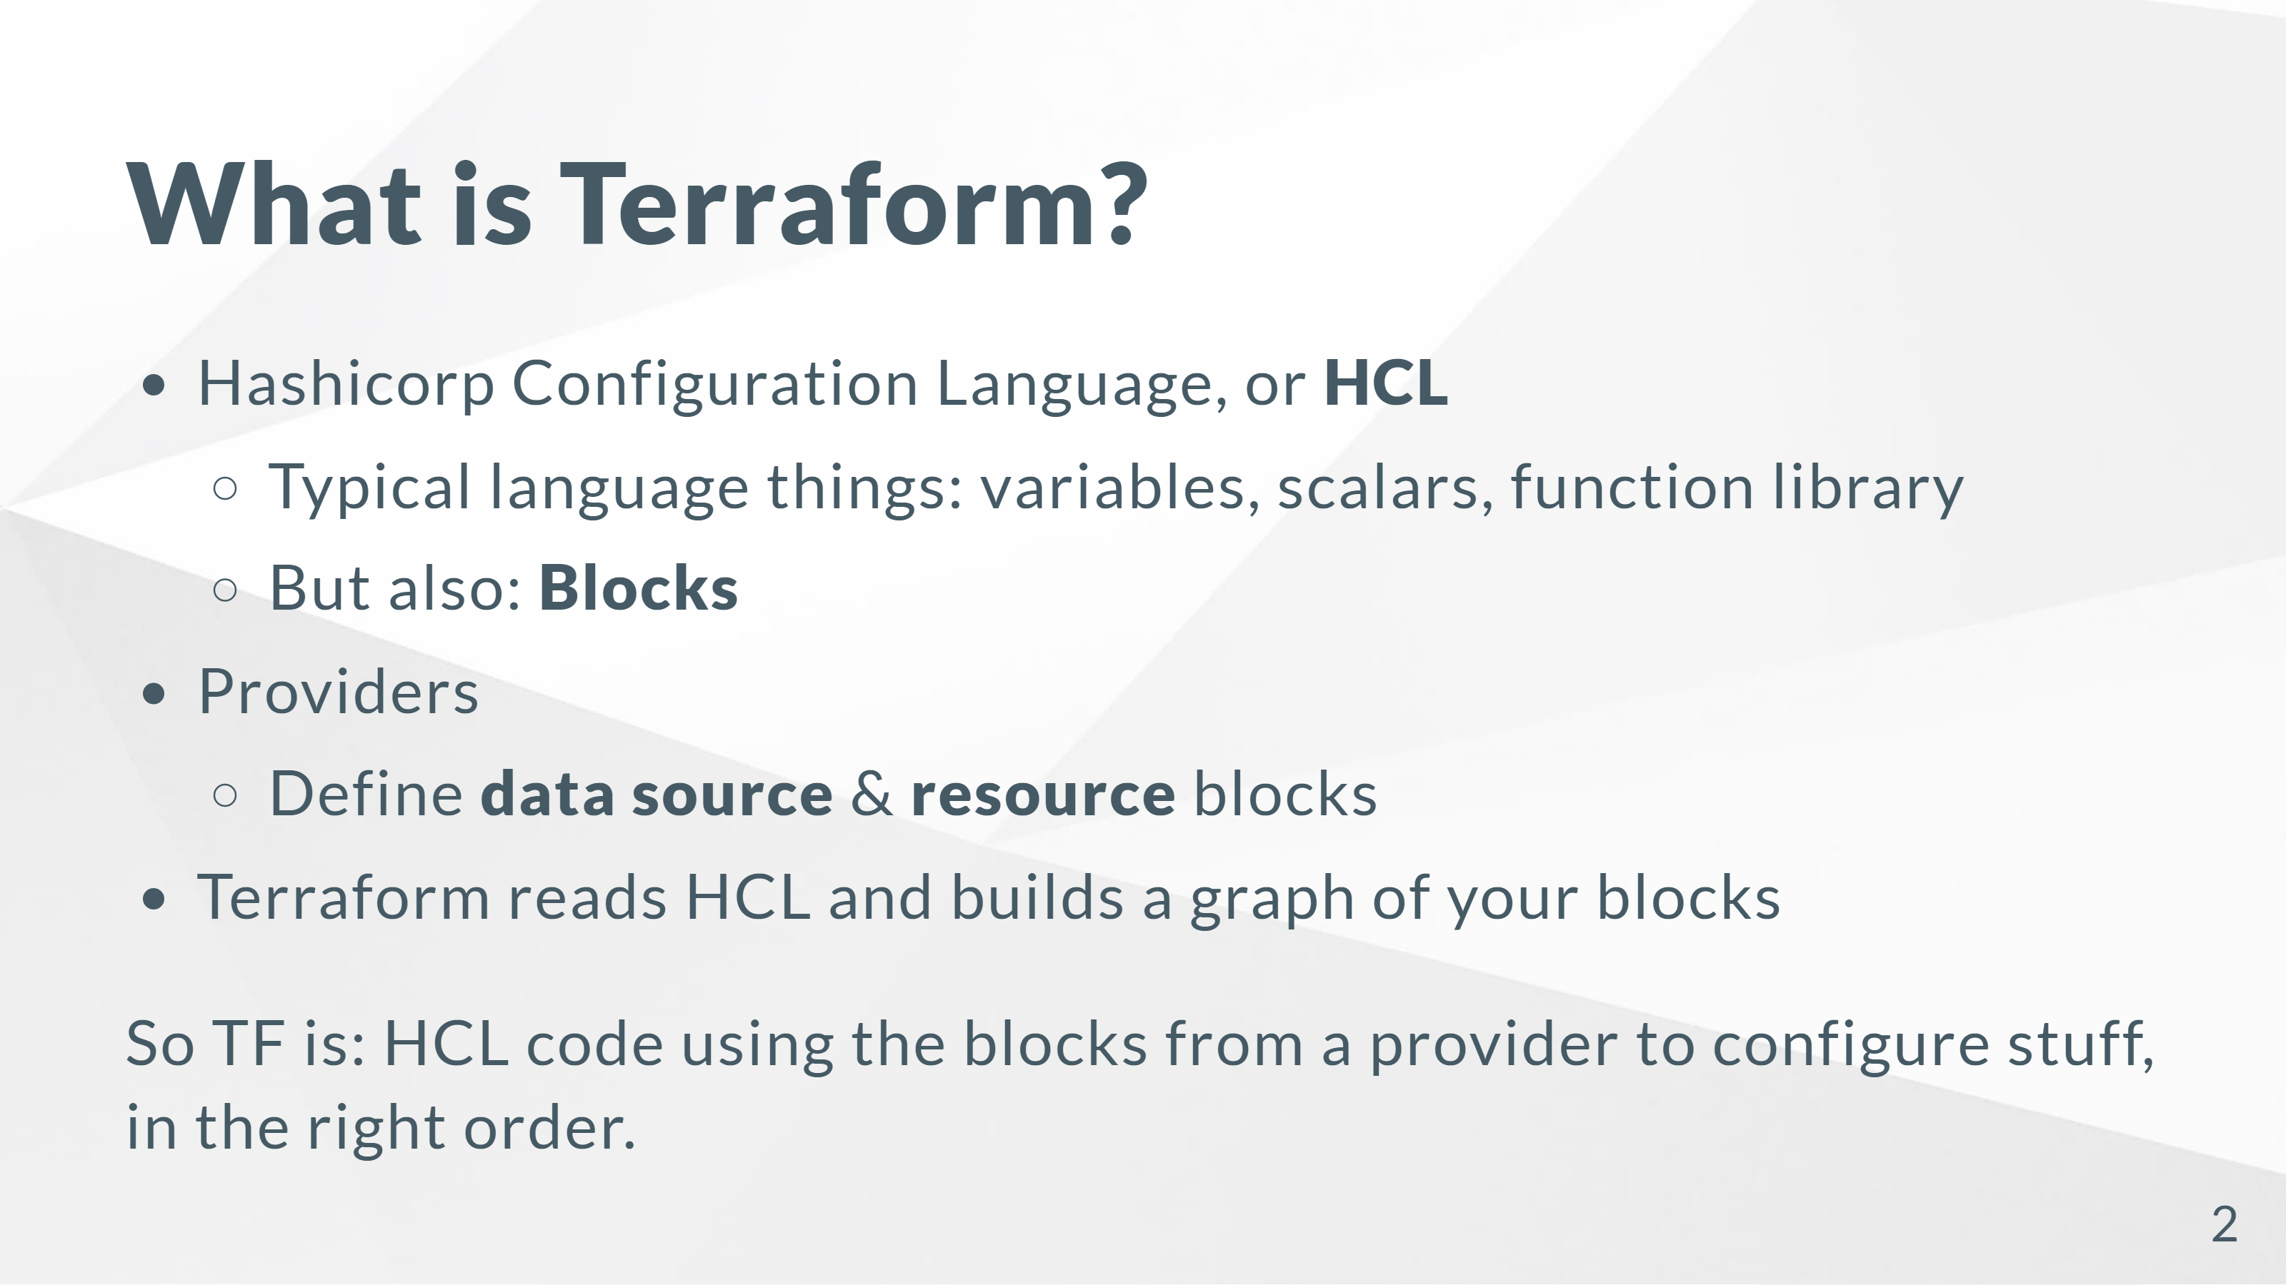
Notes:
That's actually the first tip. What even is Terraform? We use it to build cloudy things. But understanding the parts is important. Terraform isn't specific to AWS. It's not even specific to the cloud. It's a tool for writing configuration files and making them true. The core of TF is the programming language, HCL. If you've written "terraform", you're actually writing HCL. HCL has all your typical language features like scalars, functions, and flow control. But it's also got "blocks". More on that soon. What TF can do depends on what providers you load, which provide blocks. We usually just load the AWS provider, so it gets resource blocks for Lambdas and DynamoDBs and all that. But it can configure GitHub, or NU's on-prem load balancers, if you load those providers. Terraform knows how to read HCL and graph your blocks. This is important: if you need to create a ALB, then a listener on that ALB, then a rule on the listener, there's a certain order you need to make the AWS API calls in. You can't create the listener before the ALB exists -- and TF figures this out for you.

Slide 3
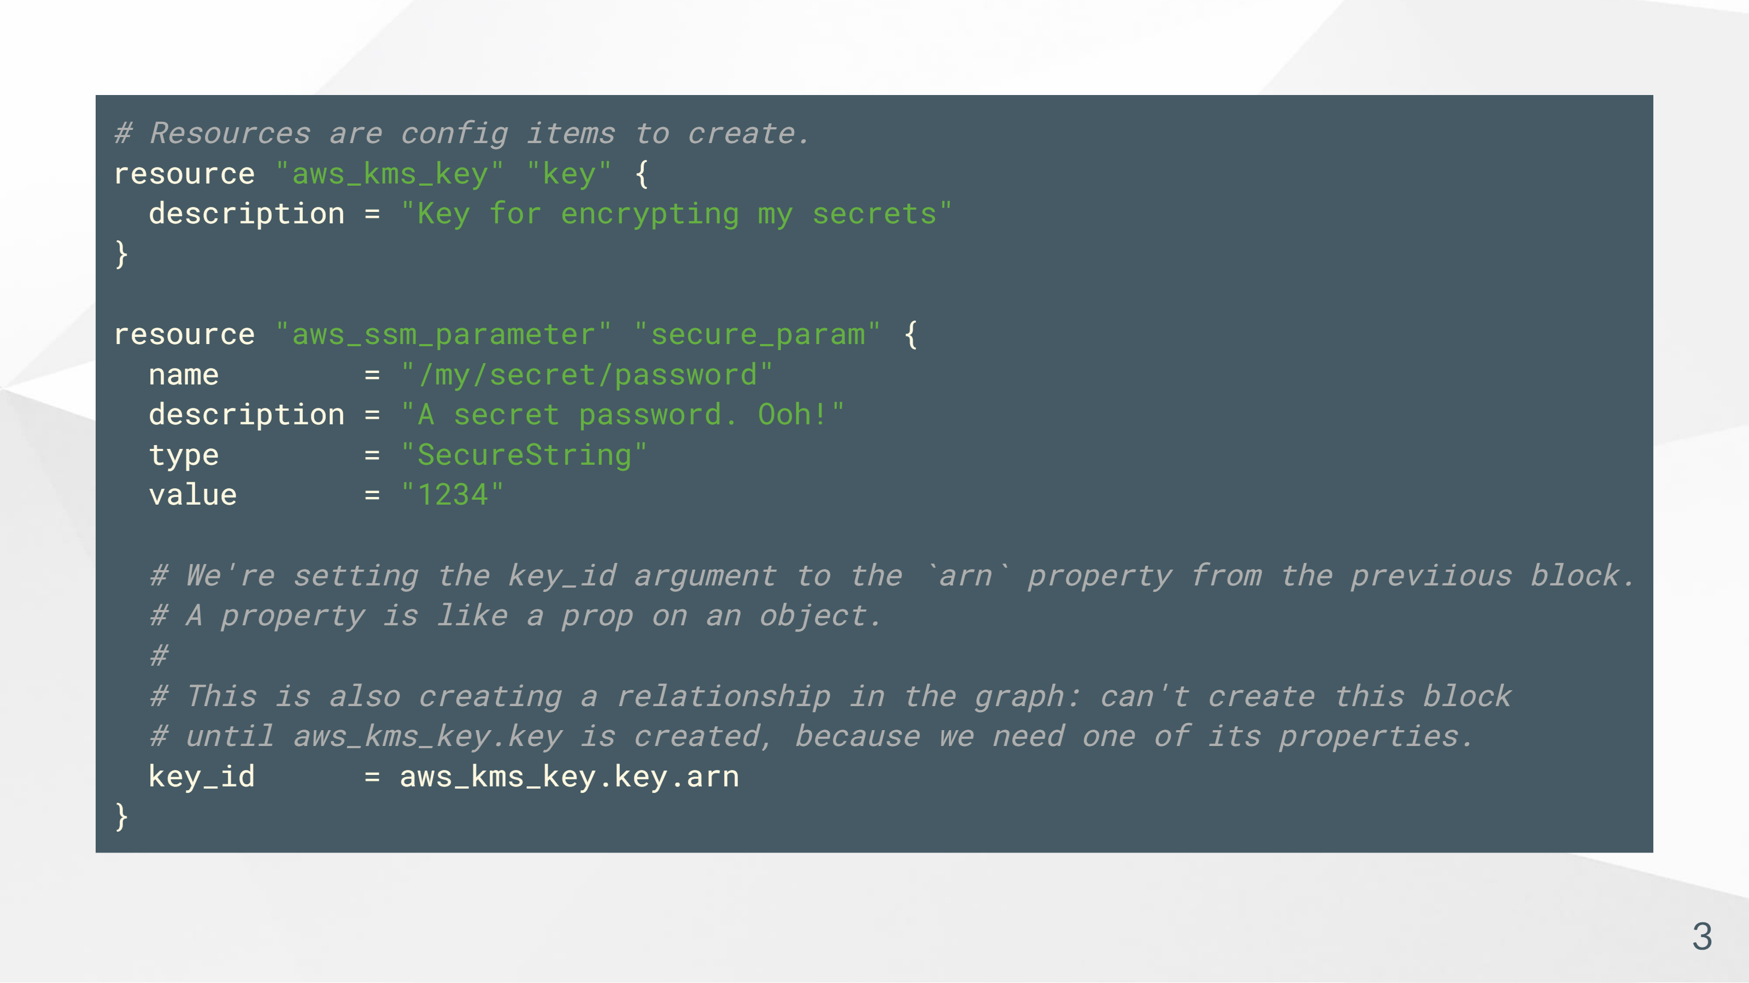
Notes:
I know most of you are familiar with .tf files organized into a couple folders, so let's not think about that today. Let's look at some HCL instead.

Slide 4
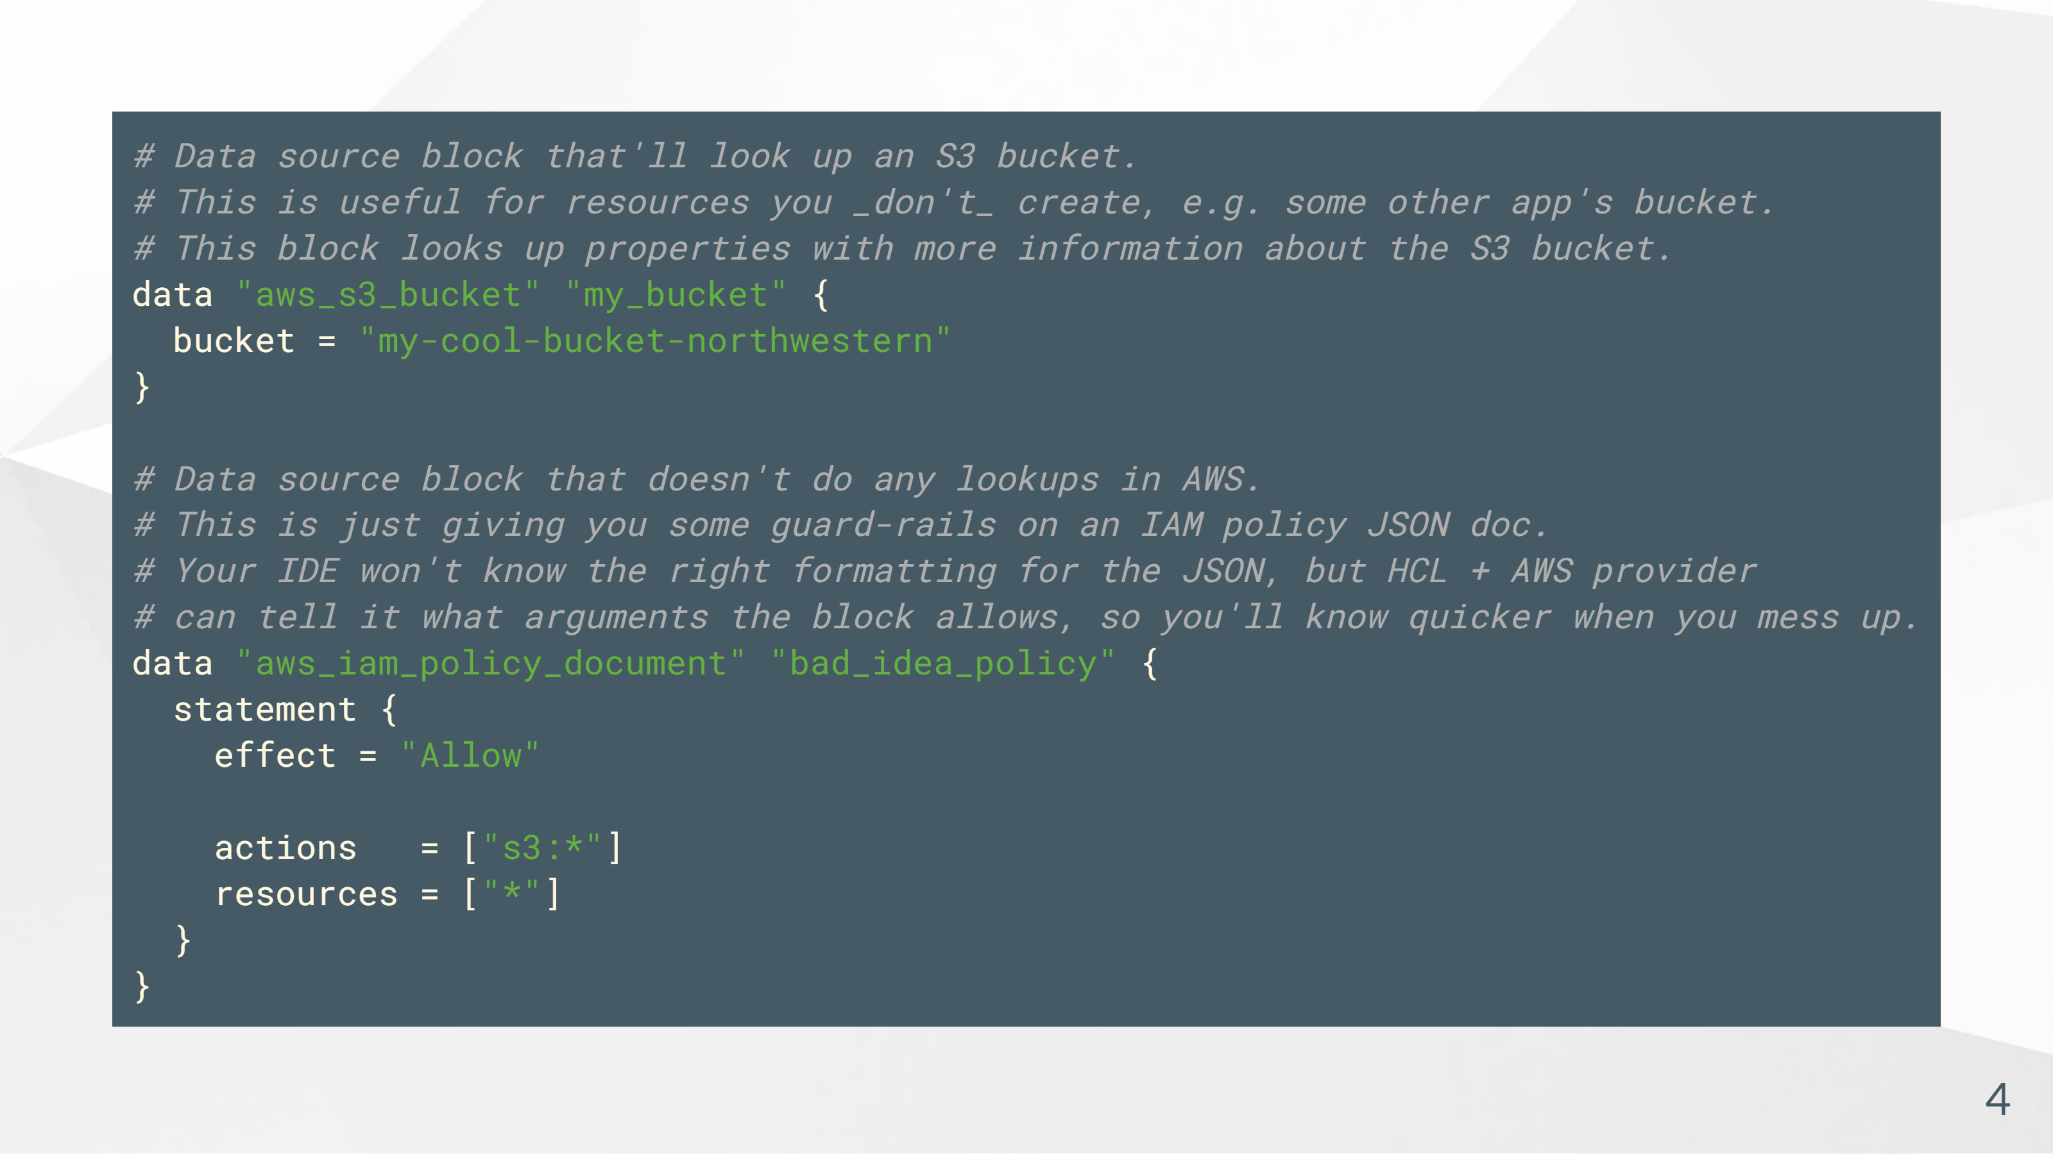
Notes:
Let's think about some other types of blocks too. Here's a data block. This isn't going to create anything in AWS, but it will lad more information (as properties) about an existing bucket. This can be helpful if you need details about shared account resources, or resources created by other projects' terraform. There are some data source blocks that don't do lookups. The IAM policies data source blocks let you write IAM policies in HCL instead of JSON, so your IDE can tell you when you're screwing it up. These aren't looking anything up in AWS; they're just providing some guard-rails.

Slide 5
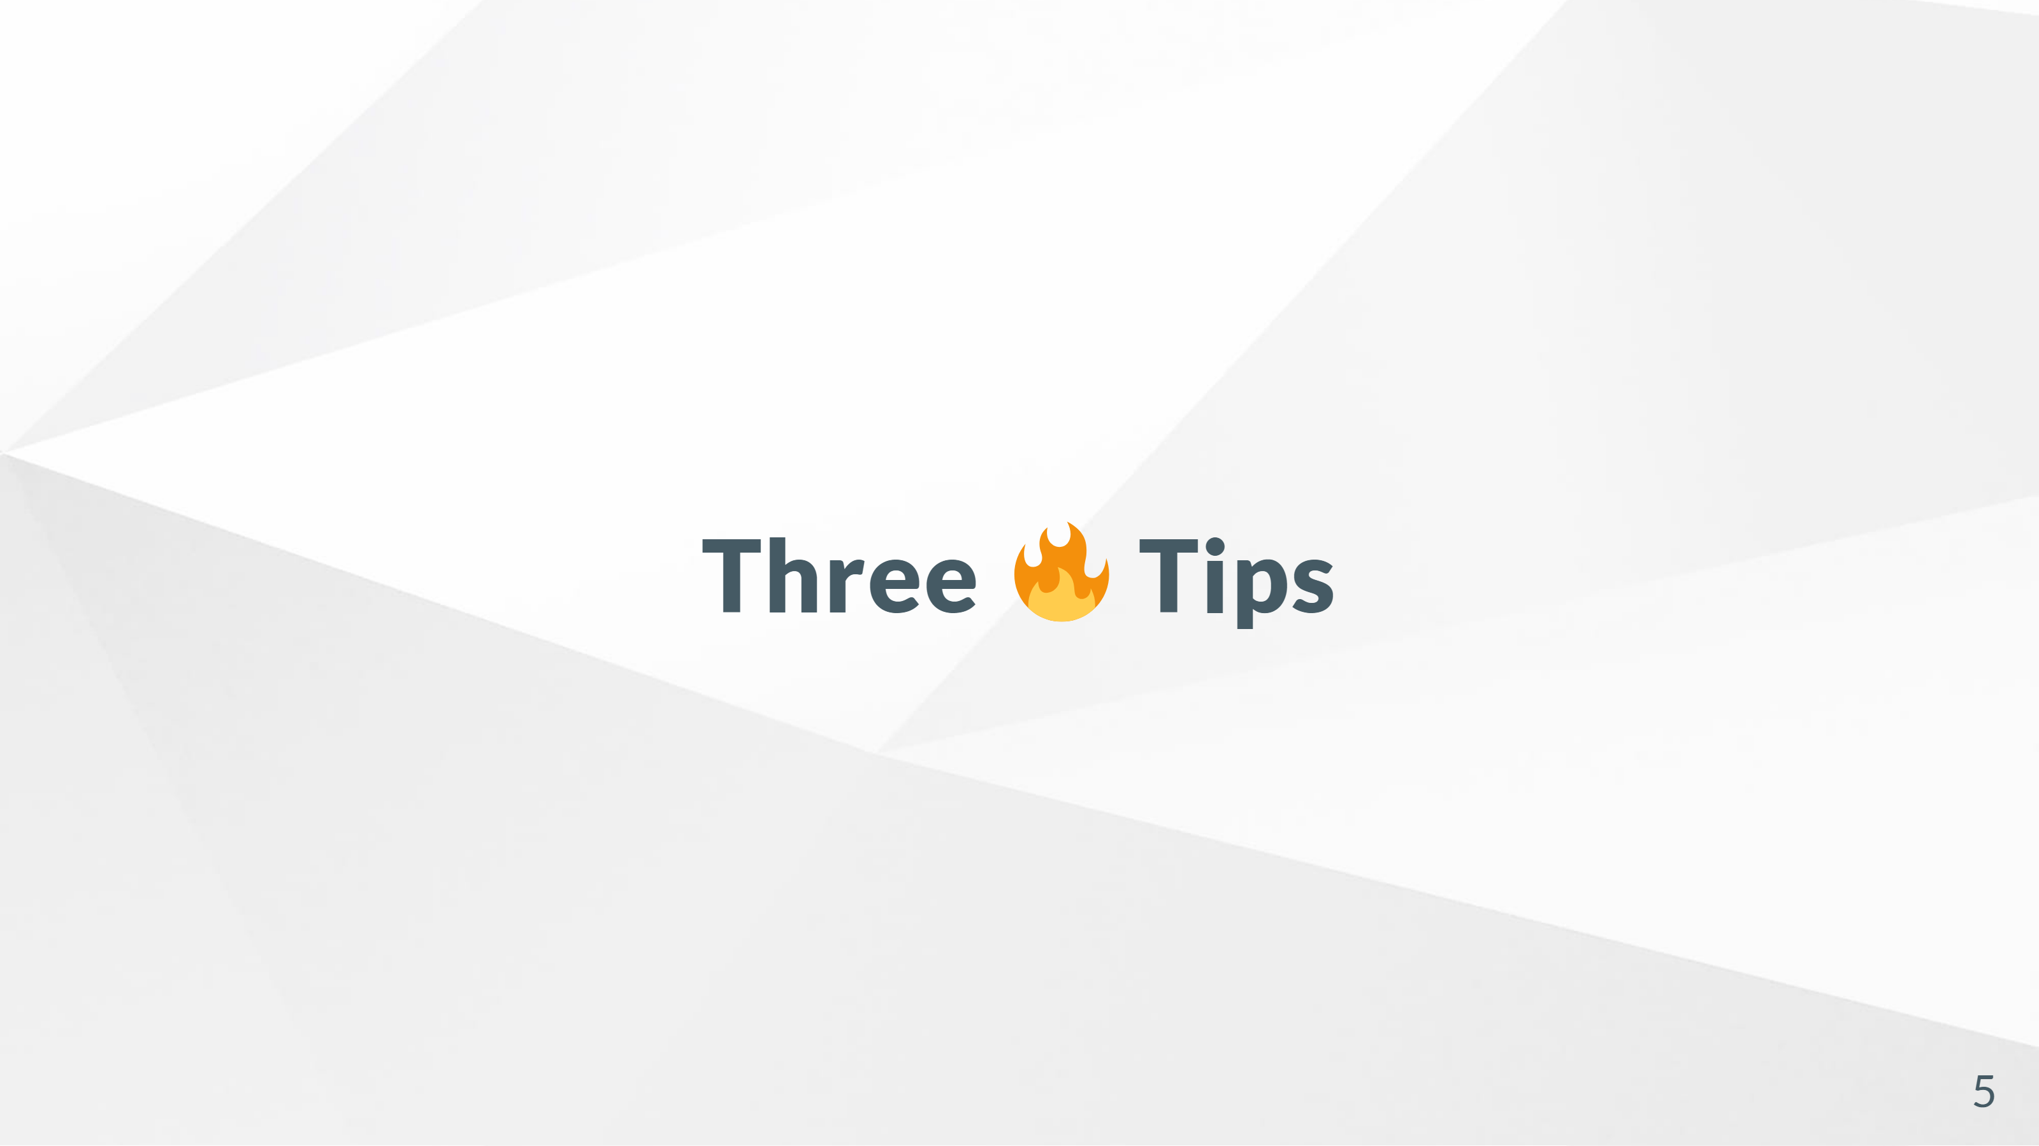
Notes:
There are other types of blocks, but I imagine you're bored now. So on with the show.

Slide 6
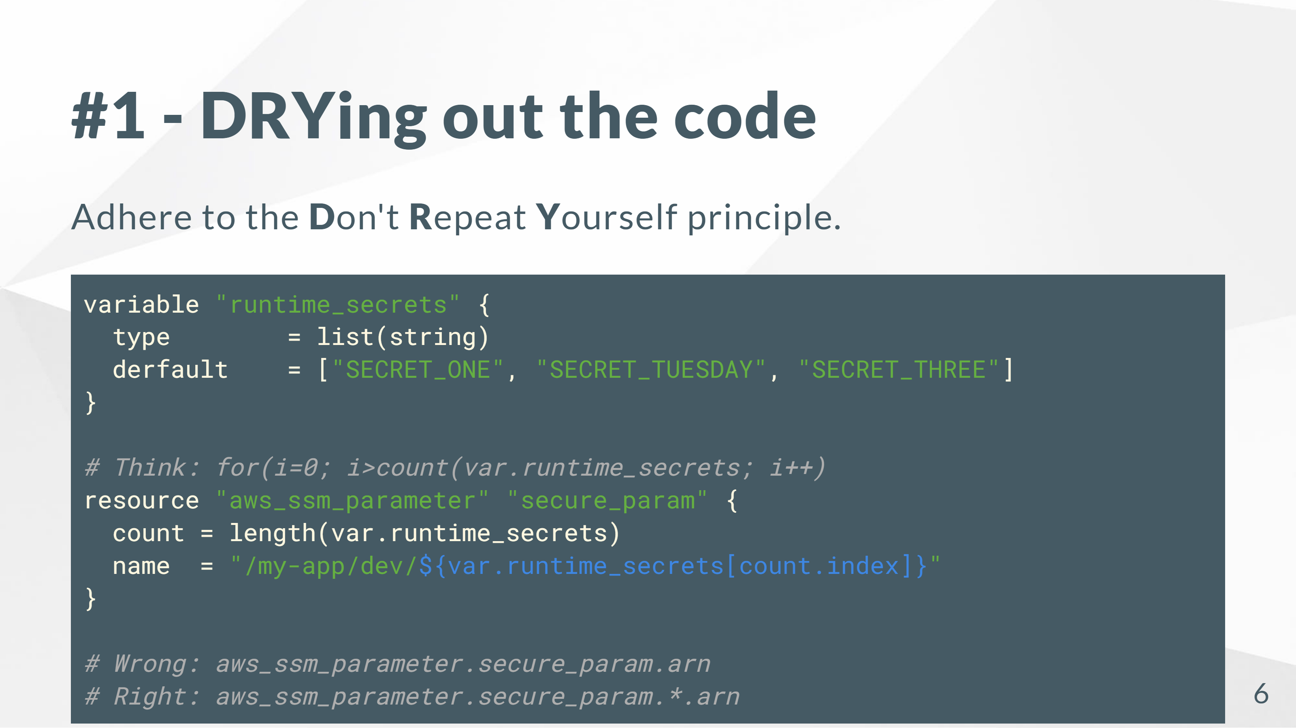
Notes:
OK, so the first tip is how to DRY out code. If you need a bunch of a resource block, they all have a "count" argument. You can set the count to an int, or in my case, I'm counting how many items are in a variable's array. When you use count on a block, you get the local count.index variable. Your block is basically in a for() now, and count.index is your i variable. This changes how you access the block's properties. Since your block is no longer just one block, it becomes an array. You can access _all_ copies' props with *.prop, or you can access one by array index. There's a for_each argument too, which works on maps: https://www.terraform.io/docs/language/meta-arguments/for_each.html

Slide 7
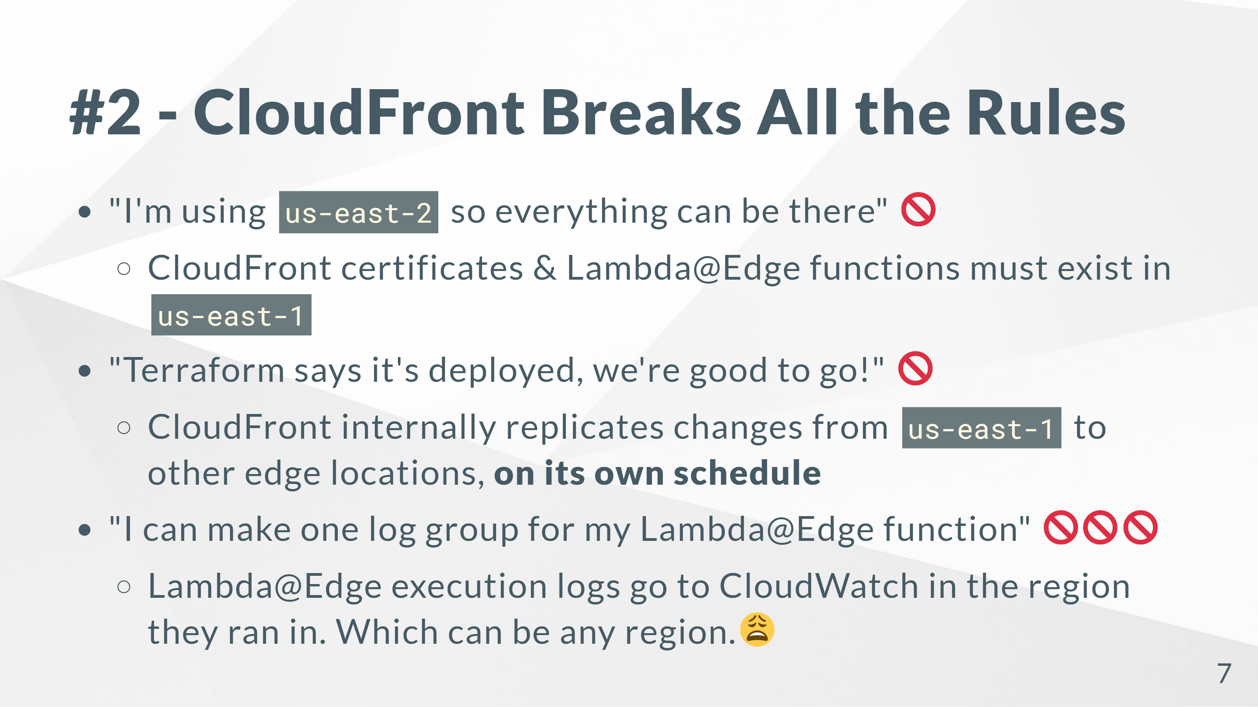
Notes:
So, CloudFront. It's a big rule breaker. Stuff like IAM is global and exists in no region, but CloudFront is a little more insidious than that: it's stuff *must* exist in us-east-1 for it to work. You can try to deploy CloudFront in us-east-2. It'll work, right up until it tries to attach to your certificate. "Can't find certificate with a perfectly-valid ARN", it'll say. Yeah. Because CloudFront and its associated service, Lambda@Edge, are weird. You create everything in us-east-1, and Amazon magically replicates the changes out to every other edge location. That replication happens on its own time too. Your `terraform apply` command will finish, but CloudFront can take fifteen minutes to finish pushing your changes out to the other locations. There's no status for this or anything -- so if you're seeing "old" config after a "successful" deployment, you've kinda gotta guess if your deployment went sideways or if it's just not replicated yet. The last -- and worst -- thing is Lambda@Edge CloudWatch logs. These Lambdas aren't normal Lambdas -- these run at edge locations when you attach them to a CloudFront distribution. Depending on where your user is located, they may hit `us-west-1`. Or `ap-east-1`. It'll automatically create a CloudWatch log group, with no log expiration timeframe, in that region and start logging. Useful if you want the logs. Not so useful when you've got 2GB of CloudWatch logs from 2015 burning a hole in your bill.

Slide 8
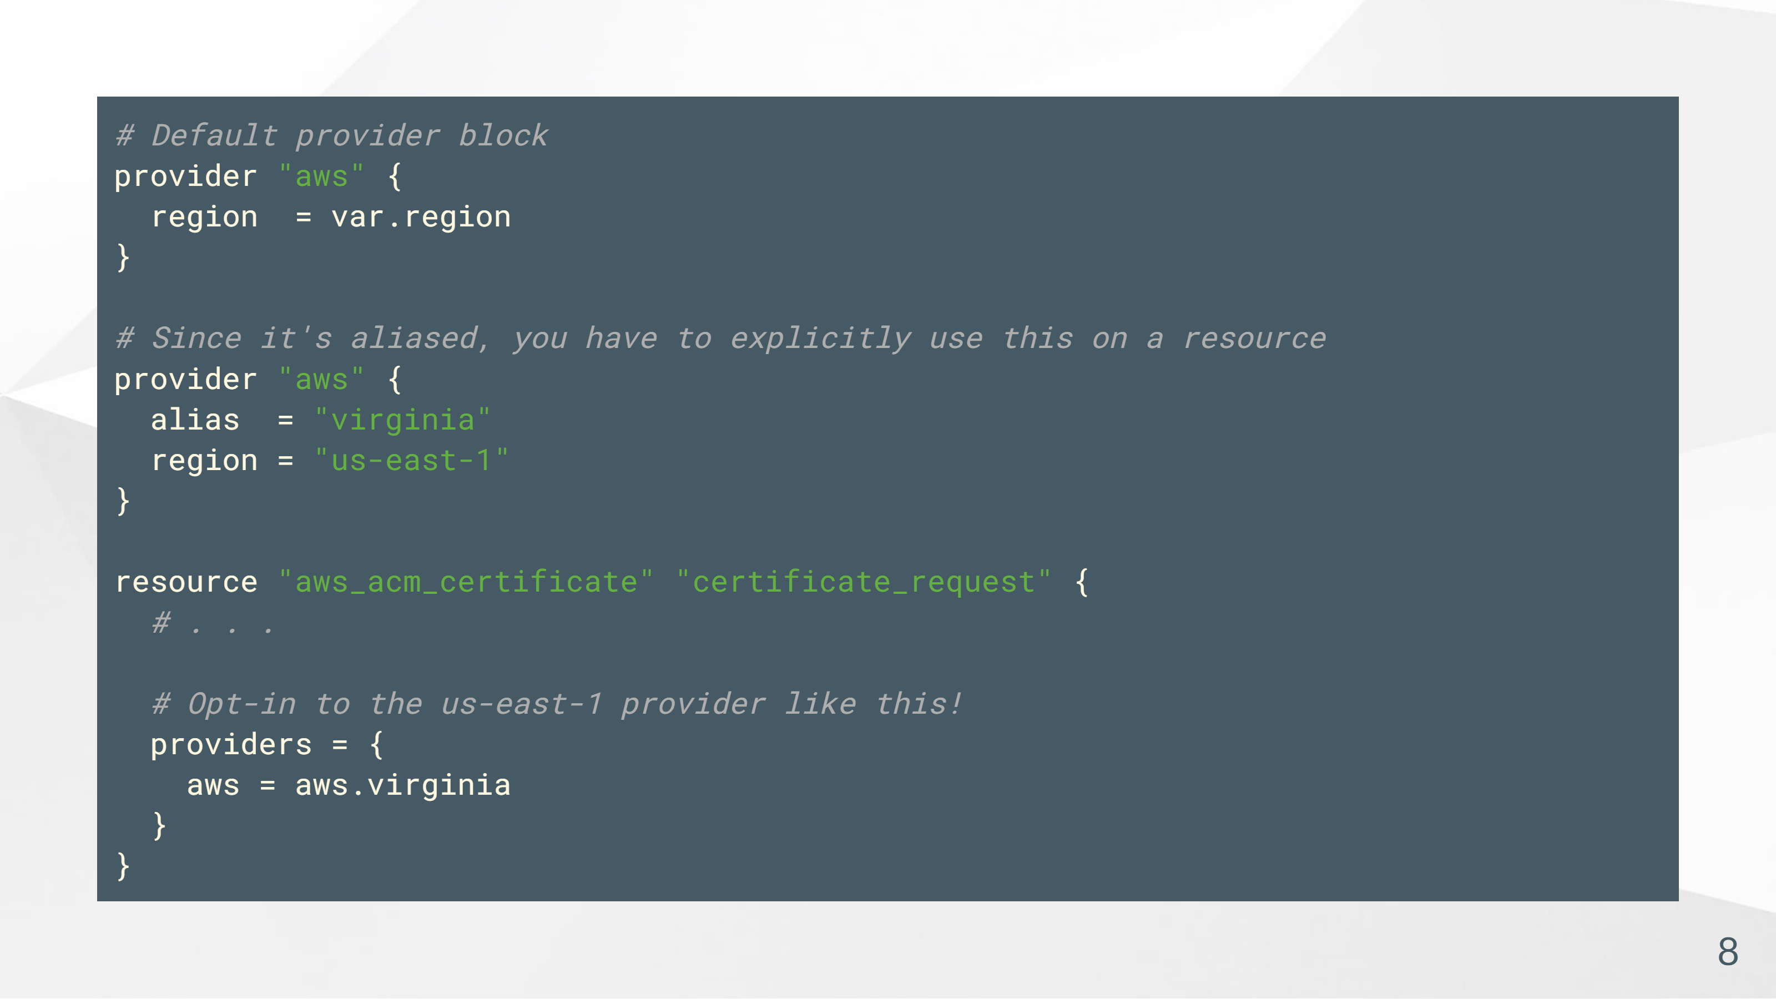
Notes:
So here's a Terraform trick for setting up a `us-east-1` provider alongside your default `us-east-2` provider. This is how you can create most of your infra in `us-east-2`, but selectively make a certificate in `us-east-1`.

Slide 9
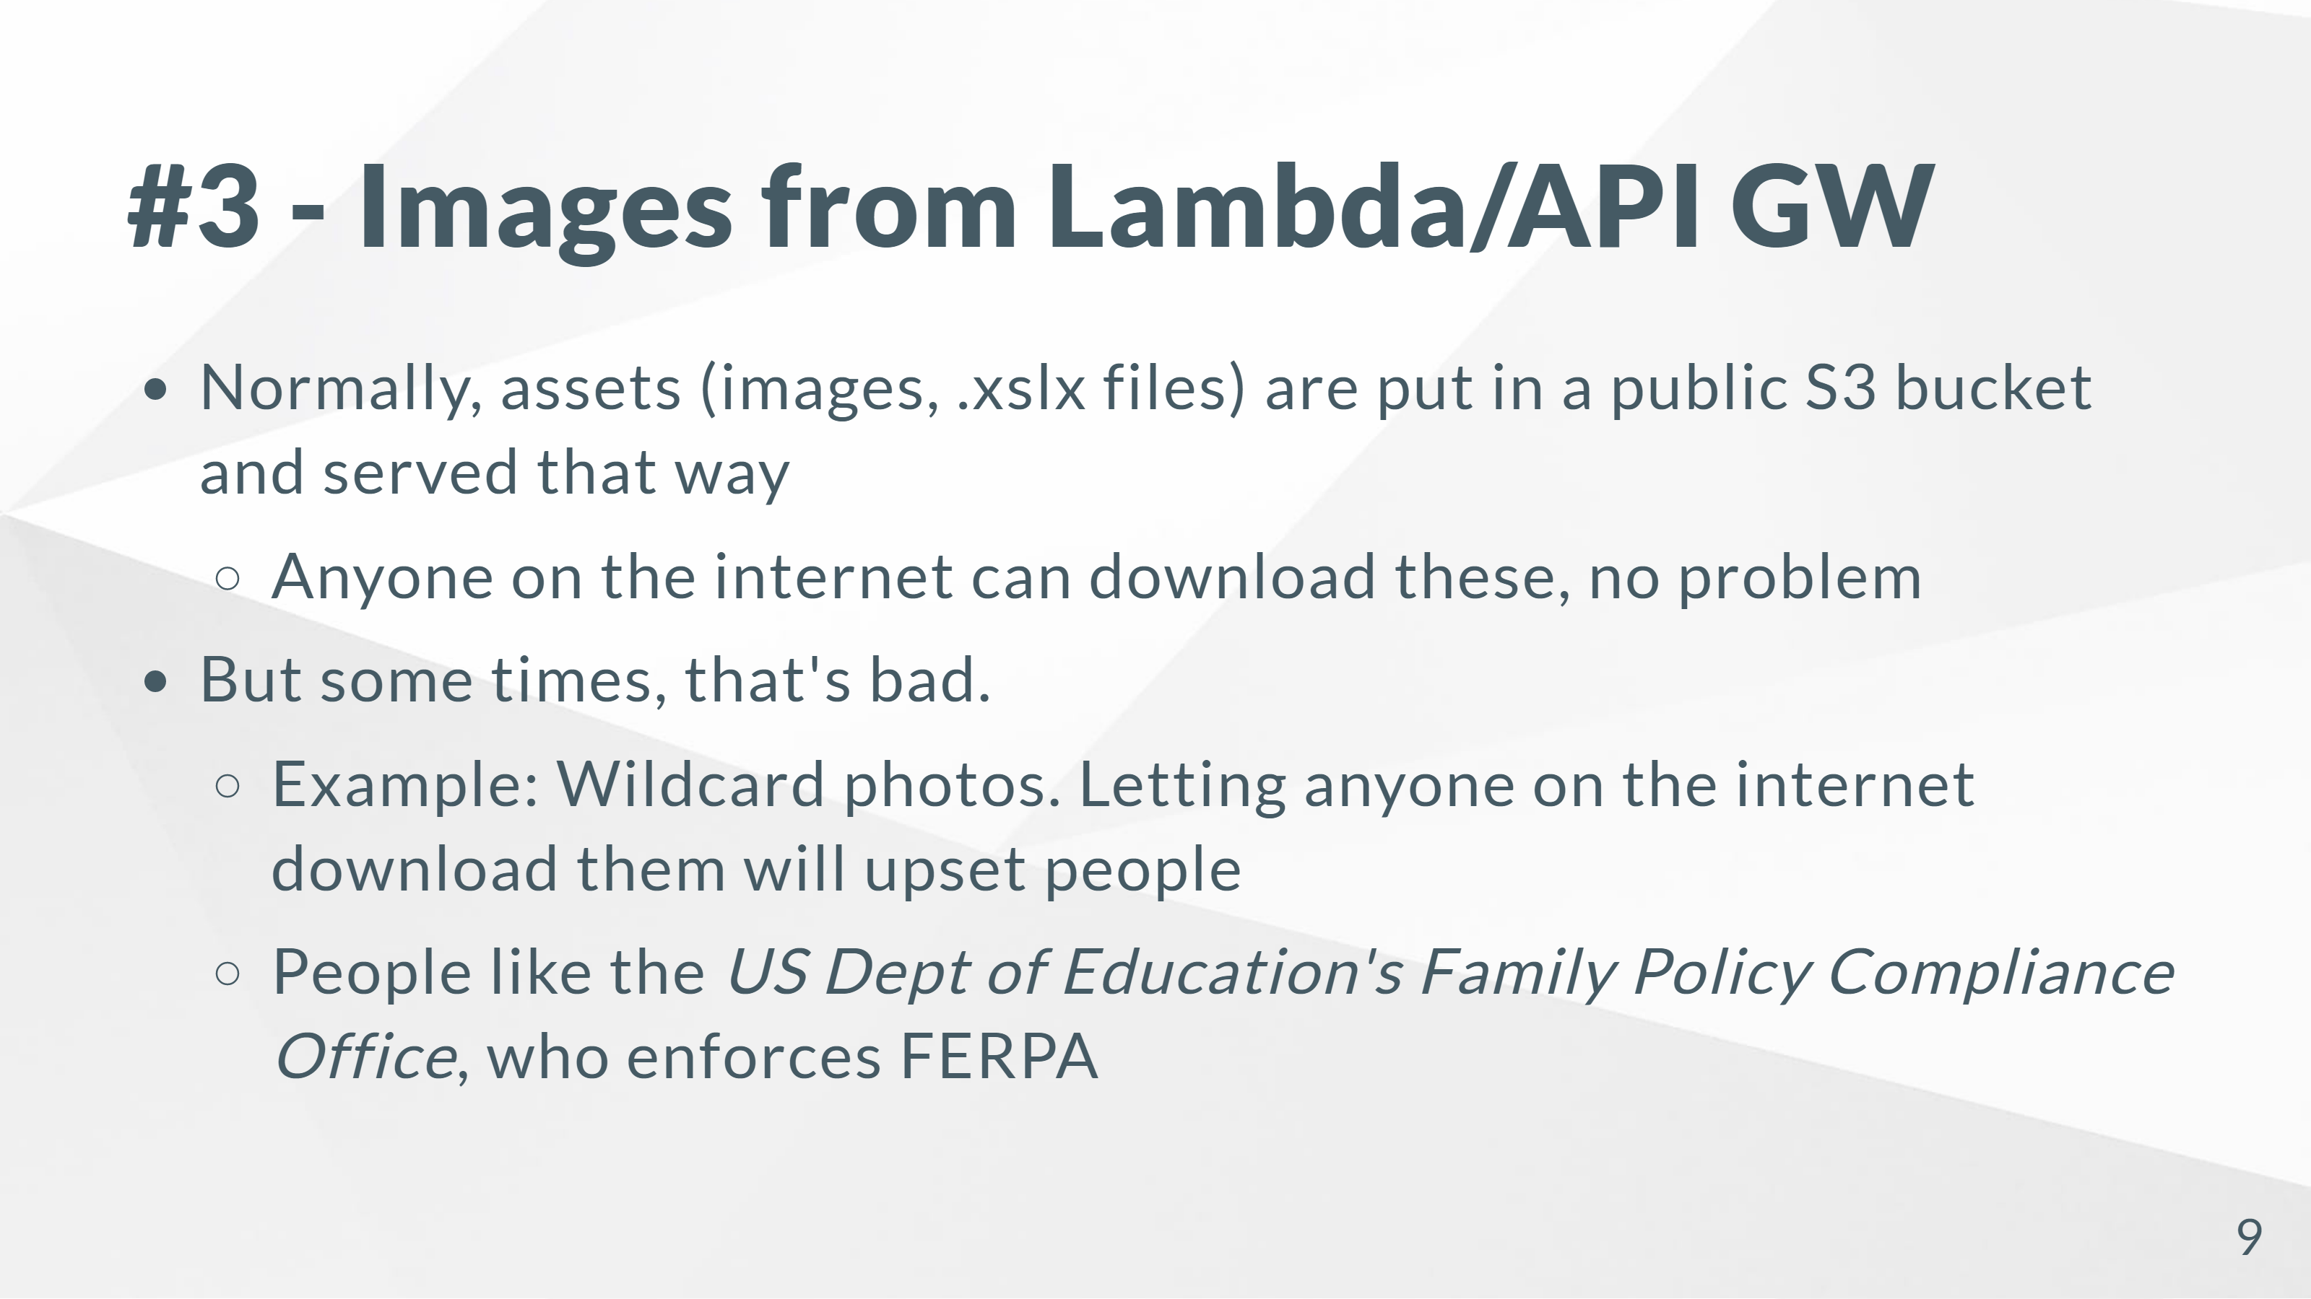

Slide 10
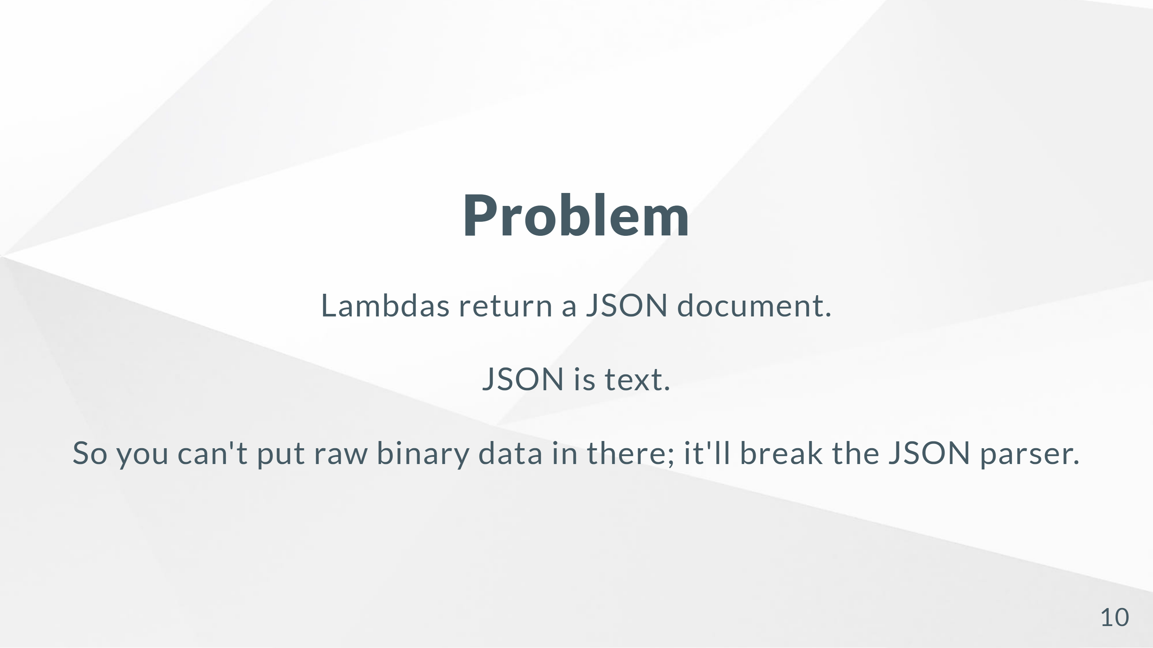

Slide 11
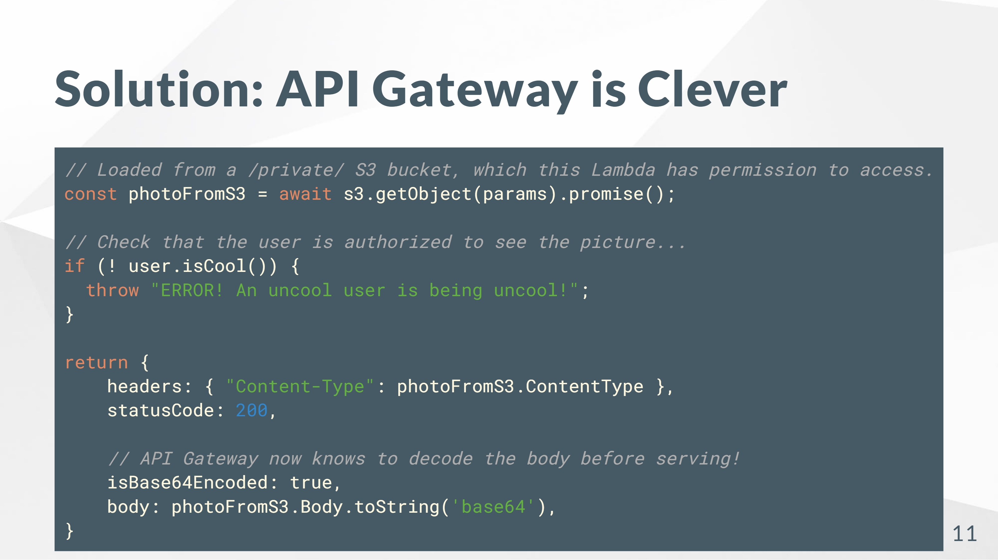

Slide 12
