Slide 1
Balanced Search Trees
AVL Trees

Slide 2
Balanced binary tree
The disadvantage of a binary search tree is that its height can be as large as N-1
This means that the time needed to perform insertion and deletion and many other operations can be O(N) in the worst case
We want minimise the height of a tree.
Thus, our goal is to keep the height of a binary search tree O(log N)
Such trees are called balanced binary search trees.
Examples are AVL tree, red-black tree.

Slide 3

Binary Search Tree - Best Time
All BST operations are O(h), where d is tree depth
minimum d is h= log₂N for a binary tree with N nodes
What is the best case tree?
What is the worst case tree?
So, best case running time of BST operations is O(log N)

Slide 4
Binary Search Tree - Worst Time
Worst case running time is O(N)
What happens when you Insert elements in ascending order?
Insert: 2, 4, 6, 8, 10, 12 into an empty BST
Problem: Lack of “balance”:
compare depths of left and right subtree
Unbalanced degenerate tree

Slide 5
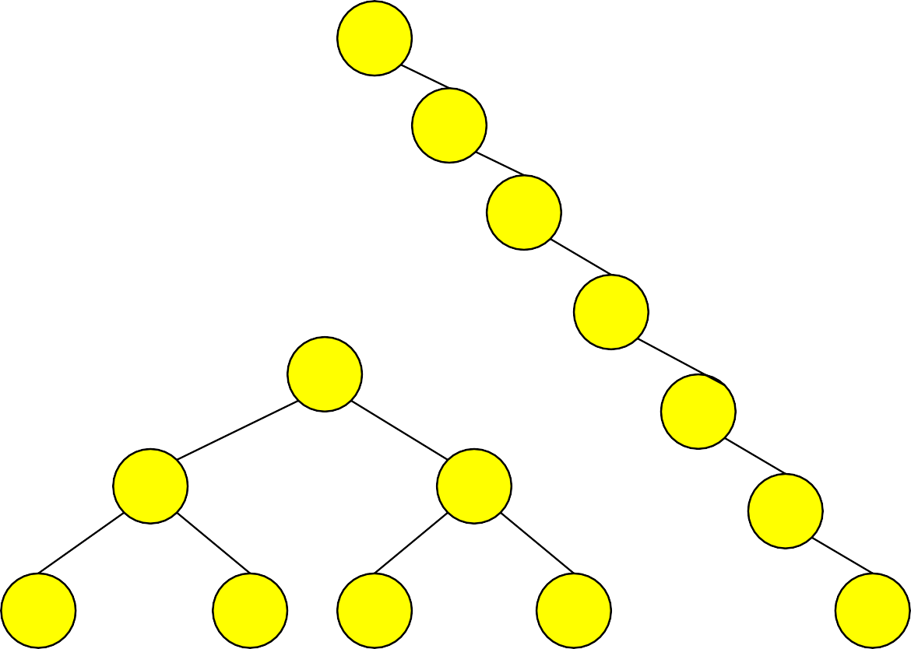
Balanced and unbalanced BST
1
4
2
2
5
3
1
3
4
4
Is this “balanced”?
5
2
6
6
1
3
5
7
7

Slide 6
AVL Trees
Many algorithms exist for keeping binary search trees balanced
Adelson-Velskii and Landis (AVL) trees (height-balanced trees)
AVL tree is a binary search tree
Whenever it becomes unbalanced
Rearranges its nodes to get a balanced binary search tree
Balance of a binary search tree upset when
Add a node
Remove a node
Thus during these operations, the AVL tree must rearrange nodes to maintain balance

Slide 7
AVL Tree is
Named after Adelson-Velskii and Landis
The first dynamically balanced trees to be propose
Rule: binary search tree with balance condition in which the sub-trees of each node can differ by at most 1 in their height

Slide 8



AVL Tree
-1
0
0
0
-1
1
0
0
0
0
AVL Tree
-2
AVL Tree
1
0
0
-1
0
Not an AVL Tree

Slide 9
Definition of a balanced tree
Ensure the depth = O(log N)
Take O(log N) time for searching, insertion, and deletion
Every node must have left & right sub-trees of the same height

Slide 10
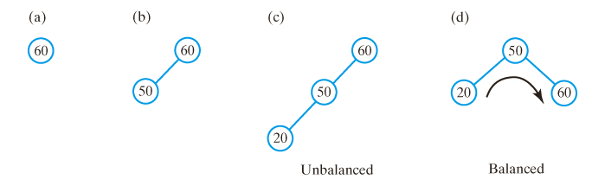
AVL Trees
After inserting (a) 60; (b) 50; and (c) 20 into an initially empty binary search tree, the tree is not balanced;
(d) a corresponding AVL tree rotates its nodes to restore balance.

Slide 11
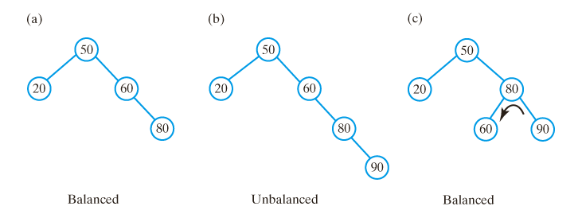
AVL Trees
(a) Adding 80 to the previous tree does not change the balance of the tree;
(b) a subsequent addition of 90 makes tree unbalanced;
(c) left rotation restores balance.

Slide 12
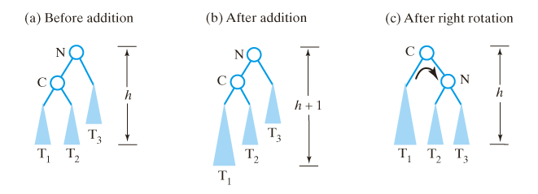
Single Rotations
Before and after an addition to an AVL subtree that requires a right rotation to maintain its balance.

Slide 13
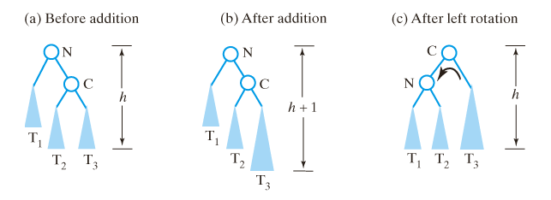
Single Rotations
Before and after an addition to an AVL subtree that requires a left rotation to maintain balance.

Slide 14
Single Rotations
Algorithm for right rotation
Algorithm for left rotation
Algorithm rotateRight(nodeN) nodeC = left child of nodeN Set nodeN’s left child to nodeC’s right child Set nodeC’s right child to nodeN
return nodeC
Algorithm rotateLeft(nodeN) nodeC = right child of nodeN Set nodeN’s right child to nodeC’s left child Set nodeC’s left child to nodeN
return nodeC
Key: An imbalance at node N in an AVL tree can be corrected by a single rotation if
a) the add occurred in the left subtree of N’s left child (rotate right)
b) the add occurred in the right subtree of N’s right child (rotate left)

Slide 15

Single Rotations
Algorithm rotateRight(nodeN) nodeC = left child of nodeN Set nodeN’s left child to nodeC’s right child Set nodeC’s right child to nodeN
return nodeC
Algorithm rotateLeft(nodeN) nodeC = right child of nodeN Set nodeN’s right child to nodeC’s left child Set nodeC’s left child to nodeN
return nodeC

Slide 16
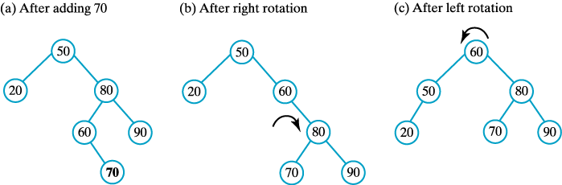
Double Rotations
(a) Adding 70 to the previous tree destroys its balance; to restore the balance, perform both (b) a right rotation and (c) a left rotation.

Slide 17
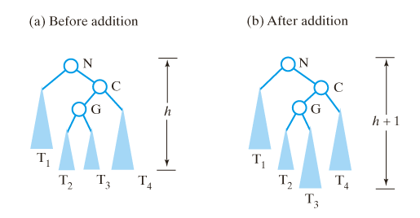
Double Rotations
(a-b) Before and after an addition to an AVL subtree that requires both a right rotation and a left rotation to maintain its balance.

Slide 18

Double Rotations
(c-d) Before and after an addition to an AVL subtree that requires both a right rotation and a left rotation to maintain its balance.

Slide 19
Double Rotations
Algorithm to perform a right-left double rotation
Algorithm rotateRightLeft(nodeN) nodeC = right child of nodeN Set nodeN’s right child to the subtree produced by rotateRight(nodeC) return rotateLeft(nodeN)

Slide 20
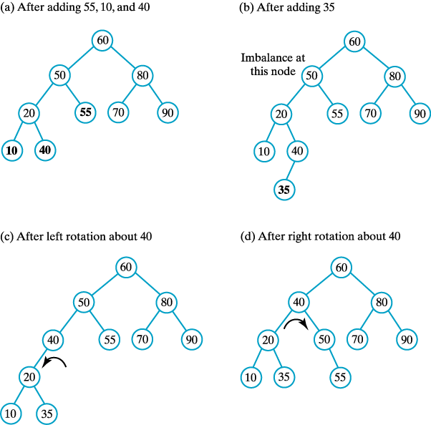
Double Rotations
(a) The previous AVL tree after additions that maintain its balance; (b) after an addition that destroys the balance … continued →

Slide 21
Double Rotations
Previous tree (c) after a left rotation; (d) after a right rotation.

Slide 22
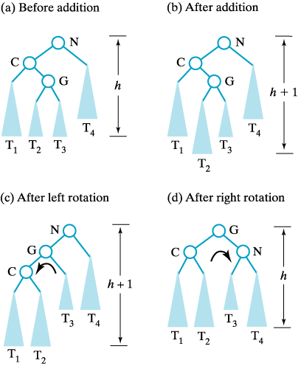
Double Rotations
Before and after an addition to an AVL subtree that requires both a left and right rotation to maintain its balance.

Slide 23
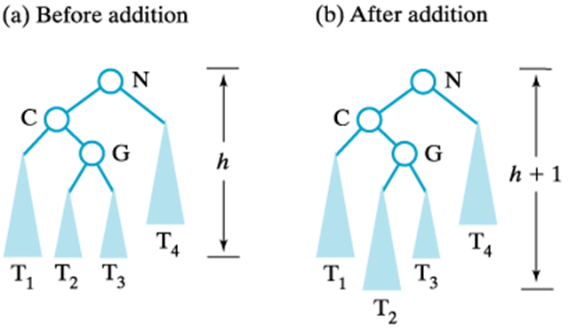
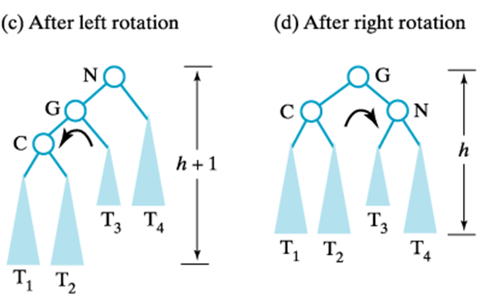
Double Rotations
Algorithm to perform a left-right double rotation
Algorithm rotateLeftRight(nodeN) nodeC = left child of nodeN Set nodeN’s left child to the subtree produced by rotateLeft(nodeC) return rotateRight(nodeN)

Slide 24
Double Rotations
An imbalance at node N of an AVL tree can be corrected by a double rotation if
The addition occurred in the left subtree of N's right child (right-left rotation) or …
The addition occurred in the right subtree of N's left child (left-right rotation)
A double rotation is accomplished by performing two single rotations
A rotation about N's grandchild
A rotation about node N's new child

Slide 25
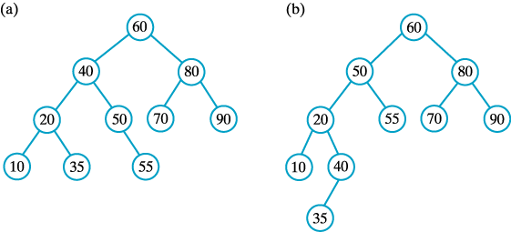
Double Rotations
The result of adding 60, 50, 20, 80, 90, 70, 55, 10, 40, and 35 to an initially empty (a) AVL tree; (b) binary search tree.

Slide 26
AVL Trees
Algorithm rebalance(nodeN)
if (nodeN’s left subtree is taller than right subtree by more than 1) {
//insertion was in nodeN’s left subtree
if (left child of nodeN has left subtree taller than its right subtree)
rotateRight(nodeN) //addition was in left subtree of left child
else
rotateLeftRight(nodeN) //addition was in right subtree of left child
}
else if (nodeN’s right subtree is taller than left subtree by more than 1) {
//insertion was in nodeN’s right subtree
if (right child of nodeN has right subtree taller than its left subtree)
rotateLeft(nodeN) //addition was in right subtree of right child
else
rotateRightLeft(nodeN) //addition was in left subtree of right child
}
//Note: requires method getHeightDifference()

Slide 27
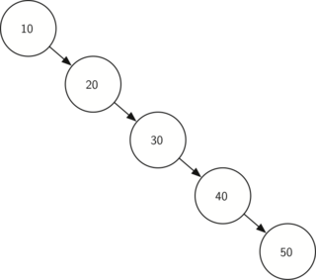
Prctice-1

Slide 28
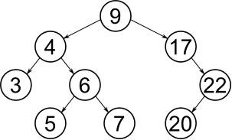
Practice-2

Slide 29
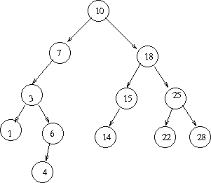
Practice-3

Slide 30
Q/A

