Slide 1
Open Community Approach (OCA)
Definition: Open Community Approach
Open Community is a generalization of the concept of
OpenSource to other collaborative effort. The term “open” for an open community refers to the opportunity for anyone to join and contribute to the collaborative effort. The direction and
goals are determined collaboratively by all members of the community.
The resulting work (“product”) is made available under a
free license, so that other communities can adapt and build
on them. In this context the “product” of the open community is an “improved public health by application of space technologies”.

Slide 2
Open Community Approach
OpenContent Development
→ Wikiversity
5%
WORKLOAD
15%
WORKLOAD
100%
OPEN
95%
OPEN
10%
WORKLOAD
100%
OPEN
85%
OPEN
90%
OPEN
TIME LINE for CAPACITY BUILDING

Slide 3
Open Proposal Management
Workload for Proposal Development
→ Fork on GitHub
5%
WORKLOAD
15%
WORKLOAD
100%
OPEN
95%
OPEN
10%
WORKLOAD
100%
OPEN
85%
OPEN
90%
OPEN
TIME LINE and Evolution of PROPOSAL

Slide 4
OCA & One Health
One Health
Environmental Health
Public Health
+
Mitigate Risk / reduce number
of people exposed to One Health Risks
NOT: Maximize the Use of a certain Piece
of Technology or Concept

Slide 5
ONE HEALTH
One Health
Environmental Health
Public Health
+
Mitigate Risk / reduce number
of people exposed to One Health Risks
Environmental Health has an impact on
Public Health

Slide 6


Holistic One Health Approach
Space
Health
LowCost Precision Farming
GPS-Tailored Decision Support
Monitoring – Health
m-Health Risk Awareness
''Bridge'' from Space to (One) Health Impact
Low Cost
App
Precision
Farming
Workflow
Optimisation
Farm Worker
GIS
Living
Lab
Decision
Support
Health
Space
Agency
Last
Mile

Slide 7
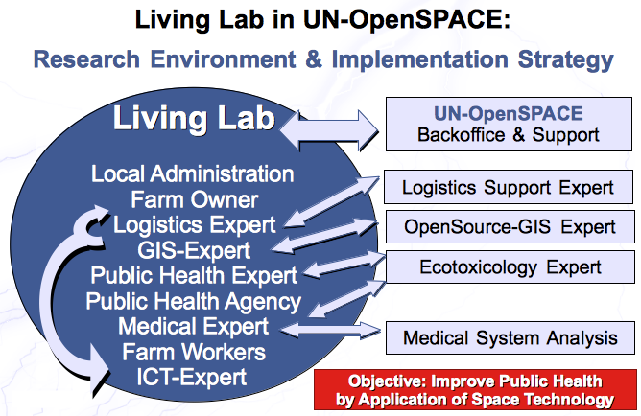
Living Lab & Application of Space Technology
User-driven Innovation – Rural Areas
Adaptation
to CKD
AT6FUI-Living Lab
Open
Resources
GRASS, QGIS
ODK, SDAPS,
Tutorials,
Capacity Building
Material,
Risk Awareness,
….....

Slide 8
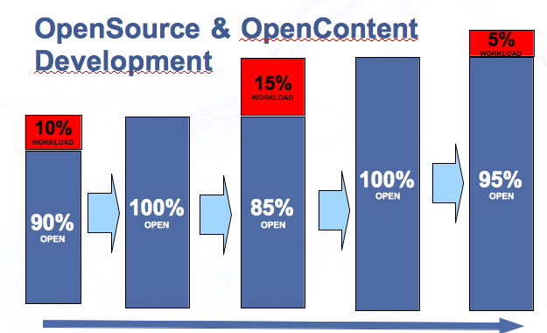
Activity of OpenSource-Community
Statistics of on OpenSource Plattform
OpenSource-Plattform sourceforge.net
Statistical data of 11h on 16. Jan 2012
4.349.930 Downloads (100% open usage)
3.963 Code Commits (0.1% Improvement)
4.105 Forum Posts (0.1% Discussion)
443 Bugs Tracked (0.01% Error Report)
Open
Usage
Workload

Slide 9
Definition:
Spatial Decision Support System
GIS
Geographical
Information System
+
DSS
Decision Support
System
=
SDSS
Spatial Decision
Support System
GIS:
Spatial Patterns of Risk &
Spatial Distribution of Resources
SDSS:
Spatial Decisions: Risk & Resources
DSS:
Water Treatment – Public Health Warning
Water Supply / Dynamic Systems – continuous temporal-spatial Monitoring

Slide 10
Definition: Spatial Public Health
Spatial Patterns of Public Health Risk &
Spatial Planing of Public Health Interventions
Spatial Allocation of Public Health Resources
SPATIAL
Spatial Public Health
PUBLIC
HEALTH
Multidisciplinary Science to prevent disease, prolong lifes and promote health as a state of
complete physical, mental & social well-being
LOW-COST
Monitoring generates Ground Data for
Spatial Decision Support System
Spatial Resolution
of Monitoring System
Temporal Resolution
of Monitoring System
Access to Technology
of Monitoring System

Slide 11

Risk & Response Cycle
Smart
Phone
Smart
Phone
EARLY WARNING & RESPONSE
Spatial Decision Support System
Diagnosis Support
Identify Risk
Response Support
Activate Response of Health System
Risk map
Remote
Sensing
Ground
data
Decision
support
Robust Data
and Voice
Communication
Resource
Allocation
Temporal/spatial risk
Low-Cost
Monitoring
Water Supply
Temporal/spatial response
Environmental
Conditions &
Socio-economic
Conditions
Disease Control and tailored
Allocation of Medical and
Public Health Resources,
Temporal/spatial
patterns of
Disease

Slide 12
Risk & Response Cycle
Smart
Phone
Smart
Phone
EARLY WARNING & RESPONSE
Spatial Decision Support System
Diagnosis Support
Identify Health Risk
Response Support
Activate Response for Health Risk
Risk map
Spatial
Patterns
of Risk
Ground
data
Decision
support
Crowd
Sourcing
Resource
Allocation
Temporal/spatial risk
Low Cost
Monitoring
Temporal/spatial response
Environmental
Conditions &
Socio-economic
Conditions
Disease Control and tailored
Allocation of Environmental Healthl and
Public Health Resources,
Validate
Temporal/spatial
patterns of
Disease

Slide 13
Risk & Response Cycle
Smart
Phone
Smart
Phone
EARLY WARNING & RESPONSE
Spatial Decision Support System
Diagnosis Support
Identify Health Risk
Response Support
Activate Response for Health Risk
Risk map
Spatial
Patterns
of Risk
Decision
support
Crowd
Sourcing
Resource
Allocation
Ground
data
Temporal/spatial risk
Low Cost
Monitoring
Temporal/spatial response
Environmental
Conditions &
Socio-economic
Conditions
Disease Control and tailored
Allocation of Environmental Healthl and
Public Health Resources,
Validate
Temporal/spatial
patterns of
Disease

Slide 14
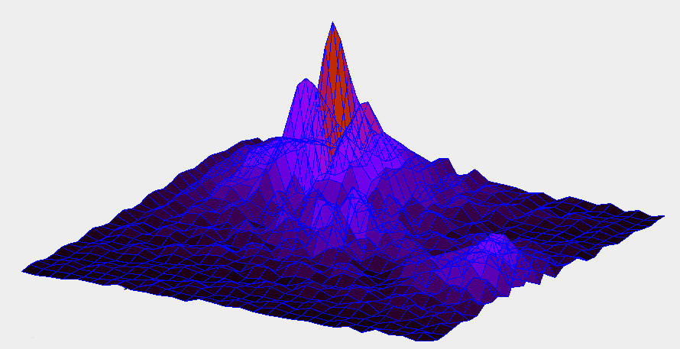
Risk & Response Cycle
RISK & RESPONSE
Spatial Decision Support System
Response Support
Activate Response of (Public) Health System
Risk map
Decision
support
Robust Data
and Voice
Communication
Allocation of Resources
Spatial Patterns of
Warnings triggered
by Low-Cost
Monitoring Systems
Feed Monitoring Results
in Geographic Information
System GIS
GPS
Smart
Phone
Temporal/spatial response
Trigger Detail Analysis
Create Public Warning
by Local or Regional Authorities

Slide 15
Risk Mapping & Remote Sensing
RISK & RESPONSE
Spatial Decision Support System
Diagnosis Support
Generate Risk Mapping
Risk map
Dry Season
Remote
Sensing
Temporal/spatial risk
Water Bodies
Environmental &
Socio-economic
Conditions
Water Body
Replication Zone Mosquito
Risk Zone (Fly Range Mosquito)

Slide 16
Risk Mapping & Math Modelling
Risk Mapping & RESPONSE
Spatial Decision Support System
Diagnosis Support
Generate Risk Mapping
Risk map
Spatial
Patterns
of Risk
GIS:
Mosquito Model in GIS interacts with
detected environmental parameters
Mathematical
Mosquito-Models
Temporal/spatial risk
math. Model 1
Water Bodies
Environmental &
Socio-economic
Conditions
math. Model 2
context dependent
Interface
Context Dependency on environmental conditions

Slide 17
Fuzzy Logic
REASONING
Extend Logical Representation
Classical Logic
Statements are true (x=1) or false (x=0)
Fuzzy Logic
Statesments can have grades of validity 0<x<1
Consider Equation/Inequations
Weather Condition for Mosquitos
5>3 (true 1)
4+2=7 (false 0)
Humidity is good for Mosquito Life Cycle (true with grade 0.7)
Temperature is good for Mosquito Life Cycle
(true with grade 0.1)
Implication (rules)
Fuzzy Implication (rules)
IF x>3 THEN x+7>3 (true 1)
IF x<3 THEN x²<9 (false 0)
counter example x= -4
IF humidity good AND temperature good
THEN apply larvicides
(true with grade 0.2)

Slide 18
Fuzzy Logic
REASONING
Extend Logical Representation
Classical Logic
Statements are true (x=1) or false (x=0)
Fuzzy Logic
Statesments can have grades of validity 0<x<1
Consider Equation/Inequations
Consider Raccoon with age 13
5>3 (true 1)
4+2=7 (false 0)
Raccoon is old (true with grade 0.7)
Raccoon is in stage 3 (paralytic stage)
damage to motor neurons
(true with grade 0.1)
Implication (rules)
Fuzzy Implication (rules)
IF x>3 THEN x+7>3 (true 1)
IF x<3 THEN x²<9 (false 0)
x= -4
IF Racoon is old AND rabies infected
THEN paralytic stage is 2 days long
(true with grade 0.2)

Slide 19
Spatial Fuzzy Logic
EARLY WARNING & RESPONSE
Spatial Decision Support System
Validity of Properties
Attached to a spatial location
Fuzzy Rules
Operating on Fuzzy spatial properties
Decision
support
Linguistic Value
IF Temperature is optimal AND high rainfall THEN Application of Lavicides have no impact on Mosquito Population
Temperature is optimal for Mosquito A
True
True
False
False
Resource Optimization
No Application of Larvicides in that Area

Slide 20
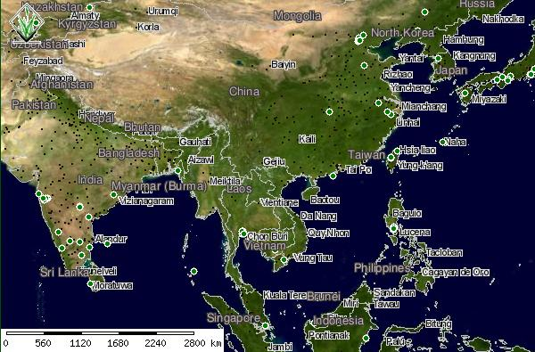
Risk & Response Cycle
RISK & RESPONSE
Spatial Decision Support System
Diagnosis Support
Generate Early Warning
Risk map
Risk Layers
my
Risk
GPS
Risk at Geo Location
Geo Location
Geographic Layer

Slide 21
Risk & Response Cycle
RISK & RESPONSE
Spatial Decision Support System
Last Mile
Diagnosis Support
Generate Early Warning
Risk map
Risk Layers
my
Risk
GPS
Risk at Geo Location
Geo Location
Geographic Layer

Slide 22

Types of GPS-Pseudo Measurement
Contamination of Water, Soil, Air ...
Contamination of Fruit, Vegetables, Meat, ...
Radioactive Radiation as Public Health Risk
Epidemiological Risk at GPS location
GPS-Location
GIS
Risk Map
Server
Smart
Phone
Public Health Risk
at GPS-Location
Mobile Devices as a
Decision Support Client for Public Health Risk

Slide 23
Digital Signature - Trust
PRIVATE
Key WHO
Sign Data
30 cases of X
in Liberia
(Data)
jSkdaksd oqkwel
SAdu823123nasi
valid
(WHO Signature)
PUBLIC
Key WHO
Last
Validated
Data
Alteration
Crowd
125 cases of X
in Liberia
(Data)
jSkdaksd oqkwel
SAdu823123nasi
invalid
(WHO Signature)
PUBLIC
Key WHO
Current
Data

Slide 24
Public Awareness, Crowdsourcing
& Public Health Authorities
Public Health Authority
Submit GPS-Location
No
real
Sensor
GIS
Risk Map
Server
Public Health Disease
Warning at GPS-Location
Create Public Awareness
Validation of Risk
Submit Crowd Sourcing Data
at GPS-location
Crowdsourcing
Server
Return Map with other
Cases in GPS-Envrionment
Community Memory

Slide 25

Public Awareness, Crowdsourcing
& Public Health Authorities
Public Health Authority
Submit GPS-Location
No
real
Sensor
GIS
Risk Map
Server
Public Health Disease
Warning at GPS-Location
Create Public Awareness
Validation of Risk
Submit Snapshot of
dead birds at GPS-location
Crowdsourcing
Server
Return Map with other
Cases in GPS-Envrionment
Community Memory

Slide 26
Chronic Kidney Disease
CKD
Common
Chronic Kidney Disease
CKDu
Chronic Kidney Disease
non traditional Cause
Working Age
Central America, India, Sri Lanka
Dehydration, Toxic Poisoning
FARM WORKERS, ...
Old Age
USA, Canada, Europa, Australia
Hypertension, Obesity
ARGICULTURE, ...

Slide 27
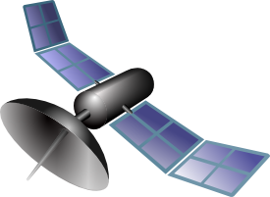
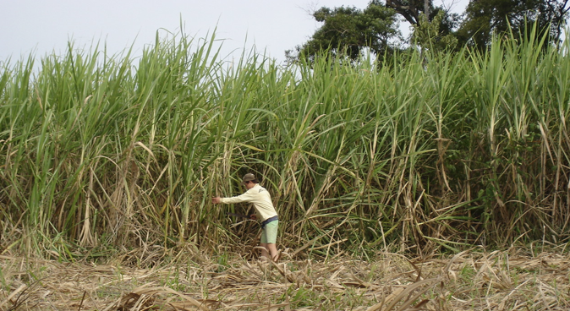
Response & Public Health Risks
Mobile Devices as a
Decision Support Client
Spatial Application of Agrochemicals
Low Tech
Precision Farming
NDVI / EVI Crop Health
Smart
Phone
Crop
Health
GIS
Decision
support
APPLY AGROCHEMICAL x
AT RATE y
OpenSource-Development
e.g. Augmented Reality-Toolkit
LookAR! for Android Phones
Economic Benefits & Public Health Benefits

Slide 28
Objectives
Objective: APPLICATION OF LOW COST TECHNOLOGY
FOR ECOTOXICOLOGICAL MONITORING
(Spatial Decision Support)
HOW? PROVIDING A LOW COST TRACKING
FRAMEWORK IMPLEMENTED WITH OPEN
SOURCE SOFTWARE
WITH: SOURCEFORGE PROJECT (LC-TrackMon?)
http://www.sourceforge.net
(Open Source)rce)
TO WHOM? OPEN COMMUNTIY OF PRACTICE
(Action Team 6 Follow-Up Initiative AT6FUI)

Slide 29
Collaborative Mapping & Trust
(1) Communuties contribute (IN) and benefit from
Collaborative Global Health Mapping (OUT)
(Communities)
(2)
Agencies & Academic Institutes contribute to
Risk Analysis (IN) & allocation of Resources (OUT)
(Agencies – WHO / PAHO)
(3)
Humanitarian Open Streetmap Team (HOT)
(Humanitarian Open Decision Support)
Analysis and Validation
of Crowd Sourcing Data
Mixed Data Source Decision Making

Slide 30

Definition: GPS-Pseudo Measurement
GPS-Pseudo Measurement is defined
as an indirect provision of Sensor Data without
a physical Sensor by using the GPS-Location
of the Mobile Device.
Smart
Phone
GPS-Location
GIS
Risk Map
Server
Radiation at GPS-Location
Mobile Devices as a
Decision Support Client for Public Health Risk

Slide 31
Response & Public Health Risks
Mobile Devices as a
Decision Support Client
Remote Sensing Data
Public Health Objective
Low Tech
Precision Farming
Smart
Phone
Navigation, Crop Health Map
Decision
support
Minimize Overlap of
Spraying Track
Plants in different areas
get different application
rates.
Workflow Optimization
for Farm Workers
APPLY AGROCHEMICAL x
AT RATE y
Economic Benefits: Optimized Farming with
Low-Tech IT-environment => Developing Countries

Slide 32
Response & Public Health Risks
Mobile Devices as a
Decision Support Client
Public Health Objective
Food Security
Minimize Exposure to
Agrochemical for
Farm Workers and
Environment. Workflow optimization & self protection of Workers
Optimize spatial patterns for Application of
Agrochemicals
Low Tech
Precision Farming
Smart
Phone
Decision
support
APPLY AGROCHEMICAL x
AT RATE y
Economic Benefits: Optimized Farming with
Low-Tech IT-environment => Developing Countries

Slide 33
Response & Public Health Risks
Smart
Phone
Mobile Devices as a
Decision Support Client
GPS-Location
Low Tech
Precision Farming
Attached Information
ICON + ABSTRACT + URL
Smart
Phone
APPLY AGROCHEMICAL x
AT RATE y
Icon
Decision
support
APPLICATION VIDEO FOR
AGROCHEMICAL
Abstract
APPLY AGROCHEMICAL x
AT RATE y
URL
WIKI – MULTIMEDIA
CONTENT
Economic Benefits: Optimized Farming with
Low-Tech IT-environment => Developing Countries
GIS-RISK & RESOURCE
INFORMATION

Slide 34

IT-Infrastructure
Offline Usage – OpenSource & OpenContent
http://maps9.navit-project.org
Smart
Phone
(1) Online
Select Map Area & Download
(1) Online
Select Map Area & Download
(2) Offline (Navigation)
Use Risk Map & Collect Data
e.g. by Vector Control Unit
OpenStreetMap & Risk Layer
Maps can be downloaded used offline e.g. in Navit
GIS
Risk Map
Server
Smart
Phone
(3) Online
Store Collected Data to GIS Server

Slide 35


Attaching Digitial Information
to a GeoLocation
http://maps9.navit-project.org
Smart
Phone
My Location
Digital Content (Risk/Health)
Tailored to the Geolocation
of Smartphone User
People at RiskVector Control Unit
OpenStreetMap & Risk Layer
Maps can be downloaded used offline e.g. in Navit
GIS
Risk Map
Server
Demo Images
of Skin Manifestion
of CKD for Public
Health Workes
Size

Slide 36
ARSI Interface to GIS (Risk & Response)
Remote Sensing Data
GIS
Geopraphic Information System
OpenSource
GRASS
Geographic Resources
Analysis Support System
Spatial Decision Support System
GPS-
Pseudo
Measurem.
& Access
Resources
Smart
Phone
> Risk Maps GIS
> Resource Maps GIS
> ARSI Interface to Indexer
Linux-OS on Mobile Device

Slide 37
GPS-Pseudo Measurement
Contamination of Water, Soil, Air ...
GPS
Smart
Phone
Contamination of Fruit, Vegetables, Meat, ...
Radioactive Radiation as Public Health Risk
These Types of Public Health Risks are not
DETECTABLE directly for the public.
Crowd Sourcing can be used to detect first indirect signs of Public Health Risks.
Early Warning and Public Health Response can be triggered if and only if Public Health Agencies have approved a Public Health Risk.

Slide 38
Smart Phones Usage
Risk & Response Cycle
Smart
Phone
Smart
Phone
RISK & RESPONSE
Spatial Decision Support System
Diagnosis Support
Generate Risk Awareness
Response Support
Activate Response of Health System
Risk map
Remote
Sensing
Ground
data
Decision
support
Robust Data
and Voice
Communication
Resource
Allocation
Temporal/spatial risk
Temporal/spatial outcome
Temporal/spatial response
Water Bodies
Environmental &
Socio-economic
Conditions
Outbreak
of
Disease
New outbreak
data
Vector Control and tailored
Allocation of Medical and
Public Health Resources,

Slide 39
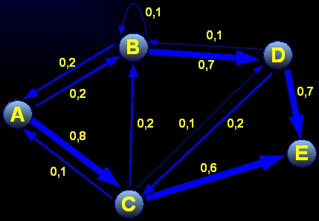
Networks & Matrices

Slide 40
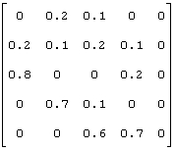
Networks & Matrices
0,1
A B C D E
B
0,1
A
D
0,2
0,7
B
0,2
0,7
A
C
0,2
0,1
0,2
0,8
D
E
0,1
0,6
E
C

Slide 41
Networks & Matrices
A B C D E
A
B
C
D
E

