Slide 1

Wikiversity and Open Community Approach for Space and Global Health
Working Group
Space and Global Health
University Koblenz-Landau
Computer Science Centre
Prof. Dr. Engelbert Niehaus

Slide 2
Space Technology
Space Technology & Global Health
Earth
Observation
Satellite
Navigation
Communication
Telemedicine

Slide 3
One Health Approach
One Health
Environmental
Health
Public
Health
Animal
Health
+
+
Create Learning Resource about Water

Slide 4
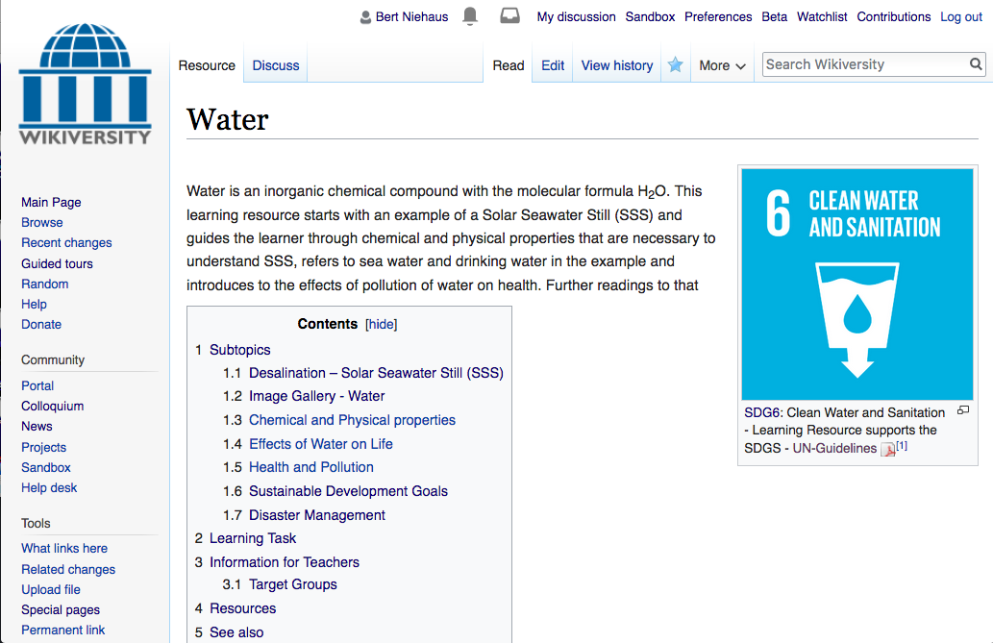
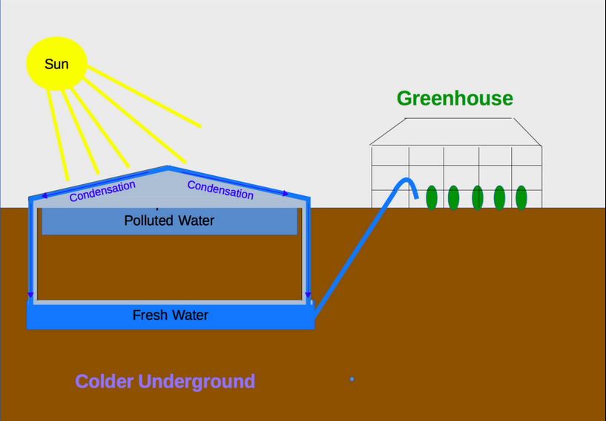
Reach People
Test: ‘Wikiversity Water‘

Slide 5
Wiki Foundation
Wiki Domains
Wikipedia
Encyclopedia
Wikiversity
Education,
Capacity
Building
Wiki
Species
Wiki about
Species
Wiki ...
Wikis driven
by MediaWiki
Semantic
of Content

Slide 6
Open Community Approach
OpenSource & OpenContent
Development
5%
WORKLOAD
15%
WORKLOAD
100%
OPEN
95%
OPEN
10%
WORKLOAD
100%
OPEN
85%
OPEN
90%
OPEN
TIME LINE

Slide 7
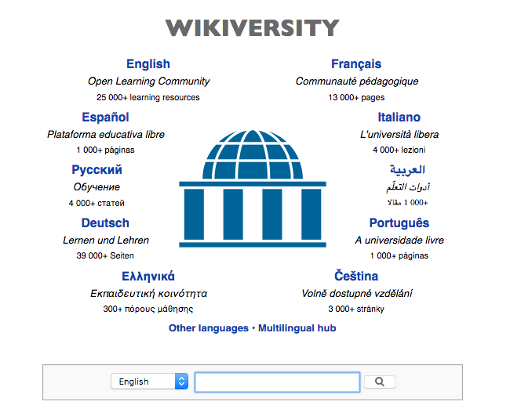
Wikiversity – Language Support

Slide 8
Wiki Article Components
Wikiversity - OER
Versioning
System (Citation)
Discussion
Talk Page
+
Export
Wiki 2 Book
+
Cite Version
Open Access

Slide 9
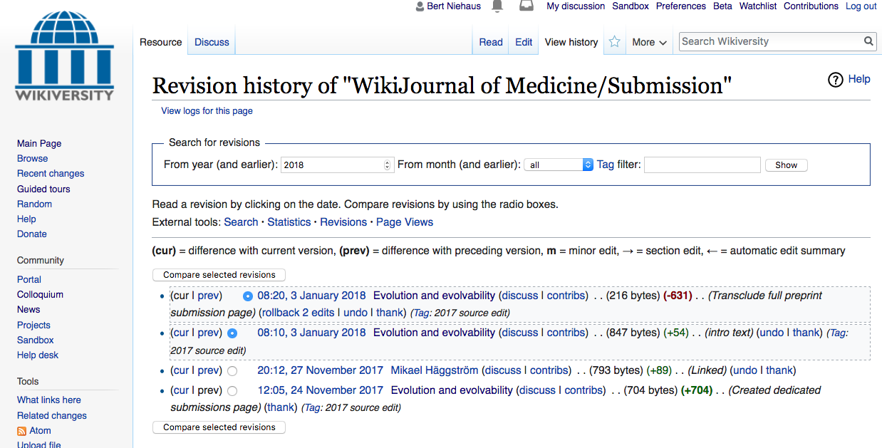
Wikiversity – Versioning
WHO DID, WHEN, WHAT? - Transparent

Slide 10
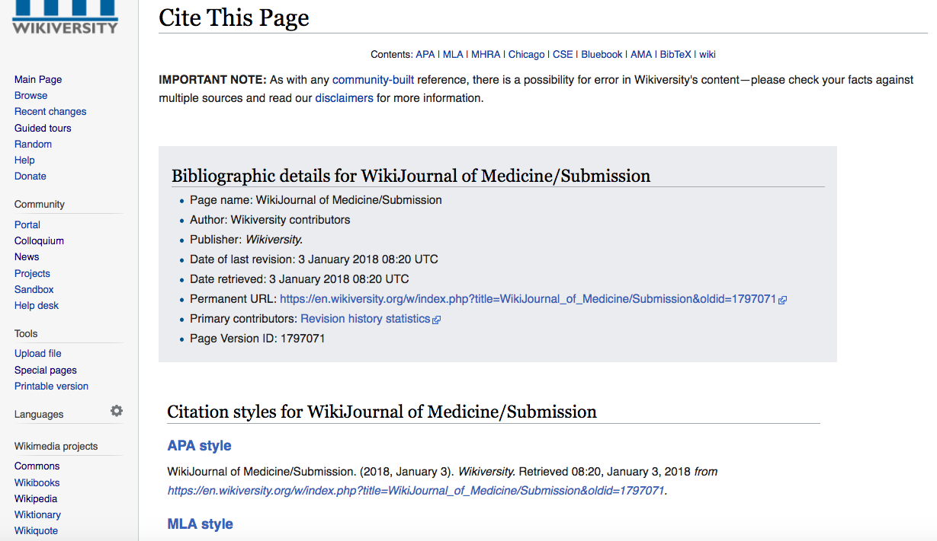

Wikiversity – Citation

Slide 11
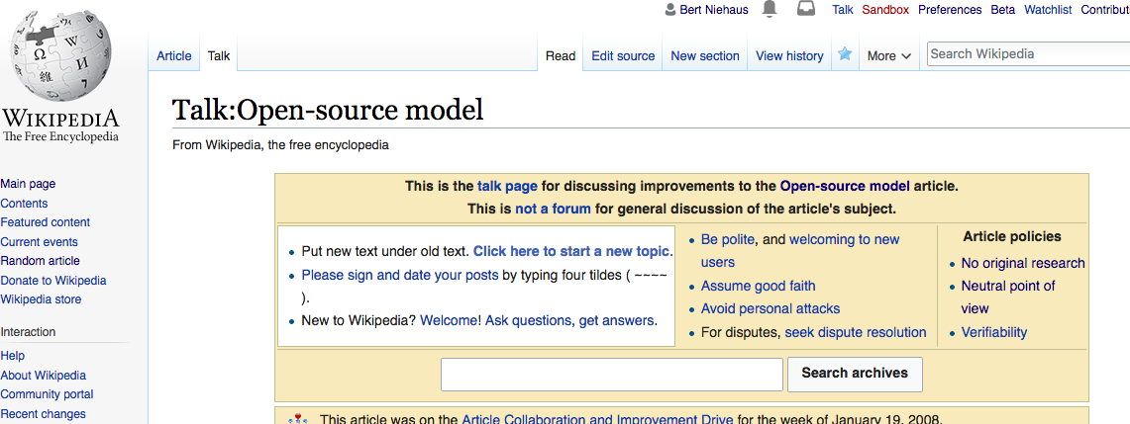
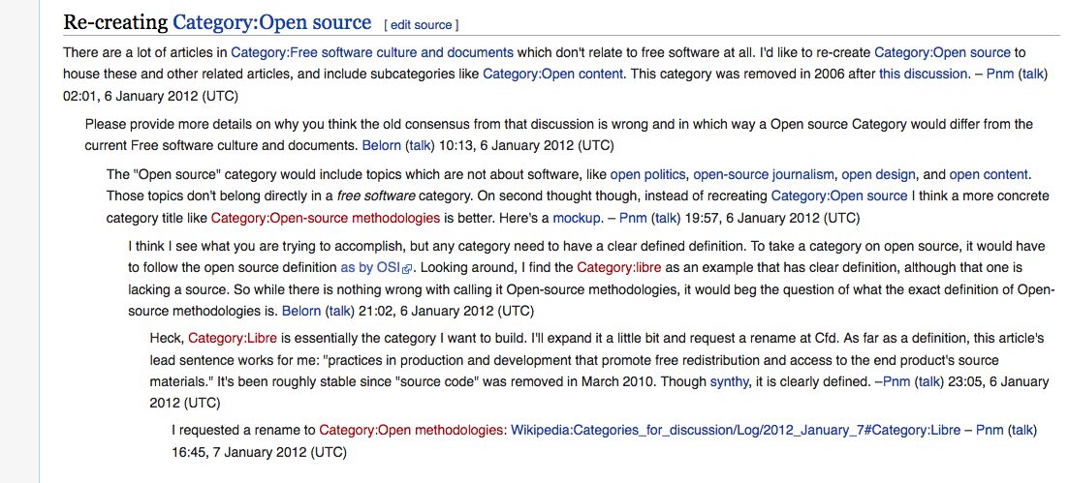
Wikiversity – Discussion/Talk

Slide 12
Wikiversity Drivers – Risk Management
(1) Maximize public access to educational
resources to the financial constraints.
(2) Translation / Customization tranfer the
educational resource according to
requirements & constraints of member states
(3) Reducing Developing Costs – Adaption to
local / regional requirements and constraints.
(4) Public-Private-Versioning – Quality
Assurance, Who Did When What in the Wiki

Slide 13
Wikiversity Application
(1) WikiJournal for publications with an
educational objective. Learn about a new
methodology or innovative results that could
have an impact on Risk Assessment,
Risk Communication, Risk Literacy, ...
(2) Learning Resources (Open Educational
Resource - OER) developed for a specific
audience.
(3) Lab Environment – How does a community
adapt content about risk to their needs.

Slide 14
Neutral Point of View NPOV
Requirement for Wikiversity/Wikipedia Contributions
NPOV
Capacity Building
no advertisment
of products &
services

Slide 15
Creative Commons Licensing
Requirement for Wikiversity/Wikipedia Contributions
CC-BY
Institutional Content
single media/text
licencing

Slide 16
Summary
(1) Reach People with Open Educational
Resources (OER) Use, Adapt, Deploy,...
(2) Quality Assurance community driven
quality assurance & institutional /
organisational Public-Private-Versioning
(3) Reducing Developing Costs – Adaption to
local / regional requirements and constraints.
(4) Collaborative Environment – Repository
CC-Licence for generation of derivative work

Slide 17
Licensing of Presentation
(1) LibreOffice the presentation was created as
Open Educational Resources (OER).
https://www.libreoffice.org/download
(2) Licence Creative Commons License CC-BY
https://creativecommons.org/licenses/by/3.0/
(3) Download Presentation – The presentation
can be downloaded as LibreOffice-ODP file at
https://niebert.github.io/wikiversity_files

