Slide 1
Classification & Anomaly Detection

Slide 2
Goal of analysis
Properly prepare (including cleaning, extracting )
Different models for classification task
  Baseline : Logistic Regression + TfidfVectorizer (packages: scikit-learn, seaborn, matplotlib)
  Keras Tokenizer + padding + CNN (packages: scikit-learn,keras,tensorflow)
  Pretrained GLOVE + Kim’s CNN (packages :scikit-learn,keras,tensorflow)
  Ensemble with Bayesian Optimizer (to find weights to do weighted ensemble applied bayesian-optimizer package)
Find out top features with decreasing/increasing impact on sentiment (package : shap)
Model | Accuracy (test) | Precision (test) | ROC (test) | F1 (test)
Logistic Regression + Tfidf Vectorizer | 0,94 | 0,86 | 0,9739 | 0,94
Base CNN | 0,9507 | 0,81 | 0,9817 | 0,95
Kim’s CNN + GLOVE | 0,9614 | 0,85 | 0,9745 | 0,96
Ensemble |  |  | 0,9835

Slide 3
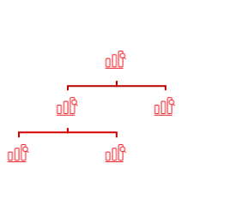

Pipeline
Different models:
Logistic regression + TfidfVectorizer
Tokenizer + Base CNN
Pretreined GLOVE + Kim’s CNN
Ensemble
Data cleaning:
Remove stopwords with some exceptions
Lowercase texts
Remove punctuations
Remove <br />
SHAP
(SHapley
Additive
exPlanations)
Train/Validation/Test split
DF
Tokenization + padding :
TfidfVectorizer
Different tokenizer
Pretrained glove
Explains the output
of ML model
General results

Slide 4
Impact on model output
ǃ Baseline in probability [0.059*].Samo words pushes lower probability like challenged, great, warmth. On the other hand words like corny, flat, not have great impact on negative sentiment. This is inline with what we expected.

Slide 5
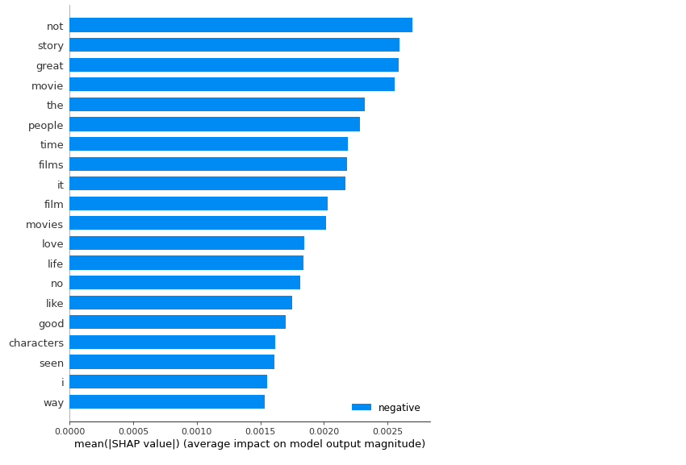
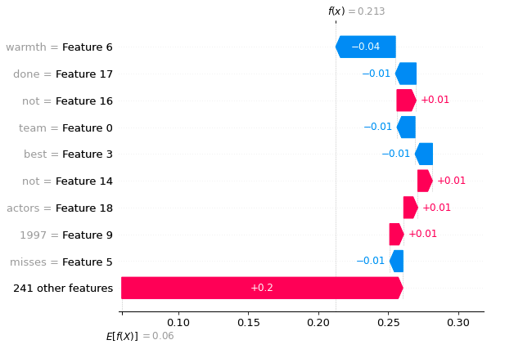
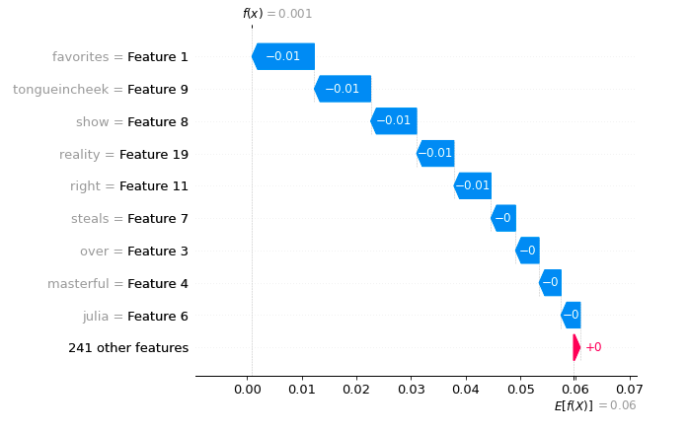
Examples of influence plots
ǃ Features with positive
impact on sentiment (blue):
Adjectives like warmth,great
Verbs like enjoy
ǃ Features with negative
impact on sentiment:
Words with negation not & no
Words like flat
Waterfall influence plot for two different example

Slide 6
Text Anomaly detection
K-means
Distance metric
P(outlier)
Embeddings
Embeddings
Corpus
New document
Two possible solution:
a) Train glove on corpus of documents by adding the vectors of each word in the document and
dividing by the total number of words. Next do k-means with many clusters
(small clusters could be possible outliers)
b) Train CNN and hidden features from last but one layer of CNN as embeddings

Slide 7
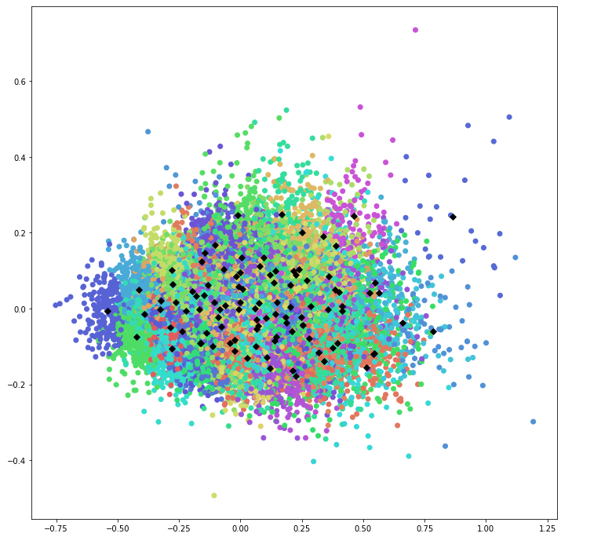
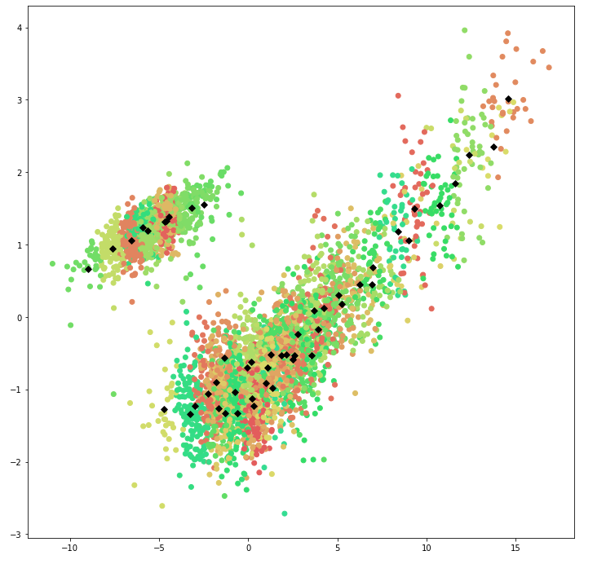
Text Anomaly detection
Cluster based on Glove + k-means
Cluster based CNN hidden features + k-means
(only test)

Slide 8
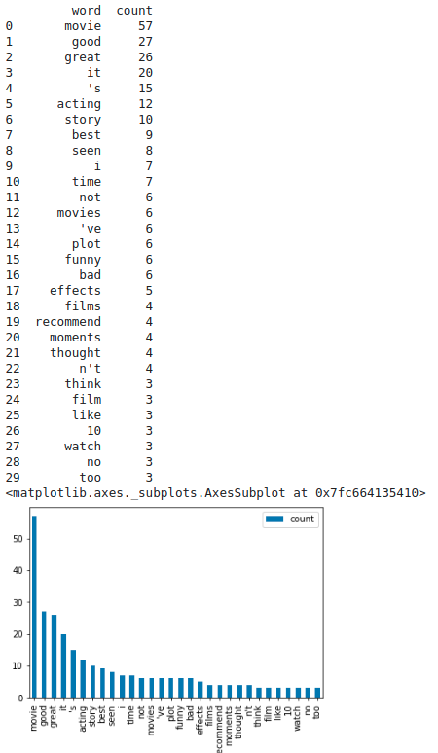
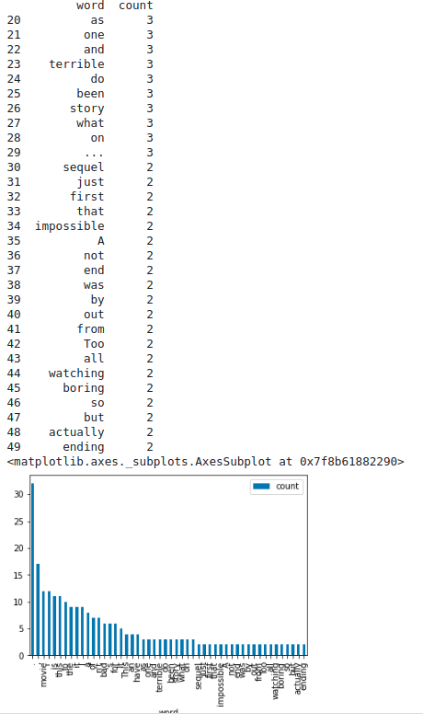
Text anomaly detection – words representing smallest cluster
Trained GLOVE
Trained CNN

