Slide 1


Plant Species Classification based on Leaves Shape Features
M05 Project
Students:
Adi Niedeberger
Fabio Mensi
Supervisors:
André Anjos
Flavio Tarsetti

Slide 2
Introduction
Goal
Apply reproducible research principles to the problem of plant species classification from leaves shape features.
Scientific hypothesis
It is possible to train a classifier that can achieve a better than random accuracy.

Slide 3
Data
Shape features dataset
N. samples: 1600
N. classes: 100
N. features: 64
Balanced splits
Train (80%)
Hyperparameter tuning
Model training
Test (20%)
Performance evaluation

Slide 4
Methods
Modeling:
Random forest algorithm
Hyperparameter tuning via cross-validation:
n_estimators = 200 max_depth = None max_features = 'log2'
Visualization:
2D PCA

Slide 5
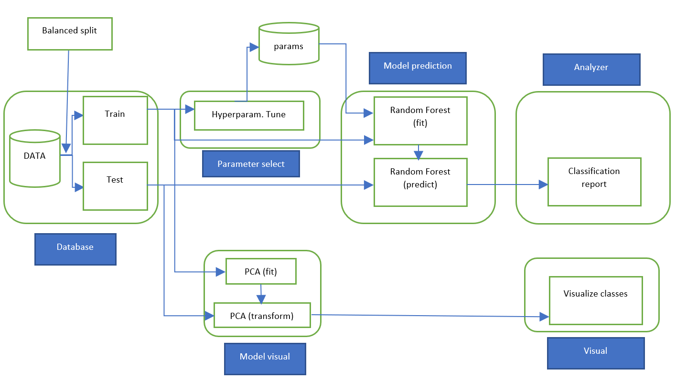
Workflow

Slide 6
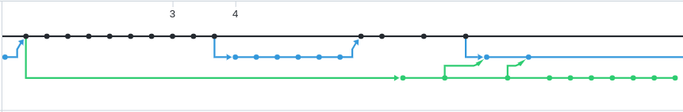
Version Control System
Use of Github
Use of feature branches
Frequent merging --> before rebase onto main
Work on same feature with multiple branches
--> use cherry-picking
Git tags for versions
Git stash
i.e. working by mistake on wrong branch:
--> stash changes and pop them on the desired branch

Slide 7
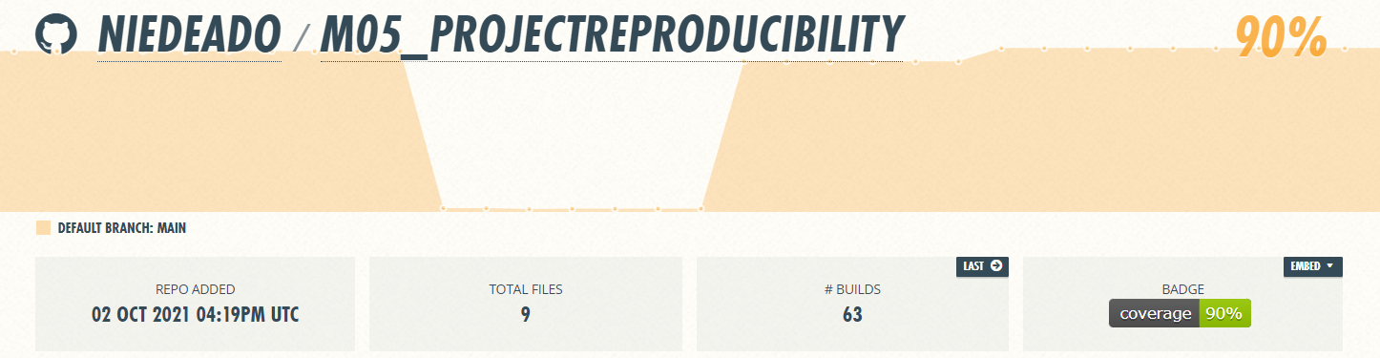
Unit Testing and Continuous Integration
Use of pytest
Base function tested with different configuration
Plots and functions with no specific return value --> use of mock patch
CI on github actions
Test on python 3.8 & 3.9
Coverage of Test with coveralls.io

Slide 8
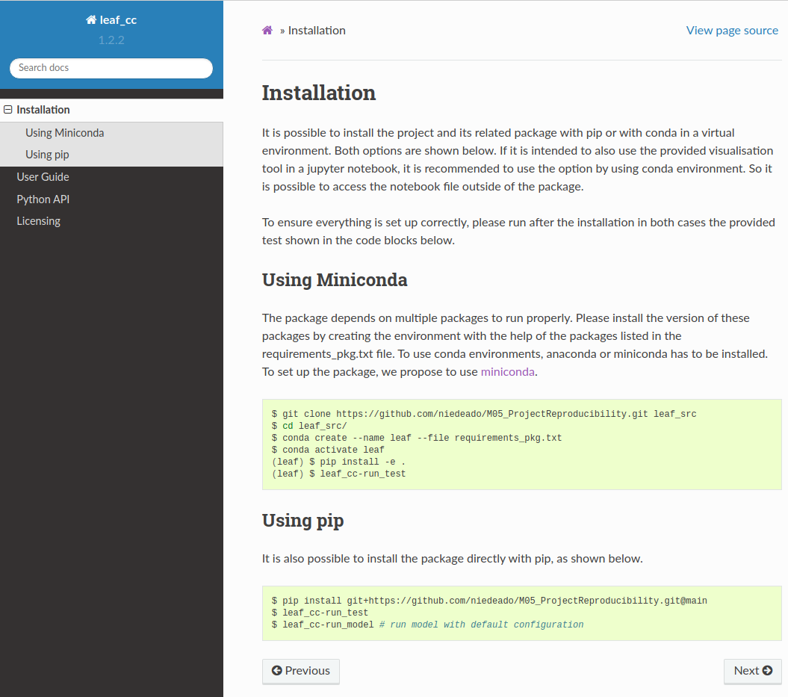
Documentation
Build with sphinx
All files in .rst format
Include docstings in Python API
Updated with github action after new push
Acess provided with github-pages
Use of crossreferences and links
Provide code examples

Slide 9
Packaging, Deployment, Licensing
Setup file with multiple console_scripts
Pinned dependencies
Included data and ipynb file in package
Installation with pip or in conda enviroment by clone repo
MIT License
- No copyleft files or packages
Notes:
- Packages defined fixed versions
- prevent issues
- provide flexibility

Slide 10
Final Remarks
Conclusion:
Following the presented workflow the test set accuracy was found to be 0.65.
Based on the obtained results we cannot reject our initial hypothesis.
Own remarks:
Both did learn the most related to the usage of git.
Having reproducibility as a goal from the start makes it easier to develop later.

